Slide 1

The FlowCore Warehouse Project
Krallis Dimosthenis and Ioanna Tagara

Slide 2
Team Introduction
Dimos
Mostly C++, Shell scripts and Docker.
Ioanna
Mostly the presentation, SQL and C++.

Slide 3
Project Overview
This project is meant to be a showcase of our commissioning skills in a small-scale warehouse environment. Specifically, it is meant to simulate a small-scale warehouse environment where some attributes and infrastructure are taken for-granted for ease of simulation.

Slide 4
Scope of Our Solution
This warehouse system simulation is of a Warehouse Management System. It only covers the toat filling and logging part. We fill the toats with the selected products and log that info via the database and text log files.
Logging includes:
When there is a connection with the database happening.
What queries are being sent to the database.
Any errors related to pushing and pulling data to and from the database.

Slide 5

Warehouse Process Flow

Slide 6
Business Rules
The system works with the basis of a simple daemonless WMS. It has one stock line as inventory since it simulates a simple warehouse. It keeps orders in-memory since they are not meant to be visible to the WCS and it selects products to be placed in toats. It only uses one toat per order.

Slide 7
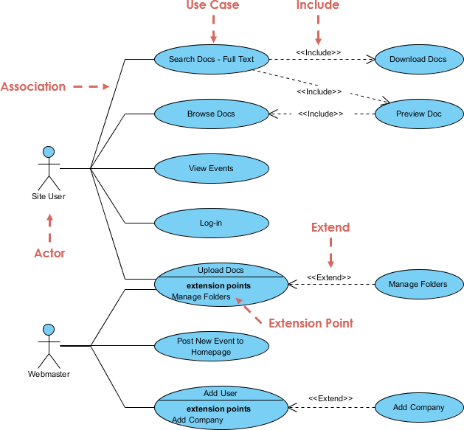
System Architecture
The structure of out system
We could use a user case diagram

Slide 8
Tech Stack
The tech stack includes:
Modern C++ for the business logic and UI
Nlohmann JSON for parsing JSON configuration files in C++
OCCI libraries for connecting the C++ components with the database
Oracle FreeSQL for our database solution.
Docker for deployment of the Oracle Linux 9 environment where the project runs.
Bash scripts for deployment and building automation as well as logging automation.
The GNU Compiler Collection for C++ compilation.
Oracle SQL*PLUS for database manipulation through scripting

Slide 9
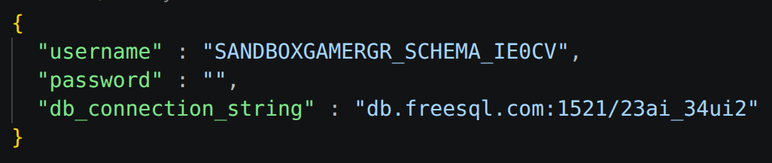
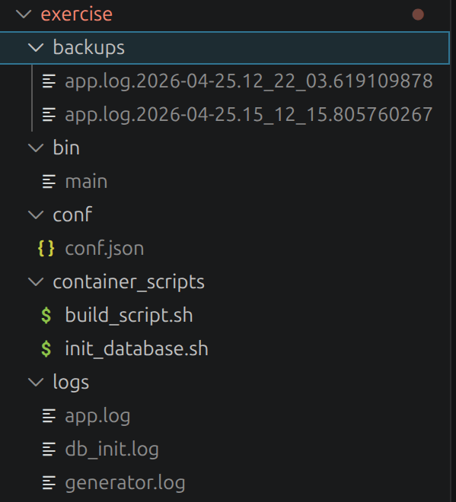
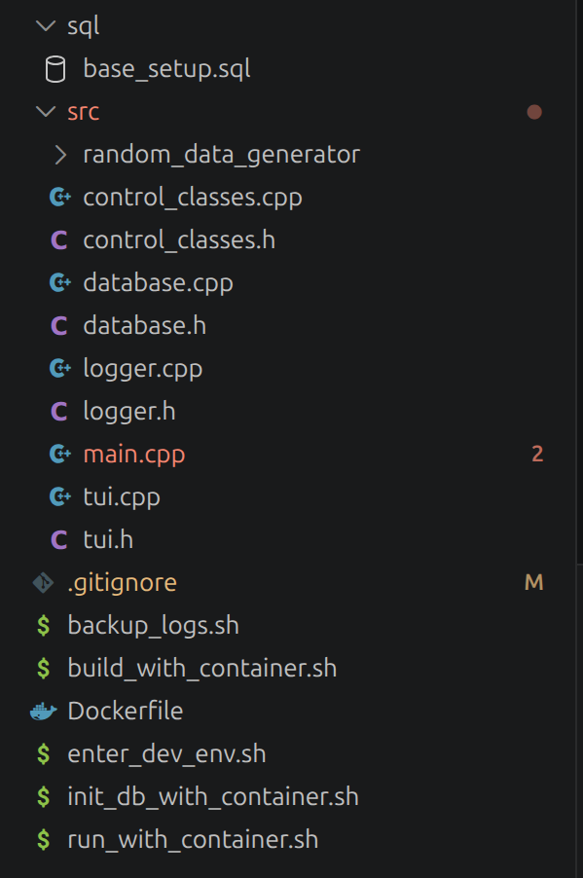
Configuration & Environment
The config files include the connection settings for the database that is saved in JSON format.
The directory structure is as follows:

Slide 10
Linux & Bash Operations
We have various scripts for controlling the environment as well as running the app. We have scripts for:
Backing up logs,
Running the app,
Running the tests,
Building the app,
Initializing the database and
Entering a docker environment as the app for testing purposes
There are more scripts meant to be ran inside the container such as build and test scripts.

Slide 11
Database Design
Same thing but with the database structure and tools

Slide 12
SQL Operations
Again explain the sql code and how the tables where made

Slide 13
PL/SQL Logic
Explainf the pl/sql logic abouy functions and triggers we could merge it with the previous slide id the info is too litle

Slide 14
C++ Component
The C++ component is functioning as a business logic part as well as a partial database initialization part.
The business logic part is the main program while the random data generator is the initialization part.

Slide 15
Testing & Validation
We have created scripts that aid in the creation of a controlled environment for testing so that we can easily check differences from normal to abnormal behaviour.

Slide 16
Challenges
There were many challenges. Mainly:
The management and figuring out the structure as well as the database schema,
The class hierarchy and attributes of those classes,
Database trigger configuration,
Version control mistake management ect.

Slide 17
Demo
Not the company, the demonstration! : )

Slide 18
Results
We have successfully made a system that:
Organizes toats per order.
Organizes the products per toat
Completes orders

Slide 19
Future Improvements
A multi-toat order could be something a future version could use. A daemon-ful version as well.

Slide 20
Conclusion
Built a complete simulation system
Demonstrated technical readiness
Supports warehouse commissioning
or something else corny

Slide 21
Thank you
Really, thank you!

