Slide 1
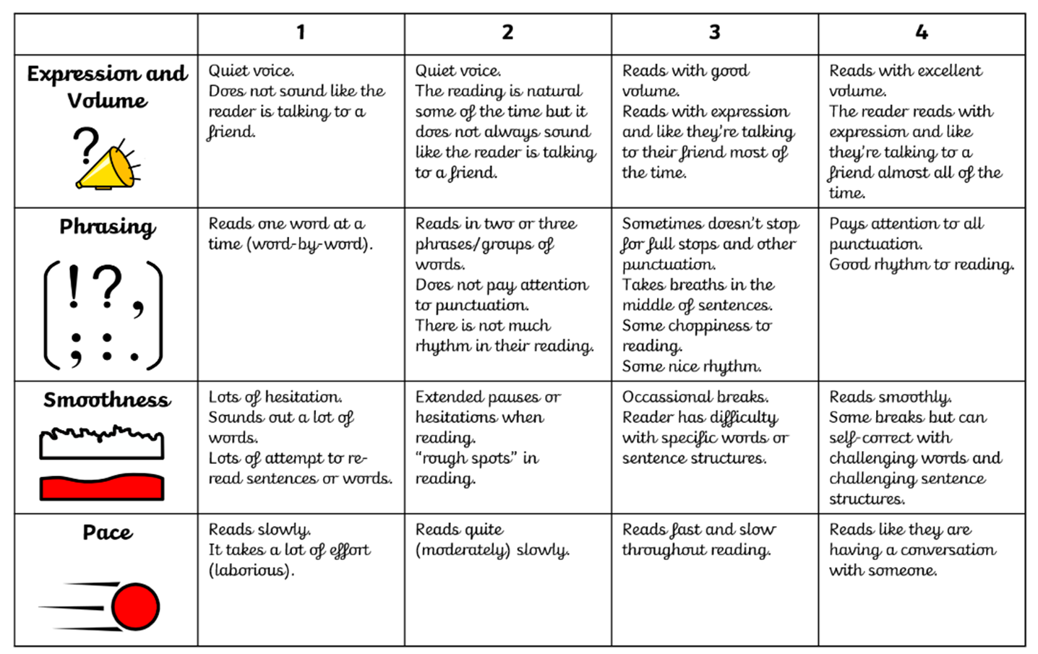

Slide 2


Being a Reader
Lesson 1 - Vocabulary
Tuesday

Slide 3
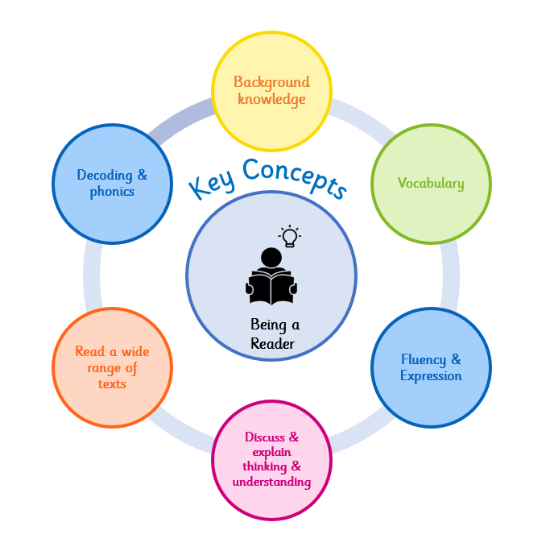


Why do we learn to read?
Reading makes me powerful because it helps me to understand the world around me.
At Wallscourt Farm Academy:
We love to read, learn to read and read to learn!
Notes:
Background knowledge – We use our background knowledge and experiences to help us with our reading
Vocabulary – we use new vocabulary when reading
Fluency & Expression – We read fluently and with expression to make our reading exciting
Discuss & explain thinking – We discuss and explain our thinking and understanding of our reading
Read a wide range of texts – We read a wide range of texts at WFA
Decoding and phonics – We use our phonics to help us decode and learn new words when we are reading

Slide 4

Vocabulary Focus
Vocabulary
Are there any words you feel confident to explain the meaning of (definition)? Are there any where you are less confident?
insulate | to stop sound or heat from passing through a material
absorb | to take something in so that it cannot pass through
muffle | to make a sound quieter by surrounding or blocking it
dense | closely and heavily packed together
transmit | to pass something through or from one place to another
?
?
?
?
?

Slide 5
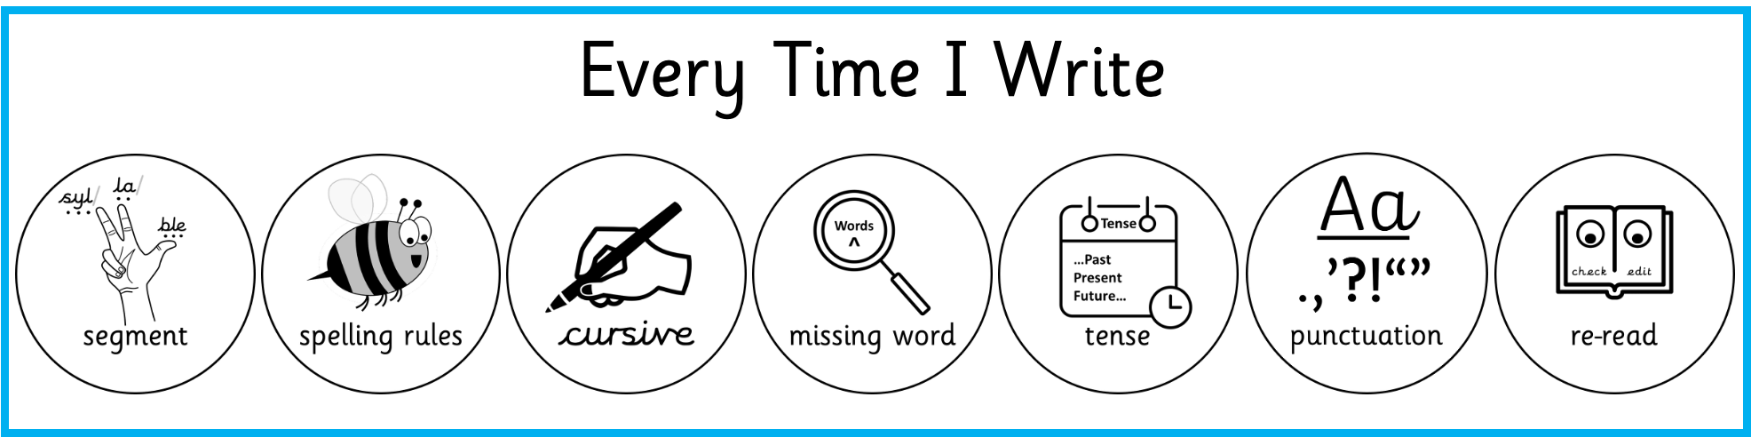
Vocabulary Focus
Vocabulary
Write it 5 times absorb | Use it in a sentence
Other linked words
absorb

Slide 6

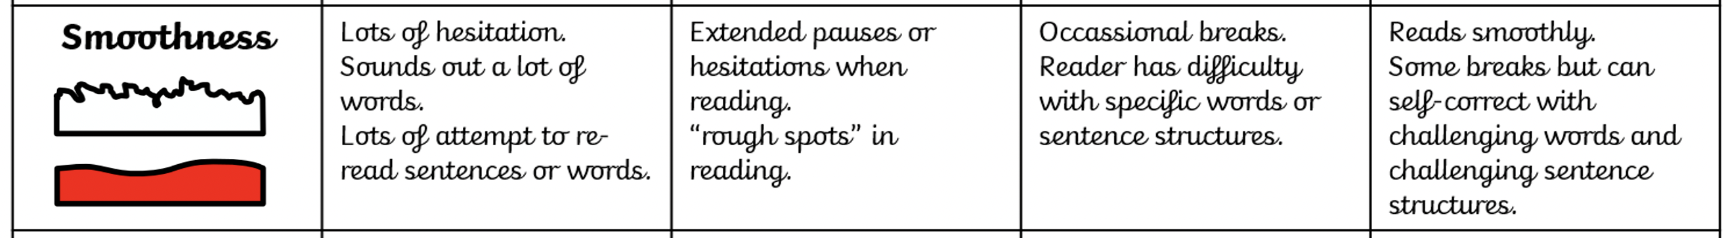
Independent Read
Decoding & phonics
Read the complete text – underline any words or phrases you don’t understand. Re-read full sentences for any parts you couldn’t read smoothly on the first attempt.
Sound does not just travel — it can also be stopped. The key is choosing the right material. When sound waves hit a soft, thick material such as foam, heavy fabric or carpet, the vibrations are absorbed. The material takes in the energy of the sound and turns it into a tiny amount of heat, so the sound cannot pass through. Dense materials like brick and concrete work differently. Because their particles are so tightly packed and heavy, vibrations struggle to transmit through them. The sound bounces back or is dampened before it can travel far. These properties are used all around us. Recording studios are lined with special foam panels on every wall. The foam absorbs the sound waves so they do not bounce around the room and muddle the recording. Concert halls are designed so that sound stays lively enough to be enjoyable but does not become an echoing mess. Ear defenders — the chunky headphones worn by builders and people at loud events — use thick, dense materials to muffle the sound before it reaches the eardrum. Sound insulation is not just about comfort. In hospitals and schools, controlling noise levels helps people concentrate and recover. Engineers test materials carefully to find out how well they insulate against sound, because the difference between a good material and a poor one can be significant.
Read by segmenting into phonemes and syllables
Make a sensible attempt, making sure you blend ALL the sounds as you read.
Use the context and parts of the word to make a sensible attempt at a definition.
Remember to re-read the entire sentence again.
Show / Hide Extract
Notes:
OH ES & KW reading phonically decodable version with TP

Slide 7

Vocabulary
I am learning to understand and take meaning from a text.
What am I learning?
I am learning this because it will help me to develop my understanding of vocabulary at a sentence and text level.
Why am I learning this ?
How will I know when I get there?
I will show this by answering questions which relate to the vocabulary used throughout the text.

Slide 8
Practice questions - Vocabulary
Sound does not just travel — it can also be stopped. The key is choosing the right material. When sound waves hit a soft, thick material such as foam, heavy fabric or carpet, the vibrations are absorbed. The material takes in the energy of the sound and turns it into a tiny amount of heat, so the sound cannot pass through. Dense materials like brick and concrete work differently. Because their particles are so tightly packed and heavy, vibrations struggle to transmit through them. The sound bounces back or is dampened before it can travel far. These properties are used all around us. Recording studios are lined with special foam panels on every wall. The foam absorbs the sound waves so they do not bounce around the room and muddle the recording. Concert halls are designed so that sound stays lively enough to be enjoyable but does not become an echoing mess. Ear defenders — the chunky headphones worn by builders and people at loud events — use thick, dense materials to muffle the sound before it reaches the eardrum. Sound insulation is not just about comfort. In hospitals and schools, controlling noise levels helps people concentrate and recover. Engineers test materials carefully to find out how well they insulate against sound, because the difference between a good material and a poor one can be significant.
How do foam panels in a recording studio help with sound?
The foam absorbs the sound waves, taking in the vibrations so they cannot bounce around the room and muddle the recording.
Why are dense materials like brick good at stopping sound? Use the word 'particles'.
Dense materials have particles packed so tightly together that vibrations struggle to transmit through them — the sound cannot get through.
Show / Hide Extract

Slide 9
Being a Reader
Lesson 2 - Retrieval
Thursday

Slide 10
Why do we learn to read?
Reading makes me powerful because it helps me to understand the world around me.
At Wallscourt Farm Academy:
We love to read, learn to read and read to learn!
Notes:
Background knowledge – We use our background knowledge and experiences to help us with our reading
Vocabulary – we use new vocabulary when reading
Fluency & Expression – We read fluently and with expression to make our reading exciting
Discuss & explain thinking – We discuss and explain our thinking and understanding of our reading
Read a wide range of texts – We read a wide range of texts at WFA
Decoding and phonics – We use our phonics to help us decode and learn new words when we are reading

Slide 11
Vocabulary Focus
Vocabulary
Are there any words you feel confident to explain the meaning of (definition)? Are there any where you are less confident?
echolocation | finding objects by sending out sounds and listening for the echoes that bounce back
frequency | how many vibrations happen per second; this determines how high or low a sound is
detect | to notice or discover something, often using the senses
evolved | changed slowly over a very long time to become better suited to surviving
locate | to find where something is
?
?
?
?
?

Slide 12
Vocabulary Focus
Vocabulary
Write it 5 times detect | Use it in a sentence
Other linked words
detect

Slide 13
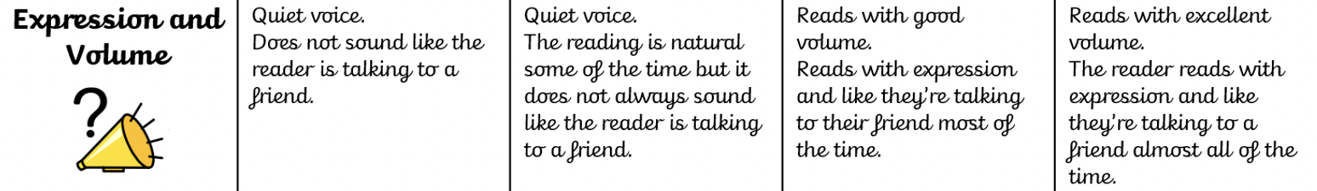
Paired reading. Read the text with a partner, taking turns sentence by sentence. Focus on reading smoothly and clearly, matching your pace to the punctuation.
Many animals use sound in ways that go far beyond what humans can manage. Bats are one of the most well-known examples. They produce very high-pitched calls — far too high for human ears to detect — and then listen for the echoes that bounce back from nearby objects. This is called echolocation. By judging how quickly the echo returns and which direction it comes from, a bat can build an accurate picture of its surroundings in complete darkness, allowing it to locate and catch insects on the wing. Dolphins use a very similar system underwater, producing clicks and whistles at high frequency and reading the echoes to find fish and navigate through murky water. Elephants communicate using sounds at the opposite end of the scale. Their rumbling calls are so low in frequency that humans cannot hear them at all, but they travel vast distances across the savannah — sometimes several kilometres. Elephants use these low sounds to find mates, warn of danger and keep in touch with family members far away. Dogs can hear sounds at a far higher frequency than humans. A dog whistle produces a sound that is completely silent to human ears but perfectly clear to a dog. This is why a dog will respond to a whistle its owner cannot even hear. Different animals have evolved to detect the exact range of frequencies that is most useful to them.
Fluency & Expression
Show / Hide Extract
Notes:
OH ES & KW reading phonically decodable version with TP

Slide 14
Discuss & explain thinking & understanding
I am learning to find and extract information from within a text.
What am I learning?
retrieve
I am learning this because it will help me to develop a clear understanding of what I am reading.
Why am I learning this ?
How will I know when I get there?
I will show this by answering questions, making reference to the text.

Slide 15
Practice questions - Retrieval
Scanning the text – I am trying to find the parts in the text where I will retrieve the answer to the question.
Many animals use sound in ways that go far beyond what humans can manage. Bats are one of the most well-known examples. They produce very high-pitched calls — far too high for human ears to detect — and then listen for the echoes that bounce back from nearby objects. This is called echolocation. By judging how quickly the echo returns and which direction it comes from, a bat can build an accurate picture of its surroundings in complete darkness, allowing it to locate and catch insects on the wing. Dolphins use a very similar system underwater, producing clicks and whistles at high frequency and reading the echoes to find fish and navigate through murky water. Elephants communicate using sounds at the opposite end of the scale. Their rumbling calls are so low in frequency that humans cannot hear them at all, but they travel vast distances across the savannah — sometimes several kilometres. Elephants use these low sounds to find mates, warn of danger and keep in touch with family members far away. Dogs can hear sounds at a far higher frequency than humans. A dog whistle produces a sound that is completely silent to human ears but perfectly clear to a dog. This is why a dog will respond to a whistle its owner cannot even hear. Different animals have evolved to detect the exact range of frequencies that is most useful to them.
How does echolocation allow a bat to hunt in complete darkness?
The bat sends out a high-pitched call. The sound bounces off the insect and the echo returns. By judging the direction and speed of the echo, the bat can locate the insect without any light.
Why do elephants and bats use such different frequencies of sound? Use evidence from the text.
Elephants use very low-frequency sounds because they need to communicate over vast distances. Bats need to detect nearby objects precisely in the dark, so high-frequency sounds that bounce off close objects work best.
Checking my answers – does my answer match the question and use information from the text?
Show / Hide Extract

Slide 16
Being a Reader
Lesson 3 - Inference
Friday

Slide 17
Why do we learn to read?
Reading makes me powerful because it helps me to understand the world around me.
At Wallscourt Farm Academy:
We love to read, learn to read and read to learn!
Notes:
Background knowledge – We use our background knowledge and experiences to help us with our reading
Vocabulary – we use new vocabulary when reading
Fluency & Expression – We read fluently and with expression to make our reading exciting
Discuss & explain thinking – We discuss and explain our thinking and understanding of our reading
Read a wide range of texts – We read a wide range of texts at WFA
Decoding and phonics – We use our phonics to help us decode and learn new words when we are reading

Slide 18
Vocabulary Focus
Vocabulary
Are there any words you feel confident to explain the meaning of (definition)? Are there any where you are less confident?
ultrasound | sound at a frequency too high for humans to hear, used in medicine and technology
sonar | a system that uses sound echoes to detect objects underwater
navigate | to find your way from one place to another
technology | the use of scientific knowledge to create tools and systems that solve problems
diagnose | to identify what is wrong with someone or something by examining it carefully
?
?
?
?
?

Slide 19
Vocabulary Focus
Vocabulary
Write it 5 times technology | Use it in a sentence
Other linked words
technology

Slide 20
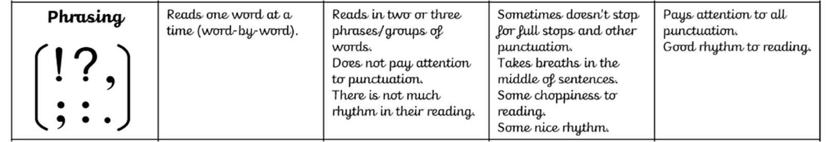
Independent Read
Fluency & Expression
Fluency focus – Echo read
Humans have learned to use sound far beyond simply speaking and listening. One of the most important uses is in medicine. Ultrasound scanners send out sound waves at frequencies far too high for human ears to hear. When these waves pass through the body, they bounce off different tissues in different ways, and a computer uses the returning echoes to build a detailed picture. Doctors use ultrasound to check on unborn babies, look at organs and locate problems inside the body — all without the need to make a single cut. Out at sea, ships use a similar technology called sonar. Sound pulses are sent down into the ocean and the echoes that return tell sailors how deep the water is and whether any objects are lurking below. Fishing boats use sonar to detect large shoals of fish below the surface, and submarines use it to navigate without needing to surface. Closer to everyday life, noise-cancelling headphones work by picking up the sounds around you and producing an opposing sound wave that cancels them out. This remarkable trick means that much of the background noise you would otherwise hear simply disappears. All of these technologies share one idea: that sound carries information. Whether it is bouncing off a baby inside the womb or cancelling out the hum of an aeroplane engine, humans have found ways to make sound work for them in ways that our ancestors could never have imagined.
Show / Hide Extract
Notes:
OH ES & KW reading phonically decodable version with TP

Slide 21
Discuss & explain thinking & understanding
I am learning to make inferences based a text and impressions given by the content
What am I learning?
infer
I am learning this because it will help me to develop a deeper understanding of what I am reading.
Why am I learning this ?
How will I know when I get there?
I will show this by using inference to answer questions making reference to the text to explain my thinking.

Slide 22
Practice questions - Inference
Remember – we need to think about the meaning of the sentence or text and not just what the words say
Humans have learned to use sound far beyond simply speaking and listening. One of the most important uses is in medicine. Ultrasound scanners send out sound waves at frequencies far too high for human ears to hear. When these waves pass through the body, they bounce off different tissues in different ways, and a computer uses the returning echoes to build a detailed picture. Doctors use ultrasound to check on unborn babies, look at organs and locate problems inside the body — all without the need to make a single cut. Out at sea, ships use a similar technology called sonar. Sound pulses are sent down into the ocean and the echoes that return tell sailors how deep the water is and whether any objects are lurking below. Fishing boats use sonar to detect large shoals of fish below the surface, and submarines use it to navigate without needing to surface. Closer to everyday life, noise-cancelling headphones work by picking up the sounds around you and producing an opposing sound wave that cancels them out. This remarkable trick means that much of the background noise you would otherwise hear simply disappears. All of these technologies share one idea: that sound carries information. Whether it is bouncing off a baby inside the womb or cancelling out the hum of an aeroplane engine, humans have found ways to make sound work for them in ways that our ancestors could never have imagined.
What do ultrasound and sonar have in common? Use evidence from the text.
Both use sound waves that bounce off objects and return as echoes. Doctors use the echoes to build pictures inside the body; ships use the echoes to detect underwater objects. Both rely on the idea that sound carries information.
The text says humans have made sound 'work for them in ways our ancestors could never have imagined'. What does this tell us about the importance of understanding sound?
It tells us that scientific understanding leads to real-world uses. Once humans understood how sound travels and carries information, they could build technologies like ultrasound scanners, sonar and noise-cancelling headphones that solve problems in medicine, navigation and everyday life.
Checking my answers – does my answer link to and use evidence from the text to explain?
Show / Hide Extract

