Slide 1

UNIVERSIDAD AUTONOMA DE ZACATECAS
MINERÍA DE DATOS
k-nn_Algorithm
Alumnos: Manuel Herrera Lara y Anahí Berumen Murillo

Slide 2
Abstract
We will apply the knn algorithm to a dataset with clinical records of patients with heart failure. This in order to predict the survival of patients with cardiac induction.

Slide 3
Index
The data domain
How the data was recollected
Description of the variables of the dataset
Basic data analysis
Describe the distribution of the data.
Boxplots – Interpretation
Histograms-Interpretation
Preprocessing knn
Applying knn algorithm
Bibliography

Slide 4
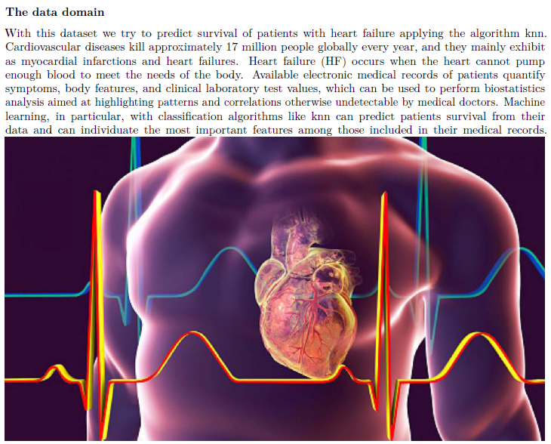

Slide 5

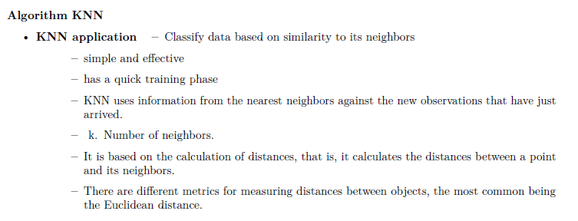

Slide 6

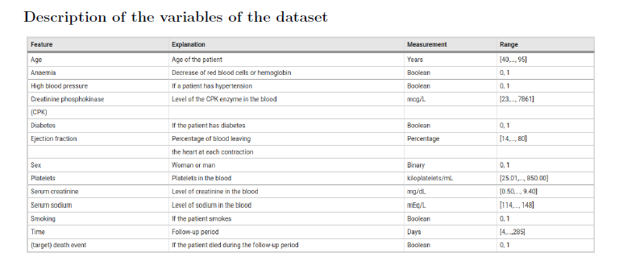

Slide 7


Slide 8
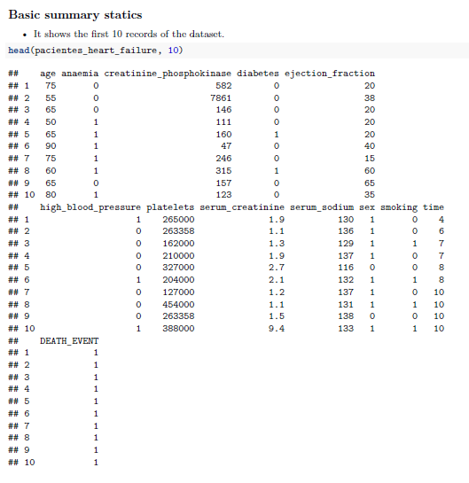

Slide 9
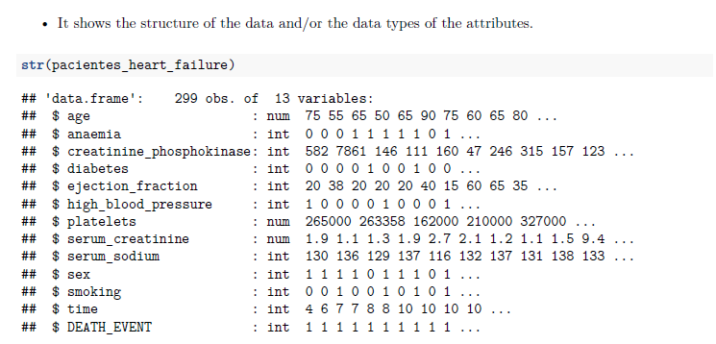

Slide 10
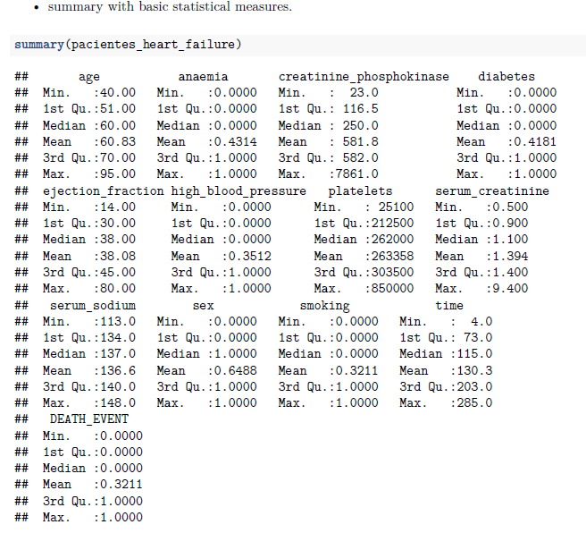

Slide 11
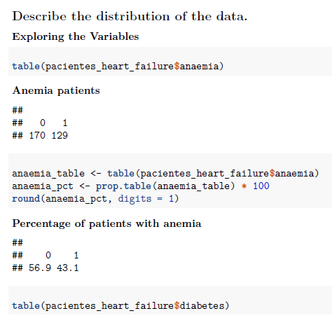
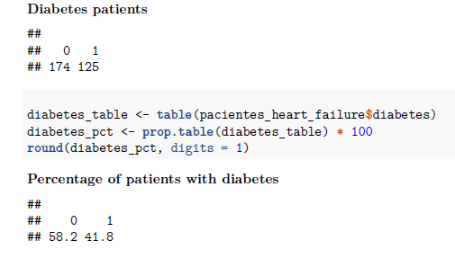

Slide 12
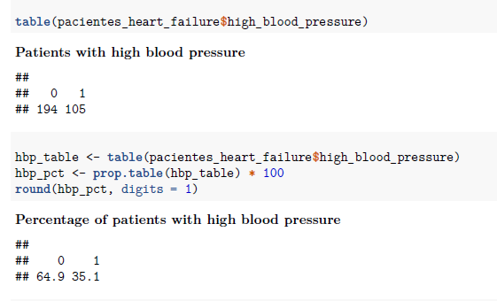
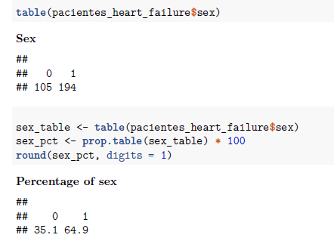

Slide 13
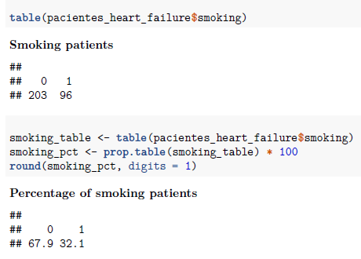
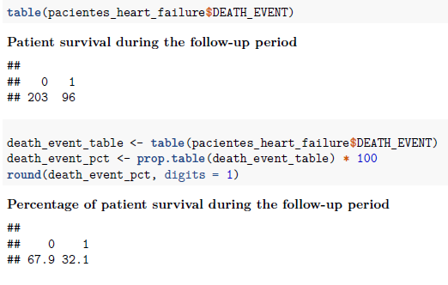

Slide 14
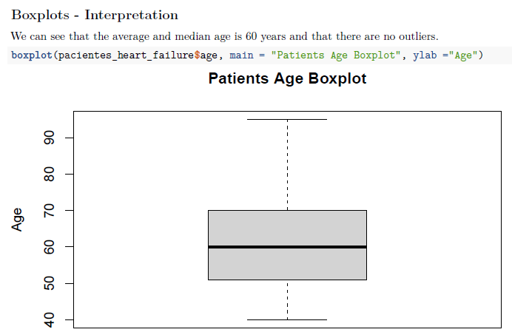

Slide 15
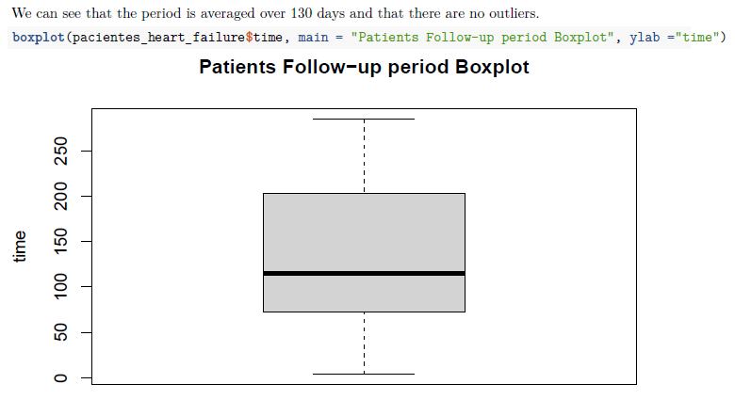

Slide 16
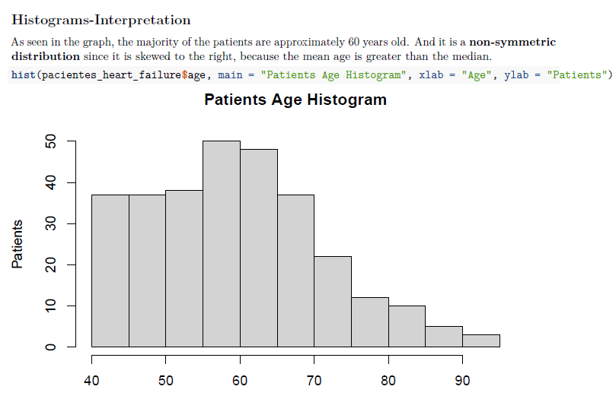

Slide 17
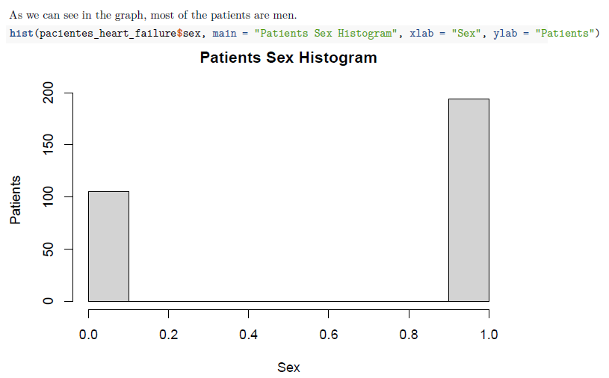

Slide 18
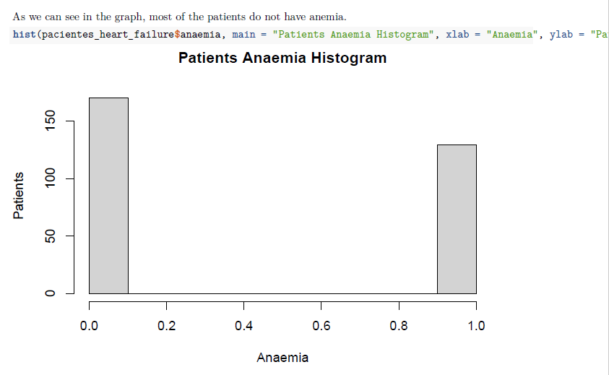

Slide 19
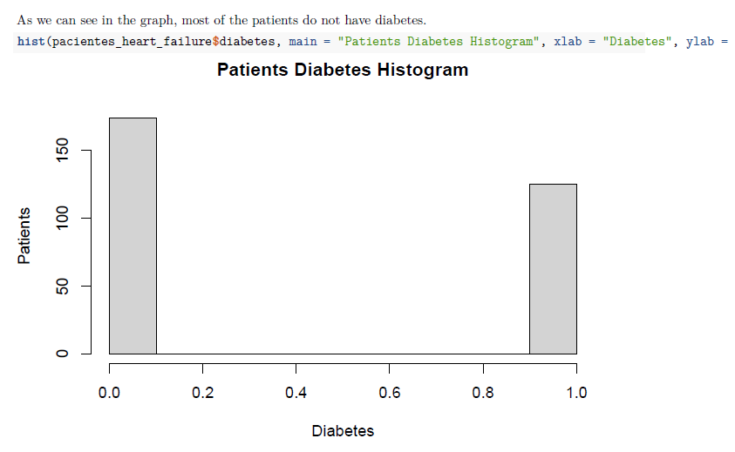

Slide 20
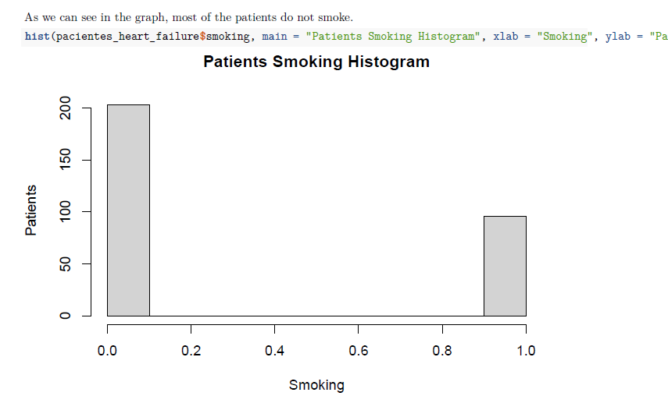

Slide 21
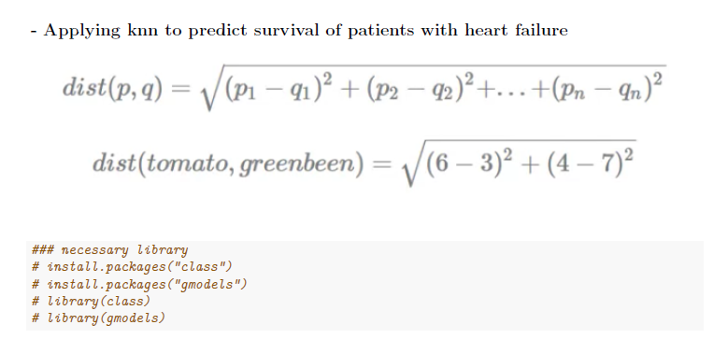


Slide 22
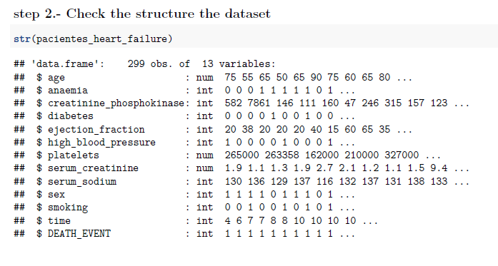
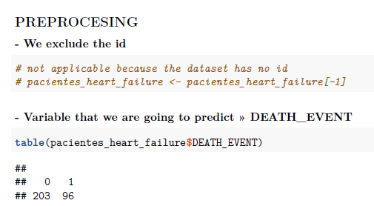

Slide 23
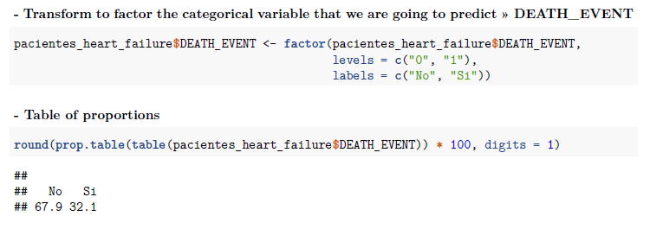
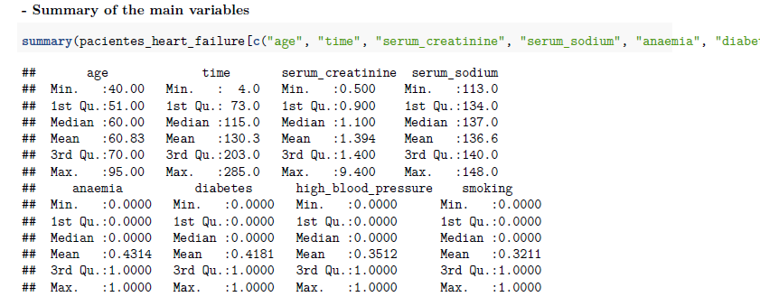

Slide 24
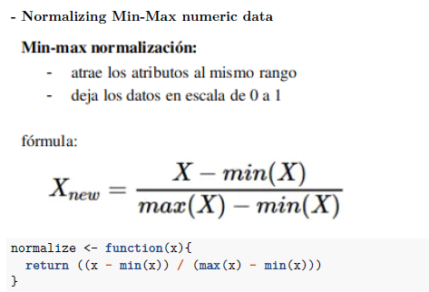

Slide 25
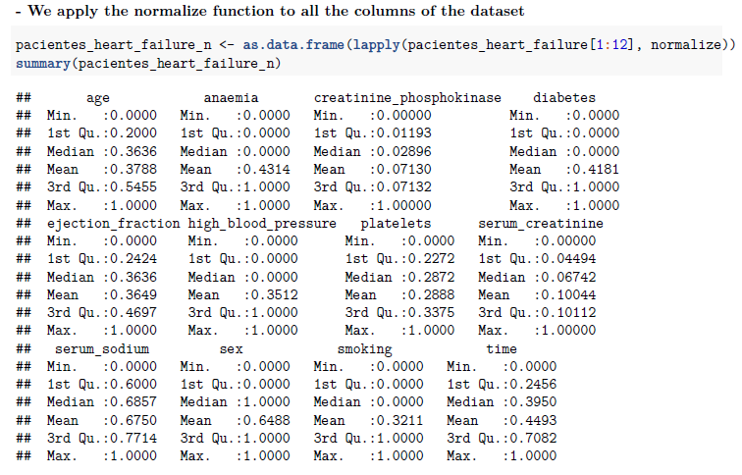

Slide 26

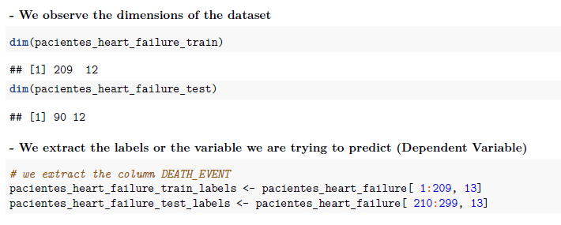

Slide 27



Slide 28
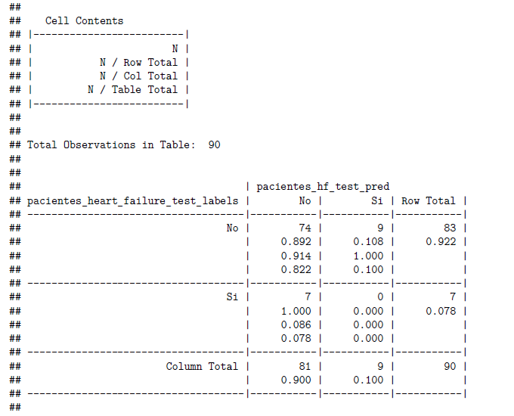


Slide 29
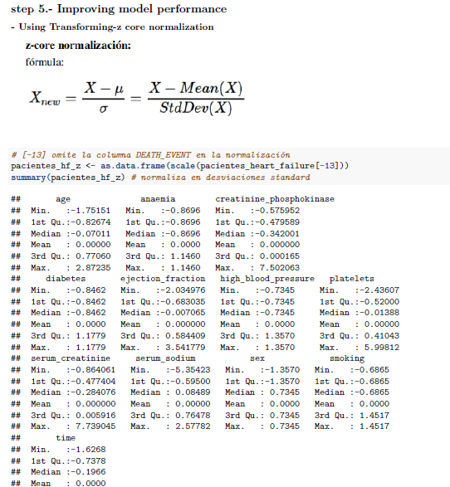

Slide 30
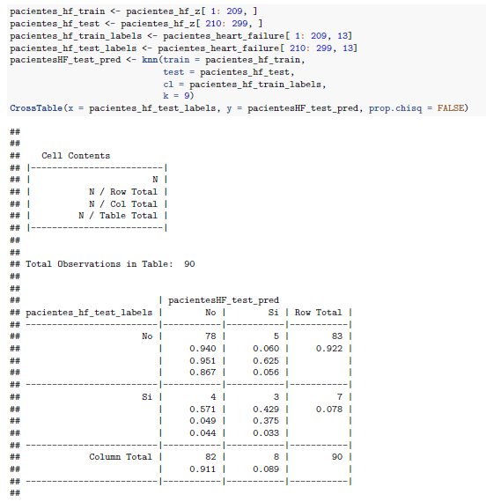

Slide 31
Bibliography
https://archive.ics.uci.edu/ml/datasets/Heart+failure+clinical+records
https://bmcmedinformdecismak.biomedcentral.com/articles/10.1186/s12911-020-1023-5

