Slide 1

UNIVERSIDAD AUTONOMA DE ZACATECAS
MINERÍA DE DATOS
Naive Bayes_Algorithm
Alumnos: Manuel Herrera Lara y Anahí Berumen Murillo

Slide 2
- Abstract
We will apply the naive bayes algorithm to a dataset with Donald Trump tweets in order to classify the tweets as positive and negative.

Slide 3
Index
The data domain
How the data was recollected
Description of the variables of the dataset
Basic data analysis
Describe the distribution of the data.
Application of the naive bayes algorithm
Exploring and preparing the data
DATA PROCESSING STAGE
APPLYING NAIVE BAYES

Slide 4
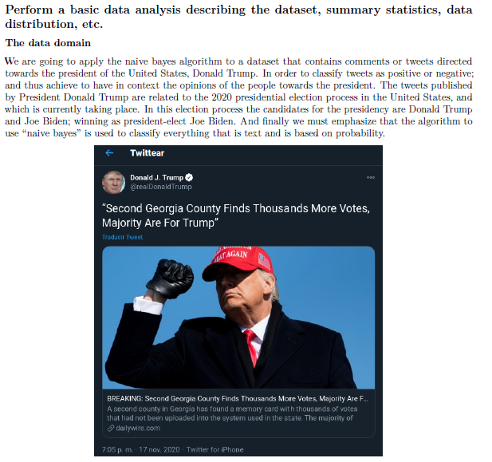

Slide 5
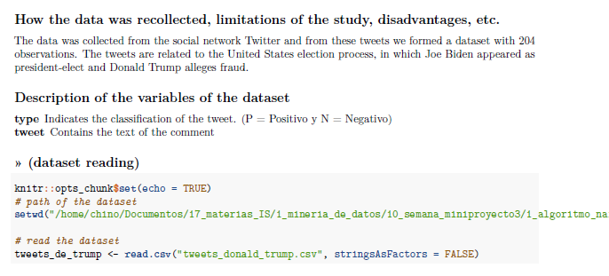

Slide 6
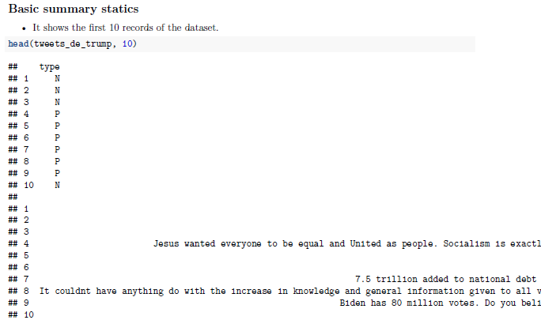

Slide 7
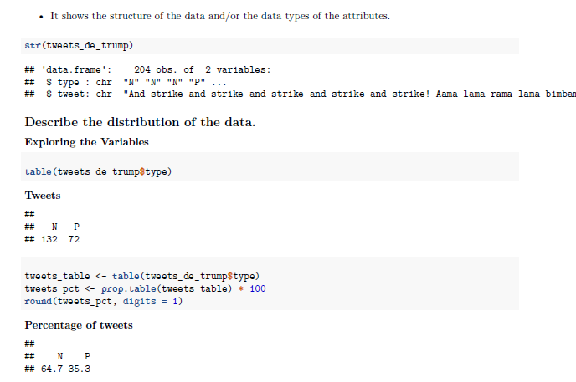

Slide 8
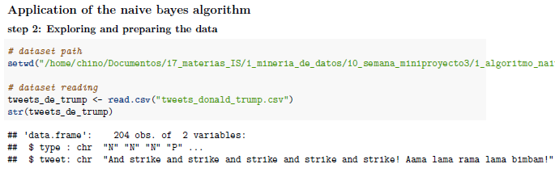
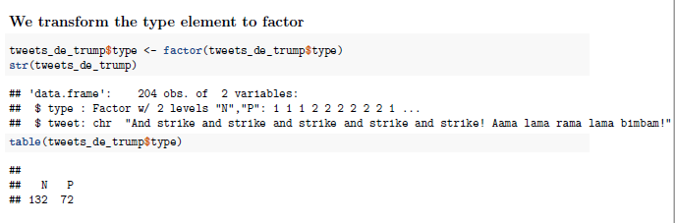

Slide 9
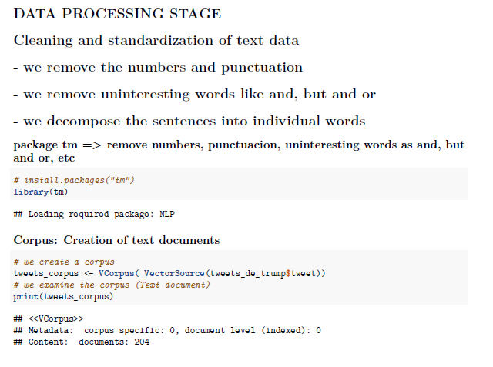

Slide 10
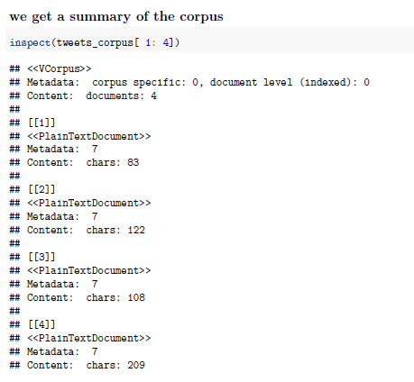
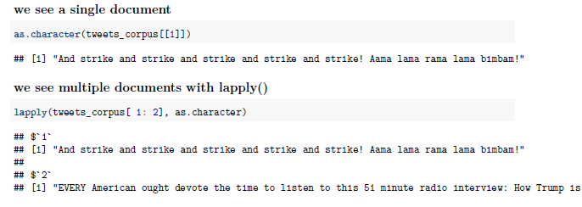

Slide 11
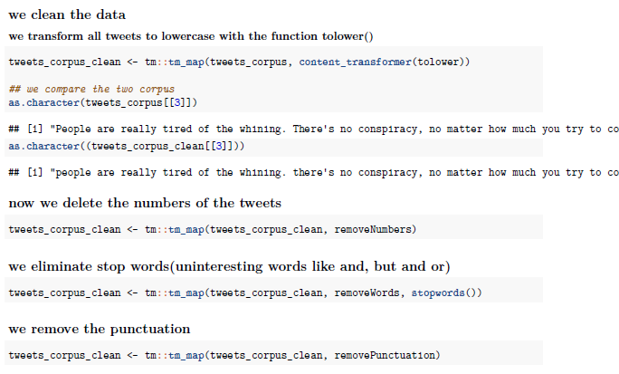

Slide 12
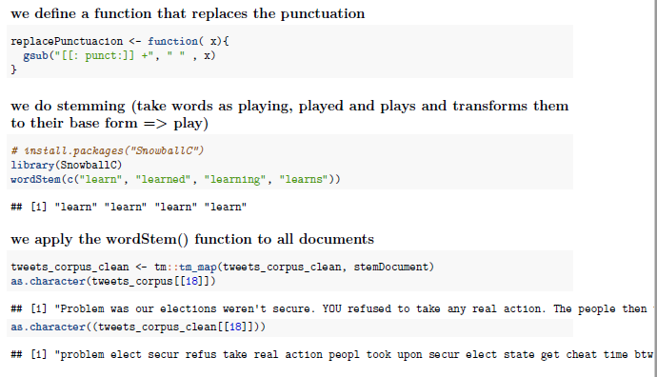

Slide 13
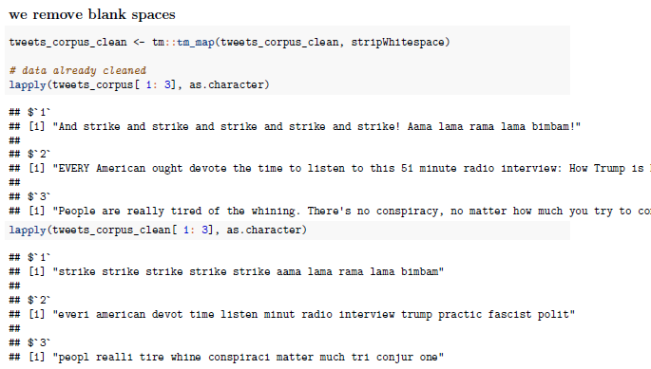

Slide 14
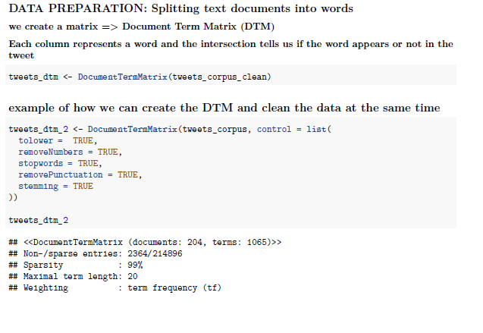

Slide 15
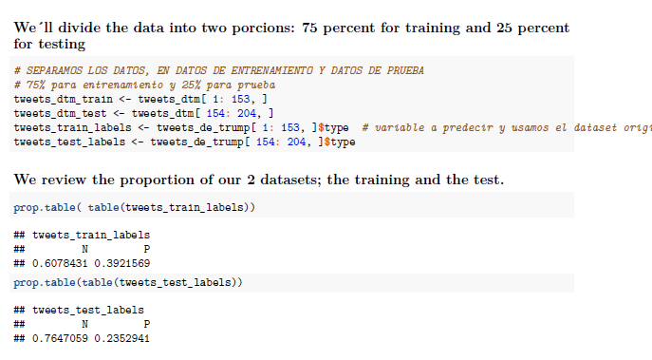

Slide 16
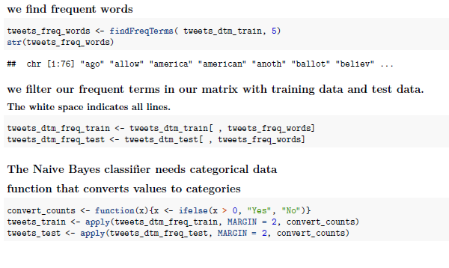

Slide 17
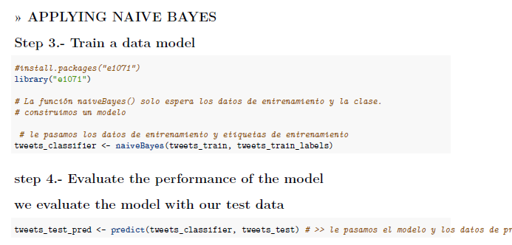

Slide 18
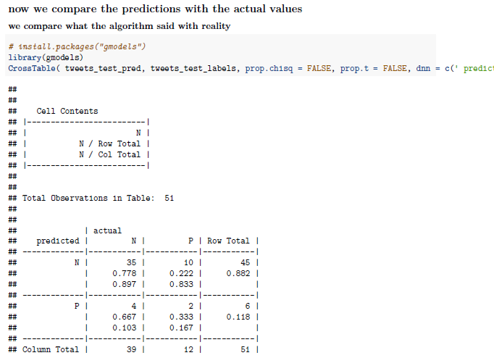

Slide 19
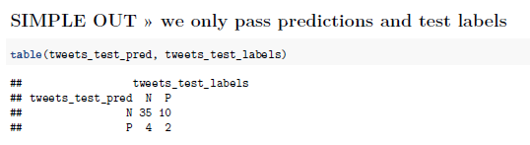
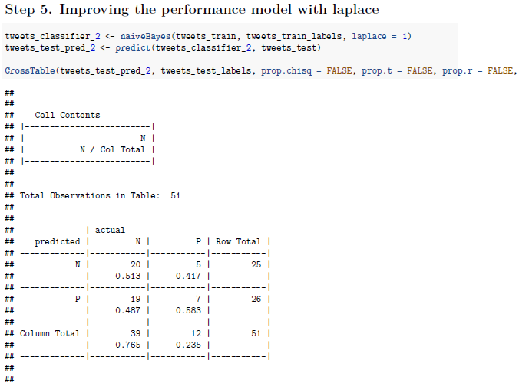
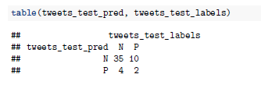

Slide 20
- conclusions
naive bayes is very useful to classify everything that is text, in this case it can be comments from youtube, twitter, Instagram, Facebook, etc. and it does everything based on probability

