Slide 1
Chapter 13 Presentation
Accounting II
Mathew Johnson
Walter Plourde
&
Carrie Baron

Slide 2
Outline - Accounting For Bad Debts
Introduction
Overview/Objectives-cb
Journalizing Bad Debts-wp
Allowance Method – Income Statement Approach-cb
Allowance Method – Balance Sheet Approach-wp
Writing Off an Account – Allowance For Doubtful Accounts-cb
Direct Write Off Methodwp-
Summary

Slide 3
Significance of Bad Debt
Fundamentally, like all accounting principles, bad debt expense allows companies to accurately ans completely report their financial position. At some point in time, almost every company will deal with a customer who is unable to pay, and they will need to record a bad debt expense. A significant amount of bad debt expenses can change the way potential investors and company executives view the health of the company.
Bad debt expense comes with tax implications. Reporting a bad debt expense will increase the total expenses and decrease net income. Therefore, the amount of bad debt expenses a company reports will ultimately change how much taxes they pay during a given fiscal period. It is critical that bad debts are recorded timely and accurately. In addition, they help companies recognize customers who defaulted on payments to avoid similar situations in the future.

Slide 4
Journalizing Bad Debts
Record the journal entry by debiting bad debt expense and crediting allowance for doubtful accounts. When you decide to write off an account, debit allowance for doubtful accounts. The amount represents the value of accounts receivable that a company does not expect to receive payment for.

Slide 5
Balance-Sheet Approach
VS.
Income- Statement Approach
There are two primary methods for estimating bad-debt expenses. The first is an income-statement approach that measures bad debt as a percentage of sale. The second is a balance-sheet approach that measures uncollectibles as a percentage of ending accounts receivable, Under the the balance-sheet approach, the company looks at historical data and estimates what percentage of receivables ends up being uncollectible.

Slide 6
Allowance Method-Income Statement Approach
The income statement approach is an approach by which management can eliminate an allowance for uncollectible receivables as a percentage of the period sales in an effective approach when the company has past experience of history to use as a guide.

Slide 7
Allowance Method-Balance Sheet Approach
When booking bad-debt expenses, the second half of the journal entry is a contra-equity account called allowance for doubtful accounts. The balance of this account reduces the net value of the accounts receivable.

Slide 8
Writing Off an Account-Allowance for doubtful Accounts
When it is determined that an account cannot be collected, the receivable balance should be written off. When the unit maintains an allowance for doubtful accounts, the write-off reduces the outstanding accounts receivable, and is charged against the allowance.

Slide 9
Direct Write Off Method
The direct write off method involves writing off a bad debt directly against the corrosponding receivable account. Therefore, under the direct srite off method a specific dollar amout from the customer account will be written off as a bad debt expense
However, the direct write-off method can result in misstating the income reporting periods if the bad debt journal entry occurred in a different period from the sale entry. For such a reason, it is only permitted when writing off immaterial amounts. The journal entry for the direct write-off methods is a bad debt expense and a credit to accoounts receivable.

Slide 10
Summary
Bad debt expense is the way businessess account for a receivable account that will not be paid. Bad debt arises ahen a customer either can not pay because of financial difficulities or chooses not to pay due to disagreements over the product of service they were sold.
Bad debt expense is used to reflect receivables that a company will be unable to collect.
The amount of bad debt expense can be estimated using the accounts receivable aging method or the percentage sales method.

Slide 11
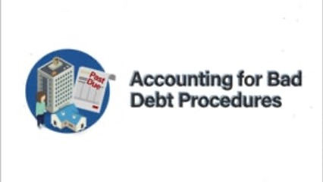
Practical Policy For Bad Debts

Slide 12
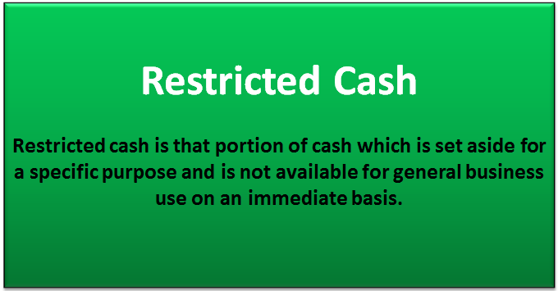
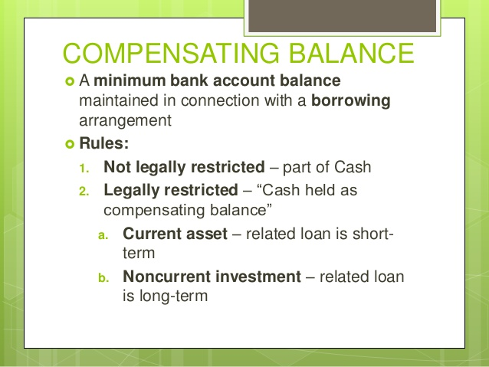
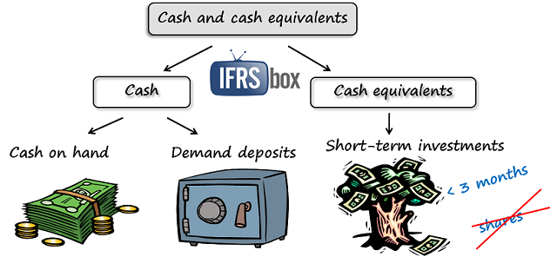
Accounting for Cash and Cash Equivalents (cont.)

Slide 13
Summary of Learning
Accounting for cash and cash equivalents
Cash consists of coins, currency, and bank deposits as well as negotiable instruments such as checks and money order.
Cash equivalents are short-term, highly liquid investments with original maturities of 3 months or less.
Companies report restricted cash and compensating balances separately from cash.
Accounting for accounts receivable: Initial measurement
Trade receivables are generally measured at the amount of the sale made.
Trade discounts are reductions of the catalog price when a company sells to a reseller in the same industry. A volume discount reduces the list price for customers purchasing a large quantity or merchandise.
Sales discounts are reductions in the cash received and sales for early payments. A company can use the most-likely-amount or expected-value method to record the receivable initially.

Slide 14

Summary of Learning (cont.)
Disclosures for accounts receivable and notes receivable
Common disclosures include the total accounts receivable, the allowance, and changes in the allowance. Companies also describe the elements that influence management’s judgement and credit risk when estimating the allowance. Other disclosures include the method used to estimate bad debts and the policy for writing off uncollectible receivables.

Slide 15
Resources
Gordon, Elizabeth A., Raedy, Jana S., & Sannella, Alexander J. (2019). Intermediate Accounting (2nd Ed.). New York, NY: Pearson.

