Slide 1
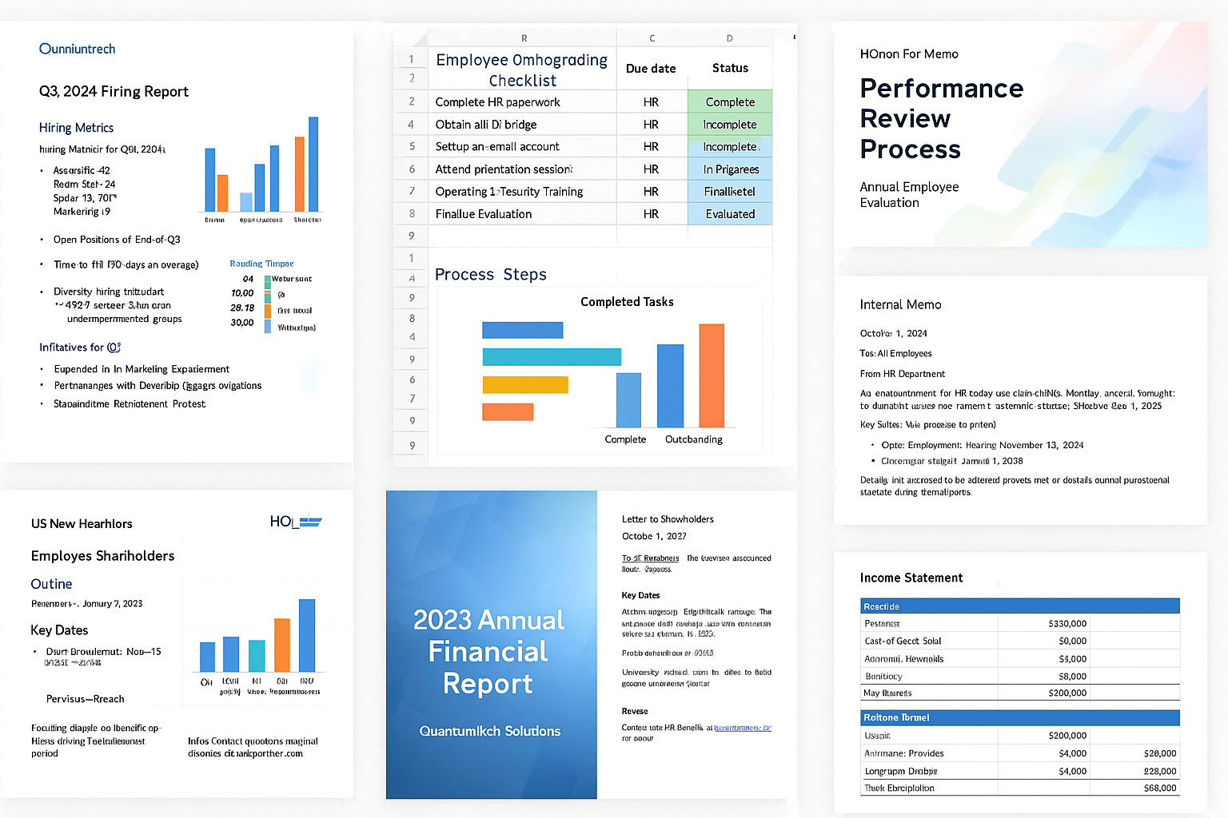
Performance Review Process
Annual Employee Evaluation

Slide 2
Overview
Purpose & Goals
Timeline & Key Milestones
Evaluation Criteria
Feedback & Goal Setting

Slide 3
Review Process Steps
Goal Setting (January): Managers and employees establish clear, measurable objectives.
Self-Assessment (June): Employees complete a reflective evaluation of their achievements.
Manager Review (July–August): Managers assess performance relative to goals and core competencies.
One-on-One Meeting (September): Managers and employees discuss performance and career development.
Final Evaluation (October): Final ratings and compensation adjustments are determined.

Slide 4
Review Timeline

Slide 5
Evaluation Criteria
Job Knowledge & Technical Skills
Quality and Productivity of Work
Communication & Collaboration
Innovation & Problem Solving
Team Leadership & Mentorship

Slide 6
Next Steps
Encourage continuous feedback throughout the year.
Leverage review outcomes to set personalized development plans.
Align employee goals with Innovatech’s strategic objectives.
Celebrate achievements and recognize high performers.

