Slide 1
✦
northstar
✦
PROJECT PURCHASE PLANNING
Every project purchase,
accounted for
PITCH DECK
A lightweight system that connects spending to the person, purpose, and project behind it.
NORTHSTAR
01

Slide 2
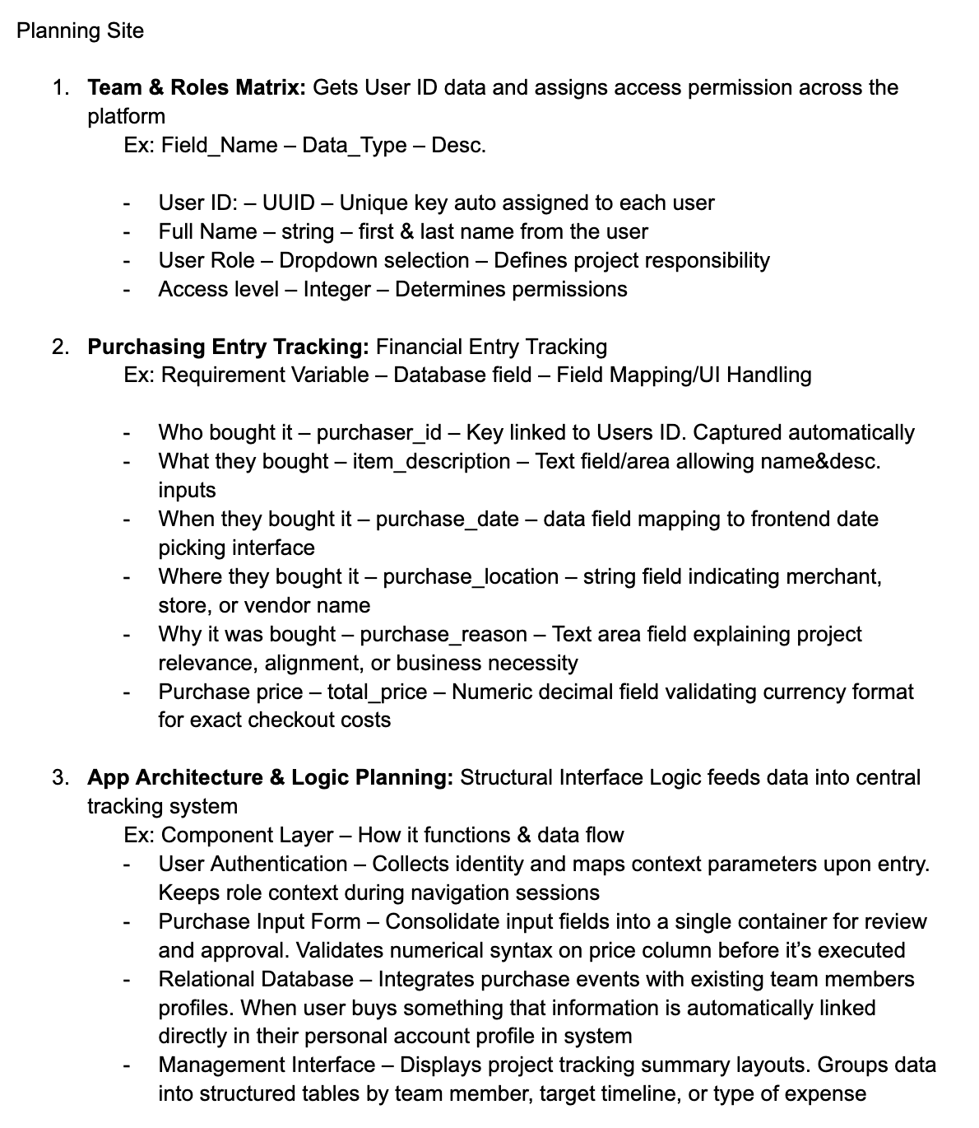
02
WHY NOW
Project spending loses context
Receipts show the amount, but they miss the full story.
WHO
The purchaser gets separated from the expense.
WHY
Business context disappears after checkout.
WHAT
Managers reconstruct the story during review.
WHO CAN ACT
Permissions live outside the spending record.
NORTHSTAR
02

Slide 3
03
FOR WHOM
Small teams sharing a project budget
Northstar gives each role the part of the spending picture they need.
PROJECT LEADS
OPERATIONS & FINANCE
TEAM MEMBERS
ADMINS
See the whole budget
Review with context
Log once at purchase
Match access to role
Track total spend, monthly movement, and who is purchasing.
Find the reason, vendor, date, and purchaser in one record.
Submit the expense while the details and business need are fresh.
Assign clear permission levels across the workspace.
01
02
03
04
NORTHSTAR
03

Slide 4
04
HOW IT WORKS
One record connects the full purchase story
Identity follows the user. Context follows the expense.
01
02
03
04
Identify
›
Capture
›
Link
›
Review
The active user and access level load with the workspace.
A single form records item, date, vendor, reason, and price.
The purchase joins the purchaser’s profile automatically.
Managers see totals by person, month, and expense type.
NORTHSTAR
04

Slide 5
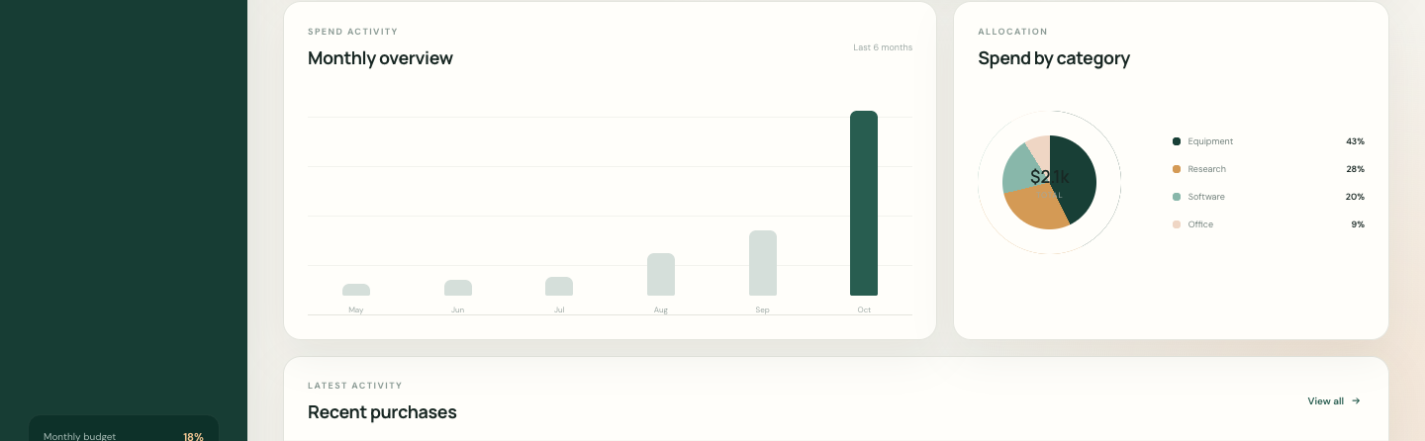
05
PRODUCT
The budget picture, ready at a glance
Leads see spend, purchasing activity, category mix, and recent entries in one place.
NORTHSTAR
05

Slide 6
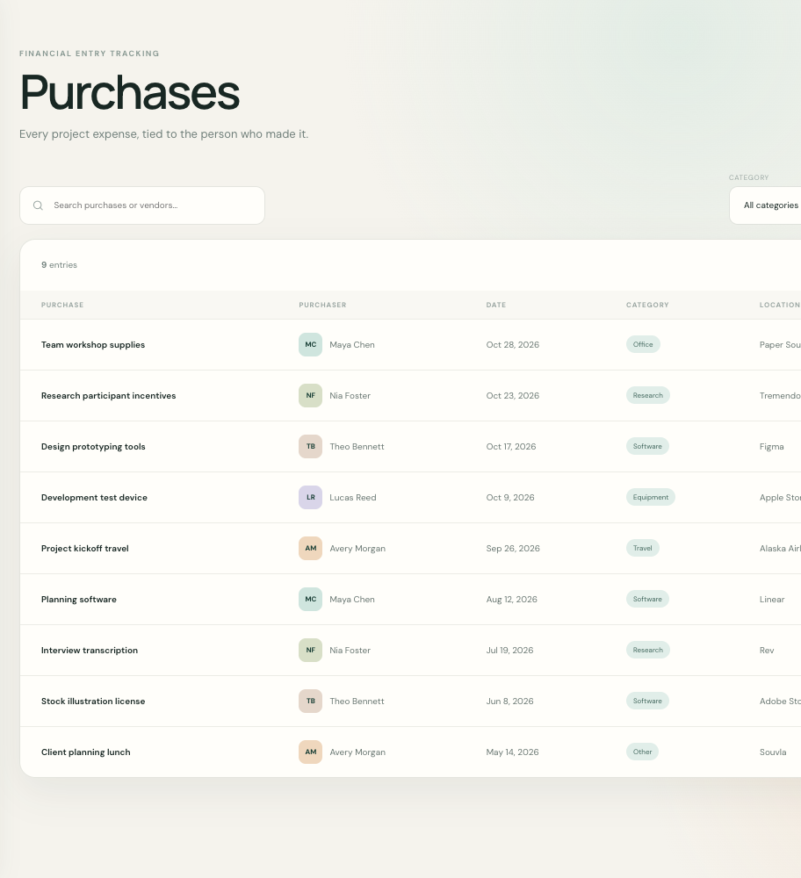
06
WHAT CHANGES
Review starts with answers
Each row explains the expense before anyone asks a follow-up question.
Scattered receipts
›
Shared purchase history
Manual ownership lookup
›
Purchaser linked automatically
Missing business reason
›
Purpose captured at entry
Late budget reconstruction
›
Current totals and filters
NORTHSTAR
06

Slide 7
07
SUGGESTED NEXT STEP
Start with one active project
A focused pilot can validate whether the team captures better context and spends less time reconstructing it.
PILOT SCOPE
LEARNING GOALS
One shared budget
Five to ten users
Four weeks of purchase activity
Are entries complete?
Can leads review without follow-up?
Does access match responsibility?
northstar
Make project spending easier to explain.
NORTHSTAR
07

