Slide 1
Introducing Microbiome Bioinformatics
Part 7.

Slide 2
Recap: Aims
Microbiome analysis
with particular regard to sequence informatics concepts
“Top down” – putting analysis tools and resources in context
No highly detailed technicalities (yet)
No instructions on how to run particular programs
Why you are using the bioinformatics approaches you use; pros, cons; alternatives

Slide 3
Topics, top-down
Aims of studies:
Types of environments studied
Variety of microbiomes, and domains of Life
Introduction
“Communities”
Functions
“barcoding”- use of marker genes
Aims of DNA/ RNA sequencing
approaches
“shotgun” metagenomics
metatranscriptomics
16S rRNA
Other markers
aims of whole-metagenome sequencing
Dealing with the data:
Informatics concepts
16S rRNA
“shotgun” meta-’omics
Later:
more technical details
Communities in detail

Slide 4
Series of talks
6 so far
Open ended… as long there is demand
Expected to be every 2 weeks, but all dates will be confirmed in advance
Bite-size bioinformatics mailing list
The next few will cover: (not necessarily in this order…)
16S analysis for community profiling
Clustering and classification issues (taxonomies etc)
Analysing richness and diversity of those communities
Dealing with sequencing and other errors
Informal and flexible
Please interrupt and ask questions
Suggestions for topics for further focus

Slide 5
Series of talks
Part 1: 27/1/2017
“Biological and Experimental Stuff that a microbiome bioinformatician needs to know”
Overview of marker gene sequencing for community analysis
Part 2: 10/2/2017
Overview of whole-metagenome sequencing
Part 3: 24/2/2017
Focus on metatranscriptomics
Part 4: 10/3/2017
Different bioinformatics approaches to processing 16S read data
Part 5: 24/3/2017
De novo OTU clustering: sequence identities and how thresholds have been determined historically; relationships to taxonomic levels
Part 6: 7/4/2017
The clustering problem: different approaches, and what can go wrong; the influence of amplification artefacts, sequencing errors and sequence lengths; computational OTUs versus species
Slideshows
http://ghfs1.ifr.ac.uk/ghfs/

Slide 6
To be confirmed…
NO SESSION ON 5th MAY
NO SESSION ON 19th MAY
2nd June Barton
16th June Barton

Slide 7
Let’s take a break from Operational Taxonomic Unit assignment…
… what can you actually do with your OTU assignments?
(or any taxonomic assignments)

Slide 8
You have a table like this:
SAMPLES …. …..
 | #1 | #2 | #3 | #4 | #5 | #6 | #7 | #8
a
b
c
d
e
f
g
h
i
j
k
This could result from 16S rRNA gene sequence (16S rDNA) analysis,
or metagenomics sequence analysis;
and from OTU-based approaches, and non-OTU based
OTUs
or species
(relative)
frequencies….
…. or other ‘phylo-types’

Slide 9
A brief recap of genera, species and OTUs in 16S rRNA gene sequencing

Slide 10
Genus A
16S gene sequence space
Whole-genomes sequence space
Genus B
species
Computationally-derived OTU

Slide 11
What taxa to use in your frequency tables?
With 16S rDNA, using species as your ‘taxonomic atom’ is not really possible
And OTUs may not be the best idea either
(may depend partly on how you arrived at those OTUs; another topic for later)
And you may not even have used an OTU-based approach in the first place
So use the labels you have got
Which will almost certainly extend to different levels
With shotgun metagenomics, species-level identification should be possible
with some but definitely not all reads
(another topic for later…)

Slide 12
Microbial ecology
Generally, the same principles and metrics apply as in other ecological studies
Estimates of
richness (numbers of different organisms)
diversity (frequency distributions of organisms)
Many different ways of calculating these
(strictly, estimating them)
Within and between communities/ecosystems

Slide 13
Ecology and taxa
Usually, these methods used in ecology are applied to species
But in principle, can be applied to other taxonomic levels
(such as genera, from 16S ; or OTUs)
That is, the formulae can be applied to any category or ‘class’, in principle
For simplicity, here we will refer to ‘phylotypes’ as the category in question (usually….)
As that can refer to different levels of relatedness, as the case may be

Slide 14
Other uses of Metrics
E.g. Richness and Diversity
These are most commonly applied to richness and diversity of phylotypic or taxonomic groups
They can also be applied to richness and diversity of other things
Such as phenotypes or molecular functions
Diversity metrics of functions inferred from metagenome/ metatranscriptome sequencing are increasingly common in the literature

Slide 15
Sampling and estimation
These methods for analysing communities / ecosystems necessarily use sampling in nearly all cases
Studies where every single individual organism can be observed with certainty, are extremely unusual
And certainly do not include microbiome studies
Many traditional ecological approaches involve capture-release-recapture sampling
Each individual might be observed once only
or more than once
or not at all

Slide 16
Sampling and estimation
Always remember the distinction between:
The numbers observed in the sample
The true numbers in the original community
(a) is used to calculate an estimate of (b)
Some methods are based on the capture-release-recapture assumption, when performing these calculations
Is this a sound assumption for sampling prokaryote cells by sequencing a piece of their DNA?
With shotgun metagenomics?
With amplified segments of 16S rRNA genes?
Discuss…?

Slide 17
Frequencies (measure of abundance)
Again, there are actual frequencies which we can try to estimate by observed frequencies
Observed frequencies:
Can be a count of number of times each species is observed
Usually dealt with as a proportion
In some ecological studies, non-discrete observations are more appropriate
E.g. dry mass

Slide 18
Richness and Diversity of organisms in ecosystems
(micro-organisms or otherwise)

Slide 19
Indices used for richness or diversity
Simpson’s index
ACE
Phylogenetic Diversity
Chao1
Chao2
ICE
Shannon entropy
Hill numbers
Many others…
Definitions of diversity are also… very diverse

Slide 20
Metrics of Richness and Diversity
Strictly speaking, these are estimates, not measurements
A useful way of describing a sample with a small amount of information (such as a single number)
Enables assessment of differences between samples, and thus estimations of:
Differences between communities/ecosystems
Changes in a community/ecosystem over time
Can be correlated with other aspects of the sample/ ecosystem e.g.
Levels of pollutants
Host phenotype
Host health/disease state

Slide 21
Richness
Total number of organisms (species, OTUs or other phylotypes) present
This can be very hard to estimate by sampling
because in the general case, we do not know what shape the distribution of frequencies is
This can be tackled with non-parametric approaches
It seems especially problematic if there are many species with a very low frequency
Many of these could be missed in any given sample
Also, some of the lowest-frequency organisms could be artefactual (undetected chimaeras; sequencing errors)

Slide 22
The simplest estimate of all
How many different phylotypes have you observed in the sample?
In general, likely to be a poor estimator for the actual number of phylotypes
It is possible to evaluate* whether this number approximates a stabilised value
I.e. the maximum value you would ever get, with increasingly larger sample sizes
Which is hopefully a good indicator of the actual number
Estimated Rarefaction: Repeatedly analyse subsets of your data, of all sub-sample sizes up to the actual size of the sample data set
(This is individual-based rarefaction)

Slide 23
Some example data
From a GHFS project
250 bp PE Illumina sequencing of 16S V4/5
Multiple samples, belonging to > 1 cohort
Reads from all samples will be considered collectively, for this illustration

Slide 24
Some example data
An indication of numbers that might be expected if you use as phylotypes:
OTUs
Named taxa from reference taxonomies (assigned to those OTUs)
Also the difference between two types of OTU-assignment
De novo clustering
Closed-reference assignment (use a reference OTU database)
And between data which has been pre-screened for chimera sequences, and those which have not
In all cases, the data has been pre-screened to discard low-quality sequences in the same way
You might get very different numbers from your data of course!

Slide 25
Clustering : comparing reads with each other (“self-referential”)
Using a reference database
taxon-assignment to reads
processing each read independently
“open
reference”
“closed
reference”
OTU-assignment to reads
OTU-assignment to reads
“de novo”
taxon-assignment to OTUs
OTU-assignment to reads
processing representative sequences of each OTU
Different Operational Taxonomic Units (OTU) approaches and non-OTU approaches

Slide 26
 |  |  | De novo OTU clustering |  | Closed-reference OTU-assignment (uses ref. DB)
 |  |  | No chimera-screening | With chimera-screening | No pre chimera-screening | With pre chimera-screening
Total reads processed |  |  | 5257222 | 5234178 | 5257222 | 5234178
reads assigned to OTUs |  |  | 100% | 100% | 97% | 97%
OTUs |  |  | 29527 | 26306 | 2905 | 2884
OTUs assigned to |  | named genus | 7229 (24%) | 6217 (24%) | 831 (29%) | 826 (29%)
 |  | named species | 2328 (8%) | 1862 (7%) | 204 (7%) | 203 (7%)
Unique taxa names assigned to OTUs |  |  | 145 | 144 | 121 | 121
Unique taxa with | named genus |  | 107 (74%) | 107 (74%) | 85 (70%) | 85 (70%)
 | named species |  | 53 (37%) | 53 (37%) | 35 (29%) | 35 (29%)

Slide 27
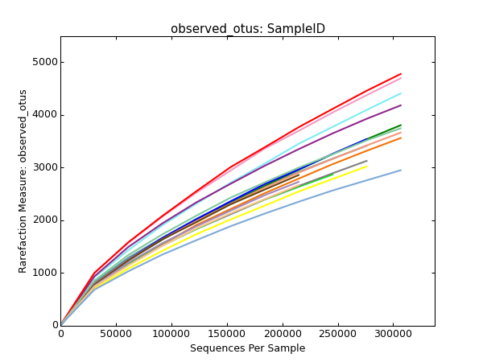
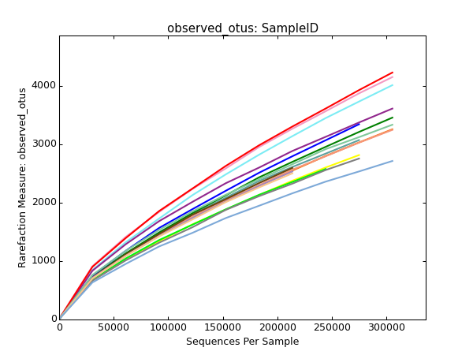
Rarefaction
only de novo clustered OTUs shown here
All samples considered separately here
No chimera-screening
With pre chimera-screening

Slide 28
It is also possible to extrapolate beyond the actual size
Which you might be interested in doing, if your curve has not levelled off
I.e. this is one way of calculating an estimate of richness (in the original community) from your observations (of the sample)
But uncertainty rapidly increases as you extrapolate substantially beyond the sample size (Haegeman et al., 2013)

Slide 29
Rarefaction can also be performed on a per-sample basis
E.g. 50 samples of the same thing
Recalculate observed numbers by repeatedly analysing n samples of those 50

Slide 30
The previous slides illustrated some differences resulting from different data-processing protocols
For any given protocol, we would like to obtain the same results if we repeated the experiment again and again
But how likely is this, given the randomness of the experimental sampling process?
This is especially pertinent to the rarest phylotypes
And indeed features of the abundance distribution in general

Slide 31
Problems with rarefaction

Slide 32
Haegeman et al. (2013)
[ Figure 2 of Haegeman et al. (2013) https://www.nature.com/ismej/journal/v7/n6/fig_tab/ismej201310f2.html#figure-title ]
Three model communities
S_{n} is the actual number of species in the community
Sampling/rarefaction gives the reverse answer to the correct one
With this sort of distribution, the problem does not get any better as the sample size increase
How realistic are these model distributions? (Discuss…)

Slide 33
Long tails of rare types

Slide 34
Abundance versus rank: What shape is the tail? How long is it?
Hypothetical example
How many of these very-low frequency phylotypes can we reliably expect to observe in each sample?

Slide 35
We expect to ‘hit’ and ‘miss’ these very-low abundance phylotypes in a random way
Can this expectation be used to estimate the true values in the community?
The abundances of the most-rarely observed types can be used to estimate the number of types which were observed zero times by sampling
(but which are present)
A principle first described by Good (1953)
“[Alan] Turing is acknowledged for the most interesting formula in this part of the work”

Slide 36
Traditional ecology versus DNA sequencing
Good-Turing type estimators enable the estimation of the frequency of events which have not yet happened
Such as, an estimation of the true frequency (abundance) of organisms which are in the community being studied – but which have not yet been observed
But by using these techniques in DNA-sequencing, we will be estimating the occurrence of rare DNA sequences not yet observed
Which will include:
True DNA sequences not yet observed
Erroneous sequences caused by the sequencing platform, not yet observed
Chimera sequences not yet observed
So are these techniques less suitable for this situation, compared to, say, capturing invertebrates in pitfall traps?
Errors and misidentifications do also occur in traditional ecology sampling methods, so will also contribute to those stats
In short: these types of estimators do not eliminate the effects of amplification/sequencing errors

Slide 37
A brief look at some of these types of estimators

Slide 38
“Abundance” versus “incidence”
In this context, abundance means relative frequencies within a sample
How many times was each type observed?
Incidence means the number of samples in which each type was observed
Irrespective of how often it was observed in each sample

Slide 39
Estimating richness from abundance
i.e. from relative frequencies of phylotypes in a sample

Slide 40
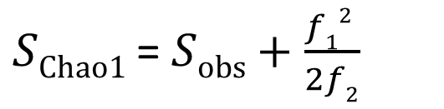
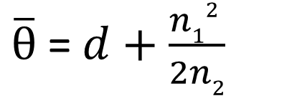
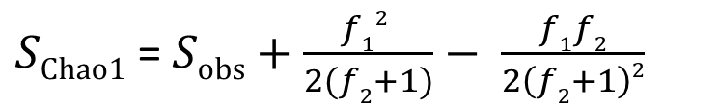
Chao1 (Chao, 1984)
$\overline{θ}$= $d+\frac{n12 }{2n2}$
Estimator for θ, the actual number of phylotypes (“classes”) – i.e. richness
d : total number of observed phylotypes
n₁ : number of phylotypes observed only once (‘singleton’)
n₂ : number of phylotypes observed only twice (‘doubleton’)
Often written as:
Modified forms usually used,
to allow for cases where f₂ is 0
Such as:
E.g. Kemp & Aller (2004)
Other forms exist in the literature
E.g. in Gotelli & Colwell (2011)
$SChao1$= $Sobs+\frac{f12 }{2f2}$
$SChao1$= $Sobs+\frac{f12 }{2(f2+1)}− \frac{f1f2}{2\left(f2+1\right)2}$

Slide 41
Chao estimators
Chao1: Particularly appropriate for communities where most phylotypes are relatively rare (Chao, 1987; Kemp & Aller, 2004)
This probably describes the gut microbiome? (Discuss….)
ACE (Chao & Lee, 1992) : considers all observed phylotypes as either ‘rare’ or ‘abundant’, and uses the numbers of each, as well as the number of singletons, explicitly
Some assessments using earlier sequencing platforms for 16S rDNA
(thus, very small sample sizes – and much longer sequences - compared to today)
E.g. Kemp & Aller (2004)
also used hypothetical, model distributions of frequencies
concluded Chao1 well-suited for estimating phylotype richness from prokaryotic 16S rDNA
ACE did not perform as well

Slide 42
Jackknife estimators for abundance data
First order: S_{jackknife1} = S_{obs} + f₁
Second-order: S_{jackknife2} = S_{obs} + 2f₁ - f₂
Burnham & Overton (1979)
See also
Gotelli & Colwell (2011)
Hortal et al. (2006)
and references therein
Many other estimators

Slide 43
Estimating richness from incidence
i.e. from how many samples a phylotype is observed in

Slide 44
Estimating richness from incidence
Requires multiple samples
In contrast to abundance-methods
Abundance in each sample is relevant only in the consideration of whether:
The frequency is zero
The frequency is non-zero
Sizes of non-zero frequencies are irrelevant

Slide 45
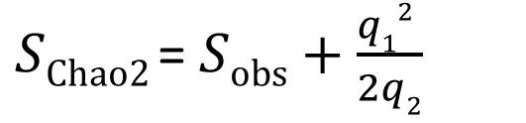
Chao2 (Chao, 1987)
Identical in form to Chao1
But q₁ is the number of phylotypes which occur in only 1 sample
q₂ is the number of phylotypes which occur in only 2 samples
ICE (Lee & Chao, 1994)
Jackknife estimators for incidence
E.g. Smith & van Belle (1984)
$SChao2$= $Sobs+\frac{q12 }{2q2}$

Slide 46
Many richness estimators exist for both abundance- and incidence-based frequencies
For a description of some of these, see:
Gotelli & Colwell (2011)
Hortal et al. (2006)

Slide 47
How reliable is all this?
How concerned should we be with richness (numbers of types)?
Consider this from two points of view
What are we actually interested in, given what we are able to sample?
Rigorous assessments of different richness estimators

Slide 48
What are we interested in?
Given the expected uncertainty in determining the exact number of (phylo)types, should we be more interested in :
determining the number of types which can be reliably observed?
determining the number of types which we actually care about?
which is another way of asking:
How miniscule does an actual abundance in the original community need to be, in order for us to treat it the same as if it was zero?

Slide 49
…which is another way of describing the limitation of richness
In this example, A, B and C represent true relative abundances in communities
(rather than observations in samples)

Slide 50
A
C
richness:
20 species
richness:
1 species
B and C have identical richness (ACTUAL number of species).
But C can be considered very similar to A in terms of “effective” number of species
B
richness:
20 species

Slide 51
The effective number of phylotypes results from a consideration of “dominance” versus “evenness”, and can be quantified (by various methods).
It is also simply related to measures of diversity
Which describe distributions of relative abundance
More in the next session…
It also relates to our ability to reliably and reproducibly estimate the number of phylotypes by sampling
The effective number is more reproducible than the actual number

Slide 52
A
C
Mean relative abundance = 0.05
Mean relative abundance = 1.0
Effective number, and Diversity, is not well represented by simple stats such as (arithmetic) mean abundance :
again C = B
B
in this example, the geometric mean performs even worse
Mean relative abundance = 0.05
Better methods needed…

Slide 53
Assessment of estimators
Numerous in the literature
That Haegeman et al. (2013) paper again:
“Species richness cannot be estimated from sample data alone”
“We claim that sample data is always consistent with very different community structures”
“computation shows that the rarefaction curves do not depend on the abundance distribution of the rare species”
“We have shown that the number of species in a community cannot be reliably estimated from sample data”
For anyone who has analysed many sets of 16S-sequenced samples from many experiments, it may be a relief to hear all this…

Slide 54
Recommendations
Measurements of richness are easy to obtain from your data
Don’t use measurements of richness
At least, quote them
but do not rely on them as a descriptor of your samples
Bad news for Richness
Better news for Diversity?

Slide 55
References

Slide 56
Burnham K.P. and Overton W.S. (1979) Robust estimation of population size when capture probabilities vary among animals, Ecology 60: 927-236
Chao A. (1984) Nonparametric Estimation of the Number of Classes in a Population, Scand J. Stat. 11 (4): 265-270
Chao A. (1987) Estimating the Population Size for Capture-Recapture Data with Unequal Catchability, Biometrics 43 (4): 783-791
Chao A. and Lee S.-M. (1992) Estimating the number of species in a stochastic abundance model, Biometrics, 43: 783-791
Colwell R.K., Chao A., Gotelli N.J., Lin S.-Y., Mao C.X., Chazdon R.L. and Longino J.T. (2011) Models and estimators linking individual-based and sample-based rarefaction, extrapolation and comparison of assemblages, J. Plant Ecol. 5 (1): 3-21
Foggo A., Attrill M.J., Frost M.T. and Rowden A.A. (2003) Estimating marine species richness: an evaluation of six extrapolative techniques, Mar. Ecol. Prog. Ser. 248: 15-26
Forest F., Grenyer R., Rouget M., Davies T.J., Cowling R.M., Faith D.P., Balmford A., Manning J.C., Procheş, van der Bank M., Reeves G., Hedderson T.A.J. and Savolainen V. (2007) Preserving the evolutionary potential of floras in biodiversity hotspots, Nature 445: 757-760
Good I.J. (1953) The Population Frequencies of Species and the Estimation of Population Parameters, Biometrika 40 (3,4): 237-264
Gotelli, N.J. and Colwell R.K. (2011) Estimating species richness, in Biological Diversity: Frontiers in Measurement and Assessment, Chapter 4, pp 39-54, Eds Magurran AE and McGill BJ, Oxford University Press

Slide 57
Haegeman B., Hamelin J., Moriarty J., Neal P., Dushoff J. and Weitz J.S. (2013) Robust estimation of microbial diversity in theory and in practice ISME J. 7: 1092-1101
Hill M.O. (1973) Diversity and evenness: A unifying notation and its consequences, Ecology 54: 427-432
Hortal J., Borges P.A.V. and Gaspar C. (2006) Evaluating the performance of species richness estimators: sensitivity to sample grain size, J. Anim. Ecol. 75: 274-287
Kemp P.F. and Aller J.Y. (2004) Estimating prokaryotic diversity: When are 16S rDNA libraries large enough? Limnol. Oceanogr. Meth. 2: 114-125
Lee S.-M. and Chao A. (1994) Estimating population size via sample coverage for closed capture-recapture models, Biometrics 50: 88-97
Legendre P. and Gallagher E.D. (2001) Ecologically meaningful transformations for ordination of species data, Oecologia 129: 271-280
Smith E.P. and van Belle G. (1984) Nonparametric estimation of species richness, Biometrics 40: 119-129
Tuomisto H. (2010) A diversity of beta diversities: straightening up a concept gone awry. Part 1. Defining beta diversity as a function of alpha and gamma diversity, Ecography 33: 2-22
Tuomisto H. (2010) A consistent terminology for quantifying species diversity? Yes, it does exist, Oecologia 164: 853-860

Slide 58
 |  |  | De novo OTU clustering |  | Closed-reference OTU-assignment (uses ref. DB)
 |  |  | No chimera-screening | With chimera-screening | No pre chimera-screening | With pre chimera-screening
Total reads processed |  |  | 5257222 | 5234178 | 5257222 | 5234178
reads assigned to OTUs |  |  | 100% | 100% | 97% | …
OTUs |  |  | 29527 | 26306 | 2905 | 2884
OTUs assigned to |  | named genus | 7229 (24%) | 6217 (24%) | 831 (29%) | 826 (29%)
 |  | named species | 2328 (8%) | 1862 (7%) | 204 (7%) | 203 (7%)
Unique taxa names assigned to OTUs |  |  | 145 | 144 | 121 | 121
Unique taxa with | named genus |  | 107 (74%) | 107 (74%) | 85 (70%) | 85 (70%)
 | named species |  | 53 (37%) | 53 (37%) | 35 (29%) | 35 (29%)

Slide 59
Good, I.J. (1953) The Population Frequencies of Species and the Estimation of Population Parameters. Biometrika, 40, 237-264.
“Turing is acknowledged for the most interesting formula in this part of the work”

Slide 60
Is it possible to calculate reliable estimates of richness from our observed numbers?
(without repeated in silico sub-sampling

Slide 61
But how reliable are those numbers in the first place?
If we repeated the experiment, would we get the same numbers?

