Slide 1
Introducing Microbiome Bioinformatics
Part 2.

Slide 2
Recap: Aims
Overview of types of microbiome analysis
with particular regard to sequence informatics concepts
“Top down” – putting analysis tools and resources in context
No highly detailed technicalities
No instructions on how to run particular programs
Why you are using the bioinformatics approaches you use; pros, cons; alternatives

Slide 3
Series of talks
At least 3 sessions to cover what I would like
Beyond that – if there is demand –
can progress to more technical talks
especially about 16S analysis (probably)
increasingly metagenomics in GHFS research
Informal and flexible
Please interrupt and ask questions
Suggestions for topics for further focus

Slide 4
Series of talks
Part 1: 27/1/2017
“Biological and Experimental Stuff that a microbiome bioinformatician needs to know”
http://ghfs1.ifr.ac.uk/ghfs/
(see post of the above date)
Part 3: 24/2/2017, 14:00, Barton

Slide 5
Topics, top-down
Aims of studies:
Types of environments studied
Variety of microbiomes, and domains of Life
Introduction
“Communities”
Functions
“barcoding”- use of marker genes
Aims of DNA/ RNA sequencing
approaches
“shotgun” metagenomics
metatranscriptomics
16S rRNA
Other markers
aims of whole-metagenome sequencing
Dealing with the data:
Informatics concepts
16S rRNA
“shotgun” meta-’omics
Later:
more technical details
Communities in detail

Slide 6
Metagenomics
FUNCTIONAL
ANALYSIS
Marker-gene barcoding
What can
they do?
COMMUNITY
ANALYSIS
Who is in there?
FUNCTIONAL
ANALYSIS
What are
they doing?
Metatranscriptomics

Slide 7
More on terminology…
“…The approach involves directly accessing the genomes of soil organisms that cannot be … cultured by isolating their DNA….
The methodology has been made possible by advances in molecular biology … which have laid the groundwork for cloning and functional analysis of the collective genomes of soil microflora, which we term the metagenome of the soil.”
Handelsman et al. (1998) Chemistry and Biology 5 R245-9
“…. This study provides positive validation of the effectiveness of targeting 16S metagenomes using short-read sequencing technology.”
Sundquist et al. (2007) Bacterial flora-typing with targeted, chip-based Pyrosequencing BMC Microbiology 7 108
Tikhonov et al. (2015) Interpreting 16S metagenomic data without clustering to achieve sub-OTU resolution
ISME Journal 9 (1) 68-80

Slide 8
Definitions used here
Best not to refer to 16S studies as “metagenomics”
This will be referred to here as “16S-barcoding” or “16S-based community analysis”
Not to be confused with “barcoding” in the sequencing platform context
Alternative names for 16S studies have been proposed, e.g. “taxonomics”

Slide 9
(Shotgun) Metagenomics “whole-metagenome sequencing”
“Sequence everything”
Everything you can
Everything you are interested in

Slide 10
Who : phylotypes/taxa – same goals as marker gene amplicons
What : genes → potential functions → potential pathways
Beyond the census : discovering and assembling new genome sequences? (maybe)
Not-whole : unless it’s a very narrow community, you are sampling, not fully sequencing the “whole metagenome”

Slide 11
Shotgun metagenomics
Goal: randomly sample the genomic sequences of any organisms present. So, randomly samples genes, regulatory regions,etc
These can be compared with database sequences
If the database sequences are annotated with:
Functional information,
then you can do functional profiling
Phylotypic/Taxonomic information
then can do community profiling

Slide 12
What about “assembly”?

Slide 13
Contrast with 16S
Sequencing lots of different
organisms’ version of the
same thing (marker gene)

Slide 14
Assembly or clustering? Chimaeras?
How much is this avoidable?
How much does it matter?
Do you even need to attempt assembly in the first place?

Slide 15
Metagenome read “assembly”
What about “assembling” your metagenomic reads?
Can you do it? To a partial extent, if you have a sufficient number of reads. Software tools available. Also depends on community structure
Do you really need to do it?
Sometimes yes, it’s very useful, in detailed studies
short reads -> longer gene sequences / genome fragments
Longer sequences can greatly reduce ambiguities in matching reads to database sequences
Helps in particular with identifying organisms
also can help with identifying types of genes
May not be necessary to attempt this
Consider what the assembled genomes will tell you which the sets of unassembled reads will not
Nowadays, it can be relatively “straightforward” to do some sort of assembly/clustering; can be computationally intensive

Slide 16

Assembly using a reference genome
De novo assembly: compare reads
with each other
“Resequencing” : align reads with reference genome sequence
Clearly, reference genomes help with identifying/assembling metagenomic reads
Does not solve all problems
May still be ambiguities
A lot depends on what sequences are available in the databases

Slide 17
Shotgun reads → whole genomes? → Whole metagenomes?
Assembly of some reads to at least a partial extent can be very helpful
Can you extract/assemble on or more entire genome sequence(s) from a set of more diverse metagenomics reads?
Yes, sometimes
Can you sequence/assemble all of the genomes of the organisms present?
If the nature of the community is tractable, then yes
Some fairly early studies came close to achieving this

Slide 18
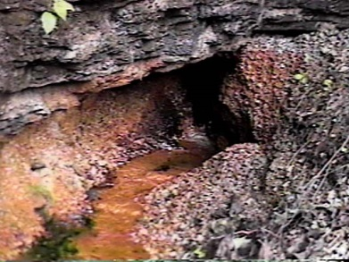
A low-diversity biofilm
Metagenomics of acid mine drainage biofilm
Tyson et al. (2004) Community structure and metabolism through reconstruction of microbial genomes from the environment, Nature 428 37-43
Sanger/capillary-sequencing
Longer reads, but much lower read number than later platforms
Biofilm dominated by 5 species
Obtained 2 near-complete genomes (still quite fragmented)
“using random shotgun sequencing of DNA from a natural acidophilic biofilm, we report reconstruction of near-complete genomes of Leptospirillum group II and Ferroplasma type II, and partial recovery of three other genomes.
This was possible because the biofilm was dominated by a small number of species populations and the frequency of genomic rearrangements and gene insertions or deletions was relatively low.
“The Ferroplasma type II genome seems to be a composite from three ancestral strains that have undergone homologous recombination to form a large population of mosaic genomes.”

Slide 19
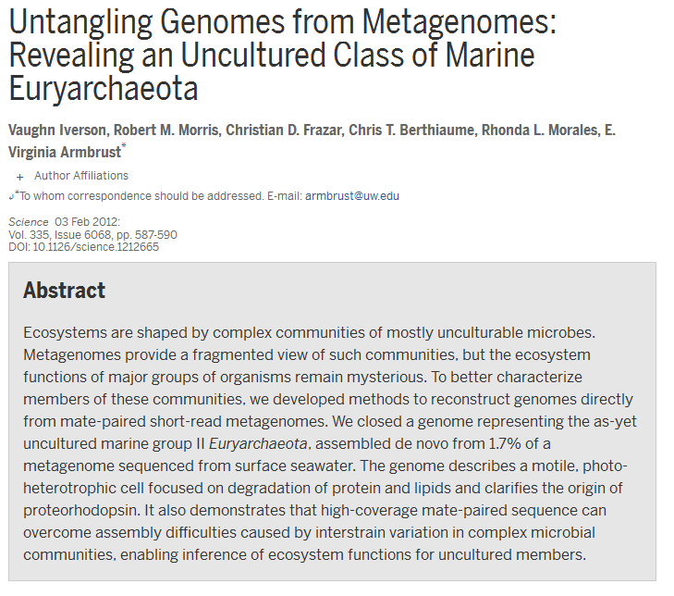

Slide 20
The what question (function)
sequence
function
Relatedness:
Divergence,
Conservation
structure

Slide 21
Conservation versus divergence: the what and who
Gene sequences of fairly closely- related organisms can be quite diverged
Gene sequences can diverge a lot, with function still conserved
But conversely…
Gene sequences of distantly-related organisms can be very conserved
Very good news if your metagenomics reads contain novel organisms
Also means that chimaeric “assemblies” don’t matter much
It depends on the gene

Slide 22
Gene/protein sequences can diverge a lot, with function still conserved
Thinking at functional level
means thinking largely at the protein level
(ignoring noncoding RNAs for the moment)
XYZase
MAEDLLSQTNNI………
Your metagenomics reads code for a protein which is…
95% identical by sequence
So you can be sure that your metagenome-coded
protein is also an XYZase
75%
even with considerably lower sequence identity
may be a closely-related variant function
60%
….
No “rules” which say precisely how low a % identity
this holds for
Caveats…

Slide 23
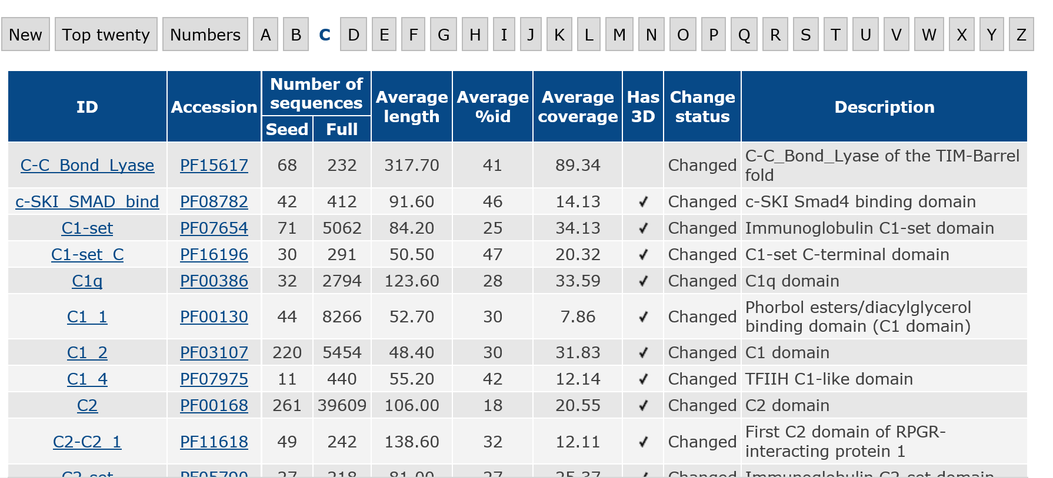
Gene/protein families
Pfam protein families database (pfam.xfam.org)

Slide 24
The bad side of the what question
So it’s easy to assign function to all of your reads? No..,.
Some of your reads might be from a completely novel gene
Nothing close to it is in any databases. So you can’t identify it.
This is also bad news for the “who” question

Slide 25
The bad side of the what question
More commonly –
Another bunch of your reads are clearly similar to numerous gene sequences in the databases
Some of these are even in sequenced genomes
so that answers the “who” question
But, nobody knows what these genes actually do

Slide 26
“E. coli K-12 and yeast Saccharomyces cerevisiae appear to be the only organisms for which at least 50% of the genes have been studied experimentally”
Galperin & Koonin (2010) From complete genome sequence to “complete“ understanding? Trends Biotechnol. 28(8) 398-406
Predicting function: The “70% hurdle”

Slide 27
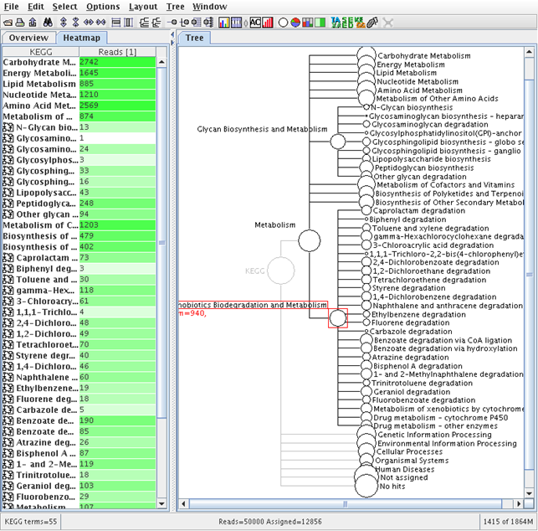

Slide 28
Metagenomics and the “who” question
A bit about bias

Slide 29
How do you get your DNA to put in the sequencer?
Contrast to PCR-amplification of marker genes, which selects particular taxa, such as:
Archaea and/or Bacteria; or Fungi
You may be interested in particular organisms
Which informs the DNA-extraction process
E.g. viromes from ocean or gut
Removal of unwanted ‘extras’ can be done at the post-sequencing stage, in silico
DNA-amplification is often necessary
Which should amplify all organisms’ DNA equally
But almost certainly won’t

Slide 30
“Whole-genome amplification”
Used in traditional genome sequencing
Also in a single-cell context
And in metagenomics
The randomness of the sampling is based on using random hexamer primers
A.k.a. Multiple Displacement Amplification
Uses DNA polymerase from Φ29, a Bacillus phage
A number of studies have found that it biases in favour of low-GC-content genomes
Biased against many Actinobacteria; some α- and β-Proteobacteria
The bias is not always uniform even for one type of microbiome
Whether there is an exact match with the primer sequence, has been found to be less important
In some studies the effect of the bias has been shown to be a lot smaller than the differences between microbiomes

Slide 31
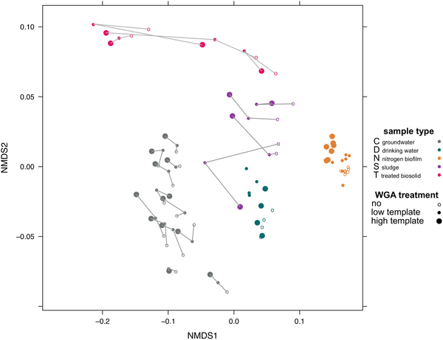

Fig 1. Various effects of WGA treatment of samples from five biotopes investigated by ordination analysis.
Probst AJ, Weinmaier T, DeSantis TZ, Santo Domingo JW, Ashbolt N (2015) New Perspectives on Microbial Community Distortion after Whole-Genome Amplification. PLOS ONE 10(5): e0124158. doi:10.1371/journal.pone.0124158
http://journals.plos.org/plosone/article?id=10.1371/journal.pone.0124158

Slide 32
So, do marker-gene sequencing and metagenomic sequencing give us the same answers?
Metagenomics
Marker-gene barcoding
What can
they do?
Who is in there?
What are
they doing?
Metatranscriptomics

Slide 33
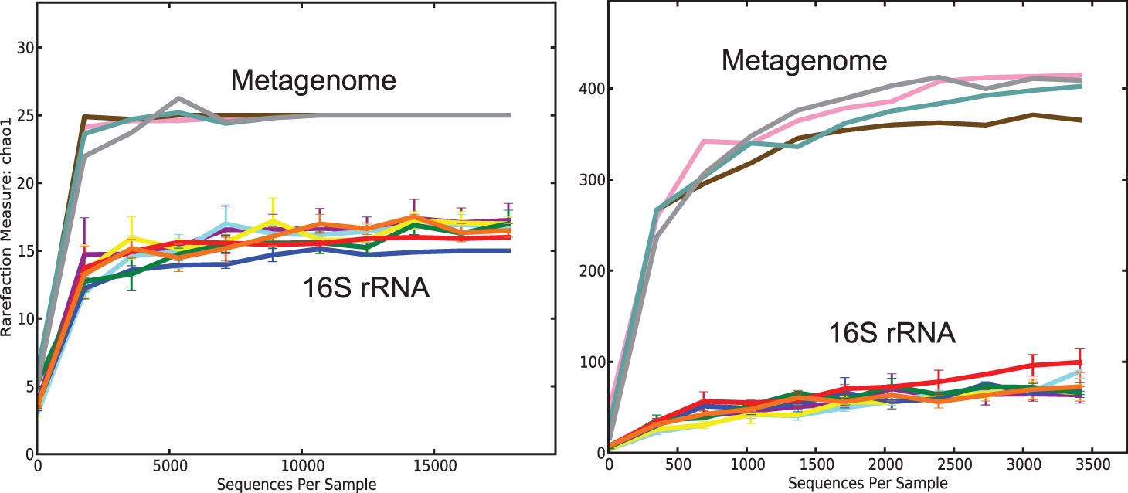
Estimated no. of phyla
Estimated no. of genera
Poretsky R, Rodriguez-R LM, Luo C, Tsementzi D, et al. (2014) Strengths and Limitations of 16S rRNA Gene Amplicon Sequencing in Revealing Temporal Microbial Community Dynamics. PLoS ONE 9(4): e93827. doi:10.1371/journal.pone.0093827
Example anomalies: Thiomonas
16S says 45% of the reads are Thiomonas
16S says 23% of the OTUs are
WGS-metagenomic contigs says 0.3% are
WGS-single reads:
10% of 16S gene fragments are
> 200 Thiomonas species/OTUs in the 16S database
But only 2 Thiomonas reference genomes

Slide 34
US-UK Bioinformatics for the Microbiome Workshop
“Summary of findings
Standards are necessary to move forward. Validating sequencing, metabolomics, and culture-based pipelines are imperative. At the moment, the field is considered by some to be a “pre-science” because labs are often not able to reproduce each other’s results. Some argued that instead of labelling the research a “pre-science,” maybe there are missing variables. Guidelines for collecting and storing samples are essential, as well as high-quality reference materials.
Informatics resources are vital for breakthroughs in microbiome research. At the moment, resources are incomplete, especially in regards to metagenomes, metabolites, metadata and gene catalogs. ….”

