Slide 1
Description Week 3

Slide 2
Data vs Metadata
Share the web archiving zine
What is the difference?
Where have you encountered them in your daily life?

Slide 3
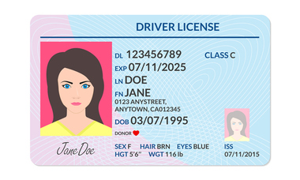
Notes:
From https://www.cumberlandlegacylaw.com/real-id-act-changes-the-drivers-license-landscape
What is the data here? What is the metadata?

Slide 4
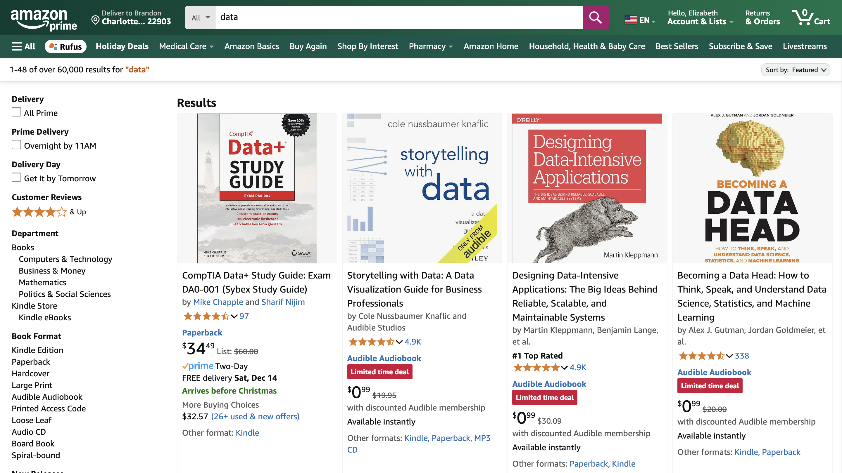
Notes:
What are we looking at? What data do we see? What metadata do we see?
How does the metadata help facilitate your use of the data

Slide 5
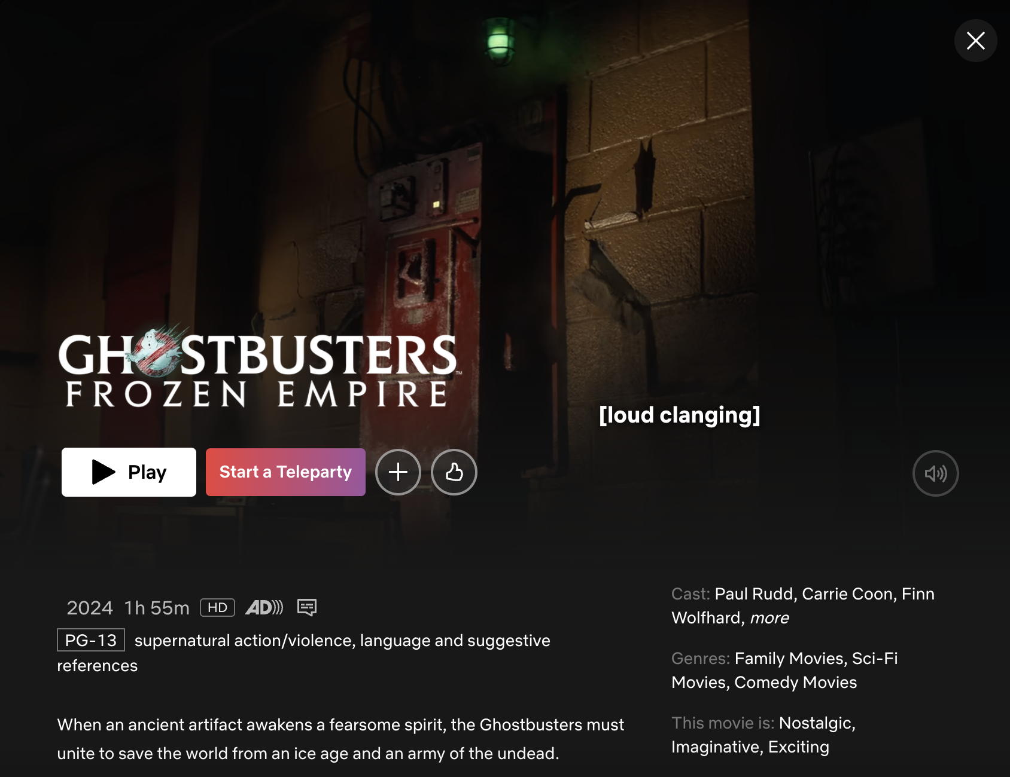
Notes:
What are we looking at? What data do we see? What metadata do we see? What about that stuff at the bottom? What kinds of metadata are there?

Slide 6
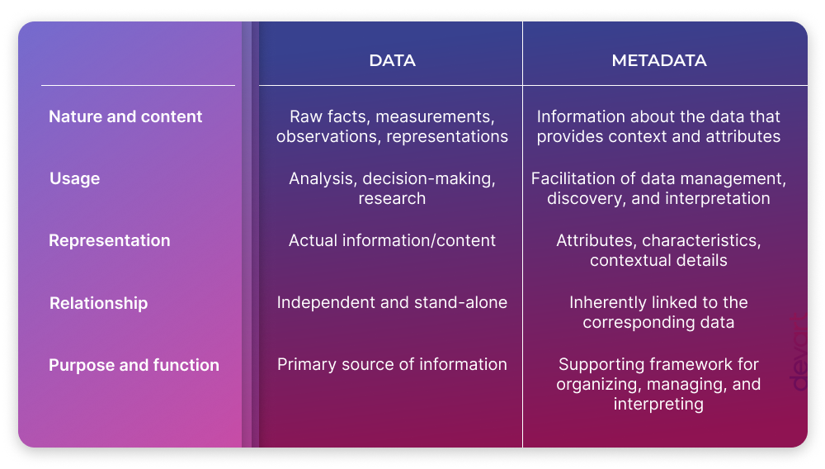
Standards
Notes:
https://blog.devart.com/data-vs-metadata.html
Data vs Metadata

Slide 7
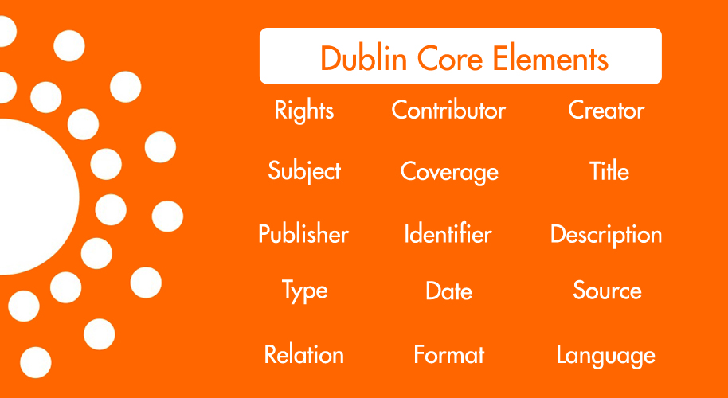

Slide 8
Organizing and Describing
Phase 1: Describe
Break into groups and select a set of books from the table.
In a spreadsheet, describe each of your books in as much detail as you can.
You can focus on any aspect of the material. Go into detail!
Notes:
(If Time Remains) Same thing but for books of the same kind. Could either do BH’s activity where you have them all pick a copy of a single thing from the center table and then compare.
Secret challenges:
Fragmented metadata – share a book that has only partial info
Share a different kind of thing that isn’t REALLY a book
What is the most popular book? How would you track it? Could you? We want to arrest the people who checked out that book.

Slide 9
Organizing and Describing
Phase 2: Add
Swap objects with a neighboring group.
Integrate the new objects into your spreadsheet.
Notes:
(If Time Remains) Same thing but for books of the same kind. Could either do BH’s activity where you have them all pick a copy of a single thing from the center table and then compare.
Secret challenges:
Fragmented metadata – share a book that has only partial info
Share a different kind of thing that isn’t REALLY a book
What is the most popular book? How would you track it? Could you? We want to arrest the people who checked out that book.

Slide 10
Organizing and Describing
Phase 3: Compare
Swap datasets with the neighboring group
How do the descriptions of the groups compare?
Make note of differences, similarities.
Notes:
(If Time Remains) Same thing but for books of the same kind. Could either do BH’s activity where you have them all pick a copy of a single thing from the center table and then compare.
Secret challenges:
Fragmented metadata – share a book that has only partial info
Share a different kind of thing that isn’t REALLY a book
What is the most popular book? How would you track it? Could you? We want to arrest the people who checked out that book.

Slide 11
Organizing and Describing
Phase 4: Metadata Mapping
Convert your dataset to use the DublinCore specification
What choices did you have to make?
Why did these matter?
https://www.dublincore.org/specifications/dublin-core/dcmi-terms/
Notes:
(If Time Remains) Same thing but for books of the same kind. Could either do BH’s activity where you have them all pick a copy of a single thing from the center table and then compare.
Secret challenges:
Fragmented metadata – share a book that has only partial info
Share a different kind of thing that isn’t REALLY a book
What is the most popular book? How would you track it? Could you? We want to arrest the people who checked out that book.

Slide 12
Famous Metadata Disasters
In 1999 NASA lost a $125-million Mars Climate Orbiter when it entered orbit too low and burned up in the atmosphere.
What do you think happened?
Notes:
(If Time Remains) Same thing but for books of the same kind. Could either do BH’s activity where you have them all pick a copy of a single thing from the center table and then compare.
Secret challenges:
Fragmented metadata – share a book that has only partial info
Share a different kind of thing that isn’t REALLY a book
What is the most popular book? How would you track it? Could you? We want to arrest the people who checked out that book.

Slide 13
Famous Metadata Disasters
In 1999 NASA lost a $125-million Mars Climate Orbiter when it entered orbit too low and burned up in the atmosphere.
What do you think happened?
A navigation team at the Jet Propulsion Laboratory used the metric system of millimeters and meters in its calculations, while Lockheed Martin Astronautics in Denver, which designed and built the spacecraft, provided crucial acceleration data in the English system of inches, feet and pounds. As a result, JPL engineers mistook acceleration readings measured in English units of pound-seconds for a metric measure of force called newton-seconds.
Notes:
(If Time Remains) Same thing but for books of the same kind. Could either do BH’s activity where you have them all pick a copy of a single thing from the center table and then compare.
Secret challenges:
Fragmented metadata – share a book that has only partial info
Share a different kind of thing that isn’t REALLY a book
What is the most popular book? How would you track it? Could you? We want to arrest the people who checked out that book.

Slide 14
Famous Metadata Disasters
Phase 5: Challenge!
Robin Wendler famously worked on a collection of items related to a US President (Roosevelt or Grant depending on the story). All materials in the collection were photographs of this president. The description field listed things like “on a horse,” “in a chair,” etc. After she was done, she noticed that she actually could not search her materials very well.
What do you think happened?
Notes:
(If Time Remains) Same thing but for books of the same kind. Could either do BH’s activity where you have them all pick a copy of a single thing from the center table and then compare.
Secret challenges:
Fragmented metadata – share a book that has only partial info
Share a different kind of thing that isn’t REALLY a book
What is the most popular book? How would you track it? Could you? We want to arrest the people who checked out that book.

Slide 15
Famous Metadata Disasters
Phase 5: Challenge!
Robin Wendler – “on a horse problem”
The title has meaning in the context where you know the whole collection is about a single person.
Outside of that, which no actual reference to the name, you lose the context.
Who is on the horse?
Notes:
(If Time Remains) Same thing but for books of the same kind. Could either do BH’s activity where you have them all pick a copy of a single thing from the center table and then compare.
Secret challenges:
Fragmented metadata – share a book that has only partial info
Share a different kind of thing that isn’t REALLY a book
What is the most popular book? How would you track it? Could you? We want to arrest the people who checked out that book.

Slide 16
Takeaway
Describing your data is challenging
Develop a schema and stick to it!
Or use a standard

