Slide 1
Identification - Scrum

Slide 2
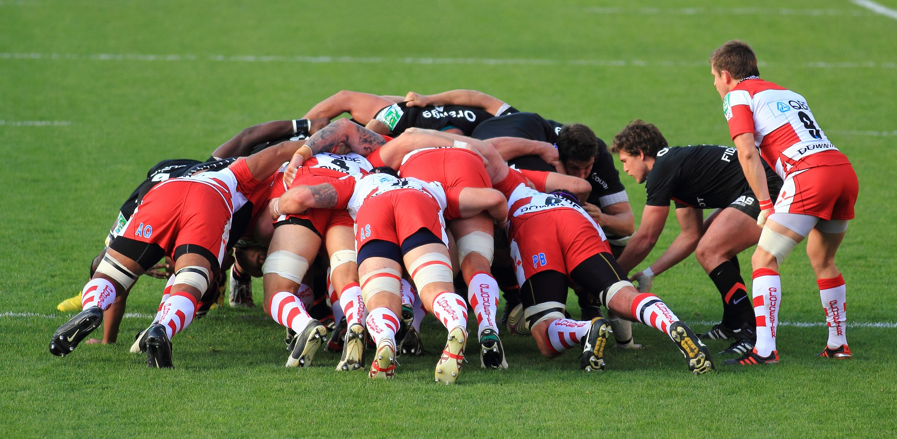

Slide 3
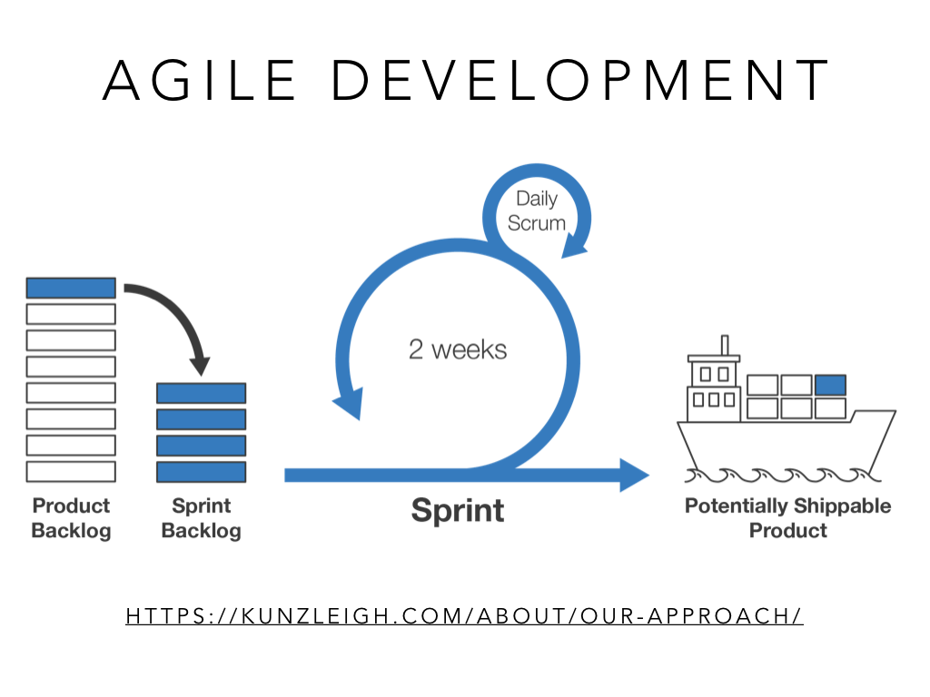

Slide 4
Daily Scrum – 1 Minute per Person
What I did
What is next for me
What I need from someone else
Then back to the larger class
Two minutes debrief

