Slide 1
Description Week 3

Slide 2
Data vs Metadata
Share the web archiving zine
Review? what is data?
What is the difference between data and metadata?
Where have you encountered them in your daily life?

Slide 3
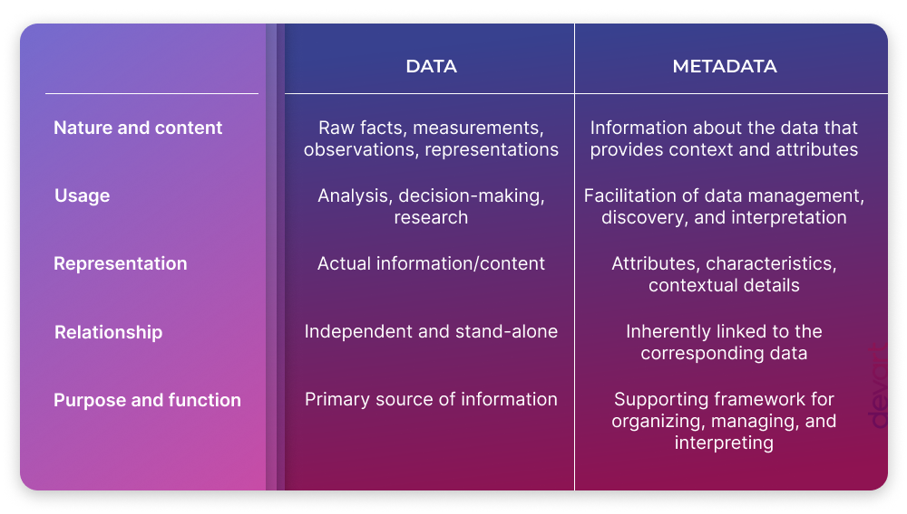
Standards
Notes:
https://blog.devart.com/data-vs-metadata.html
Data vs Metadata

Slide 4
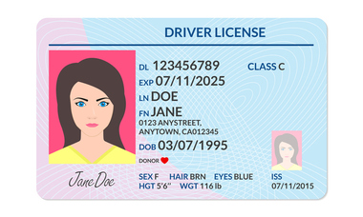
Notes:
From https://www.cumberlandlegacylaw.com/real-id-act-changes-the-drivers-license-landscape
What is the data here? What is the metadata? Is there a standard at work here?

Slide 5
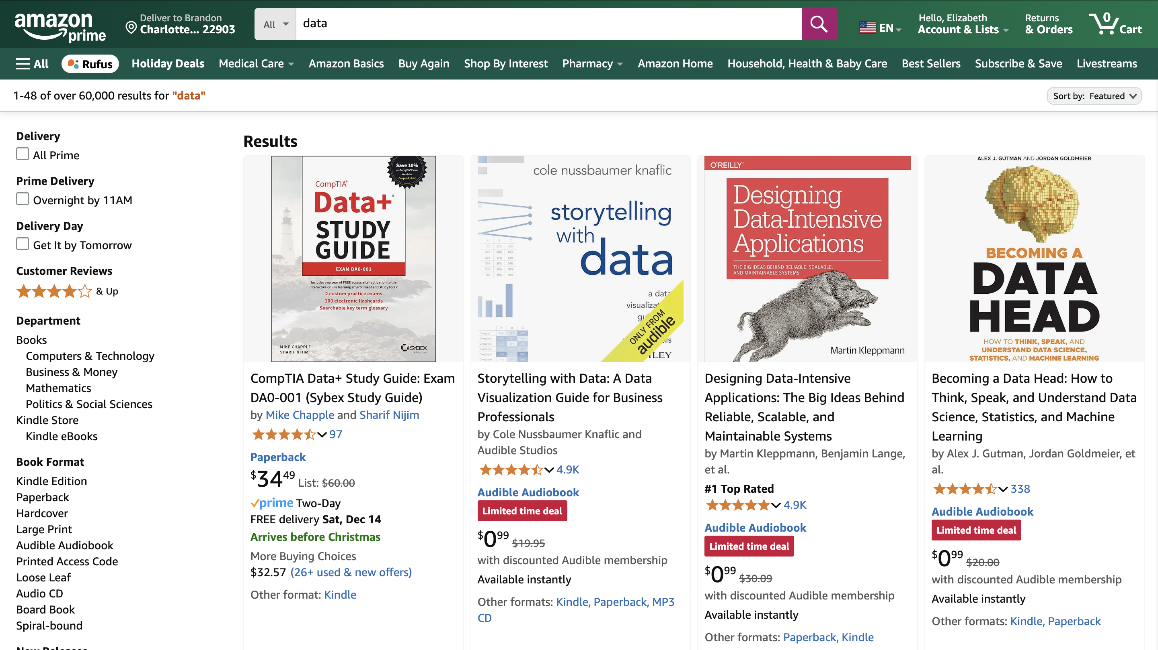
Notes:
What are we looking at? What data do we see? What metadata do we see?
How does the metadata help facilitate your use of the data

Slide 6
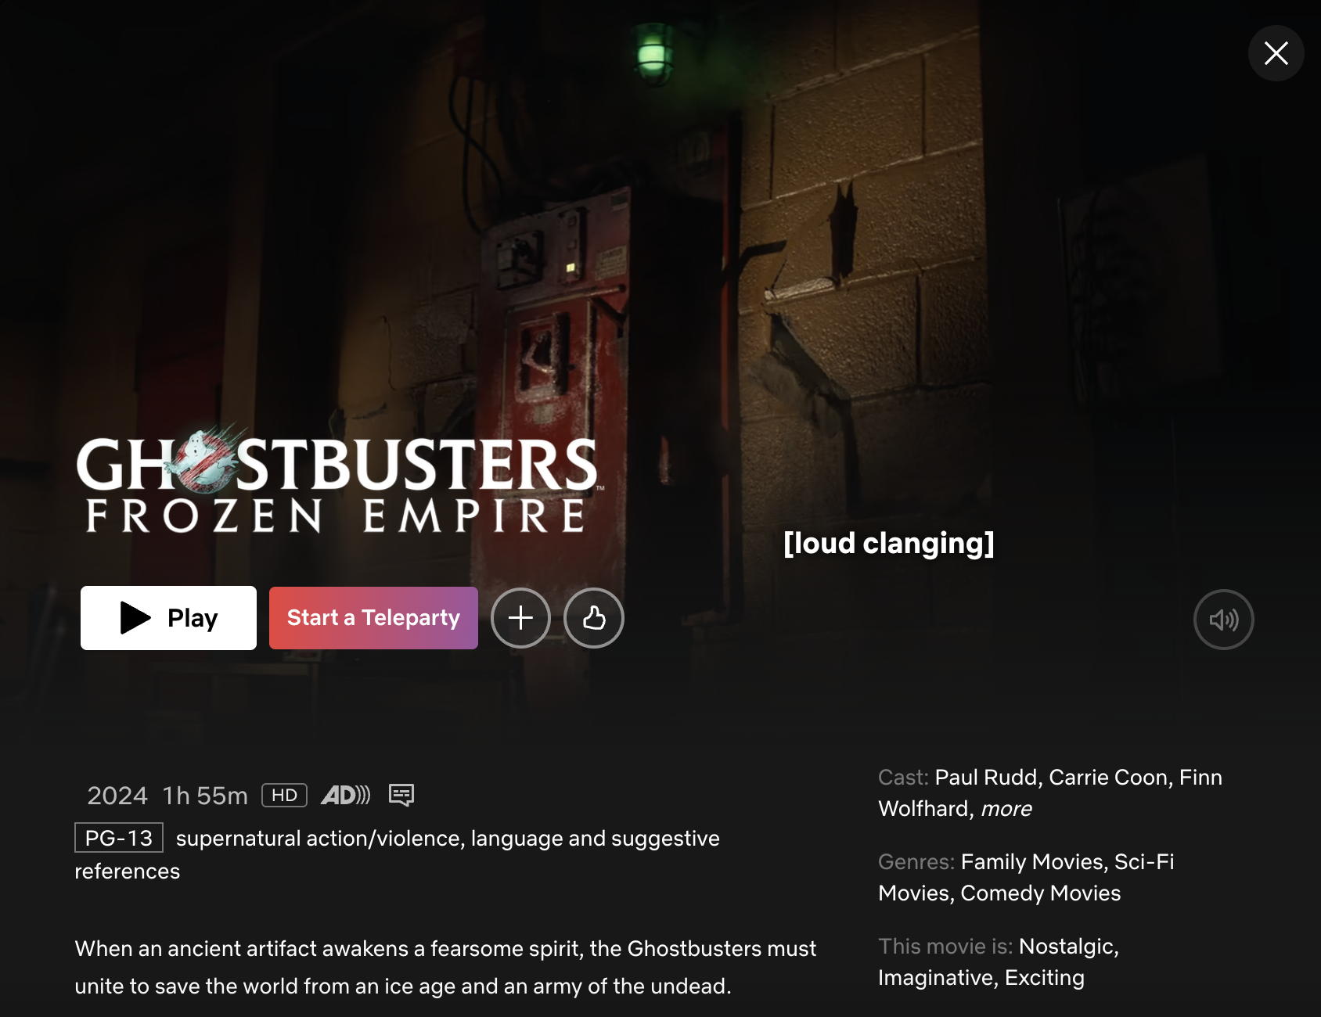
Notes:
What are we looking at? What data do we see? What metadata do we see? What about that stuff at the bottom? What kinds of metadata are there?
What do we make of those last categories? Where do we think they come from? Are they objective? Are they useful or not? What could problems be?

Slide 7
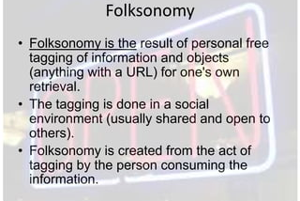
Notes:
https://www.slideshare.net/slideshow/lecture-16-folksonomy-and-tagging/11576053#4

Slide 8
Have you ever participated in folksonomy?

Slide 9
Have you ever participated in folksonomy?
If you have used social media – probably! Hashtags!
What are they good for? What are they not good for?

Slide 10
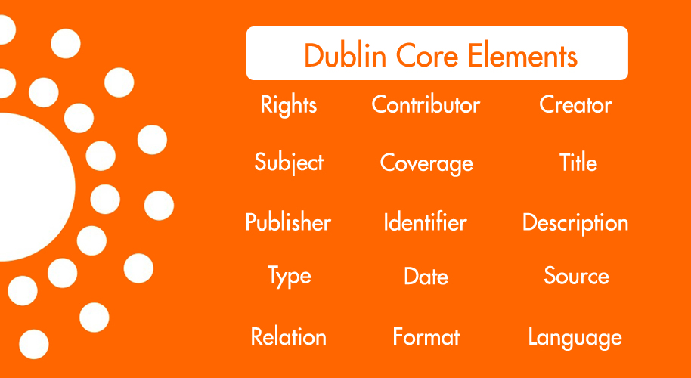
Notes:
Folksonomy is one extreme end. The other is a metadata standard like Dublin core that tight

Slide 11
Takeaways
Metadata facilitates data discovery, analysis, and interaction
It takes work
Result of human + computational labor
Choices to make re: freedom and constraint
Standards facilitate data exchange

Slide 12
Organizing and Describing
Phase 1: Describe
Break into groups and select a set of books from the table.
In a spreadsheet, describe each of your books in as much detail as you can.
You can focus on any aspect of the material. Go into detail!
Notes:
(If Time Remains) Same thing but for books of the same kind. Could either do BH’s activity where you have them all pick a copy of a single thing from the center table and then compare.
Secret challenges:
Fragmented metadata – share a book that has only partial info
Share a different kind of thing that isn’t REALLY a book
What is the most popular book? How would you track it? Could you? We want to arrest the people who checked out that book.

Slide 13
Organizing and Describing
Phase 2: Add
Swap objects with a neighboring group.
Integrate the new objects into your spreadsheet.
Notes:
(If Time Remains) Same thing but for books of the same kind. Could either do BH’s activity where you have them all pick a copy of a single thing from the center table and then compare.
Secret challenges:
Fragmented metadata – share a book that has only partial info
Share a different kind of thing that isn’t REALLY a book
What is the most popular book? How would you track it? Could you? We want to arrest the people who checked out that book.

Slide 14
Organizing and Describing
Phase 3: Compare
Swap datasets with the neighboring group
How do the descriptions of the groups compare?
Make note of differences, similarities.
Did you all document the same kinds of things?
Notes:
(If Time Remains) Same thing but for books of the same kind. Could either do BH’s activity where you have them all pick a copy of a single thing from the center table and then compare.
Secret challenges:
Fragmented metadata – share a book that has only partial info
Share a different kind of thing that isn’t REALLY a book
What is the most popular book? How would you track it? Could you? We want to arrest the people who checked out that book.

Slide 15
Organizing and Describing
Phase 4: Metadata Mapping
Convert your dataset to use the DublinCore specification
What choices did you have to make?
Why did these matter?
Did you have to get rid of anything?
https://www.dublincore.org/specifications/dublin-core/dcmi-terms/
Notes:
(If Time Remains) Same thing but for books of the same kind. Could either do BH’s activity where you have them all pick a copy of a single thing from the center table and then compare.
Secret challenges:
Fragmented metadata – share a book that has only partial info
Share a different kind of thing that isn’t REALLY a book
What is the most popular book? How would you track it? Could you? We want to arrest the people who checked out that book.

Slide 16
Discuss
What did you notice?
What was challenging?
Were certain people better at certain things?

Slide 17
Famous Metadata Disasters
In 1999 NASA lost a $125-million Mars Climate Orbiter when it entered orbit too low and burned up in the atmosphere.
What do you think happened?
Ht to Steven L. Johnson
Notes:
(If Time Remains) Same thing but for books of the same kind. Could either do BH’s activity where you have them all pick a copy of a single thing from the center table and then compare.
Secret challenges:
Fragmented metadata – share a book that has only partial info
Share a different kind of thing that isn’t REALLY a book
What is the most popular book? How would you track it? Could you? We want to arrest the people who checked out that book.

Slide 18
Famous Metadata Disasters
In 1999 NASA lost a $125-million Mars Climate Orbiter when it entered orbit too low and burned up in the atmosphere.
What do you think happened?
A navigation team at the Jet Propulsion Laboratory used the metric system of millimeters and meters in its calculations, while Lockheed Martin Astronautics in Denver, which designed and built the spacecraft, provided crucial acceleration data in the English system of inches, feet and pounds. As a result, JPL engineers mistook acceleration readings measured in English units of pound-seconds for a metric measure of force called newton-seconds.
Notes:
(If Time Remains) Same thing but for books of the same kind. Could either do BH’s activity where you have them all pick a copy of a single thing from the center table and then compare.
Secret challenges:
Fragmented metadata – share a book that has only partial info
Share a different kind of thing that isn’t REALLY a book
What is the most popular book? How would you track it? Could you? We want to arrest the people who checked out that book.

Slide 19
Famous Metadata Disasters
Phase 5: Challenge!
Robin Wendler famously worked on a collection of items related to a US President (Roosevelt or Grant depending on the story). All materials in the collection were photographs of this president. The description field listed things like “on a horse,” “in a chair,” etc. After she was done, she noticed that she could not actually search her materials very well.
What do you think happened?
Ht to Sarah Potvin
Notes:
(If Time Remains) Same thing but for books of the same kind. Could either do BH’s activity where you have them all pick a copy of a single thing from the center table and then compare.
Secret challenges:
Fragmented metadata – share a book that has only partial info
Share a different kind of thing that isn’t REALLY a book
What is the most popular book? How would you track it? Could you? We want to arrest the people who checked out that book.

Slide 20
Famous Metadata Disasters
Phase 5: Challenge!
Robin Wendler – “on a horse problem”
The title has meaning in the context where you know the whole collection is about a single person.
Outside of that, with no actual reference to the name, you lose the context of each individual item.
Who is on the horse?
Notes:
(If Time Remains) Same thing but for books of the same kind. Could either do BH’s activity where you have them all pick a copy of a single thing from the center table and then compare.
Secret challenges:
Fragmented metadata – share a book that has only partial info
Share a different kind of thing that isn’t REALLY a book
What is the most popular book? How would you track it? Could you? We want to arrest the people who checked out that book.

Slide 21
My whole life I have gotten mail for someone named Brandonm from a modeling agency. Why is that?

Slide 22
Famous Metadata Problems
Can you think of any from in your own life?
Notes:
(If Time Remains) Same thing but for books of the same kind. Could either do BH’s activity where you have them all pick a copy of a single thing from the center table and then compare.
Secret challenges:
Fragmented metadata – share a book that has only partial info
Share a different kind of thing that isn’t REALLY a book
What is the most popular book? How would you track it? Could you? We want to arrest the people who checked out that book.

Slide 23
Famous Metadata Problems
Name changes
Columns collapsing
Brandonm
Library of Congress Subject Headings
Folksonomies
Notes:
(If Time Remains) Same thing but for books of the same kind. Could either do BH’s activity where you have them all pick a copy of a single thing from the center table and then compare.
Secret challenges:
Fragmented metadata – share a book that has only partial info
Share a different kind of thing that isn’t REALLY a book
What is the most popular book? How would you track it? Could you? We want to arrest the people who checked out that book.

Slide 24
Homework
Select a cultural interest (film, books, music) of yours and manually create a dataset from it. You should have at least 10 objects in your dataset with five metadata categories each. Be detailed! Bonus points for using an established metadata standard. Submit Friday by 9:00 AM.

