Slide 1
Description Week 3

Slide 2
Data vs Metadata
What is the difference?
Where have you encountered them in your daily life?

Slide 3
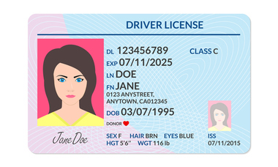
Notes:
From https://www.cumberlandlegacylaw.com/real-id-act-changes-the-drivers-license-landscape
What is the data here? What is the metadata?

Slide 4
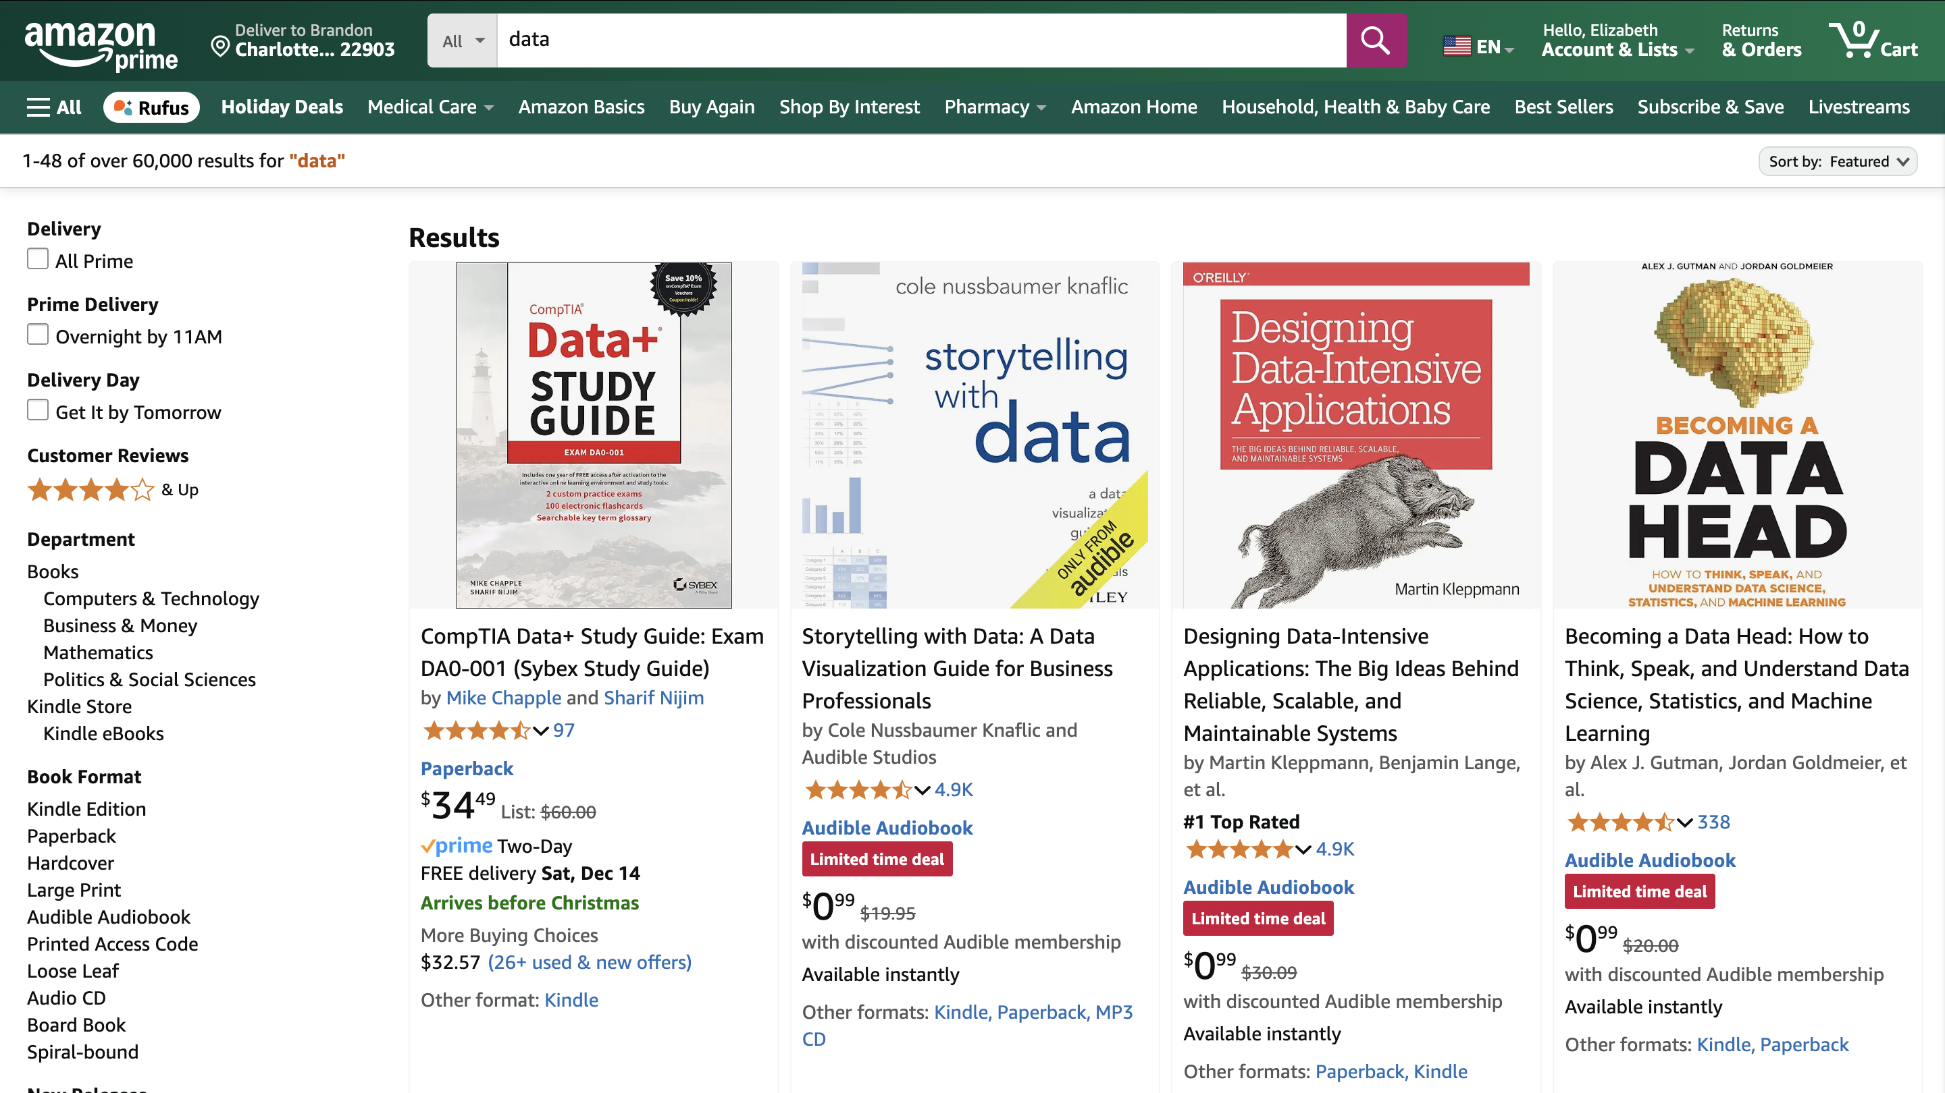
Notes:
What are we looking at? What data do we see? What metadata do we see?

Slide 5
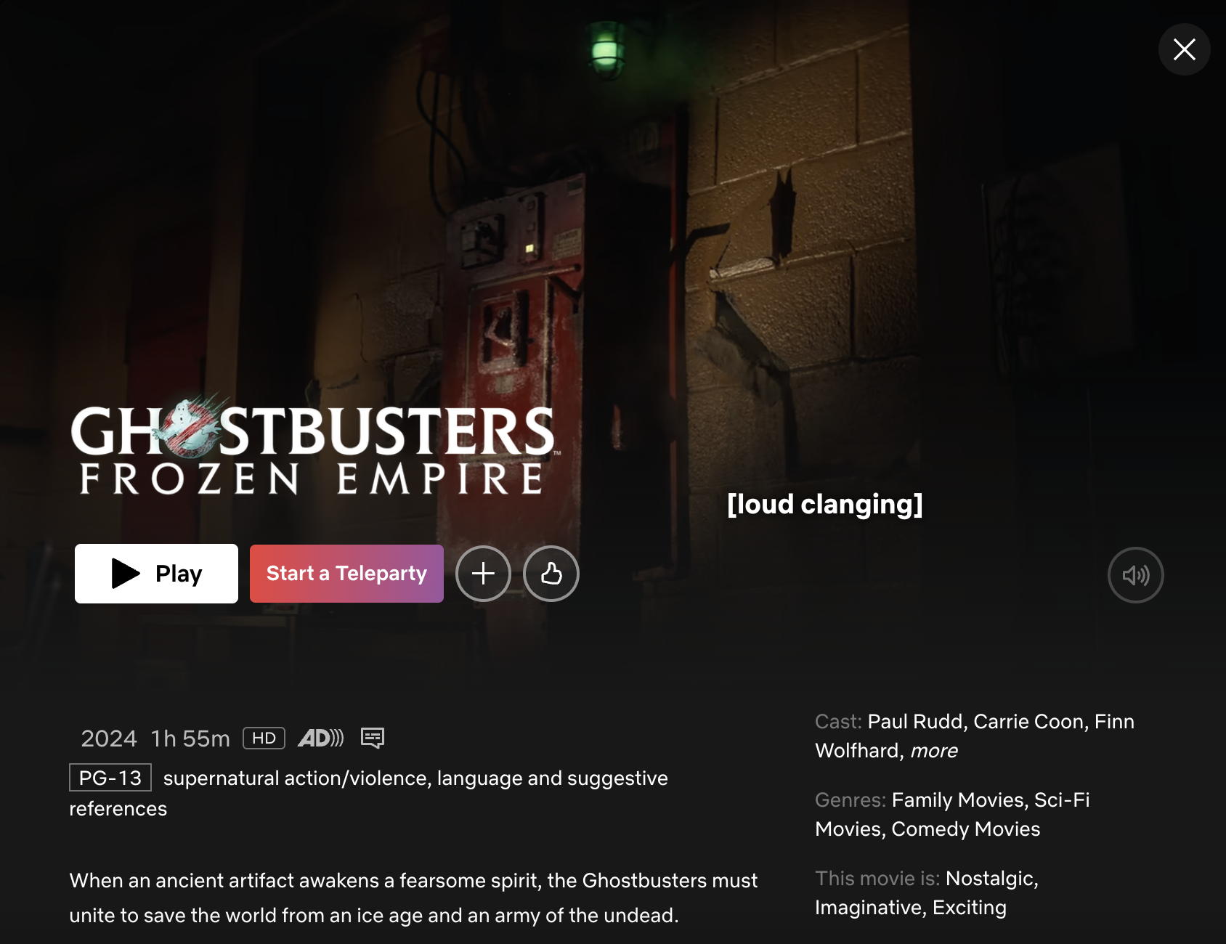
Notes:
What are we looking at? What data do we see? What metadata do we see? What about that stuff at the bottom?

Slide 6
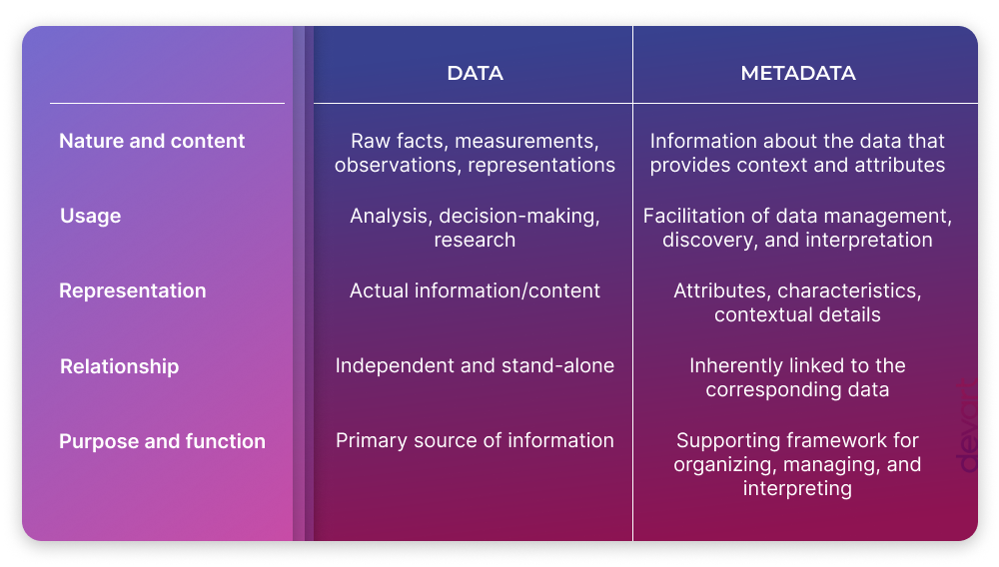
Standards
Notes:
https://blog.devart.com/data-vs-metadata.html
Data vs Metadata

Slide 7
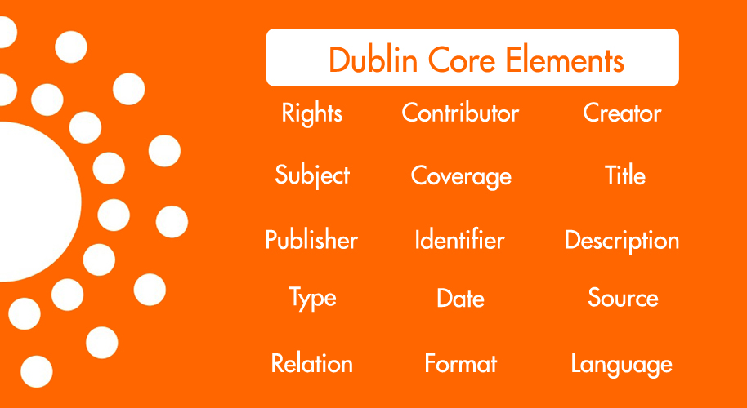

Slide 8
Organizing and Describing
Phase 1: Describe
Break into groups and select a few books from the table.
In a spreadsheet, describe your book in as much detail as you can.
You can focus on any aspect of the material.
Notes:
(If Time Remains) Same thing but for books of the same kind. Could either do BH’s activity where you have them all pick a copy of a single thing from the center table and then compare.
Secret challenges:
Fragmented metadata – share a book that has only partial info
Share a different kind of thing that isn’t REALLY a book
What is the most popular book? How would you track it? Could you? We want to arrest the people who checked out that book.

Slide 9
Organizing and Describing
Phase 2: Add
Swap objects with a neighboring pair.
Integrate the new objects into your spreadsheet
Notes:
(If Time Remains) Same thing but for books of the same kind. Could either do BH’s activity where you have them all pick a copy of a single thing from the center table and then compare.
Secret challenges:
Fragmented metadata – share a book that has only partial info
Share a different kind of thing that isn’t REALLY a book
What is the most popular book? How would you track it? Could you? We want to arrest the people who checked out that book.

Slide 10
Organizing and Describing
Phase 3: Compare
Swap datasets with a neighbor
How do the descriptions of the groups compare?
Make note of differences, similarities. Focus on the metadata
Notes:
(If Time Remains) Same thing but for books of the same kind. Could either do BH’s activity where you have them all pick a copy of a single thing from the center table and then compare.
Secret challenges:
Fragmented metadata – share a book that has only partial info
Share a different kind of thing that isn’t REALLY a book
What is the most popular book? How would you track it? Could you? We want to arrest the people who checked out that book.

Slide 11
Organizing and Describing
Phase 4: Integrate
Without using the primary materials, combine the two datasets into one.
What choices did you have to make?
Why did these matter?
Notes:
(If Time Remains) Same thing but for books of the same kind. Could either do BH’s activity where you have them all pick a copy of a single thing from the center table and then compare.
Secret challenges:
Fragmented metadata – share a book that has only partial info
Share a different kind of thing that isn’t REALLY a book
What is the most popular book? How would you track it? Could you? We want to arrest the people who checked out that book.

Slide 12
Organizing and Describing
Phase 5: Challenge!
The people who need your data only work with dublincore. Convert your dataset to this standard.
Notes:
(If Time Remains) Same thing but for books of the same kind. Could either do BH’s activity where you have them all pick a copy of a single thing from the center table and then compare.
Secret challenges:
Fragmented metadata – share a book that has only partial info
Share a different kind of thing that isn’t REALLY a book
What is the most popular book? How would you track it? Could you? We want to arrest the people who checked out that book.

Slide 13
Organizing and Describing
Phase 5: Challenge!
What is the most popular book? What do you need to track this?
Notes:
(If Time Remains) Same thing but for books of the same kind. Could either do BH’s activity where you have them all pick a copy of a single thing from the center table and then compare.
Secret challenges:
Fragmented metadata – share a book that has only partial info
Share a different kind of thing that isn’t REALLY a book
What is the most popular book? How would you track it? Could you? We want to arrest the people who checked out that book.

Slide 14
Takeaway
Describing your data is challenging
Develop a schema and stick to it!
Or use a standard

