Slide 1
Description Week 3

Slide 2
Data vs Metadata
What is the difference?
Where have you encountered them in your daily life?

Slide 3
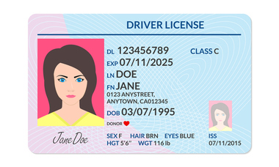
Notes:
From https://www.cumberlandlegacylaw.com/real-id-act-changes-the-drivers-license-landscape
What is the data here? What is the metadata?

Slide 4
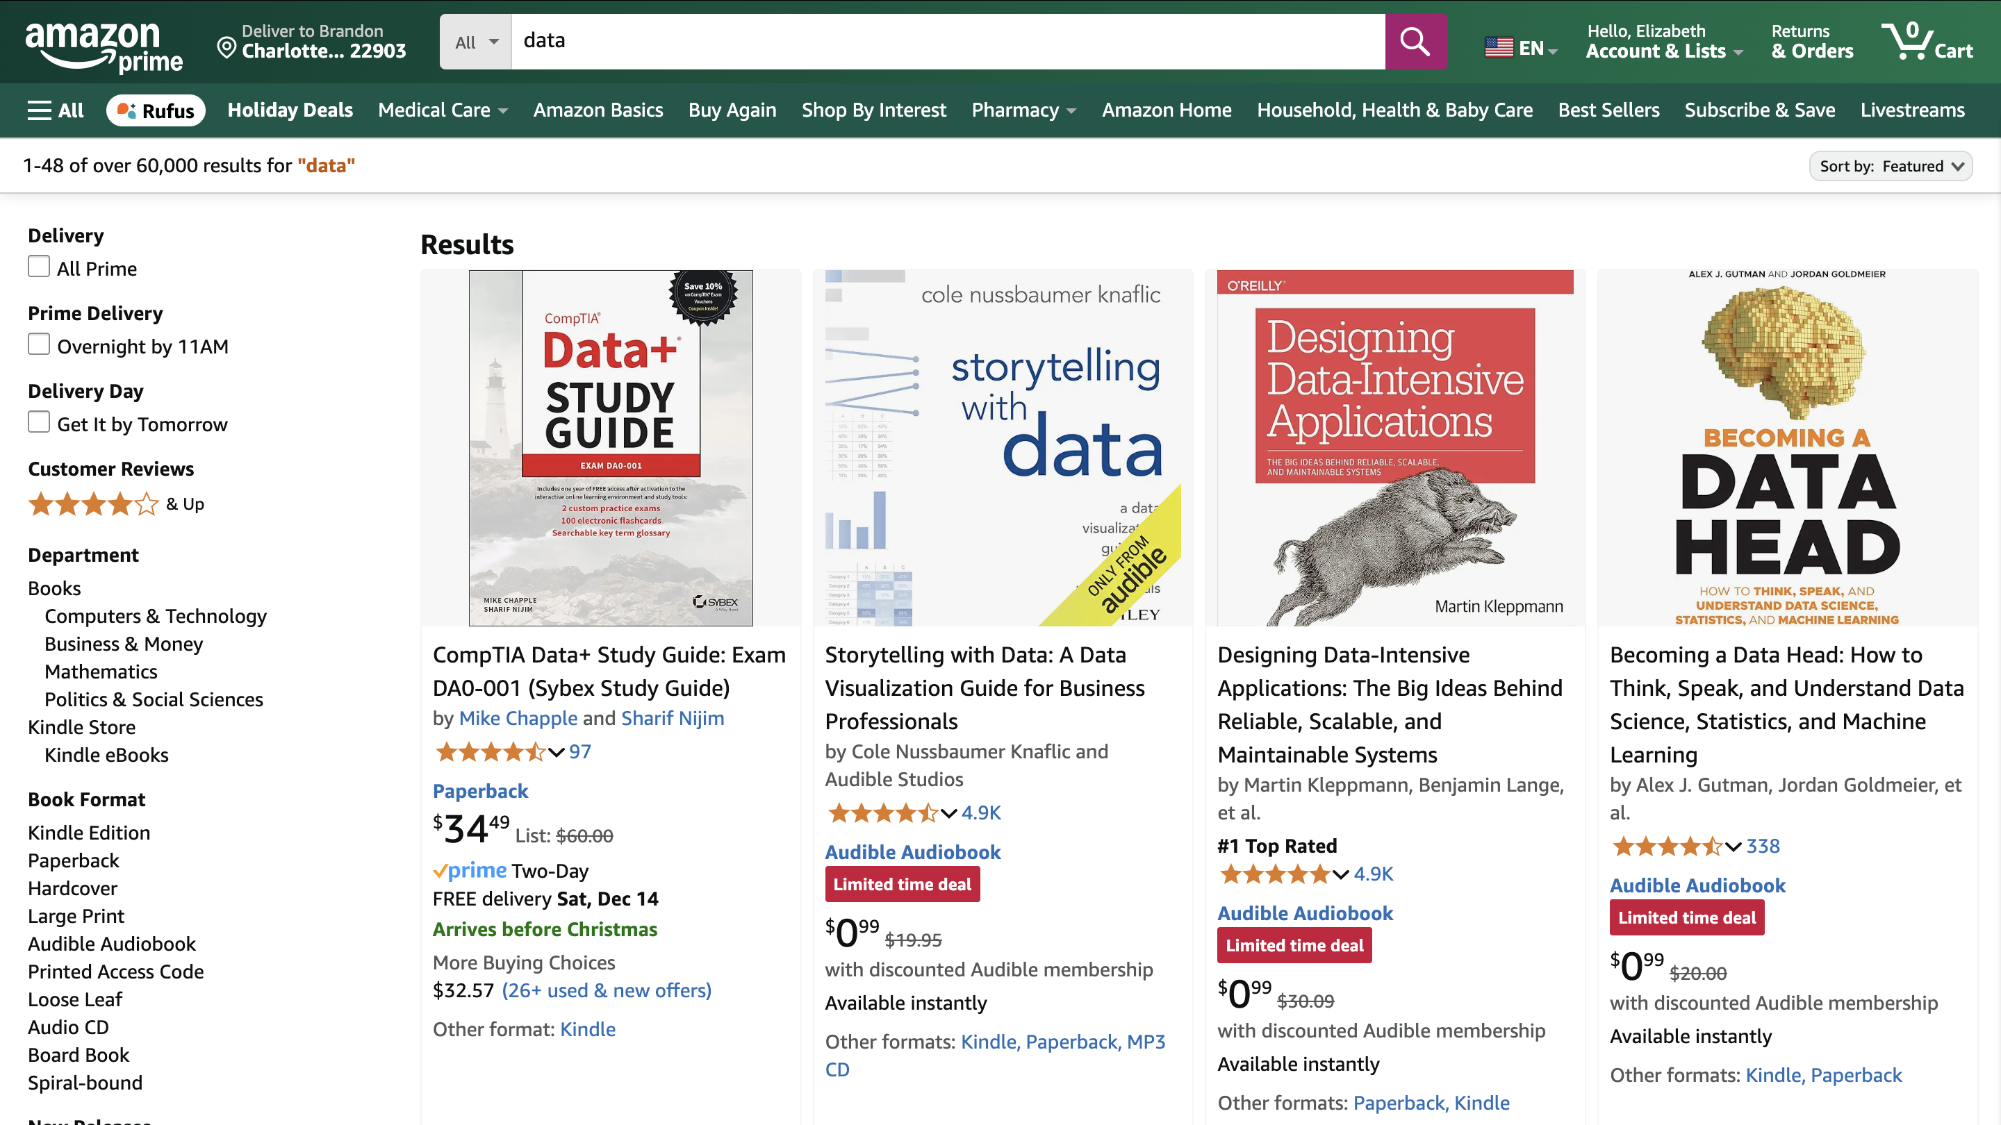
Notes:
What are we looking at? What data do we see? What metadata do we see?

Slide 5

Notes:
What are we looking at? What data do we see? What metadata do we see? What about that stuff at the bottom?

Slide 6
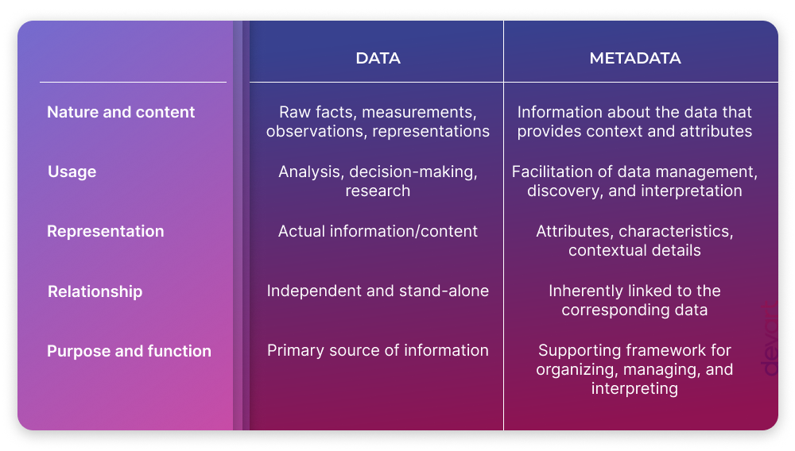
Standards
Notes:
https://blog.devart.com/data-vs-metadata.html
Data vs Metadata

Slide 7


Slide 8
Organizing and Describing Data - Workshop
Phase 1 (15 min)
Break into pairs and select a book from the table.
In a spreadsheet, describe your book in as much detail as you can.
You can focus on any aspect of the material.
Hint: think about your metadata categories!
Phase 2 (15 min)
Swap objects with a neighboring pair.
Integrate the new book into your spreadsheet
Compare (15 min)
How do the descriptions of the groups compare?
If we were to combine all the datasets what issues would we run into?
Why would they matter and how would you solve them?
Notes:
In four groups, give them a book each.

Slide 9
Takeaway
Describing your data is challenging
Develop a schema and stick to it!
Or use a standard

