Slide 1
Week 1 Data for the Rest of Us

Slide 2

Brandon Walsh
PhD in Literature
Head of Student Programs, Scholars’ Lab
Music, cooking, cats
@walshbr
bmw9t@virginia.edu

Slide 3
We Data: An Icebreaking Activity (~45 Min)
Identify your data
Who are you? (Give me a few things)
Describe your data
What are you interested in describing as a part of your dataset? What are you not?
Collect
Gather your data in one place.
Clean
Edit the dataset so that it’s in a presentable, consistent format.
Analyze
What stories are in your dataset?
Distribute
How will you share it back to me?

Slide 4
Discussion
What is data?
What is it not?
What was hard?
What did you learn?
How did it feel to represent yourselves in this way?

Slide 5
Related Job Outcomes
Precursor to more work in data science
Project management and adjacent roles
Technical Writing
Digital library, cultural heritage, digital humanities

Slide 6
Other Things
Syllabus site – https://bit.ly/data-for-us
Office hours by appointment
Arc of the course
First half – learning
Second half – doing
Weekly Schedule
Weekly pre-work due in class (readings, podcasts, tutorials)
Short individual or group assignments due the following Friday by 9AM
Other policies
Attendance
Specifications grading

Slide 7
Pull up the site
https://bit.ly/data-for-us
Note pre-work and homework

Slide 8
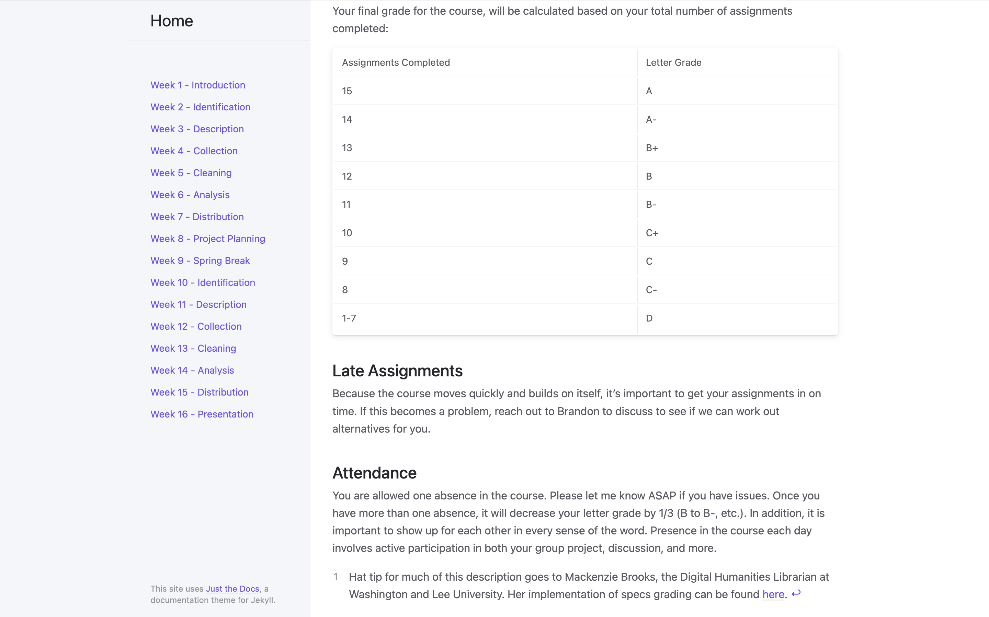

Slide 9
Other Questions?
Homework for Friday:
By Friday morning at 9:00 AM, share your class dataset with me along with a 50-100 word reflection on the activity. What was the most challenging piece? What did you learn?
Homework for next week.

