Slide 1
Introduction to Command Line
Digital Literary Studies 2019

Slide 2
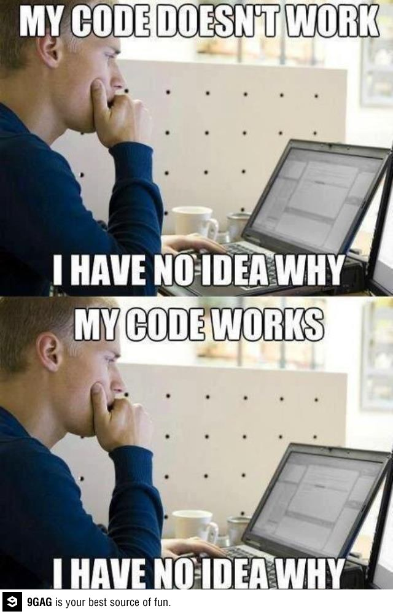
Programming Rules
Expect confusion.
Embrace it!
Ask questions.
Look online!
Ask each other!

Slide 3
Plan Today
Talk about fear
Command Line and GUI as concepts
Introduce command line
Practice it
Review how this relates to Python
Use command line to read

Slide 4
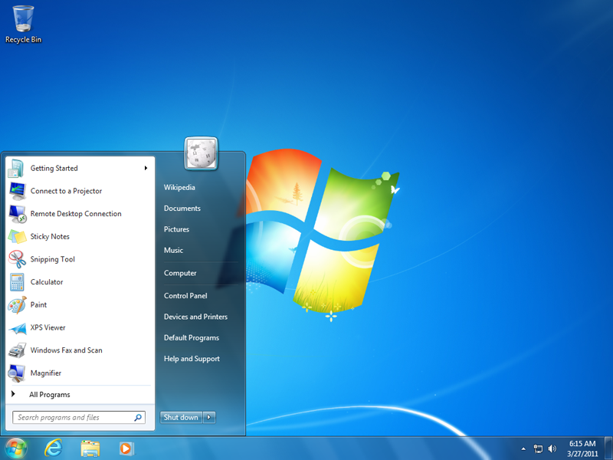

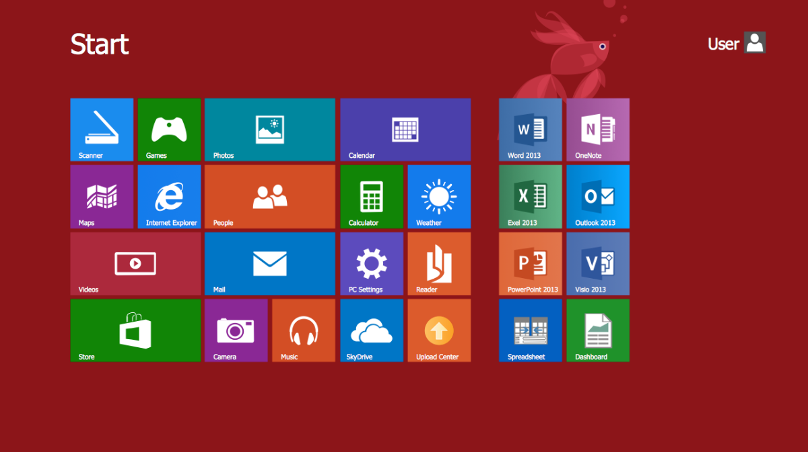
GUI (Graphical User Interface)

Slide 5
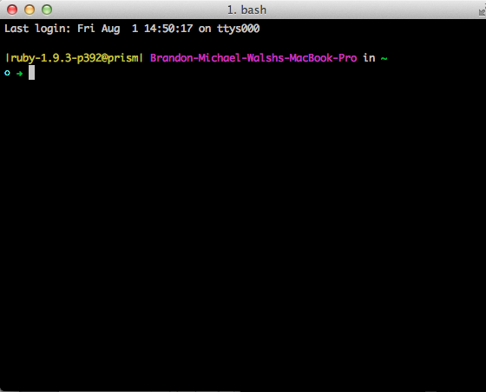
CLI (Command Line Interface)

Slide 6
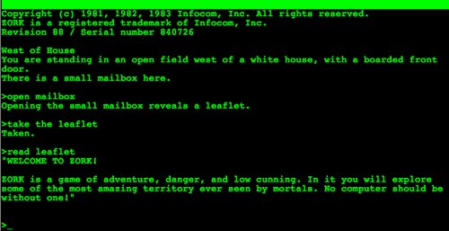
From Zork, 1981

Slide 7
Commands We’ll Learn
Command Structure
cd – change directory
ls – list directory contents
pwd – print working directory
touch – create new file
rm – remove file (careful!)
mkdir – make directory
cp – copy file
mv – move file
man – help page
$ command parameters
$ mkdir new_project
$ touch index.html
command = what to do
parameters = how or to what

Slide 8
Switch to Terminal
Make a folder - projects
Make a folder – command_line
Change into it
Make some files in it
Delete those files
Change back out of it
Repeat.
Introduce Python

Slide 9
Prompt
Terminals show a line of text after a command finishes
Whenever instructions start with "$ ", type the rest of the line into the terminal
Let's give the terminal a command to open Python 3.3 (python3)
$ python3

Slide 10
python3
Python has its own prompt that ends with >>>
$ python3
>>>
You can use Control + D to exit Python at any time or type exit() on its own line
When running Python in terminal, terminal commands won’t work

Slide 11
python3
You'll run Python from the command line, but you can't run command line commands once you're running Python. In other words…
$ python3
>>> cd
Traceback (most recent call last):
File "<stdin>", line 1, in <module>
NameError: name 'cd' is not defined

Slide 12
Two Pythons
Starting Python 2
$ python
Starting Python 3
$ python3
Might be reversed on your machine (High Sierra reversed them for me)
You can change this behavior – on my laptop I have those switched because I tend to use Python3 more.
Notes:
When programming, it’s not as easy as saying “oh we’ll just upgrade to the most recent version.

Slide 13
Other Things to Remember
$ means you're typing in terminal. >>> means Python
Spaces and capitalization are meaningful
The up arrow will generally pull up your last command
Terminal and your GUI are related – if you make a file in terminal it will show up in the finder and vice versa.

Slide 14
Terminal Magic – Things You Can Do
Delete all files on your computer
Turn your computer into a local web server
Anything you can do with the mouse and a thousand other things
youtube-dl – downloads youtube videos and can convert them to mp3
caffeinate – keeps a mac from dimming, screensavering, or falling asleep
pianobar – run Pandora from the terminal
imagemagick – crop, resize, transform, etc. images from terminal

Slide 15
Reading with Terminal

Slide 16
Getting Help for the NEXT LEVEL
Learn Code the Hard way
http://cli.learncodethehardway.org/
Codecademy
https://www.codecademy.com/learn/learn-the-command-line
CLI Quiz
http://walshbr.com/command_line_browser_quiz/

