Slide 1


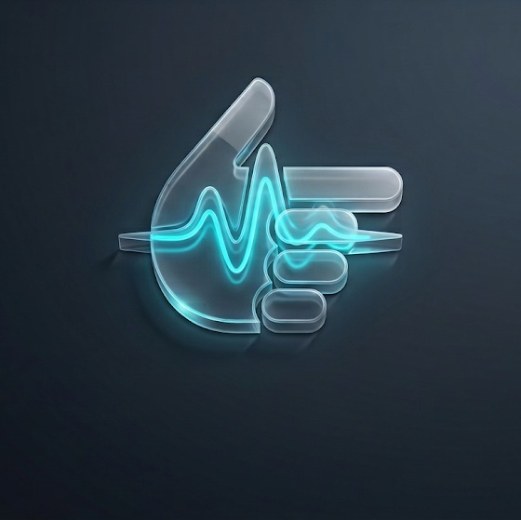

U N M U T E
01 / 06
BIT N BUILD 2026 / HACKATHON PITCH
UNMUTE
AI ACCESSIBILITY PRODUCT
TEAM NAME
RAMPAGE
MEMBERS
Walsh D’Souza · Soham Pendse · Vauldan D’Souza · Abdullah Mukadam
SELECTED TRACK
Agentic AI For Good / Accessibility
Turning English speech and captions into expressive 3D ASL playback
with contextual facial and head cues
R A M P A G E / B I T N B U I L D 2 0 2 6
Notes:
Source: user-supplied unmute_pitch_deck.pdf. Product details: https://github.com/walshdsouza/Bit-n-Build/blob/main/README.md (main at 1aa2318, 13 September 2026).
Team and selected track preserved from the source deck. Current product focus: English input and ASL output.

Slide 2
U N M U T E
02 / 06
THE CHALLENGE
Problem Statement
THE REAL PROBLEM
Signed communication uses facial expression, head movement, and spatial structure alongside hand gestures. UNMUTE explores how these cues can accompany captions in media and meetings.
WHO IS AFFECTED
WHY IT MATTERS
DESIGN GOAL
Deaf and hard-of-hearing students and professionals who prefer signed communication alongside captions.
Text captions and signed languages express information differently. Presenting both can offer another way to follow spoken content.
Make speech visible through synchronized captions, hand movements, and contextual non-manual cues.
R A M P A G E / B I T N B U I L D 2 0 2 6
Notes:
Source: user-supplied unmute_pitch_deck.pdf. Product details: https://github.com/walshdsouza/Bit-n-Build/blob/main/README.md (main at 1aa2318, 13 September 2026).
This slide describes the design rationale. It does not present a measured outcome or a comparative study of existing translators.

Slide 3
U N M U T E
03 / 06
OUR ANSWER
The Solution
PROPOSED SOLUTION
KEY FEATURES
UNMUTE turns English speech and captions into ASL signing plans, displayed by the NEXA 3D avatar. It supports recordings, public YouTube videos, and selected live audio.
YouTube and recorded-media imports
Live signing from a tab, microphone, or both
Contextual facial cues and playback controls
USER FLOW
ADDRESSING THE PROBLEM
1
Open UNMUTE. Sign-in is optional.
Captions, animated signing, and contextual cues share one view.
The current prototype supports English input and ASL output. Vocabulary and translation quality continue to improve.
2
Import media or choose live audio.
3
Retrieve captions or transcribe speech.
4
Generate ASL gloss and a timed motion plan.
5
Watch NEXA beside the text or source video.
R A M P A G E / B I T N B U I L D 2 0 2 6
Notes:
Source: user-supplied unmute_pitch_deck.pdf. Product details: https://github.com/walshdsouza/Bit-n-Build/blob/main/README.md (main at 1aa2318, 13 September 2026).
YouTube availability depends on public access and the configured transcript provider. Live capture supports microphone, shared tab, or both. The current avatar is NEXA. Translation quality requires validation with fluent ASL users.

Slide 4
U N M U T E
04 / 06
UNDER THE HOOD
Technology & Implementation
TECH STACK
Next.js / TypeScript / Tailwind CSS / Three.js / Groq + OpenAI / Supadata / Supabase / Vercel
SYSTEM ARCHITECTURE & DATA FLOW
Media or
selected live audio
Timed
transcript
ASL gloss +
contextual cues
SiGML +
motion plan
NEXA
3D renderer
AI / ML COMPONENTS
TECHNICAL CHOICES
Whisper transcribes speech. AI-assisted glossing and language rules create ASL-oriented text and contextual cues. A dictionary and pose solver generate timed motion.
Reusable sign dictionaries and procedural motion run in the browser. Live captions arrive after five-second audio windows plus transcription and translation.
R A M P A G E / B I T N B U I L D 2 0 2 6
Notes:
Source: user-supplied unmute_pitch_deck.pdf. Product details: https://github.com/walshdsouza/Bit-n-Build/blob/main/README.md (main at 1aa2318, 13 September 2026).
Technical references: lib/live-audio.ts (LIVE_CHUNK_SECONDS=5), components/player/NexaAvatar.tsx, components/player/avatar/nexaRig.ts, extension/manifest.json. The optional meeting extension is a Firefox Manifest V2 sidebar. Supabase sign-in and cloud history are optional. This is not a claim of zero latency or edge-hosted ASR.

Slide 5
U N M U T E
05 / 06
VIABILITY & REACH
Feasibility, Scalability & Impact
FEASIBILITY
SCALABILITY
Hosted speech services, reusable sign dictionaries, and browser rendering support a working prototype. A built-in demo and device saves work without an account.
The pipeline lets vocabulary and language profiles grow independently of the renderer. Each additional sign language needs its own grammar, vocabulary, and validation.
EXPECTED IMPACT & TARGET USERS
FUTURE GROWTH
UNMUTE aims to give Deaf students and professionals another way to follow recorded content and live conversations, alongside captions.
Potential extensions include validated ISL and BSL support, broader meeting integrations, and an accessibility API for partner applications.
R A M P A G E / B I T N B U I L D 2 0 2 6
Notes:
Source: user-supplied unmute_pitch_deck.pdf. Product details: https://github.com/walshdsouza/Bit-n-Build/blob/main/README.md (main at 1aa2318, 13 September 2026).
Impact is an intended outcome, not a measured result. ISL and BSL are separate languages. Broader language support, native enterprise integrations, and a partner API remain future work.

Slide 6
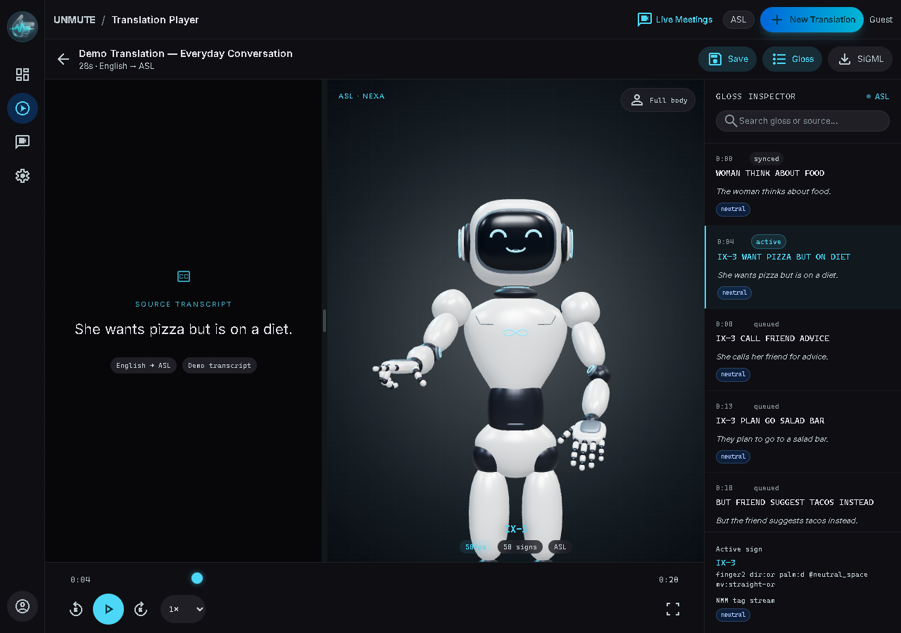
U N M U T E
06 / 06
WHAT WE BUILT
Prototype & Future Scope
PROTOTYPE / DEMO
KEY SCREENS
Media dashboard
NEXA translation player
Live Meetings: tab + microphone
Optional Firefox meeting sidebar
FUTURE IMPROVEMENTS
Sign-to-text via webcam
Open the demo player
Validated language and regional vocabulary
Personalized avatars
Live app
Live Meetings
GitHub repository
R A M P A G E / B I T N B U I L D 2 0 2 6
Notes:
Source: user-supplied unmute_pitch_deck.pdf. Product details: https://github.com/walshdsouza/Bit-n-Build/blob/main/README.md (main at 1aa2318, 13 September 2026).
Screenshot: repository public/features/player.png. Links: https://unmute-ai.vercel.app ; https://unmute-ai.vercel.app/player/demo ; https://unmute-ai.vercel.app/live ; https://github.com/walshdsouza/Bit-n-Build . Future improvements are not current features.

