Slide 1

Student Network Idea Proposal
Michael Walsh - 17428926
Karl Hannigan - 17435332
Project Advisor: Gareth Jones

Slide 2
Project Summary
Introduction
Student Social Networking Platform: connect, chat, share, discuss, debate.
Access to tutoring / grinds services, student discussion boards, second hand books marketplace.
Reason for Proposing the Idea:
Difficulty 1st year students are having with making friends this year due to the pandemic.
The original Facebook model for example (confined to class / university) has gotten lost due to growth.
There is now a need for a networking platform where students will actually meet each other in person.

Slide 3
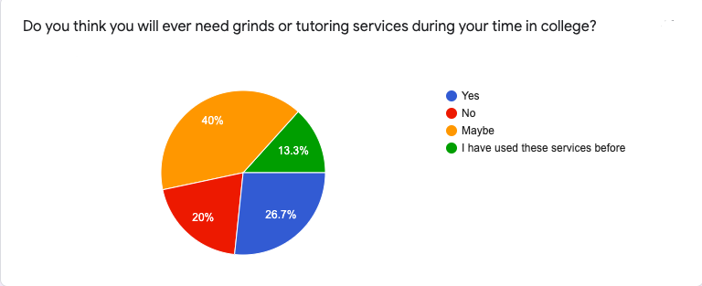
Market Rationale
Target Market Size:
Networking Aspect: 231,710 students in Ireland. 93% use social media for at least 1 hour a day. This gives us a target market of 215,490 users.
Tutoring Aspect: 231,710 students in Ireland. Based on our result of one of the questions from our questionnaire, we have a potential target market of 92,684 users.
Customer Segments & Value Propositions:
Students: Build a student network and access valuable student resources.
Tutors & Advertisers: Access to a large pool of students.

Slide 4
Research
Planned Market Validation
Primary: Zoom call with students & tutors, DCU SU, DCU ISS.. Questionnaire for students to yield quantitative data.
Secondary: (1)‘HEA Key Facts & Figures 2017/2018’ Statistics Unit Report, (2) NUIM Student Social Media Usage Report.
Competitor Analysis:
Tutoring Platforms: Hometutors.ie, Firsttutors.com/Ireland, Tutorhub.ie
Services offered, feedback/review system, Garda vetting
Student Discussion: Boards.ie
Colleges, faculties, topics

Slide 5

Expected Technical Delivery
Networking Aspect:
Fully functioning social networking platform.
Register, login, customise profile, add friends, share posts, etc.
Implementation of gamification.
All Other Aspects:
Tutoring Section, Second Hand Book Marketplace, Student Discussion Board
Hardcoded pages at a minimum
Expected Method of Delivery:
Development: Django, HTML, CSS, Javascript
Deployment: AWS EC2 or AWS Elastic Beanstalk, AWS RDS, AWS S3

Slide 6
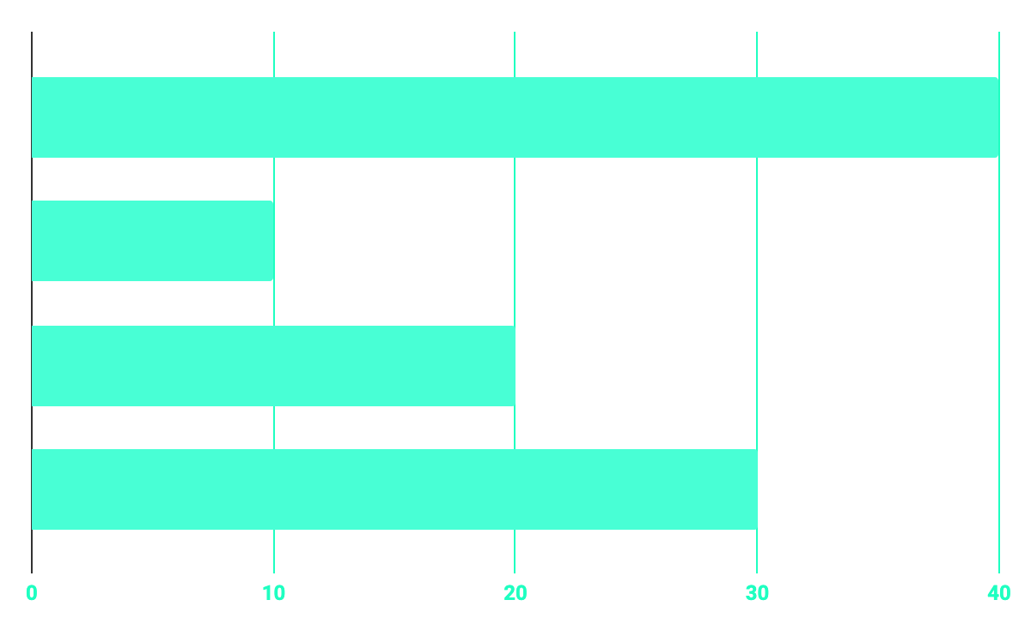
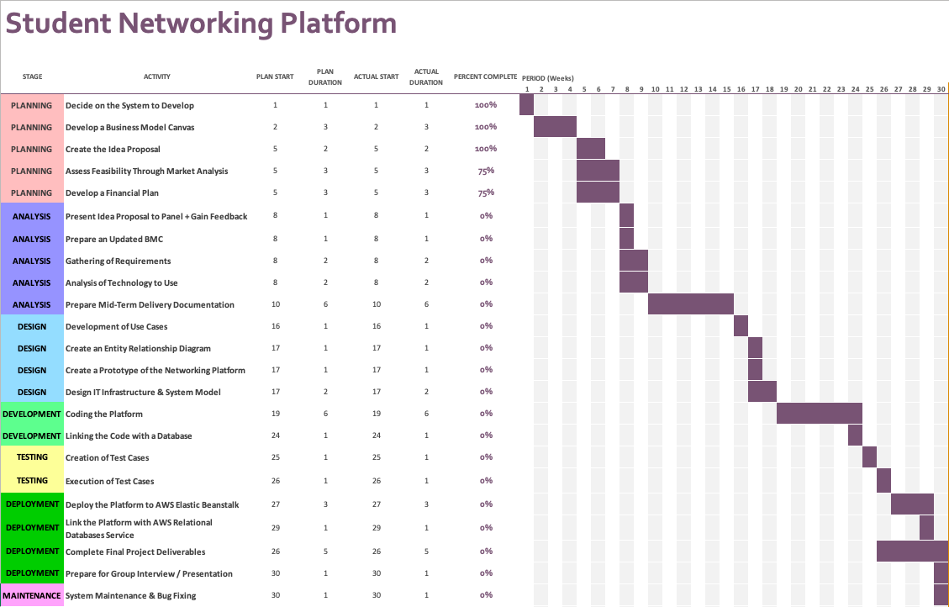
Proposed Project Timeline

Slide 7
References
2018. Higher Education Key Facts And Figures 2017/2018. [ebook] Dublin: HEA, p.6. Available at: <https://hea.ie/assets/uploads/2019/01/Higher-Education-Authority-Key-Facts-Figures-2017-18.pdf> [Accessed 22 November 2020].
2)
Kettle, P., Gilmartin, N., Corcoran, M., Byrne, D. and Sun, T., 2016. Time Well Spent? A Survey Of Student Online Media Usage. [ebook] Maynooth: National University Ireland Maynooth. Available at: <https://www.maynoothuniversity.ie/sites/default/files/assets/document/SOCIAL%20MEDIA%20SURVEY%20FINALV_1.pdf> [Accessed 13 November 2020].
1)

