Slide 1
Book1
File created on: 9/1/2021 11:47:28 PM

Slide 2
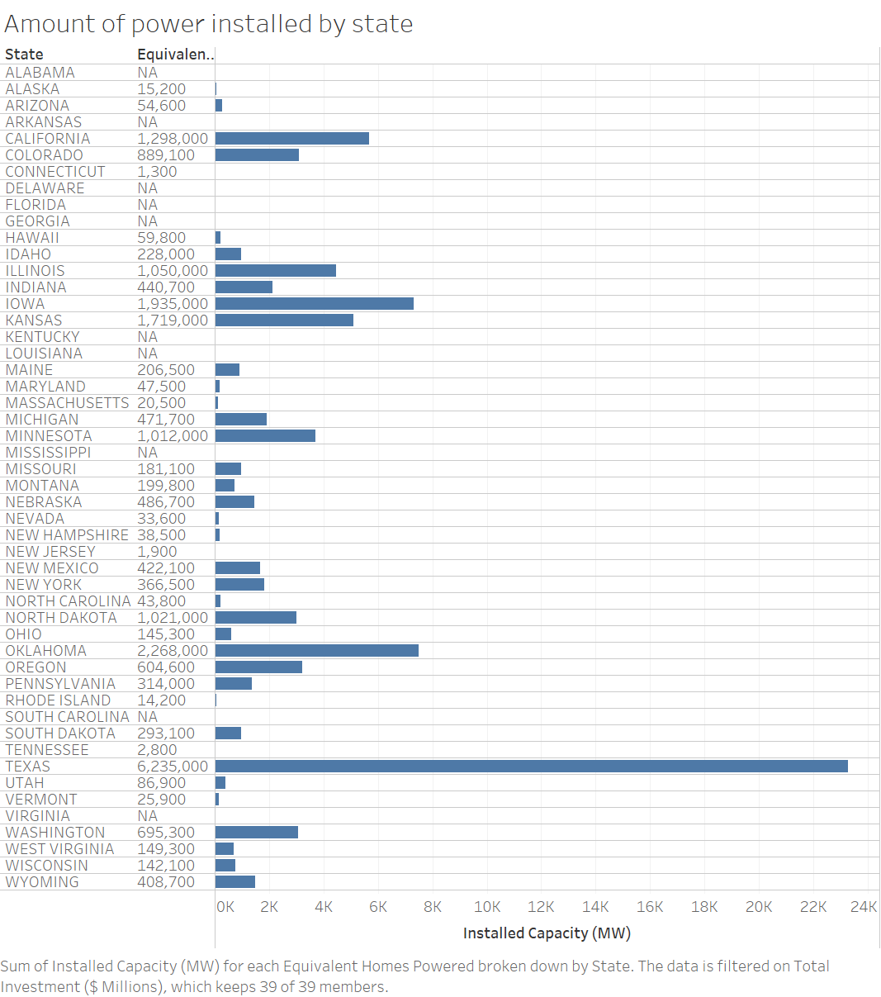

Slide 3
