Slide 1
Topic: Presentation of Telco Customer Churn Project Walter Kiptanui Data Science Enthusiast

Slide 2
Agenda
EDA
Modeling and prediction
Deployment
Recommendations
Conclusions
Notes:
Customer churn refers to the percentage of customers who stop using a product or service within a given time period.

Slide 3
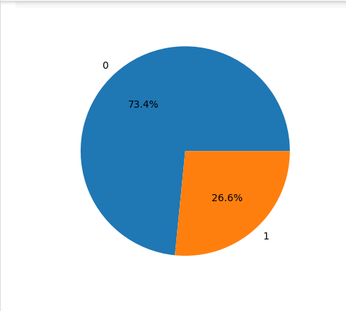
Customer Loyalty
0 – not churning
1 - churning

Slide 4
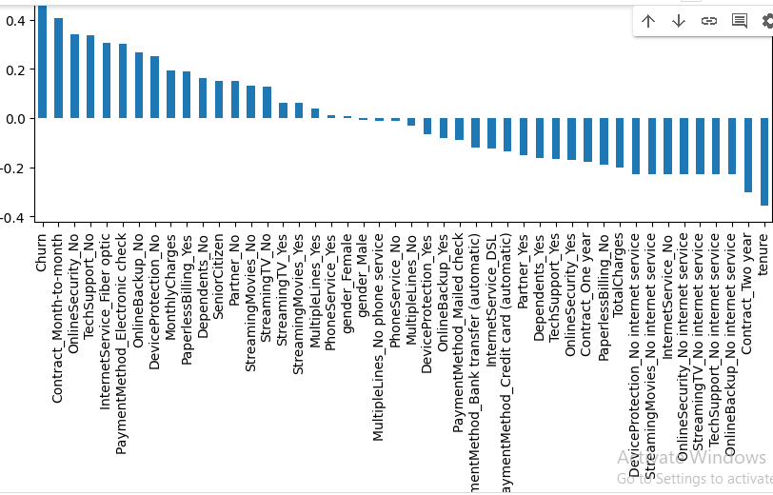
How customer characteristics affect churning

Slide 5
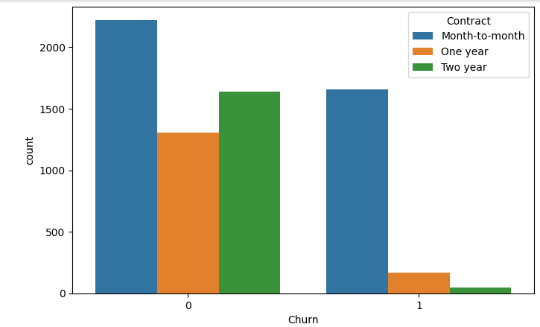
Behavior of clients based on their contracts
Notes:
Those clients with short contracts of month to month are likely to churn. The others with longer contracts churn at a lower rate.

Slide 6
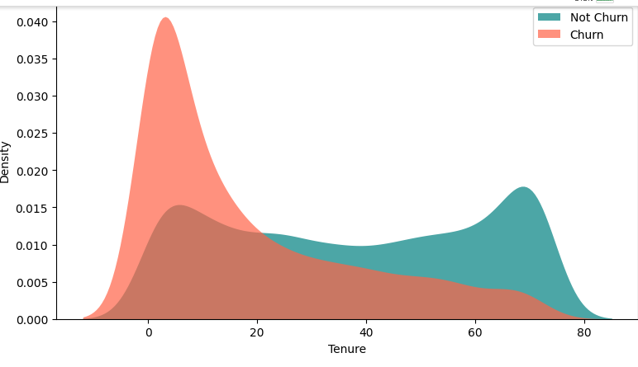
Relationship between Tenure and Churn
Notes:
When a customer has been in the company for a short period of time, the chances of quitting are high but when they have been present for a long time, the chances of quitting are low.

Slide 7
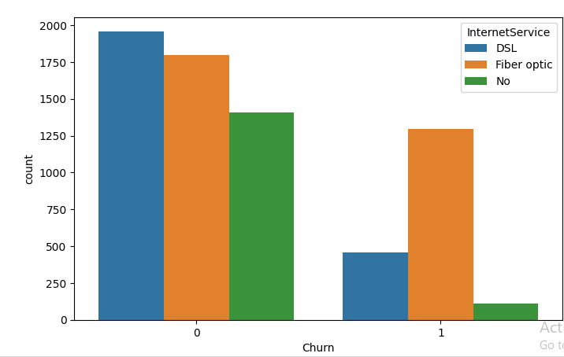
Relationship between Internet Service and Churn
Notes:
Customers that use fiber optic churn the most.

Slide 8
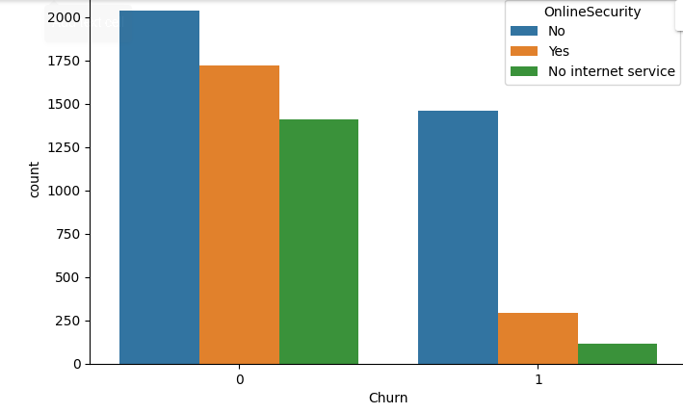
Relationship between Online security and Churn
Notes:
Customers churn because of lack of online security

Slide 9
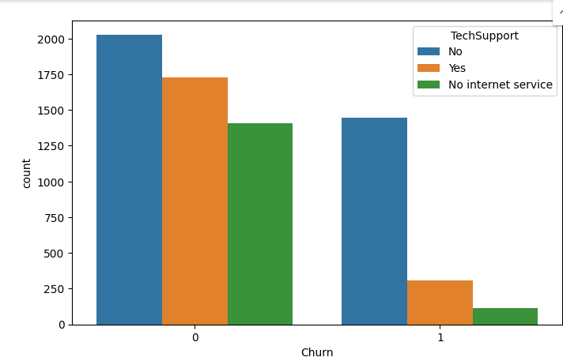
Relationship between Techsupport and Churn
Notes:
Clients with no tech support churn the most. They quit when they find no assistance on how to use the telecommunication services.

Slide 10
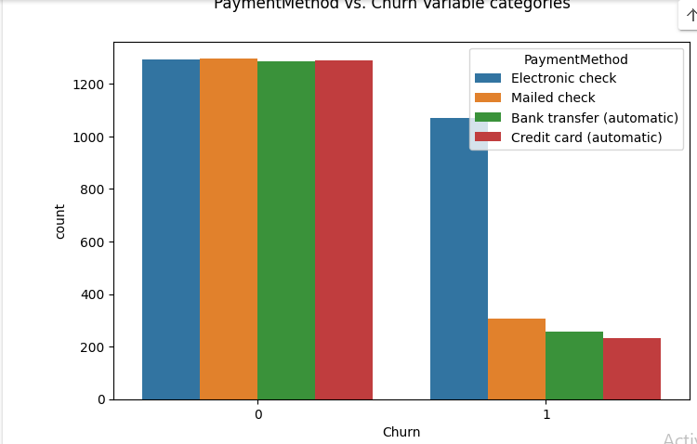
Relationship between Payment Method and Churn
Notes:
In comparison with the other methods of payment, electronic check results in more customers churning. The other methods have low rates of churning at almost the same measure with the use of automatic credit card being the lowest.

Slide 11
Performance Metrics of predictive model
True Positives - 1014
False Positives - 124
True Negatives - 343
False Negatives - 277
Notes:
This involved choosing classifying machine learning models to help in classifying new customers.

Slide 12
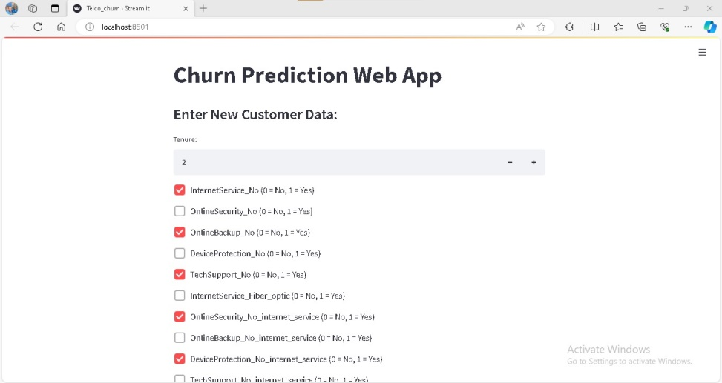
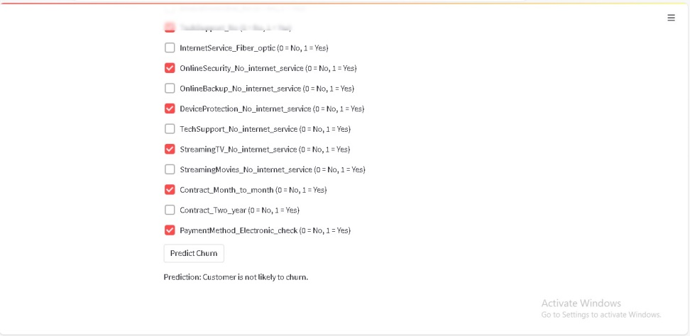
Real-time prediction of churn of a new customer

Slide 13
Conclusions and Recommendations
The company has to:
1. Check its fiber internet service.
2. Inform customers about the importance of online.
3. Advise customers about using online backup
4. Provide tech support.
5. Tie down customers to long term contracts.
6. Drop the electronic payment.
More recommendations can be found here https://colab.research.google.com/drive/1nS5qCGkZHX1OeyRVA68RPM8V5jFcCRBh#scrollTo=4SexFOKPrTOb

