Slide 1

Aspect Oriented Programming
1

Slide 2
Example (Cross-cutting concerns)
public class Konto {
private String owner;
private double amount;
private double interestRateSoll;
private double interestRateHaben;
public void setOwner (String aOwner) { this.owner = aOwner; }
public void setAmount (double newAmount) { this.amount = newAmount; }
public void setInterestRateSolll(double newInterestRate) { this.interestRateSoll = newInterestRate; }
public void setInterestRateHaben(double newInterestRate) { this.interestRateHaben = newInterestRate; }
public void addInterest() {
if (amount < 0 ) {
amount = amount * (1-interestRateSoll);
} else {
amount = amount * (1+interestRateHaben);
}
}
public String toString() {
return "Konto " + this.owner + " " +this.amount + " " + "(" + this.interestRateSoll + "/" +
this.interestRateHaben + ")";
}
}
2

Slide 3
Example (Cross-cutting concerns)
Class Konto
Business logic only: 35 LoC
Add logging: 51 LoC
Add persistence, versioning, parameter checks: 66 LoC
➔ Business logic gets lost in the code
➔ Separation of concerns
3

Slide 4
Possible solution
Code for each aspect is in separated files.
  Implemented by different people (Not seen by the others; encapsulated)
  Maintained and extended independent of business logic
No calls have to be added.
Code for each aspect gets "weaved" in by the so called weaver
Useful Links:
AspectJ:
http://www.aspectj.org
AspectJ Programming Guide:
http://www.eclipse.org/aspectj/doc/released/progguide/index.html
4

Slide 5
Terms used
A place where code will be weaved in ➔ Pointcut
Code which will be weaved in ➔ Advice
Pointcut + Advice ➔ Aspect
Possible places where advices can be weaved in ➔ Join Points
e.g.
Methods or Ctr calls
Access attributes
Exceptions
Pointcut is a filter for a Join Point
5

Slide 6
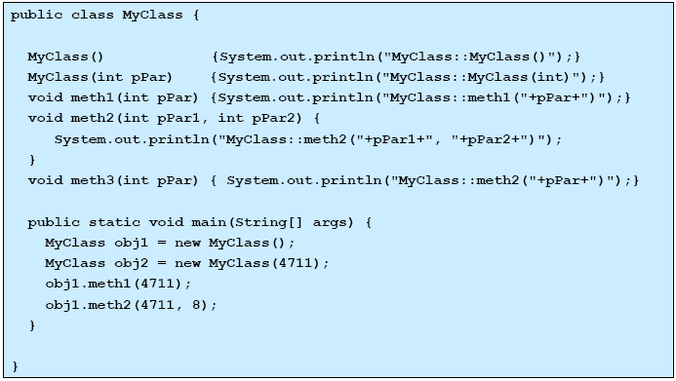
Example (Business logic)
6

Slide 7
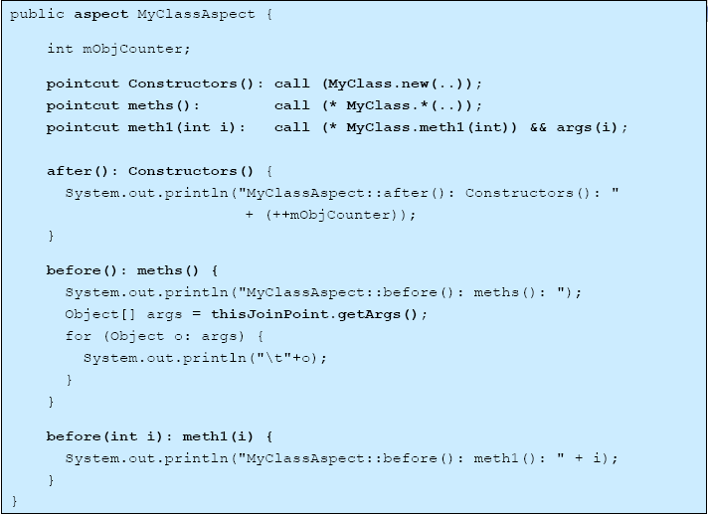
Example (Aspect Logging)
Pointcut
Advice
7

Slide 8
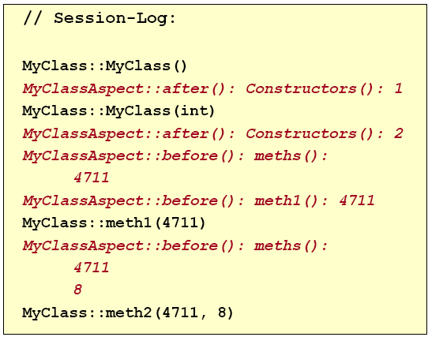
Example (Result)
8
Notes:
PUTTY example (puttygen)

Slide 9
Pointcut
call(): context caller
  e.g. call(* MyClass.*(..))
  gets called from all methods from MyClass
execution(): context the one being called
  e.g. execution(* *run(..))
  gets called from all methods with name run
set():
e.g. set(int MyClass.*)
  gets called when ever an int Attribute in class MyClass gets changed
get() handler() within() this() target() args() .....
9
Notes:
PUTTY example (puttygen)

Slide 10
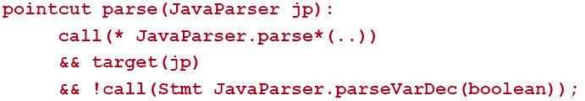
Pointcut combination
AND: piontcut1 && pointcut2
OR: piontcut1 || pointcut2
NOT: !piontcut
10
Notes:
PUTTY example (puttygen)

Slide 11
Patterns and Wildcards
..: all possible parameter lists
*: all data types (classes)
+: derived classes
In combination:
*: string without a .
..: string starts and ends with a .
e.g.
*..*Pers* class which contains Pers in the name from any packages.
Foo+.new(..) all constructors from Foo and its derived classes.
11
Notes:
PUTTY example (puttygen)

Slide 12
Advice
before()
e.g. before(): get(int Person.alter) {code}
executed before the attribute Person.alter gets changed
after()
e.g. after(): call(Person.new(..)) {code}
executed after each ctr from class Person has been executed
after() throwing after() returning
12
Notes:
PUTTY example (puttygen)

Slide 13
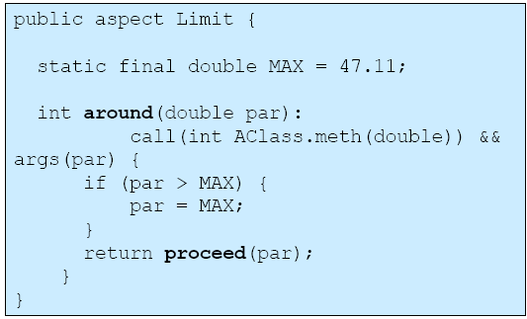
Advice
around() and proceed()
e.g. for method AClass.meth(double par) is max of par 47.11
13
Notes:
PUTTY example (puttygen)

