Slide 1
Step-by-Step 5.7.18

Slide 2
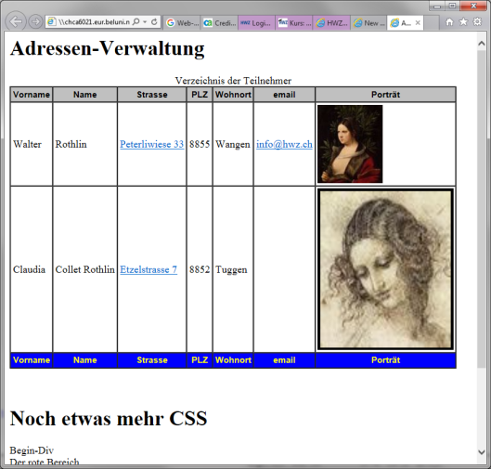
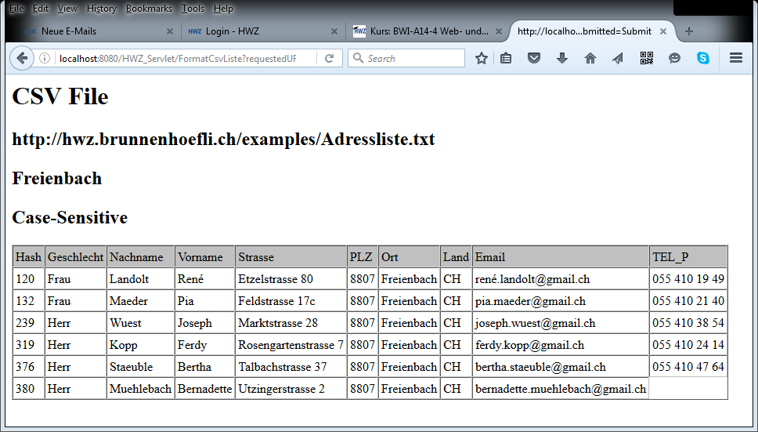
HTML / CSS / Formulare
Client-Side
Server-Side
<HTML>
</HTML>
<HTML>
</HTML>
Publishing: Transfer via ftp
Local Open file::c:\HWZ\index.html
URL-Request
http://www.hwz.ch/berichte/index.html

Slide 3
Entkoppeln von Content und View
Client-Side
Server-Side
Name;Vorname;
Rothlin;Walti
Meier;Heinz
Muster;Felix
CSV-Parser.java
<HTML>
</HTML>
<HTML>
</HTML>
Publishing: Transfer via ftp
Local File
Local File
URL-Request
http://www.hwz.ch/berichte/index.html

Slide 4
Globale Resource
Server-Side
Name;Vorname;
Rothlin;Walti
Meier;Heinz
Muster;Felix
Client-Side
Server-Side
CSV-Parser.java
<HTML>
</HTML>
<HTML>
</HTML>
URL-Request
Publishing: Transfer via ftp
Local File
URL-Request
http://www.hwz.ch/berichte/index.html

Slide 5
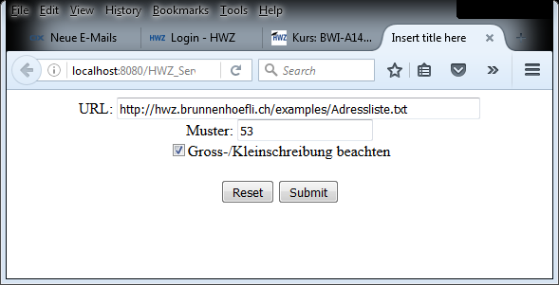
Servlet
Server-Side
Server-Side
Web-Server
Application-Server
Name;Vorname;
Rothlin;Walti
Meier;Heinz
Muster;Felix
Servlet
GetAdressliste.java
URL-Request
URL-Request
URL-Submit
<HTML>
</HTML>
Client-Side
URL-Response

Slide 6
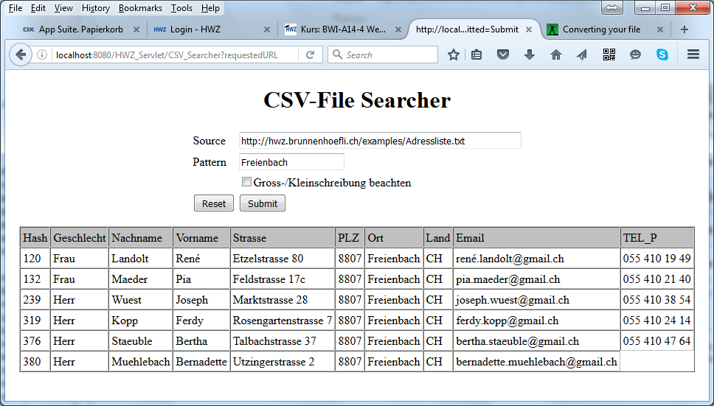
Servlet
Server-Side
Server-Side
Name;Vorname;
Rothlin;Walti
Meier;Heinz
Muster;Felix
Servlet
GetAdressliste.java
URL-Request
URL-Request
URL-Submit
<HTML>
</HTML>
Client-Side
URL-Response

Slide 7
Servlet calls Bean
Server-Side
Name;Vorname;
Rothlin;Walti
Meier;Heinz
Muster;Felix
Server-Side
URL-Request
EJB
CsvFileManager.java
Servlet
CsvFileManagerApplication.java
Methode-Invocation
URL-Request
URL-Submit
Client-Side
<HTML>
</HTML>
URL-Response

Slide 8
Servlet calls Enterprise Java Bean (EJB)
Server-Side
Name;Vorname;
Rothlin;Walti
Meier;Heinz
Muster;Felix
Server-Side
Server-Side
URL-Request
EJB
CsvFileManager.java
Methode-Invocation
Über Server-Grenzen hinaus!
Servlet
CsvFileManagerApplication.java
URL-Request
URL-Submit
Client-Side
<HTML>
</HTML>
URL-Response

Slide 9
Java-Client calls Enterprise Java Bean (EJB)
Server-Side
Name;Vorname;
Rothlin;Walti
Meier;Heinz
Muster;Felix
Server-Side
URL-Request
EJB
CsvFileManager.java
Methode-Invocation
Über Server-Grenzen hinaus!
Client-Side
POJO
CsvFileManagerClient.java

Slide 10
