Slide 1

Java Annotations
1

Slide 2
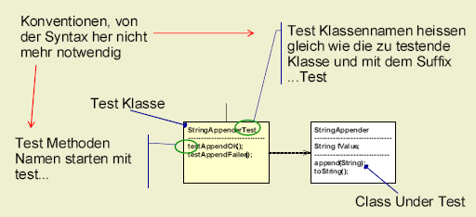
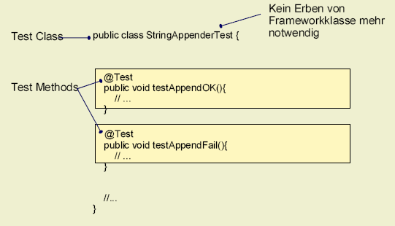
Java Annotations: Example for use of annotations (JUnit)
Alt
Neu
2

Slide 3
Java Annotations: Example (JUnit)
import WarenAutomat.Kasse;
import junit.framework.TestCase;
import WarenAutomat.*;
public class KasseMockTest extends TestCase {
private Kasse testKasse1;
private static int testCaseNr = 0;
private final String testCaseMsg = " kann als Rückgeld ausgegeben werden ";
protected void setUp() { .... }
protected void tearDown() { .... }
public void testIsValid1() {
boolean expectedResult = true;
int testBetrag = 880;
System.out.println("Running Test " + testCaseNr + " with amount " +
testBetrag + " Expected result:" + expectedResult);
KasseMockTest.assertTrue(testBetrag + testCaseMsg, testKasse1.auszahlungRestGuthabenMöglich(testBetrag) == expectedResult);
}
...........
3

Slide 4
Java Annotations: Example (JUnit)
import static org.junit.Assert.*;
import org.junit.After;
import org.junit.Before;
import org.junit.Test;
public class StackImplTest {
private Stack testStack = null;
@Before
public void setUp() {
testStack = new StackImpl(2);
}
@After
public void tearDown() {
testStack = null;
}
@Test
public void testIsEmpty() throws StackException {
assertTrue("Stack ist leer; isEmpty returns false",testStack.isEmpty());
assertFalse("Stack ist leer; isFull returns true",testStack.isFull());
testStack.push("Walti");
assertFalse("Stack ist nicht leer; isEmpty returns true",testStack.isEmpty());
}
4

Slide 5
Java Annotations: Other Example
EJB 3.0
@Stateful(mappedName = "StatefulSession_EJB30_1")
@Local ({StatefulSession_EJB30_1Local.class})
@Remote ({StatefulSession_EJB30_1Remote.class})
public class StatefulSession_EJB30_1Bean implements StatefulSession_EJB30_1{ }
Hibernate
@OneToMany(cascade = {CascadeType.ALL} )
@JoinTable(
name="DiscoveredRisks",
joinColumns = @JoinColumn(name = "assessment_id"),
inverseJoinColumns = @JoinColumn(name = "risk_id")
)
@Filter(name="deleted", condition="deleted = false")
public List<Risk> getRisks() {
return risks;
}
5

Slide 6
Java Annotations: Boilerplate code and "Side files"
Web-Services
Paired interface and implementation => Decorate implementation and interface definition can be generated
➔ Less error-prone; Simpler maintenance
EJB Deployment descriptor
Java Bean BeanInfo
Simpler if these information would be maintained in the program itself
JAVA Language
transient is meta info an should be marked differently to regular logic syntax
➔ Separation of concerns
Boilerplate: Immer zu wiederholende Code-Fragmente
6

Slide 7
Java Annotations: Annotation @
Annotations do not directly affect program semantics (logic)
Annotations are read by tools like compiler, ....
Annotations are Meta-Data
Annotation Type (Abbreviation AT => @)
7

Slide 8
Java Annotations: Define your own annotation
Where ever you can define an interface you can define an annotation
import java.lang.annotation.*;
@Retention(RetentionPolicy.RUNTIME) // Meta-Annotation
@interface ClassReference {
IdentAnnotation ident(); // Method in annotation is called Element
String contact() default "-"; // const expression, Class Literal (e.g. Pers.class)
IdentAnnotation[] refs(); // Possible types: primitive type, String, enum,
// other annotations and array of these types
}
If Annotations has no elements ➔ Marker Annotation (e.g. @Deprecated)
No generic type
No inheritance
Extends or implements possible ➔ Result is a normal Interface or Class (Not anymore an annotation)
8

Slide 9
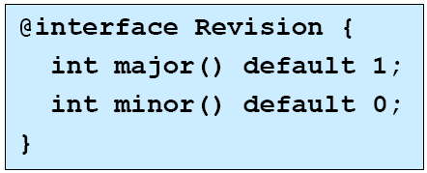
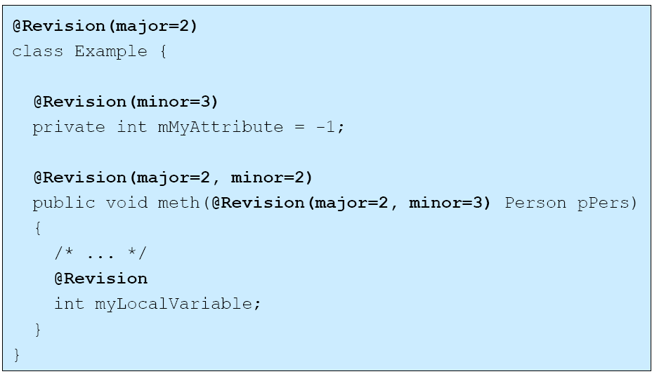
Java Annotations: Usage of own annotation
Where ever you can add a modifier like abstract, final, private, static,...
-- Types (Class, Interfaces, Enums, Annotations)
-- Attributes
-- Methods
-- local Variables
-- formal method parameters
9

Slide 10
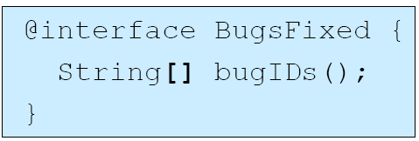
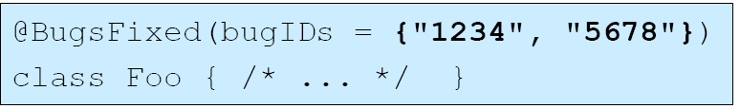
Annotation element as array
10

Slide 11
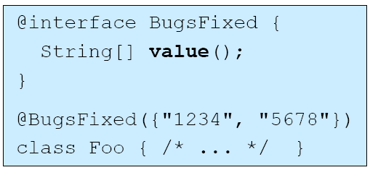
Annotation with only ONE element with name value
Kein Name nötig
11

Slide 12
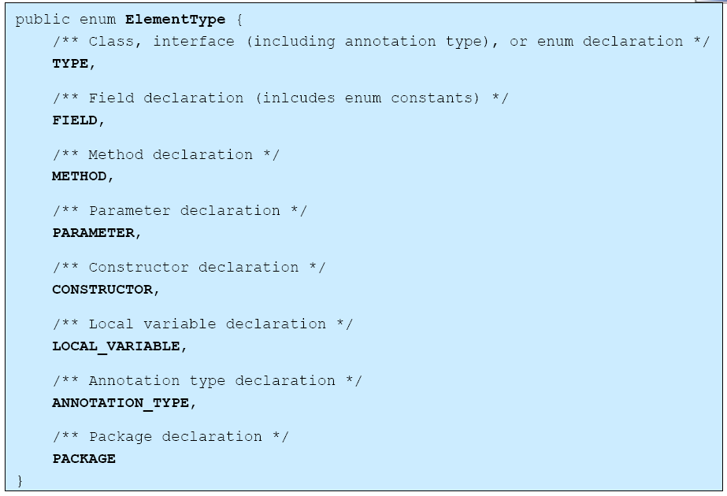
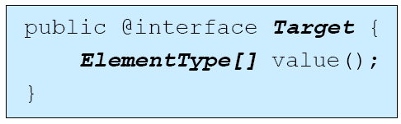
Restricted usage of an Annotation
12

Slide 13
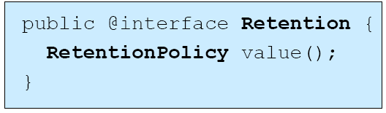
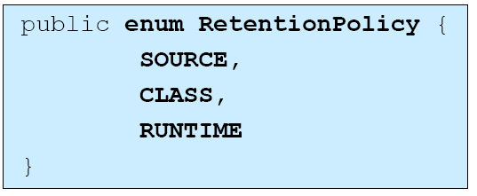
Retention
Source: only in source file
Class: in class file to but not accessible via reflection (DEFAULT)
Runtime: accessible via reflection
Annotations of local variable are never in class file!
13

Slide 14

Annotation-Übung
Übung 0.1:
Definieren sie eine eigene Annotation, so dass Sie Ihre Java-Classes «markieren» können
  Mögliche «Markierungen» sind:
    Klassen-Type
    Klassen-Ident
    Klassen-References
Erstellen Sie zwei eigene Java-Dummy Classes.
Schreiben sie ein Programm, welches die Annotation Ihrer Dummy Classes ausliest
und in einer Tabelle darstellt.
14

Slide 15
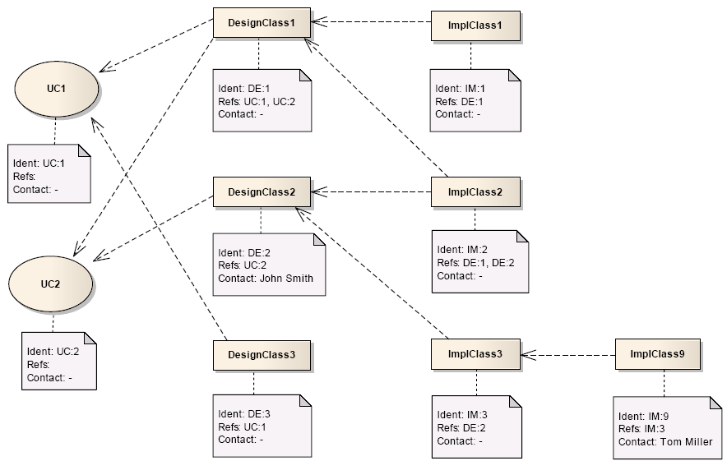
Java Annotations: Übung
15

Slide 16
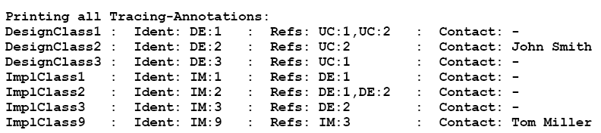
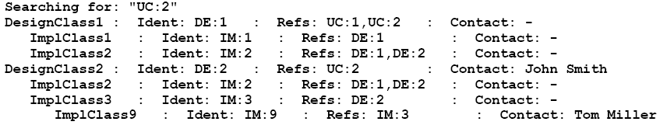
Java Annotations: Übung
16

Slide 17
Java Annotations: Übung-Lösung
package com.rothlin.hwz;
public enum ClassType {
UC,
DE,
IM;
}
ClassType.java
package com.rothlin.hwz;
public @interface IdentAnnotation {
ClassType classType();
int number();
}
IdentAnnotation.java
package com.rothlin.hwz;
import java.lang.annotation.*;
@Retention(RetentionPolicy.RUNTIME)
public @interface ClassReference {
IdentAnnotation ident();
String contact() default "-";
IdentAnnotation[] refs();
}
ClassReference.java
17

Slide 18
Java Annotations: Übung-Lösung
package com.rothlin.hwz;
@ClassReference (
ident = @IdentAnnotation (
classType = ClassType.IM,
number = 2
),
contact = "Owner ImplClass 2",
refs = {
@IdentAnnotation (
classType = ClassType.DE,
number = 1
),
@IdentAnnotation (
classType = ClassType.DE,
number = 2
)
}
)
public class ImplClass2 {}
ImplClass2.java
18

Slide 19
Java Annotations: Übung-Lösung
package com.rothlin.hwz;
import java.io.File;
import java.util.Arrays;
public class DependencyParser {
public static void main(String[] pArgs) {
System.out.println("Dependency Parser");
@SuppressWarnings("unused")
DesignClass1 designClass1 = new DesignClass1();
File binDir = new File("bin\\com\\rothlin\\hwz");
String[] filenamen = binDir.list();
Arrays.sort(filenamen);
for (String filename: filenamen) {
try {
if (! filename.matches(".*\\.class$")) continue;
filename = "com.rothlin.hwz." + filename.substring(0,filename.lastIndexOf(".class"));
Class<?> c = Class.forName(filename);
ClassReference classReference = (ClassReference) c.getAnnotation(ClassReference.class);
if (classReference != null) {
System.out.print(filename + ": Ident:" + classReference.ident().classType() + ":");
System.out.print(classReference.ident().number() + " Refs:");
IdentAnnotation[] identAnnotations = classReference.refs();
for ( IdentAnnotation aIdentAnnotation: identAnnotations) {
System.out.print(aIdentAnnotation.classType()+":"+aIdentAnnotation.number()+" ");
}
System.out.print("Conatct:" + classReference.contact());
System.out.println();
}
} catch (ClassNotFoundException e) { e.printStackTrace();}
} // for
} // main
} // class
DependencyParser.java
19

