Slide 1
Web-Applikationen Server- / Client-Side 5.5.21

Slide 2
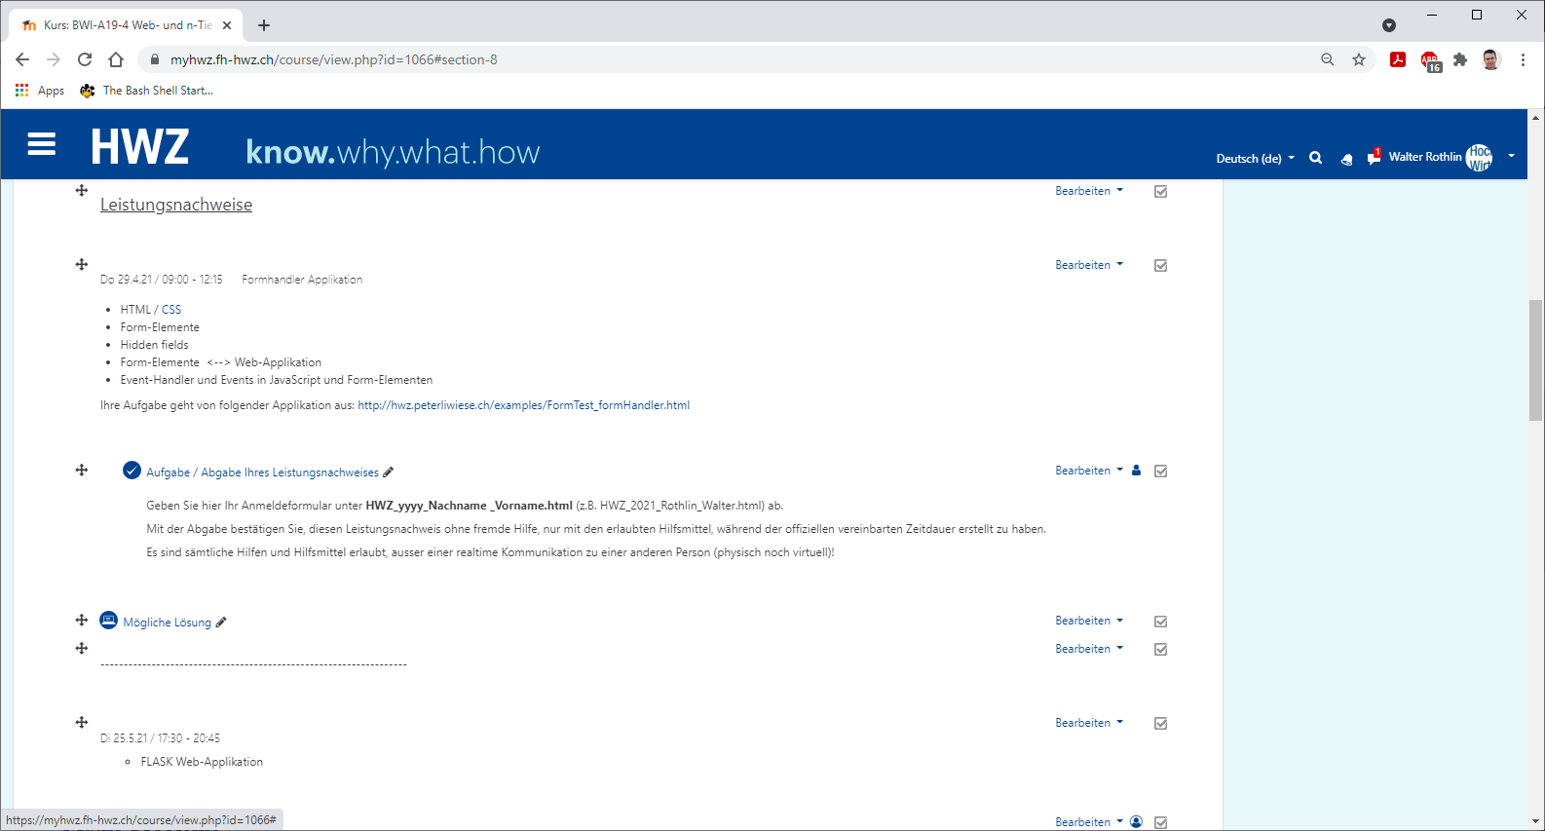
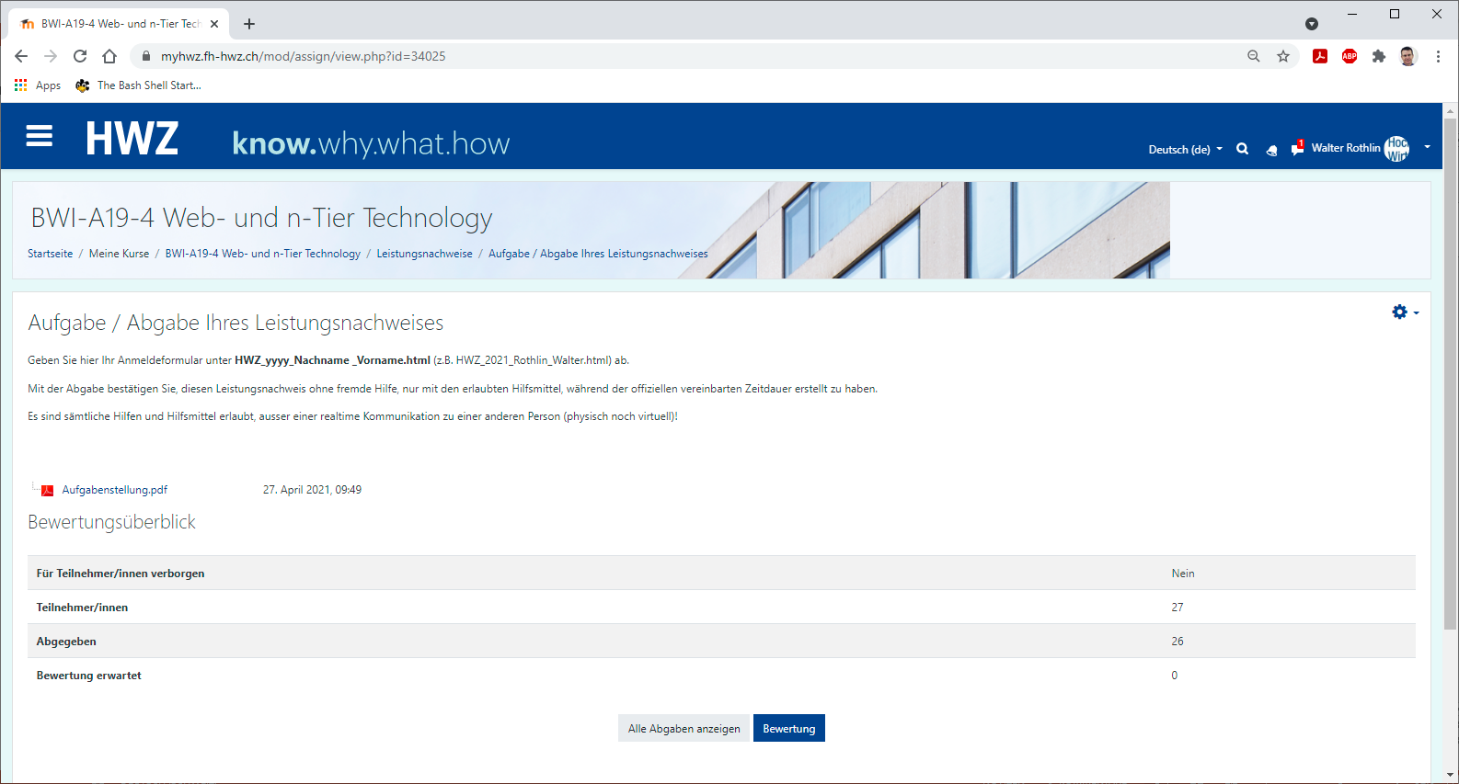
HTML / CSS / Links
Client-Side
(z.B. HTML, CSS, Links,…)
Server-Side
URL-Request mit Get-Parameter
Web-Server
https://myhwz.fh-hwz.ch/mod/assign/view.php?id=34025
Response with Mime-Type und Parameter

Slide 3
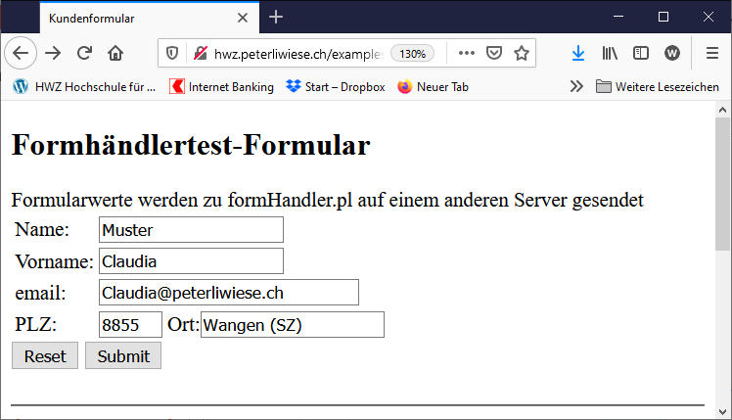
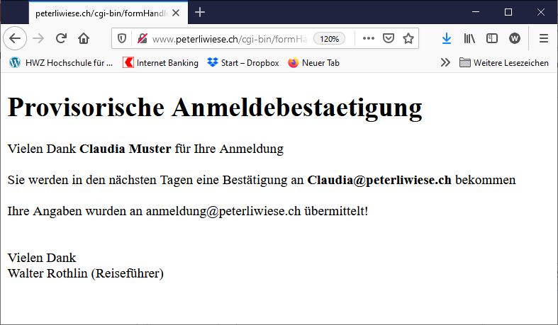
Interaktive Elemente / Server Side Programme
Client-Side
(mit User-Interaction possibilites)
Server-Side
URL-Request mit Post or Get-Parameter
Web-Server
http://www.peterliwiese.ch/cgi-bin/formHandler.pl?Name=Muster&Vorname=Claudia&Email=Claudia..
Server-Programm
Response with Mime-Type
Server-Programme (Business-Logik)
Programmiersprachen: Java, Perl, Python, C#,…
Verschiedenste Frameworks: Servlet, ASP, CGI, WSGI, FLASK,…
Generiert verschiedenste Mime-Types: HTML/CSS, JavaScript, JSON, PDF, JPG,…

Slide 4
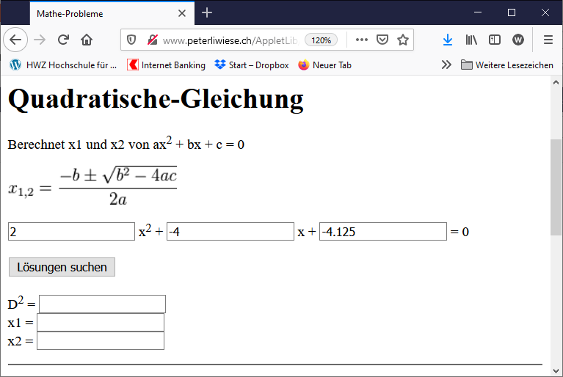
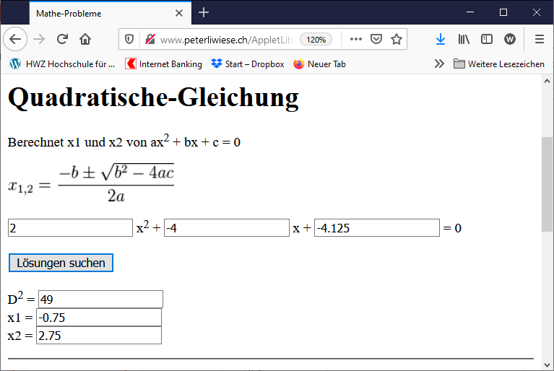
Interaktivität wird Client-Seitig behandelt
Client-Side
(mit Java-Script und Event-Handler)
Client-Programme (Business-Logik)
Programmiersprache: JavaScript (JS)
Client-Programm
Event-Handler call
Java-Script verändert DOM (HTML)

Slide 5
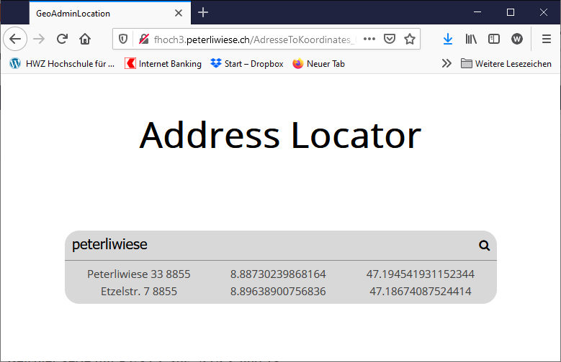
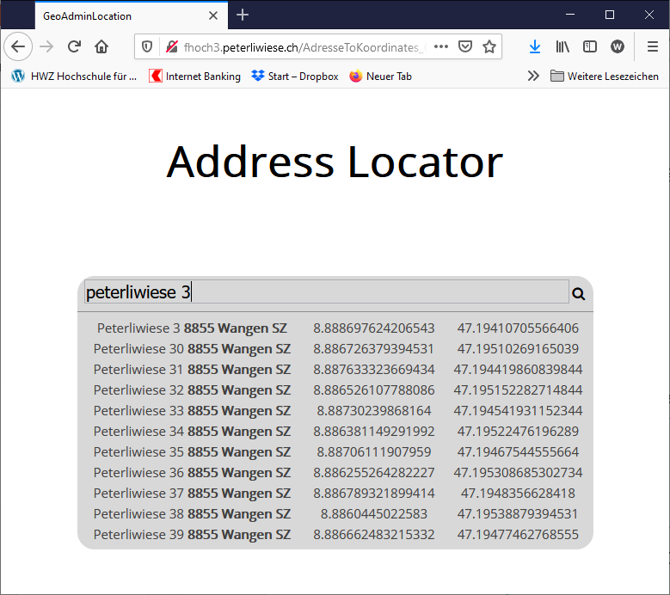
Client-Programm ruft Server-Programm auf AJAX
Client-Side
(mit Java-Script und Event-Handler)
Server-Side
Web-Server
Client Business-Logik
Calls Server-Programme
Composes multiple Server-Programme
URL-Request
(Service Request / REST)
Server-Programm
Event-Handler call
Client-Programm
Response
(JSON)
Server Business-Logik
Orchestrieren / Komponieren
Java-Script verändert DOM (HTML)

Slide 6
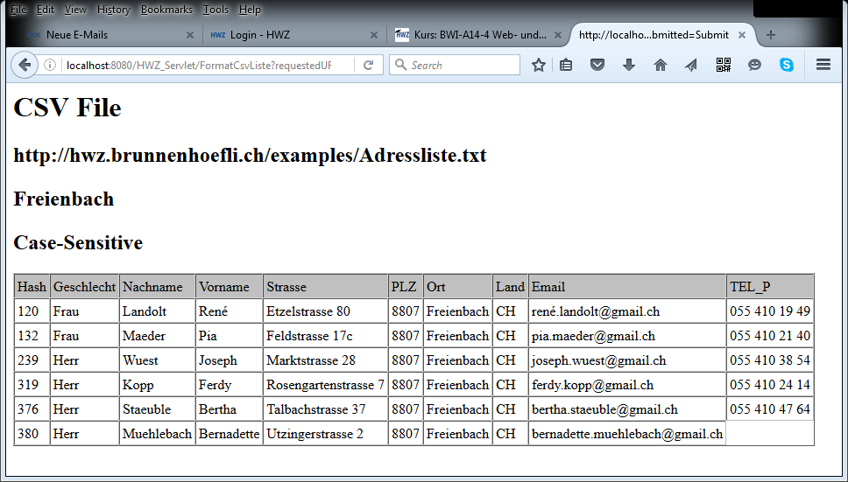
Entkoppeln von Content und View
Client-Side
Server-Side
Name;Vorname;
Rothlin;Walti
Meier;Heinz
Muster;Felix
CSV-Parser.java
<HTML>
</HTML>
<HTML>
</HTML>
Publishing: Transfer via ftp
Local File
Local File
URL-Request
http://www.hwz.ch/berichte/index.html

Slide 7
Globale Resource
Server-Side
Name;Vorname;
Rothlin;Walti
Meier;Heinz
Muster;Felix
Client-Side
Server-Side
CSV-Parser.java
<HTML>
</HTML>
<HTML>
</HTML>
URL-Request
Publishing: Transfer via ftp
Local File
URL-Request
http://www.hwz.ch/berichte/index.html

Slide 8
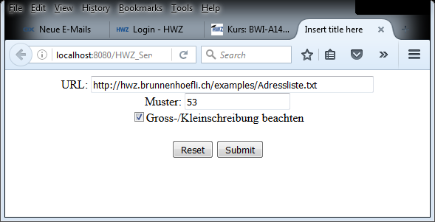
Servlet
Server-Side
Server-Side
Web-Server
Application-Server
Name;Vorname;
Rothlin;Walti
Meier;Heinz
Muster;Felix
Servlet
GetAdressliste.java
URL-Request
URL-Request
URL-Submit
<HTML>
</HTML>
Client-Side
URL-Response

Slide 9
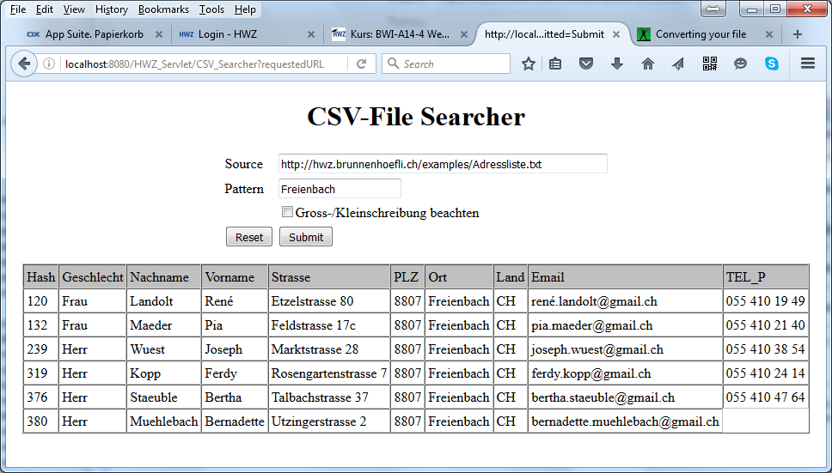
Servlet
Server-Side
Server-Side
Name;Vorname;
Rothlin;Walti
Meier;Heinz
Muster;Felix
Servlet
GetAdressliste.java
URL-Request
URL-Request
URL-Submit
<HTML>
</HTML>
Client-Side
URL-Response

Slide 10
Servlet calls Bean
Server-Side
Name;Vorname;
Rothlin;Walti
Meier;Heinz
Muster;Felix
Server-Side
URL-Request
EJB
CsvFileManager.java
Servlet
CsvFileManagerApplication.java
Methode-Invocation
URL-Request
URL-Submit
Client-Side
<HTML>
</HTML>
URL-Response

Slide 11
Servlet calls Enterprise Java Bean (EJB)
Server-Side
Name;Vorname;
Rothlin;Walti
Meier;Heinz
Muster;Felix
Server-Side
Server-Side
URL-Request
EJB
CsvFileManager.java
Methode-Invocation
Über Server-Grenzen hinaus!
Servlet
CsvFileManagerApplication.java
URL-Request
URL-Submit
Client-Side
<HTML>
</HTML>
URL-Response

Slide 12
Java-Client calls Enterprise Java Bean (EJB)
Server-Side
Name;Vorname;
Rothlin;Walti
Meier;Heinz
Muster;Felix
Server-Side
URL-Request
EJB
CsvFileManager.java
Methode-Invocation
Über Server-Grenzen hinaus!
Client-Side
POJO
CsvFileManagerClient.java

Slide 13
