Slide 1
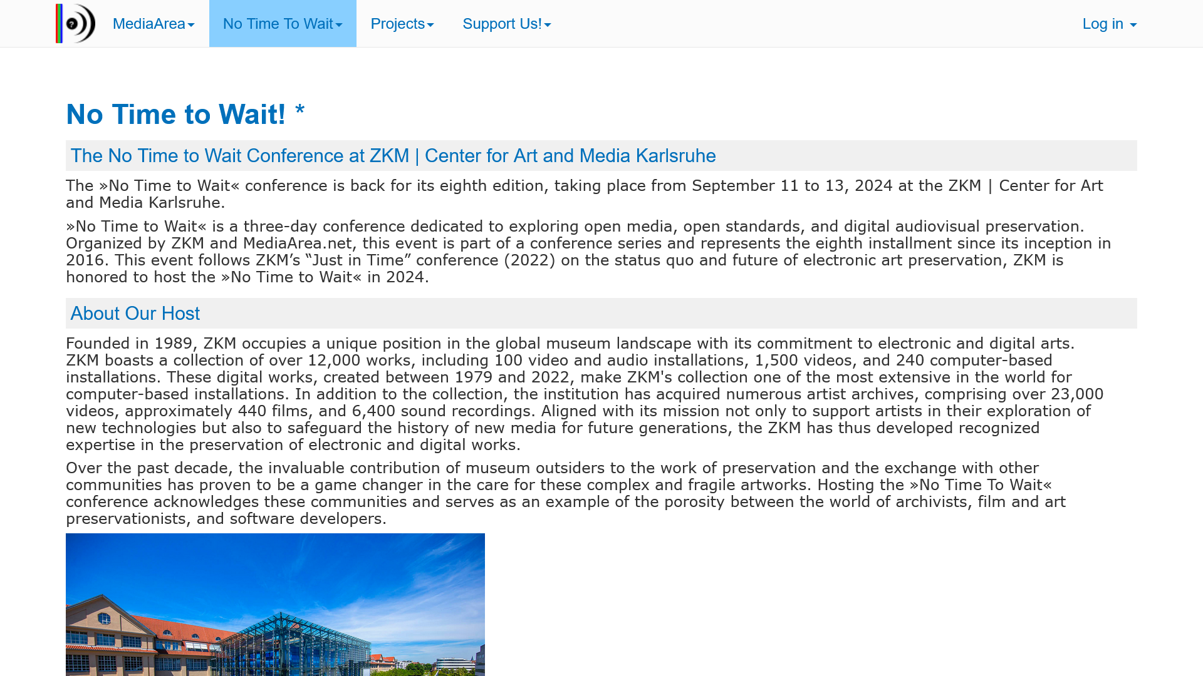
https://mediaarea.net/NoTimeToWait8

Slide 2
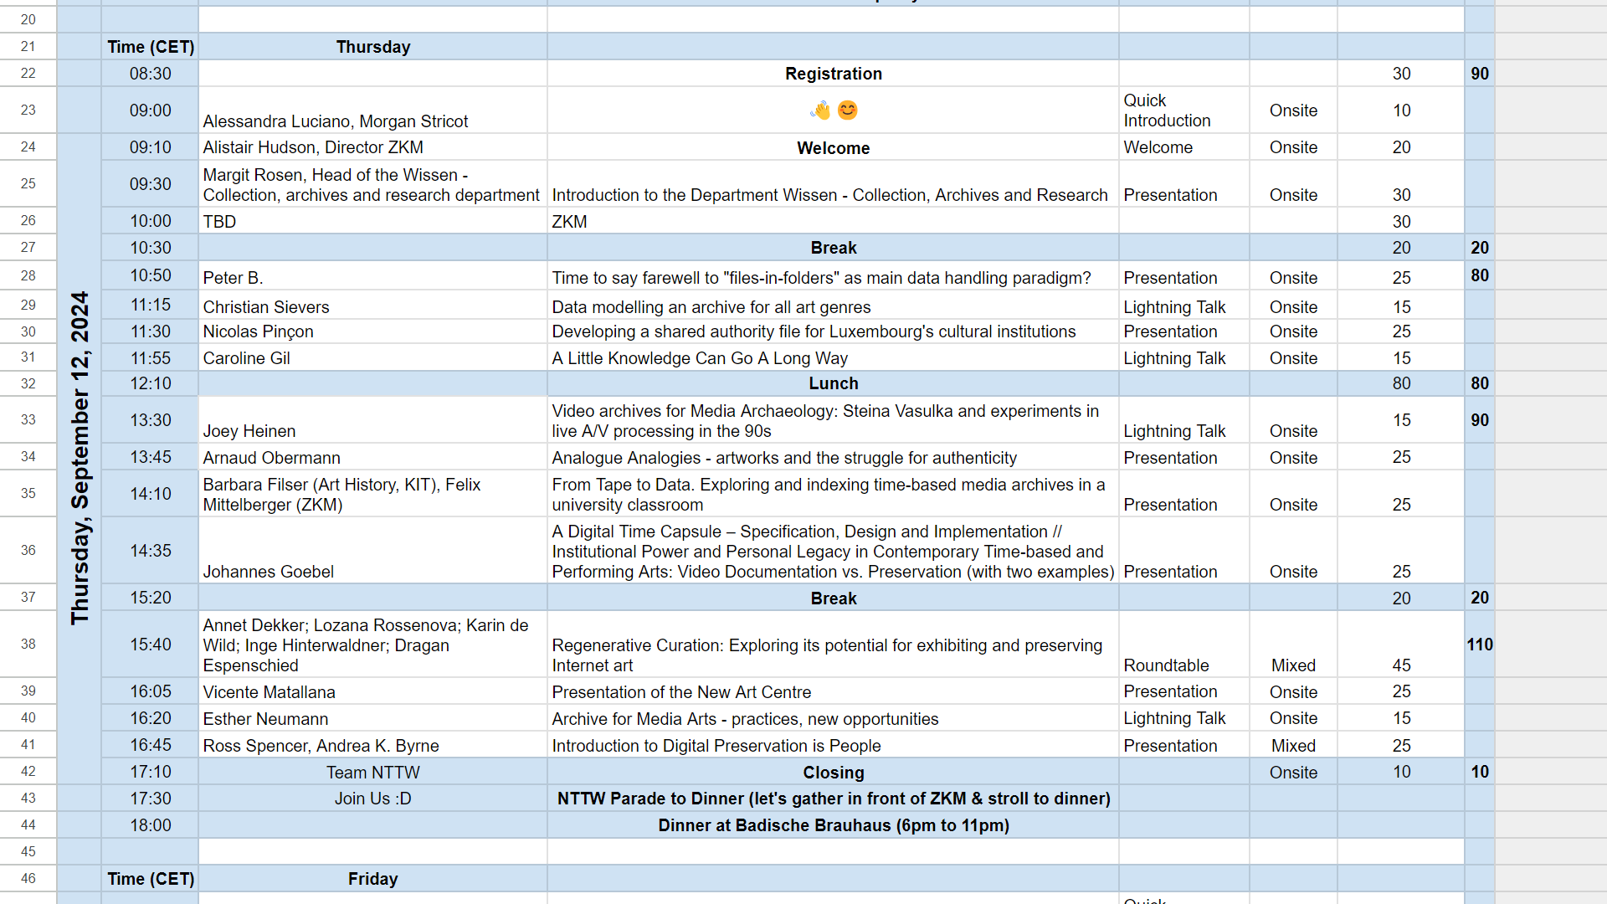
https://bit.ly/nttw8program

Slide 3
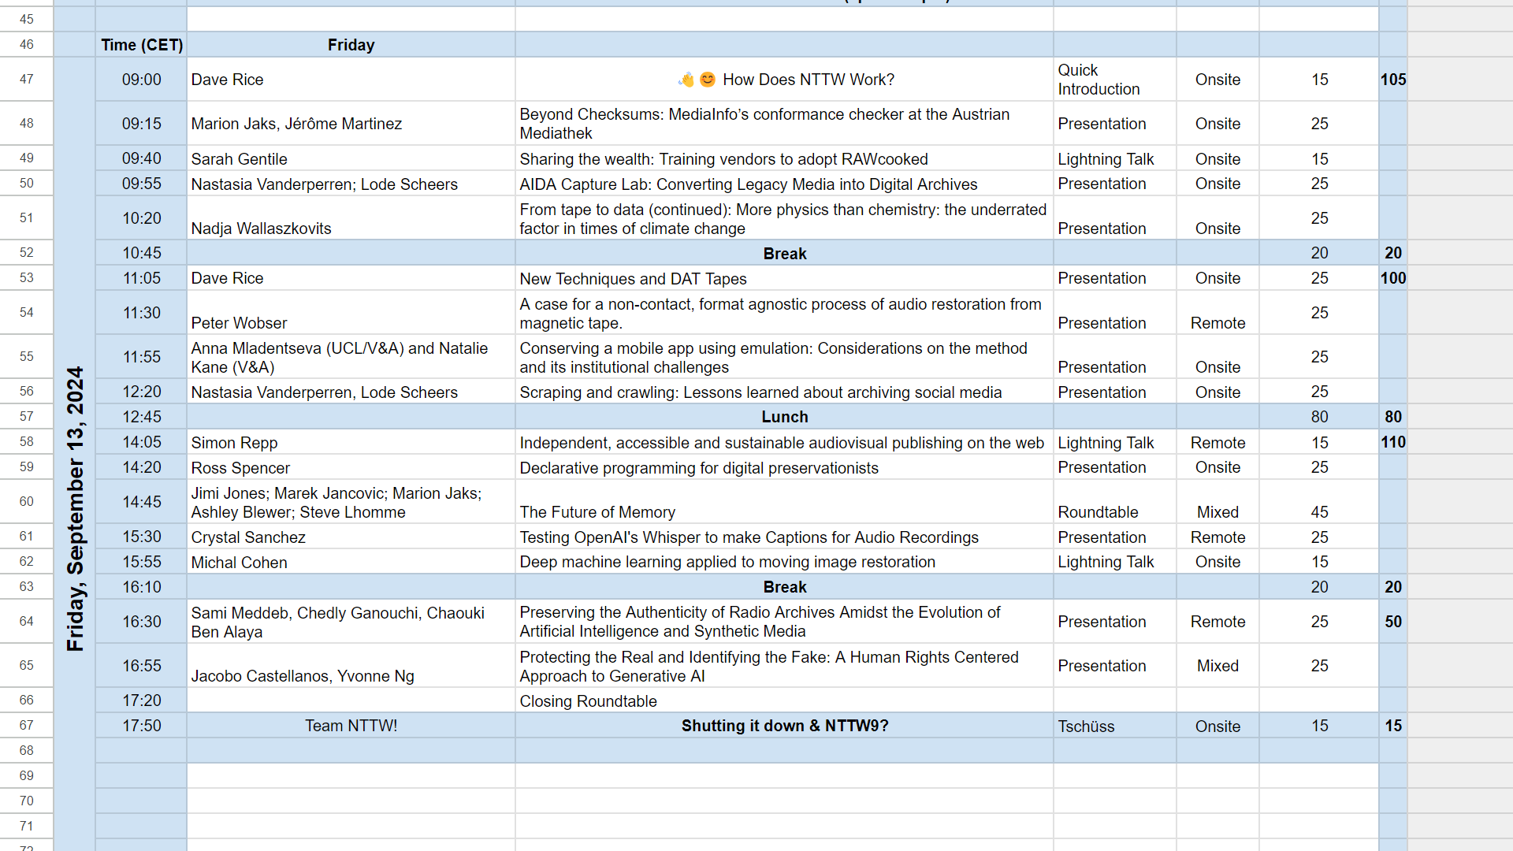
https://bit.ly/nttw8program

Slide 4
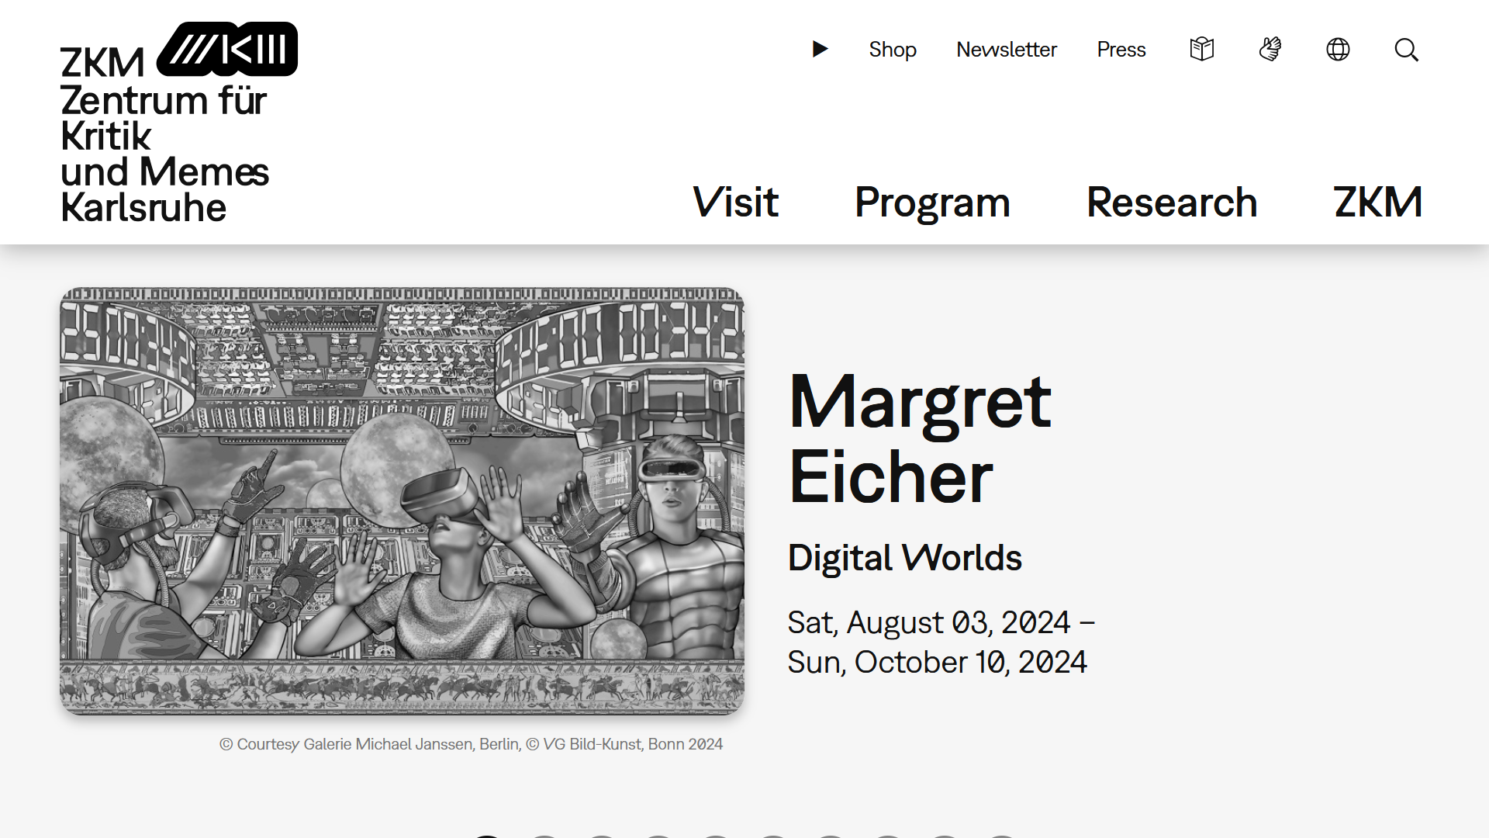
https://zkm.de

Slide 5
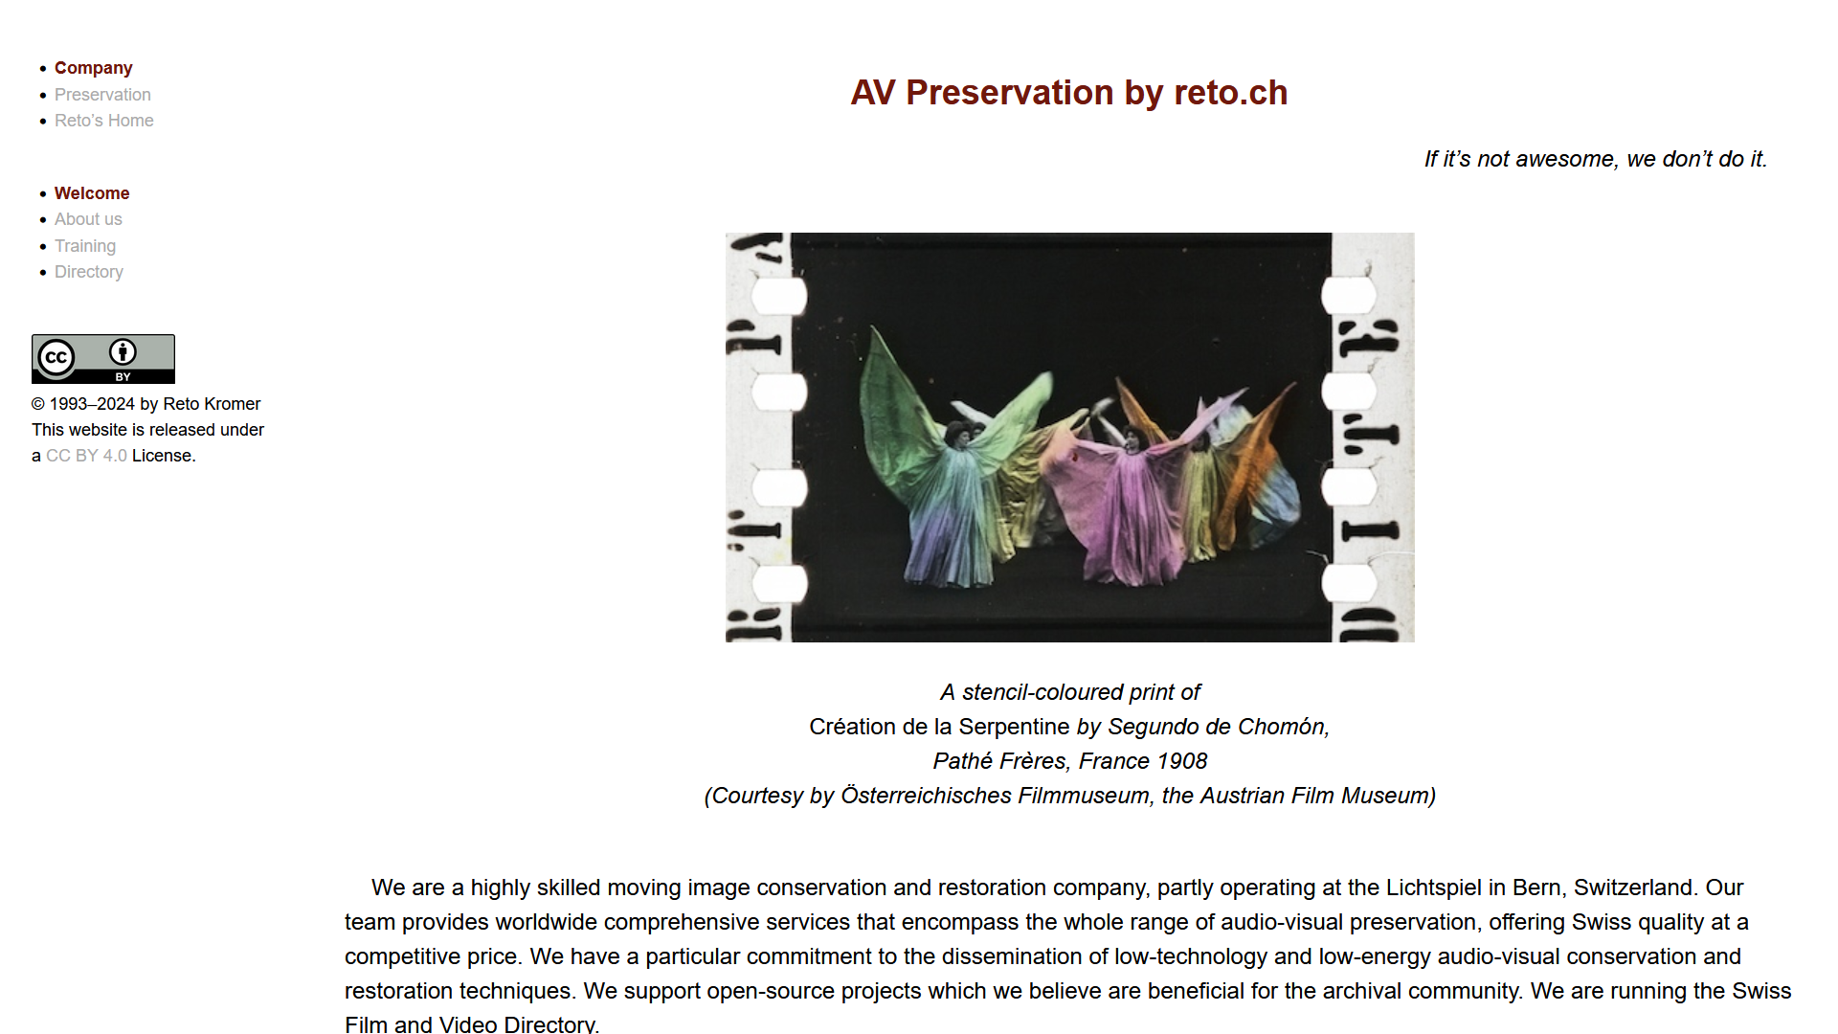
https://reto.ch

Slide 6
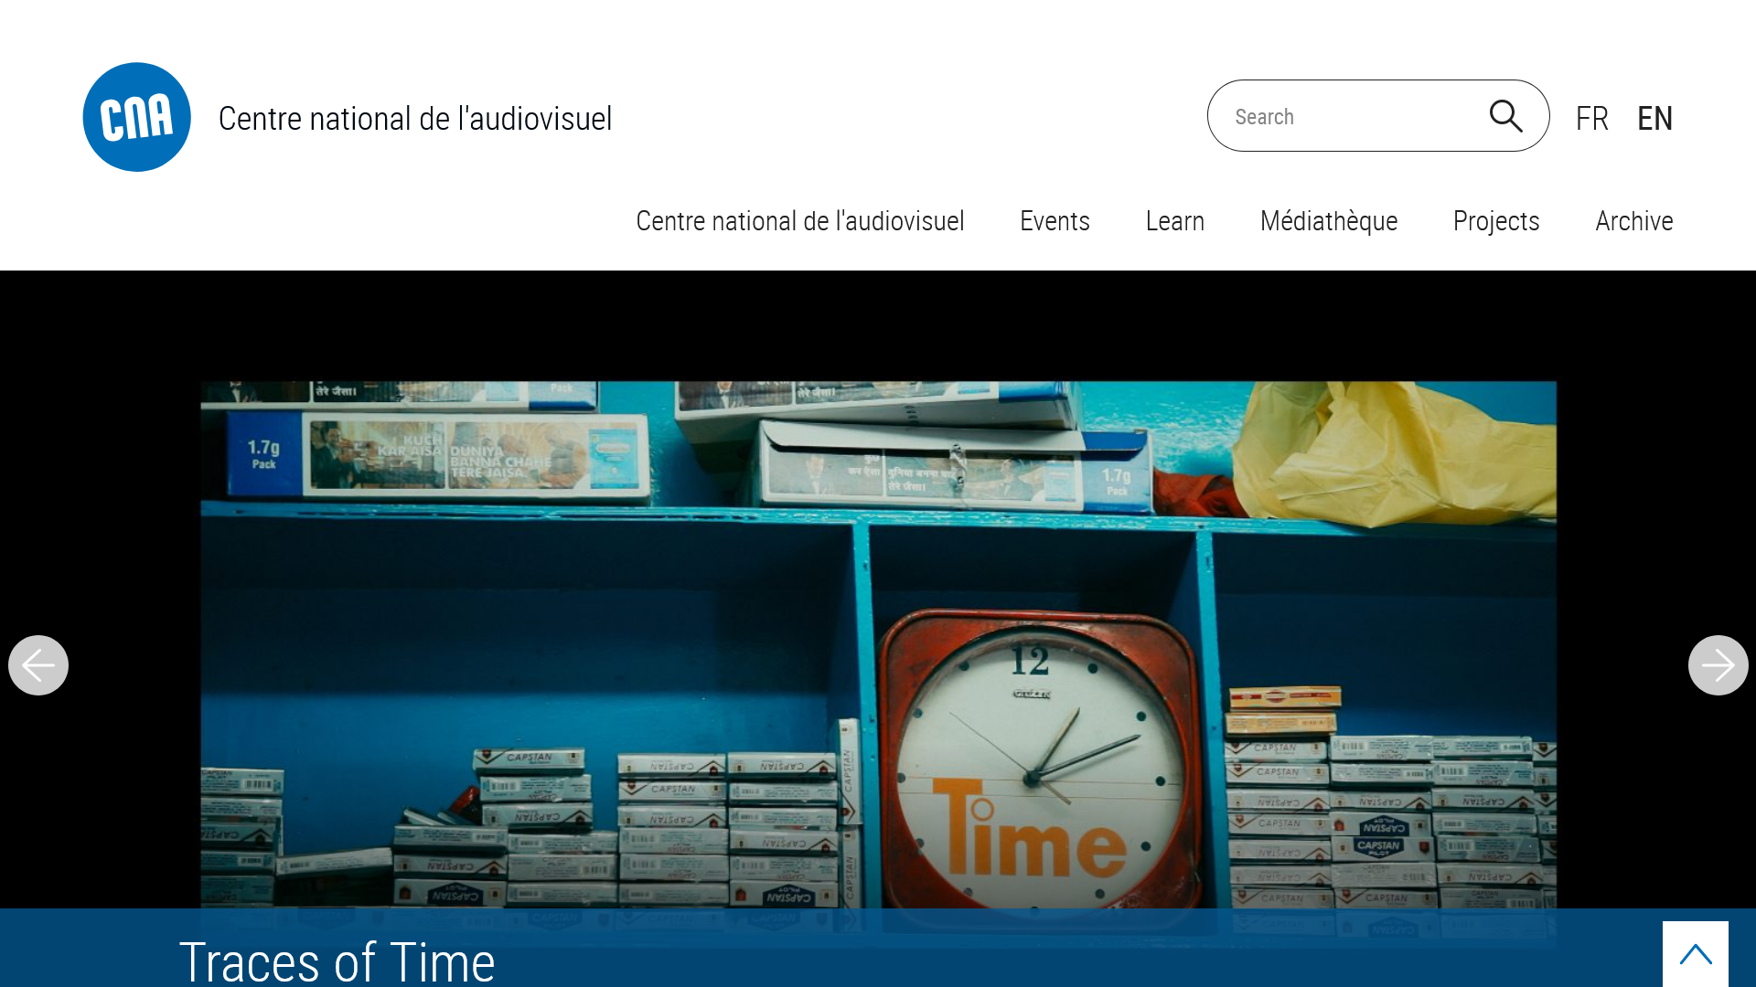
https://cna.public.lu

Slide 7
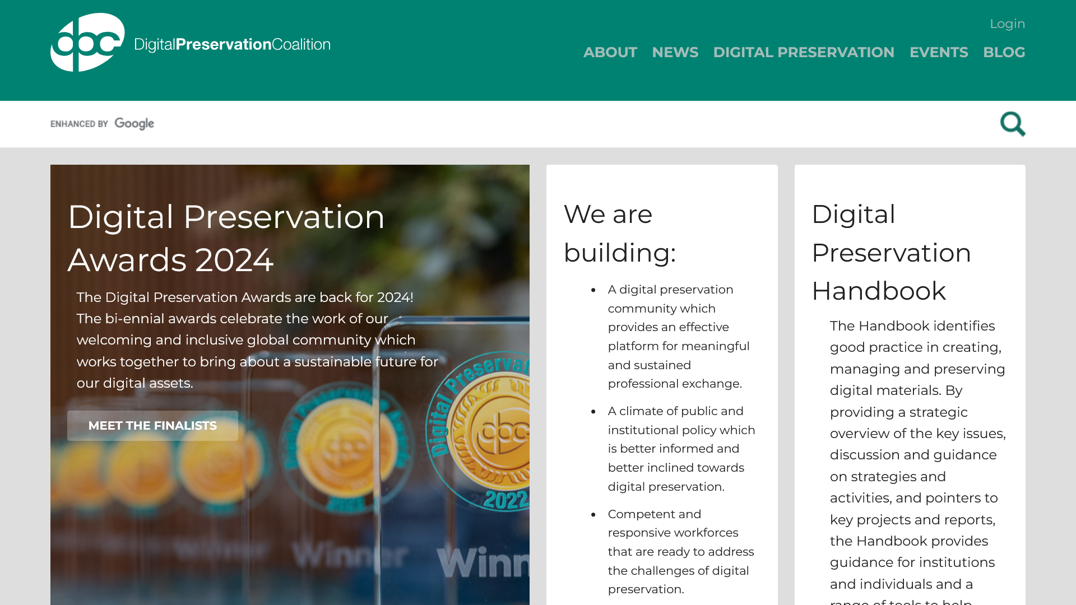
https://www.dpconline.org

Slide 8

https://memoriav.ch

