Slide 1
“Dirty Machine Learning” MQP Kickoff Meeting
Walter Gerych
August 31 2021

Slide 2
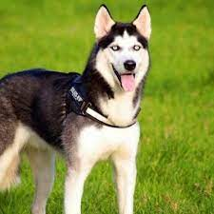
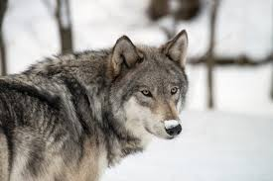
Classification
Husky
ML/DL Classifier
Wolf

Slide 3
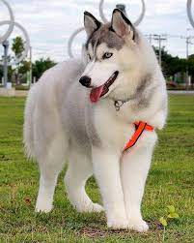
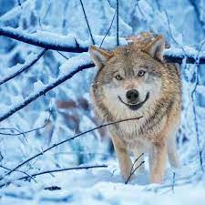
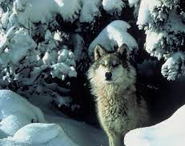
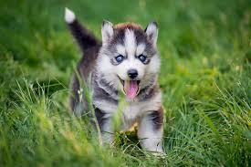
Training Data
X
Y
X
Y
Husky
Wolf
Husky
Wolf
Husky
Wolf

Slide 4
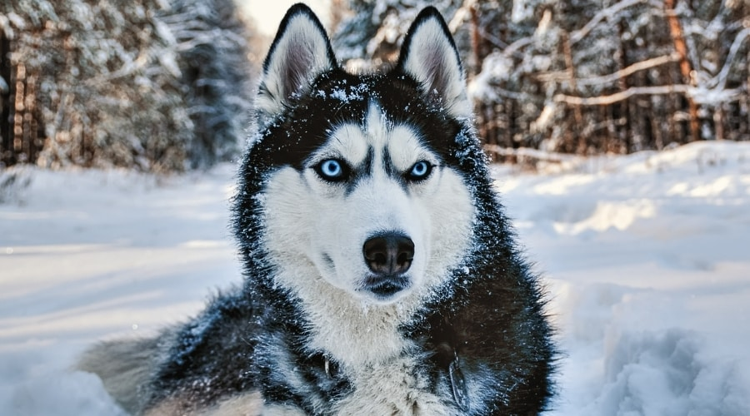
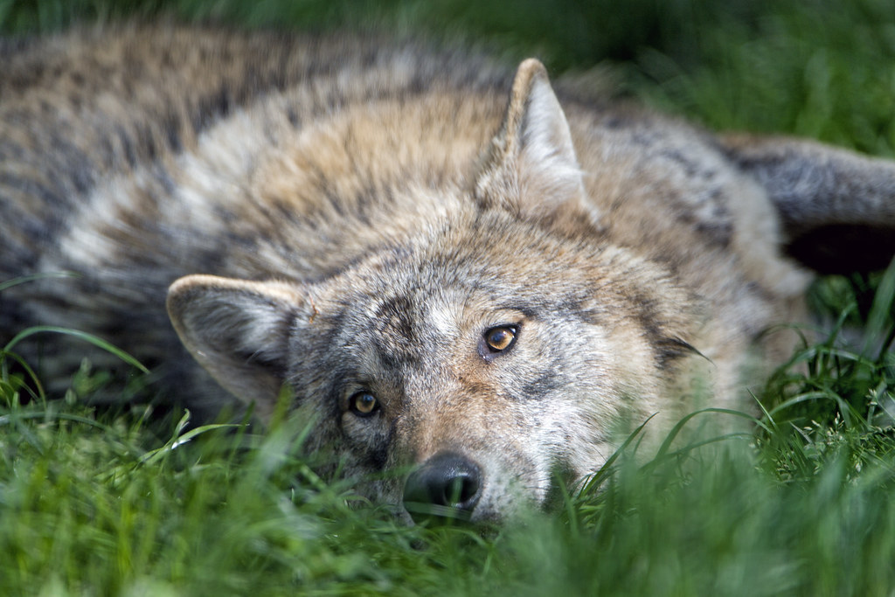
“Dirty” Training Data
Missing Labels
Wrong Labels
Incomplete Coverage
X
Y
X
Y
X
Y
X
Y
X
Y
X
Y
????
Wolf
Wolf
Wolf
Husky
Wolf
Husky
????
Husky
Wolf
Husky
Wolf
????
Wolf
Husky
Husky
Husky
Wolf
Husky
????
Husky
Wolf
Husky
Wolf
Missing

Slide 5
“Dirty” Training Data
Missing Labels
Wrong Labels
Incomplete Coverage
X
Y
X
Y
X
Y
X
Y
X
Y
X
Y
????
Wolf
Wolf
Wolf
Husky
Wolf
Husky
????
Husky
Wolf
Husky
Wolf
????
Wolf
Husky
Husky
Husky
Wolf
Husky
????
Husky
Wolf
Husky
Wolf
Missing
Some of my previous research
Focus of this MQP

Slide 6
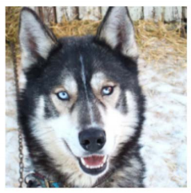
Case Study
ML/DL Classifier
Wolf
Besse, Philippe, et al. "Can Everyday AI be Ethical? Machine Learning Algorithm Fairness." Machine Learning Algorithm Fairness. 2018.

Slide 7
Case Study
ML/DL Classifier
Wolf
Explainability Process
Besse, Philippe, et al. "Can Everyday AI be Ethical? Machine Learning Algorithm Fairness." Machine Learning Algorithm Fairness. 2018.

Slide 8
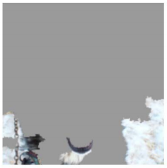
Case Study
ML/DL Classifier
Wolf
Explainability Process
Besse, Philippe, et al. "Can Everyday AI be Ethical? Machine Learning Algorithm Fairness." Machine Learning Algorithm Fairness. 2018.

Slide 9
Case Study
ML/DL Classifier
Wolf
Explainability Process
Decision based on background of image
Besse, Philippe, et al. "Can Everyday AI be Ethical? Machine Learning Algorithm Fairness." Machine Learning Algorithm Fairness. 2018.

Slide 10
Why did this happen?
X
Y
X
Y
Husky
Wolf
Husky
Wolf
Husky
Wolf
All huskies are in grass
All wolves are in snow
Besse, Philippe, et al. "Can Everyday AI be Ethical? Machine Learning Algorithm Fairness." Machine Learning Algorithm Fairness. 2018.

Slide 11

Why did this happen?
Properties of Real-World Data
X
Y
X
Y
Grass
Snow
Husky
Wolf
Husky
Wolf
Properties of Training Data
Husky
Wolf
Grass
Snow
Husky
Husky
Wolf
Wolf
All huskies are in grass
All wolves are in snow
“Incomplete Coverage”
Besse, Philippe, et al. "Can Everyday AI be Ethical? Machine Learning Algorithm Fairness." Machine Learning Algorithm Fairness. 2018.

Slide 12
How do we fix this?
Option 1: Collect more training data
Downsides:
Expensive
Time-consuming
Often impossible
Properties of Training Data
Grass
Snow
Husky
Wolf
Option 2: Generate synthetic data
Downsides:
Difficult to train generative methods
Difficult to evaluate
“Incomplete Coverage”

Slide 13
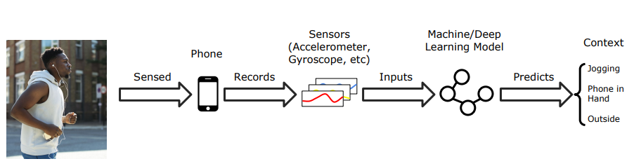
Can’t always collect more data

Slide 14






Can’t always collect more data
Activites
User

Slide 15
Controllable GANs
Training Data
Wolf
Grass
Generative Model
(Generative Adversarial Network)
All huskies in grass, all wolves in snow

Slide 16
Controllable GANs
Training Data
Wolf
Grass
Generative Model
(Generative Adversarial Network)
Generate synthetic data
Downsides:
Difficult to train generative methods
Difficult to evaluate
All huskies in grass, all wolves in snow

Slide 17
GAN Training
What we want to happen
What usually happens
Error
Error
Training Time
Training Time

Slide 18
GAN Training
What we want to happen
What usually happens
Error
Error
Training Time
Training Time

Slide 19
GAN Training
What we want to happen
What usually happens
Error
Error
Training Time
Training Time

Slide 20
Direction for MQP
Focus of MQP:
Research and develop novel training strategies for generative models
What’s been done:
One novel training strategy has been proposed by Josh + REU team
Implemented in code
Preliminary experiments
What needs to be done
Extensive set of experiments
Results on vanilla GAN, controllable GANs, etc
Generalization of code to work for other architectures
Creating easily usable PyTorch package
Theoretical analysis of method
Any provable claims?
Improvements to method
Initially developed for standard GAN - changes for controllable GAN?
Other new training strategies
An unlimited number of directions you can discover

