Slide 1



Crop Yield Prediction Using Machine Learning
County-Level Corn Yield Prediction via Meteorological and Soil Sequences
Walter Hampton III | Université Jean Monnet

Slide 2


Problem Statement: The Challenge of County-Level Forecasting
Macro-Level Importance
The Data Science Bottleneck
Accurately predicting crop yields is a cornerstone of global food security, regional economic planning, and modern agriculture. Stakeholders rely on early forecasts to anticipate supply shocks and guide trade policies.
Forecasting corn yields county-by-county is extremely difficult due to complex non-linear interactions between soil profiles, microclimates, farming techniques, and sudden weather shifts during pollination.

Slide 3



Context and Professional Motivation
Louis Dreyfus Company
M1 MLDM Research
Robust Forecasting
Aspirations to join a major global agricultural trading house where accurate bushel yield projections are vital for risk mitigation and trade execution.
Executed as an applied Master's project at Université Jean Monnet, demonstrating advanced predictive modeling for professional portfolios.
Building rigorous, leakage-free machine learning pipelines capable of handling multi-year weather and soil sequences across 778 counties.

Slide 4

Survey of the State of the Art
According to van Klompenburg et al. (2020), literature reviews indicate that temperature, rainfall, and soil makeup are the primary inputs for agricultural forecasting.
•
Standard Metrics: Evaluation relies heavily on R², RMSE, and MAE.
Key Research Takeaway
Advanced predictive models must account for underlying temporal trends to accurately assess generalizability rather than blindly tracking historical momentum.
•
Evolution: Transitioning from linear regression to tree models and deep sequence architectures.
•
Sequence Advantage: LSTMs and CNNs capture multi-year weather accumulation and long-term trends.

Slide 5

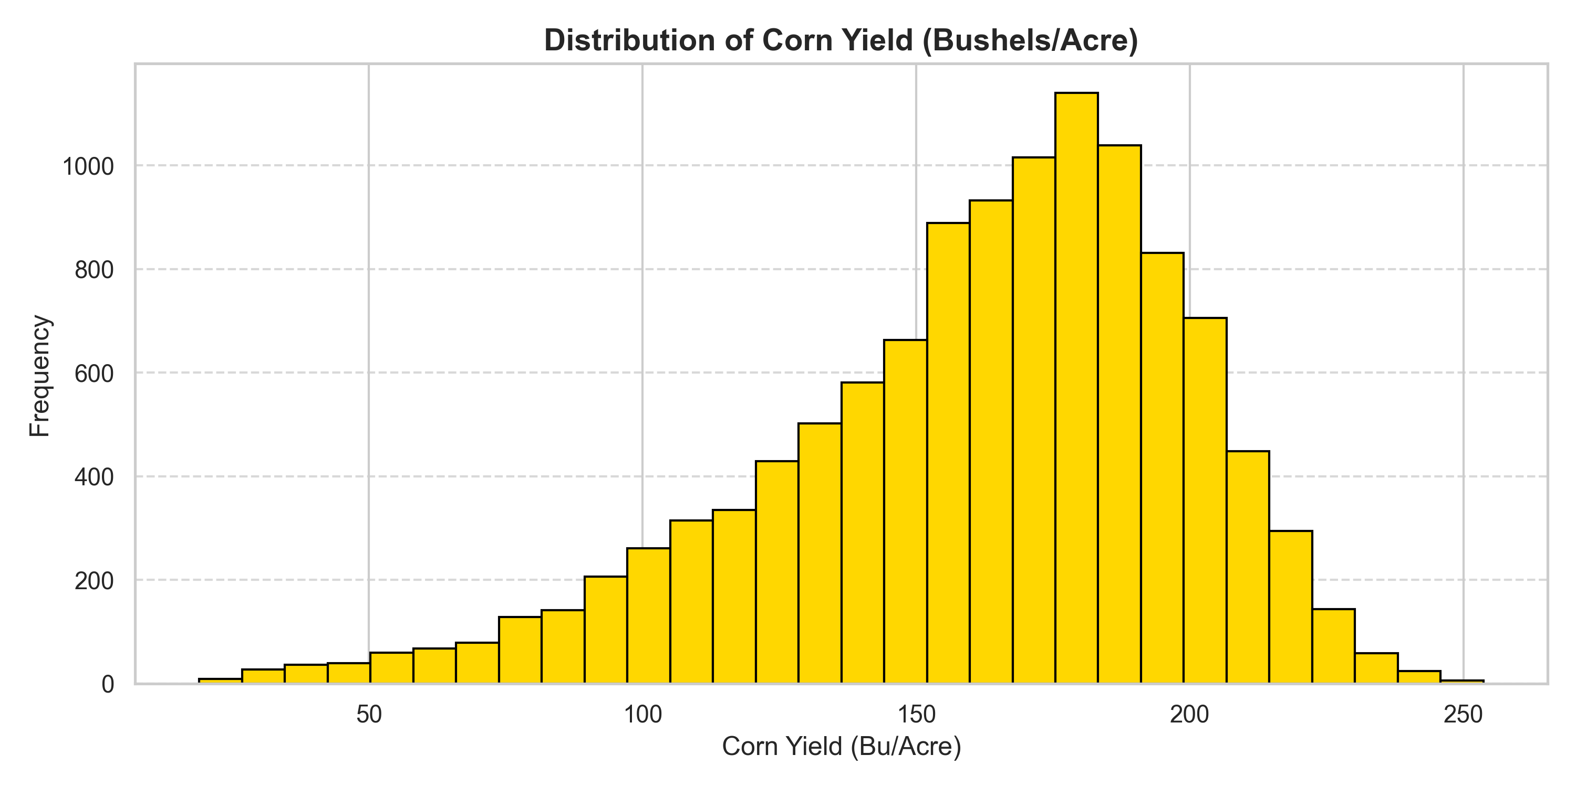

Dataset Overview: Scale, Scope, and Yield Distribution
13,736 Total Observations
778 Unique Counties
The target variable (corn yield in bushels per acre) follows a normal bell curve centered around 160–175 bu/acre, bounded by natural performance extremes across 2005–2025.

Slide 6

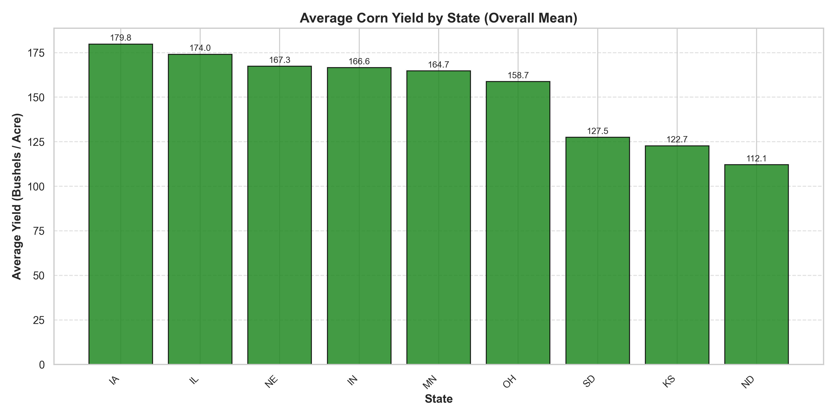
Mapping the U.S. Corn Belt & Soil Advantages
State-level aggregations clearly highlight the famous U.S. Corn Belt, with Iowa (IA) and Illinois (IL) leading near 180 bu/acre.
•
Mollisol Soils: Deep, nutrient-rich glacial soils provide exceptional moisture retention.
•
Climatic Advantage: Favorable summer rainfall paired with top-tier precision farming technology.
•
Regional Disparities: Western/northern states average lower yields due to dry climates and irrigation limits.

Slide 7


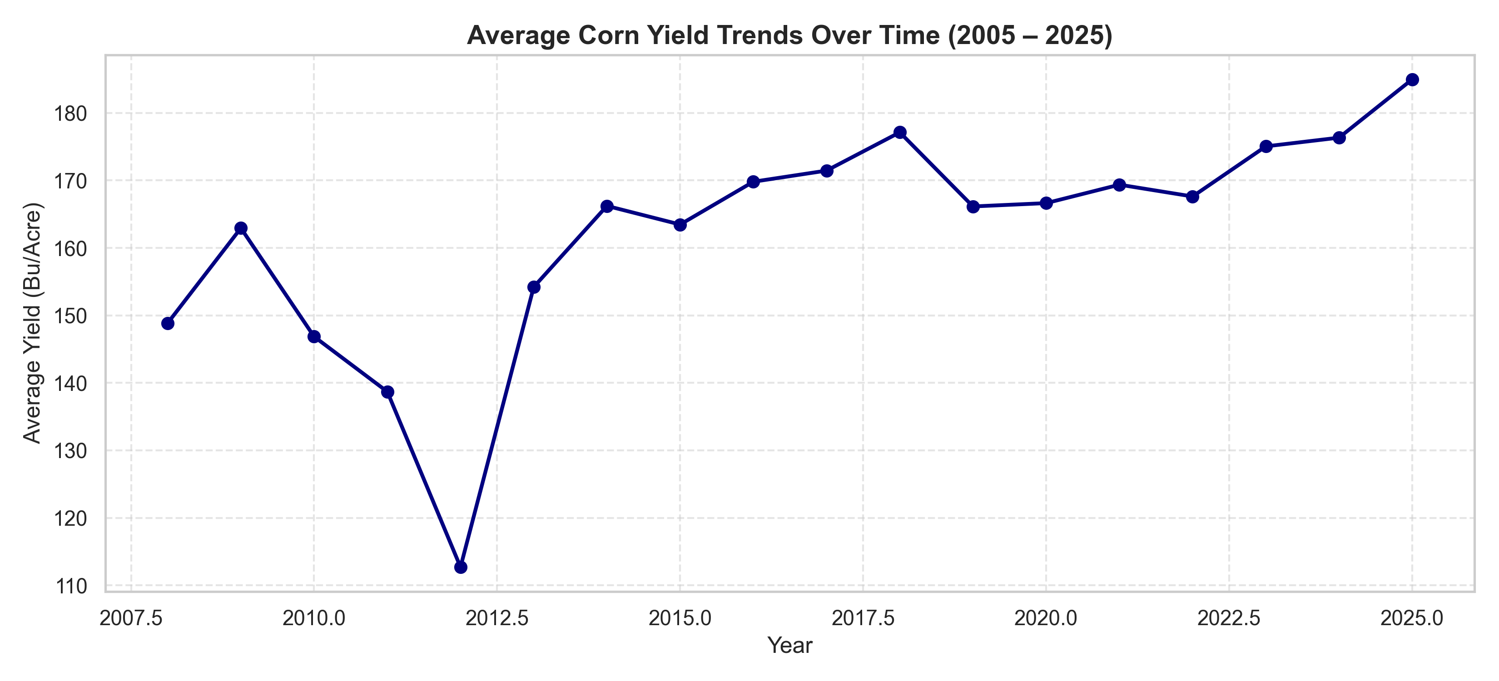

Historical Trends & Eras: Pre-Drought to Modern Era
Pre-Drought Stability
Steady productivity hovering between 140 and 160 bushels/acre.
Extreme Drought Shock
Zero rain during pollination caused national average to plummet to ~112 bu/acre.
Modern Recovery
Driven by drought-hardy seeds and smart irrigation, yields climbed toward 185 bu/acre.

Slide 8


Data Preprocessing & Chronological Splitting
2005 – 2022 (12,083 rows)
2023 – 2025 (1,653 rows)
Utilized for exploratory data analysis, expanding-window time-series cross-validation, hyperparameter tuning, and initial model training.
Strictly locked away and untouched until final out-of-sample evaluation across 696 counties to prevent data leakage.

Slide 9





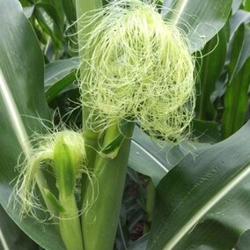

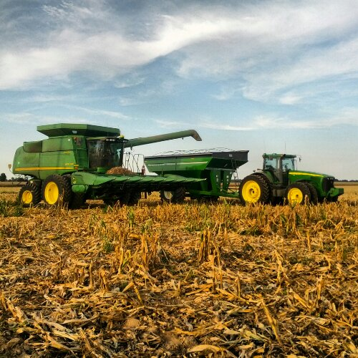
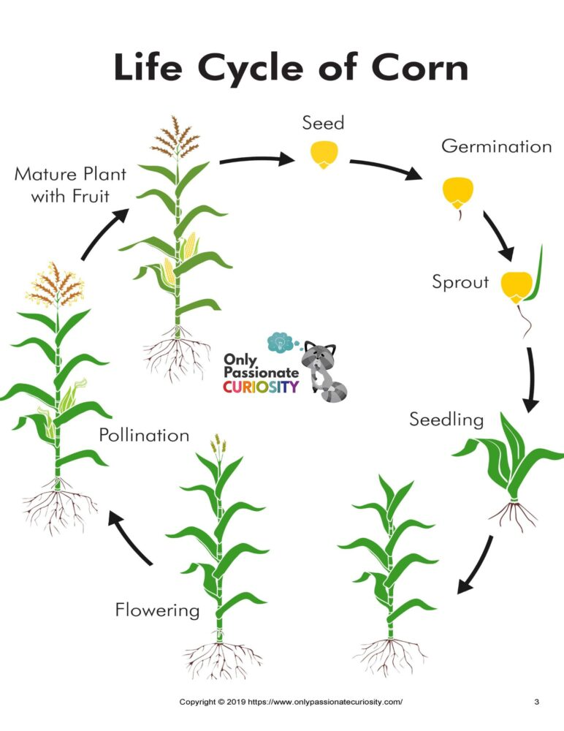
Crop Growth Stages & Plant Morphology
Recharge & Planting
Pollination
Grain Fill
Harvest
Biological Impact
Pre-season moisture accumulation and early root development.
Critical reproductive silking window highly sensitive to extreme heat.
Kernel starch accumulation determining final harvest weight.
Dry-down phase prior to commercial field collection.
Vulnerability mapped across progressive seasonal windows.

Slide 10


Leakage-Free Z-Score Weather Anomalies & Aridity
Raw weather statistics can be misleading when comparing different geographic regions with distinct baseline climates.
•
Z-Score Standardization: Measures how unusual weather is relative to each county's specific historical norm (2005–2022).
Mathematical Formulation
•
Aridity Ratios: Evaluates moisture balance via precip / (PET + 1e-5) to capture atmospheric thirst.
•
Noise Reduction: Strips background climate bias so models focus purely on severe weather swings.

Slide 11

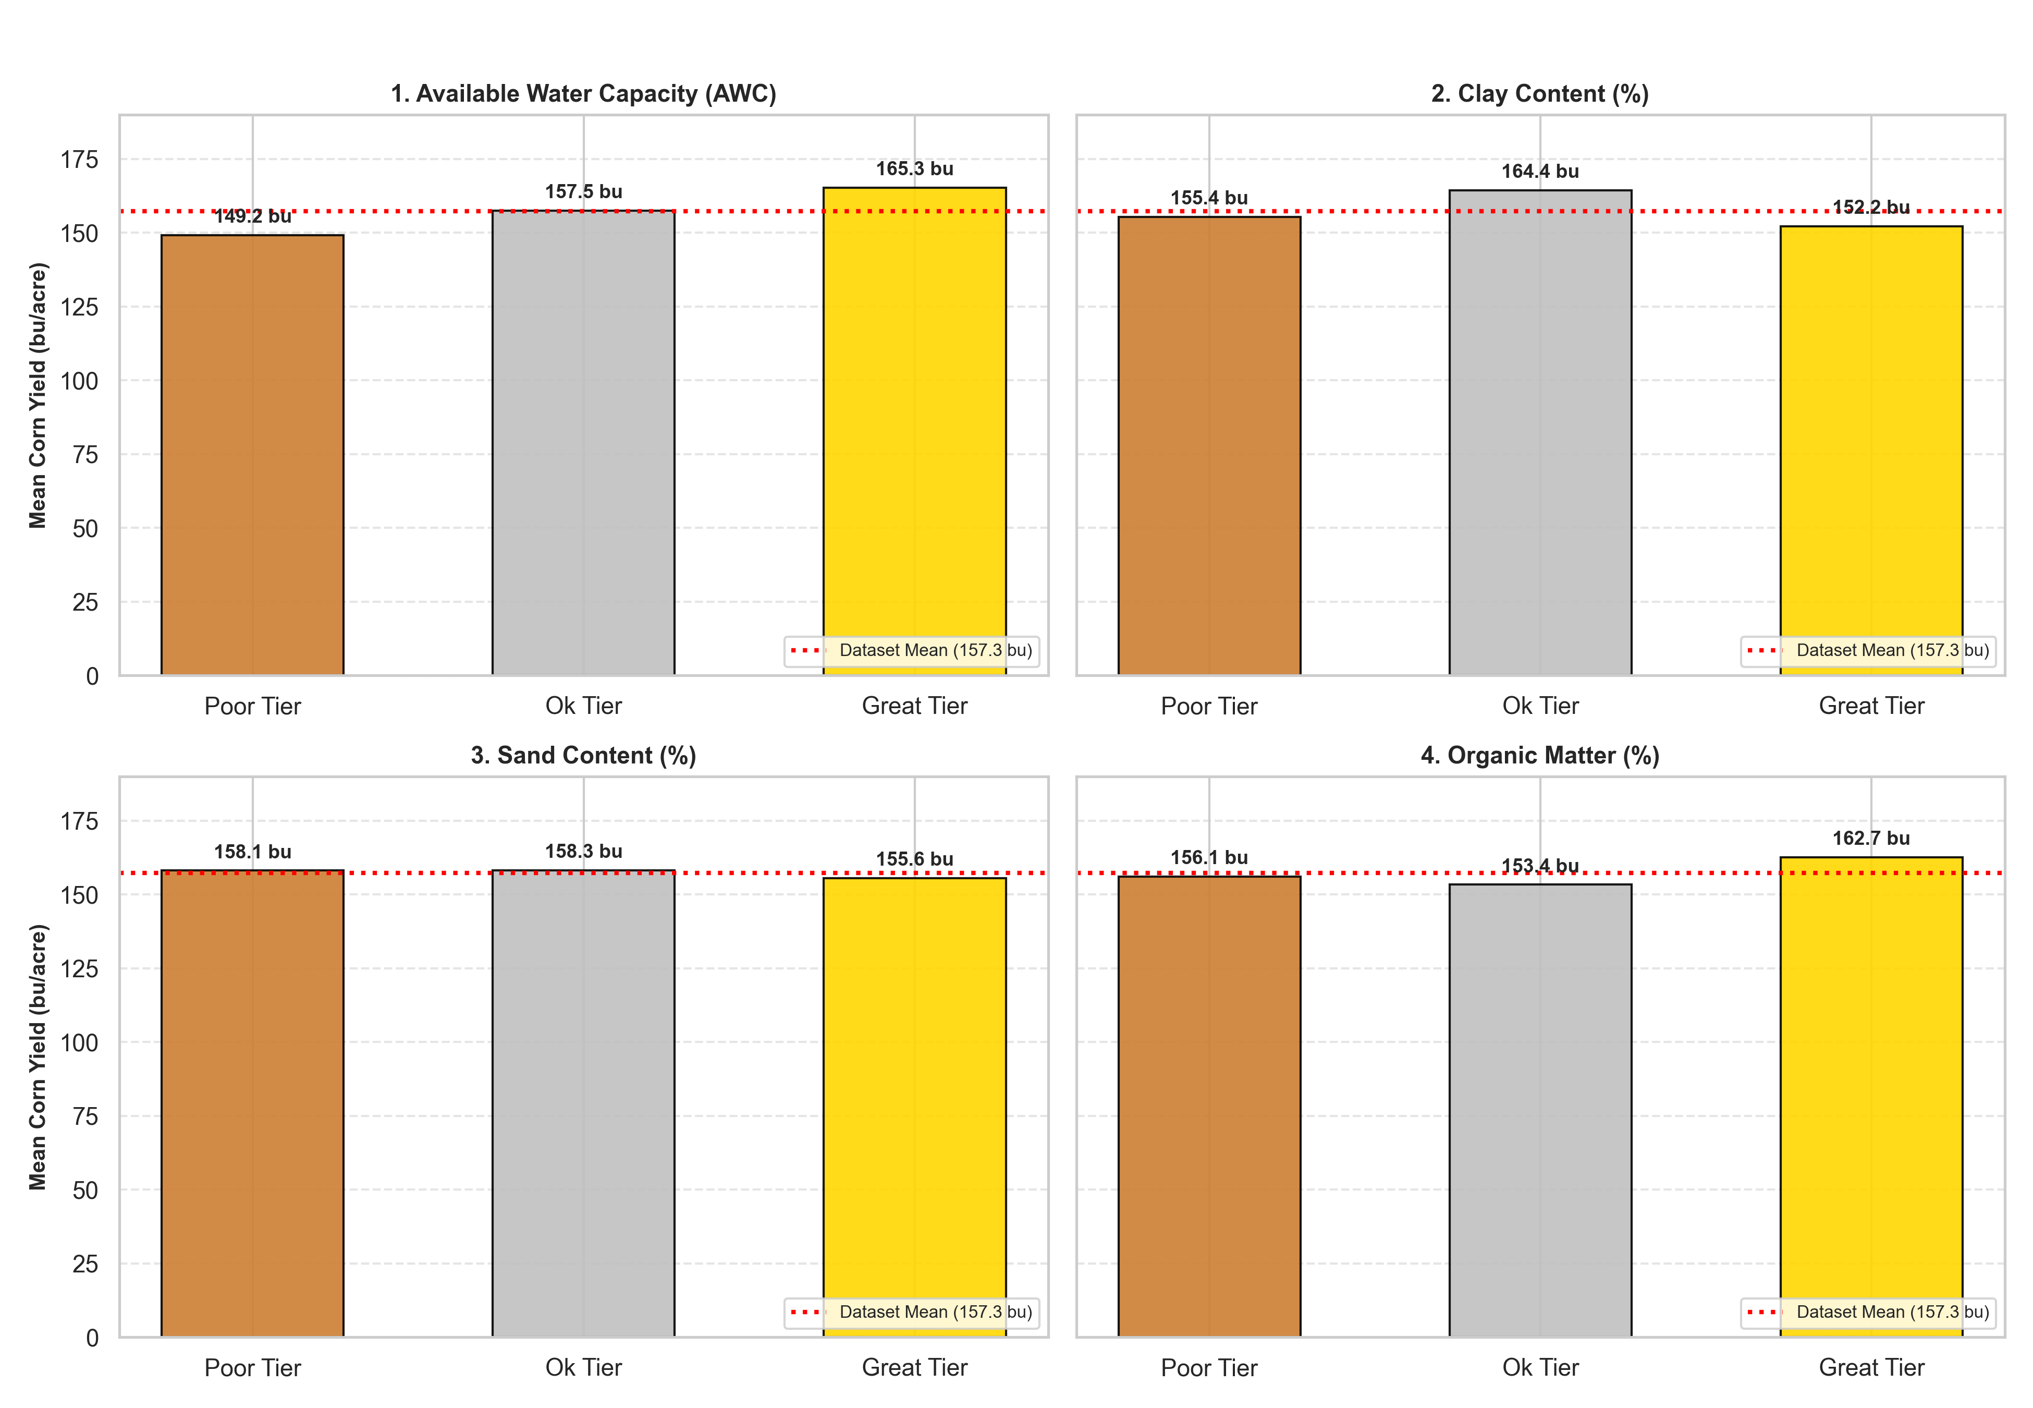

Soil Hydrology as a Buffer: USDA SSURGO AWC
Available Water Capacity
Quantifies soil moisture retention capabilities, acting as a natural sponge during dry summer spells.
Organic Matter (OM)
High organic content improves soil structure and resilience against extreme thermal stress.

Slide 12



Selection of Machine Learning & Deep Learning Techniques
Tree Ensembles
LSTM & 1D CNN
Meta-Models
Random Forest, XGBoost, and LightGBM selected for exceptional handling of messy tabular features and sharp environmental thresholds.
Custom PyTorch sequence architectures implemented to capture multi-year weather trajectories and seasonal accumulation.
Stacking regressors combining tree models with regularized Ridge Regression to smooth individual prediction variances.

Slide 13


Hyperparameter Tuning & TensorFlow/Keras Architectural Pivots
Hyperparameter Search
TensorFlow/Keras LSTM Bottleneck
Expanding-window time-series cross-validation was used to tune tree depths, learning rates, subsample ratios, and regularization parameters, ensuring models generalized cleanly across time.
Initial sequence LSTMs built in TensorFlow/Keras suffered from excessive epoch training times (>1 hour) due to high-dimensional tensor shapes, driving a successful pivot to lighter PyTorch sequence and boosted tree frameworks.

Slide 14
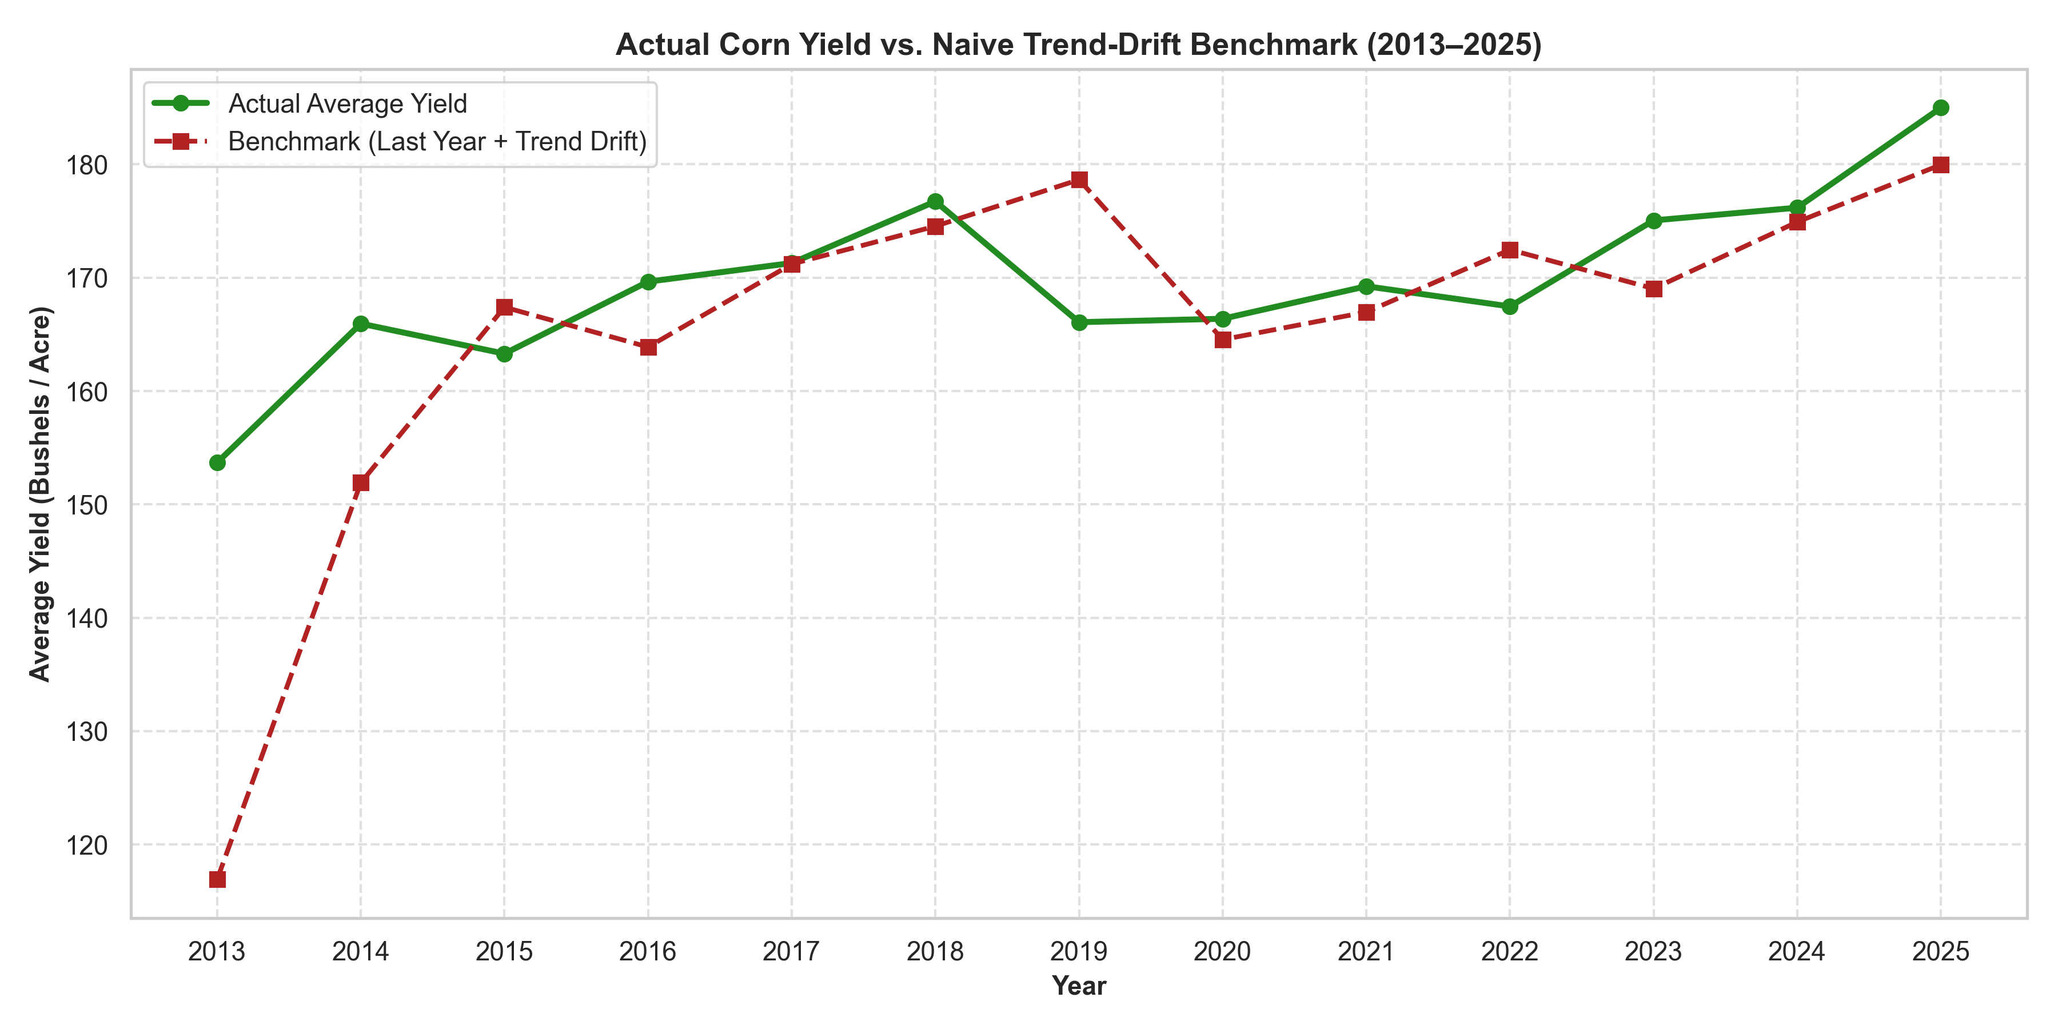
Naive Trend-Drift vs. Actual Corn Yield
We can see that the Naive Trend-Drift gets very close in some years while anomalies throw the predictions off.

Slide 15
Comprehensive Model Performance Comparison
Model Architecture | R² Score | RMSE (bu/acre) | MAE (bu/acre)
Naive Trend-Drift Benchmark | 0.604 | 23.080 | 17.635
Random Forest (Tuned) | 0.767 | 17.718 | 13.895
XGBoost Boosted Tree (Tuned) | 0.779 | 17.259 | 13.483
LightGBM Tree (Tuned) | 0.772 | 17.519 | 13.639
Stacking Ensemble (RF + XGB + LGB) | 0.769 | 17.629 | 13.667
Sequence-Based Neural Net (LSTM) | 0.652 | 20.061 | 15.895
1D Convolutional Neural Network (CNN) | 0.640 | 20.405 | 15.662
As Table 1 shows, gradient-boosted trees and ensembles beat both the basic benchmark and the deep learning setups when predicting out-of-sample county yields (2023-2025).

Slide 16
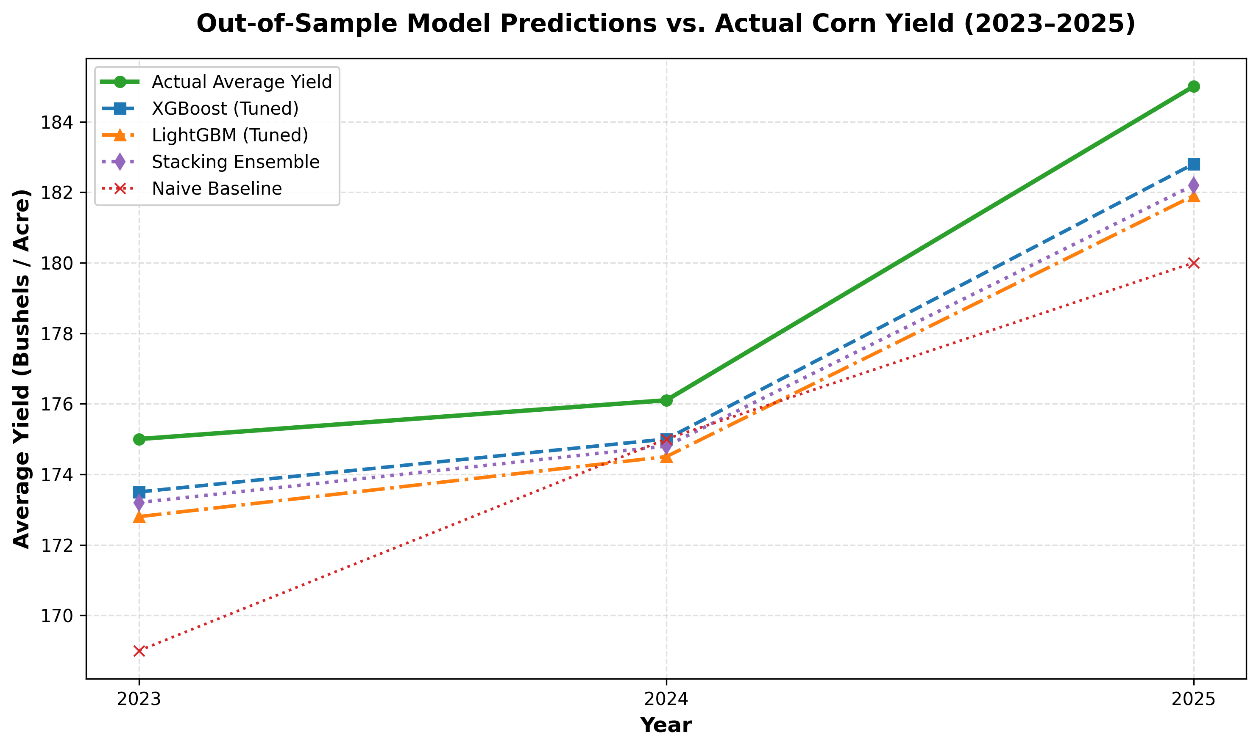
Benchmark Performance vs. Naive Trend-Drift
To give an idea a bushel of corn is about 25kg and an acre is ~4000m² .

Slide 17



Model Evaluation: Tree Ensembles vs. Neural Nets
XGBoost & LightGBM
LSTM & 1D CNN
Axis-Aligned Splits
Gradient-boosted trees achieved superior stability and predictive accuracy (R² ~ 0.78) on messy tabular features.
Sequence neural networks scored lower (R² = 0.65 and 0.59), struggling with tabular noise and smaller sample sizes.
Tree models naturally handle irregular decision boundaries and non-linear climate thresholds without scaling overhead.

Slide 18
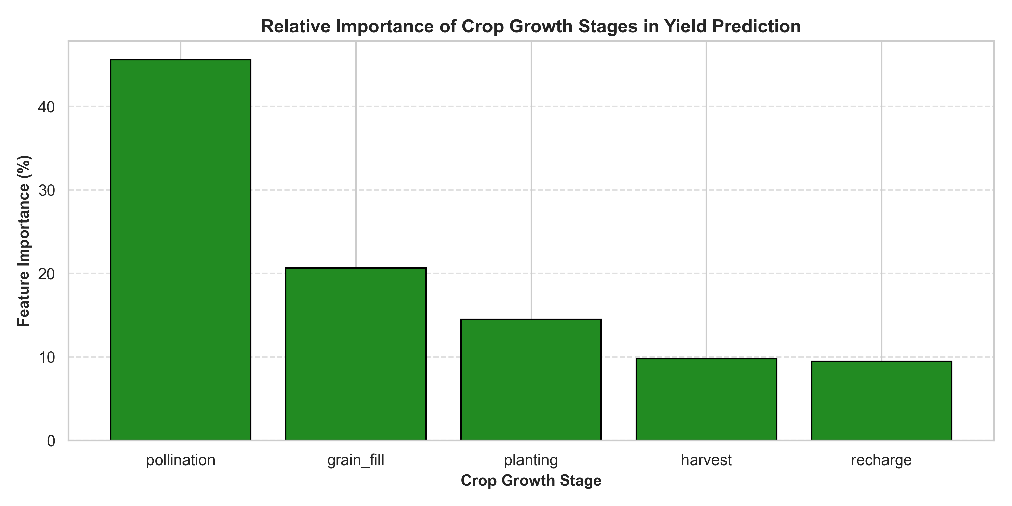
Feature Importance: Pollination & Yield Lags
•
Historical Lags: yield_lag_1 and yield_lag_3 score highest due to capturing local management habits and soil fertility.
•
Pollination Dominance: Weather during the pollination window alone drives over 45% of total predictive power.
•
Grain Fill Impact: Contributes an additional 21% of model importance during kernel weight determination.

Slide 19
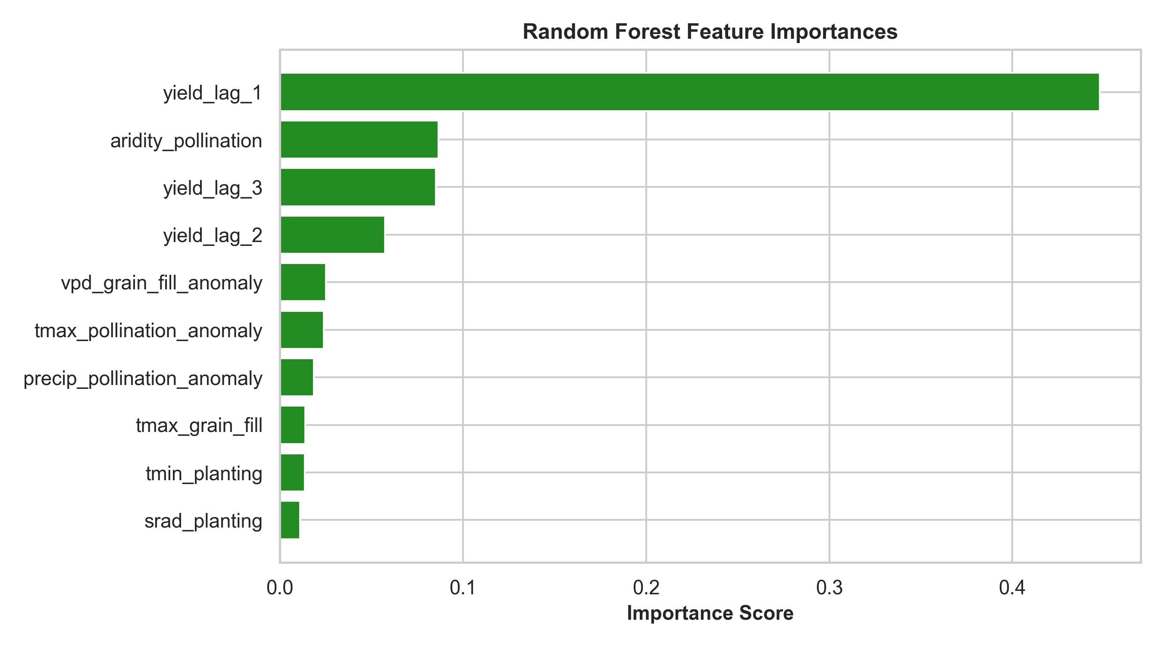
Feature Importance: Pollination & Yield Lags
•
Historical Lags: yield_lag_1 and yield_lag_3 score highest due to capturing local management habits and soil fertility.
•
Pollination Dominance: Weather during the pollination window alone drives over 45% of total predictive power.
•
Grain Fill Impact: Contributes an additional 21% of model importance during kernel weight determination.

Slide 20
What I Learned: Core Research Takeaways
Leakage Prevention
Domain Engineering
Model Suitability
Strict chronological splitting and training-only Z-scores are vital to eliminate look-ahead bias in agricultural modeling.
Aridity ratios and soil-climate interaction terms outperform raw weather totals by capturing actual plant physiological stress.
Gradient-boosted trees decisively outperform heavy neural networks on tabular farm datasets due to axis-aligned splits.

Slide 21

Project Reflection: Overcoming Architectural Hurdles
The TensorFlow LSTM Bottleneck
Generalization via Normalization
Initial sequence LSTMs in Keras suffered from high training times (>1 hour per epoch) and overfitting on tabular noise. Pivoting to lighter PyTorch structures and GBDTs unlocked stable performance.
Moving away from raw weather totals to county-level Z-score anomalies successfully resolved regional climate bias between humid and arid production zones.

Slide 22
Future Research Outlook & Next Steps
Remote Sensing
Spatial GNNs
Commercial Deployment
Integrating MODIS/Sentinel-2 NDVI, EVI, and Solar-Induced Fluorescence (SIF) for real-time canopy health monitoring.
Modeling county adjacency using Graph Neural Networks to capture cross-border weather spillovers and shared microclimates.
Deploying models into live commodity trading dashboards (e.g., Louis Dreyfus Company) for real-time risk simulation.

Slide 23

Thank You
Questions & Discussion
Walter Hampton III
M1 MLDM Student | Université Jean Monnet

