Slide 1



IN PARTNERSHIP
×
Exploratory Data Analysis
in Python
A complete, hands-on walkthrough of all four EDA chapters, applied to real regional unemployment data.
Our Data. Our Intelligence. Our Future.
Presented at Deep Learning IndabaX Botswana · 2026
PRESENTED IN COLLABORATION WITH

Slide 2





The four stages of EDA
Exploratory data analysis is the process of reviewing and cleaning data to derive insights and generate hypotheses.
1
2
3
4
Getting to Know a Dataset
Cleaning & Manipulation
Relationships in Data
Turning EDA into Action
Explore shape & types, validate categories and ranges, summarize with groupby/agg.
Handle missing data, convert types, engineer categories, and manage outliers.
Patterns over time, correlation heatmaps, scatter & KDE distributions.
Class balance, cross-tabs, new features, and forming testable hypotheses.
Exploratory Data Analysis in Python · IndabaX Botswana 2026
2

Slide 3
The dataset
Regional unemployment — monthly, Jan to Oct 2020. Each row is one region in one month.
Column
Description
Type
State
The state / region
string
267
27
Date
Month of observation
datetime
observations
regions
Unemployment_Rate
Estimated unemployment %
float
Employed
Estimated number employed
int
Labour_Participation_Rate
% of population in labour force
float
5
76%
Zone
Geographic zone (N/S/E/W/NE)
string
zones
peak rate
Exploratory Data Analysis in Python · IndabaX Botswana 2026
3

Slide 4
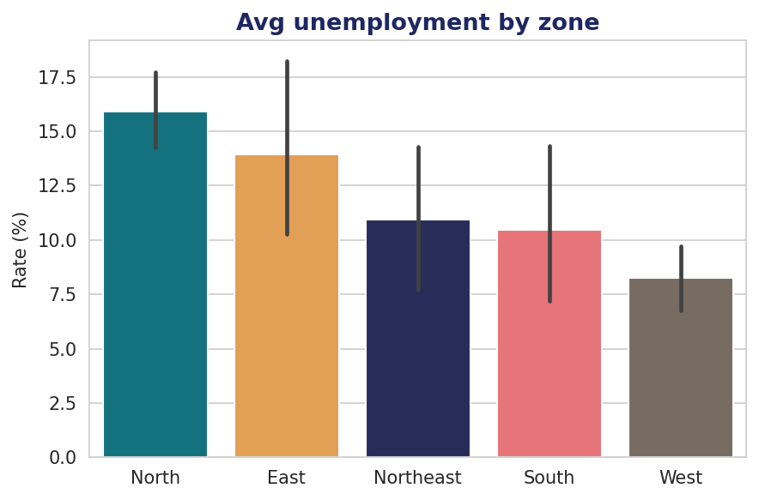
Chapter 1
Getting to Know a Dataset
First contact: shape, types, validation, and summaries
1
Explore. .head(), .info(), .describe() reveal structure & dtypes.
2
Count. .value_counts() and .nunique() profile categories.
3
Validate. .isin() checks categories; .min()/.max() check ranges.
4
Summarize. groupby().agg() with named aggregations per zone.
Exploratory Data Analysis in Python · IndabaX Botswana 2026
4

Slide 5
Chapter 1
Getting to Know a Dataset — implementation
Six core techniques, with code · rate = Unemployment_Rate for brevity
1
1. Initial exploration
2
2. Count categorical values
df.head()
df.info()
df.describe()
df["Zone"].value_counts()
df["State"].nunique()
3
3. Detect data types
4
4. Validate categories with .isin()
df.dtypes
df.info() # non-null + dtype
zones = ["North","South","East",
"West","Northeast"]
df["Zone"].isin(zones).all()
5
5. Validate numeric range
6
6. Named group aggregations
df["rate"].min()
df["rate"].max()
sns.boxplot(data=df, x="rate")
df.groupby("Zone").agg(
avg=("rate","mean"),
std=("rate","std"))
Exploratory Data Analysis in Python · IndabaX Botswana 2026
5

Slide 6
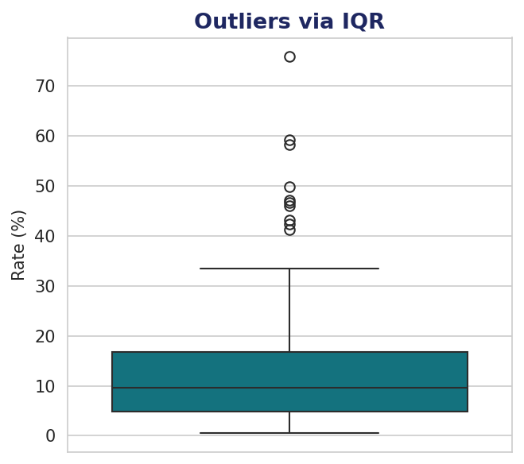
Chapter 2
Data Cleaning & Manipulation
Missing data, type conversion, feature creation, outliers
1
Missing data. Drop if <5%; else impute mean/median/mode, or by sub-group.
2
Categoricals. .str.contains() + np.select() build new labels.
3
Numerics. .str.replace().astype(float); attach stats via .transform().
4
Outliers. IQR rule flags extremes beyond 1.5×IQR of the quartiles.
Exploratory Data Analysis in Python · IndabaX Botswana 2026
6

Slide 7
Chapter 2
Data Cleaning & Manipulation — implementation
Six core techniques, with code · rate = Unemployment_Rate for brevity
1
1. Check for missing values
2
2. Drop rows missing ≤5%
df.isna().sum()
thresh = len(df) * 0.05
cols = df.columns[df.isna().sum() <= thresh]
df.dropna(subset=cols, inplace=True)
3
3. Impute a summary statistic
4
4. Impute by sub-group
df["rate"].fillna(df["rate"].median())
df["Zone"].fillna(df["Zone"].mode()[0])
df["rate"] = df["rate"].fillna(
df.groupby("Zone")["rate"]
.transform("median"))
5
5. New category with np.select
6
6. Flag outliers with IQR
conds = [df["State"].str.contains("Punjab"),
df["State"].str.contains("Kerala")]
df["Region"] = np.select(conds,
["North","South"], default="Other")
q1,q3 = df["rate"].quantile([.25,.75])
iqr = q3 - q1
upper = q3 + 1.5*iqr
out = df[df["rate"] > upper]
Exploratory Data Analysis in Python · IndabaX Botswana 2026
7

Slide 8
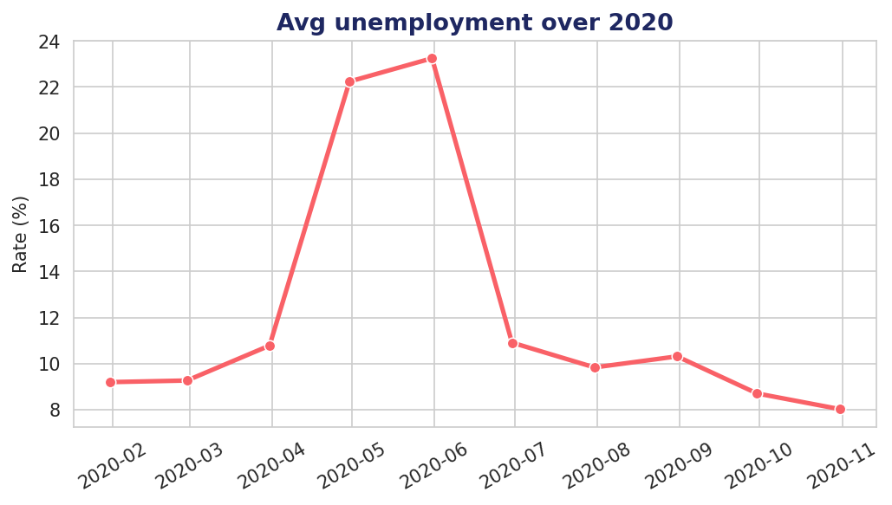
Chapter 3
Relationships in Data
How variables move together — over time and in strength
1
Over time. to_datetime() + lineplot expose the 2020 lockdown spike.
2
Correlation. .corr() + heatmap show direction & strength.
3
Scatter. scatterplot & pairplot for numeric relationships.
4
Distributions. stripplot & kdeplot reveal per-group spread.
Exploratory Data Analysis in Python · IndabaX Botswana 2026
8

Slide 9
Chapter 3
Relationships in Data — implementation
Six core techniques, with code · rate = Unemployment_Rate for brevity
1
1. Convert to DateTime
2
2. Extract date parts
df["Date"] = pd.to_datetime(
df["Date"], format="%d-%m-%Y")
df["month"] = df["Date"].dt.month
df["quarter"] = df["Date"].dt.quarter
3
3. Relationships over time
4
4. Correlation heatmap
m = df.groupby("Date")["rate"].mean()
sns.lineplot(data=m.reset_index(),
x="Date", y="rate")
corr = df[num_cols].corr()
sns.heatmap(corr, annot=True,
cmap="coolwarm")
5
5. Scatter & pairplot
6
6. KDE distribution by group
sns.scatterplot(data=df, x="lpr",
y="rate", hue="Zone")
sns.pairplot(df[num_cols])
sns.kdeplot(data=df, x="rate",
hue="Zone", fill=True)
Exploratory Data Analysis in Python · IndabaX Botswana 2026
9

Slide 10
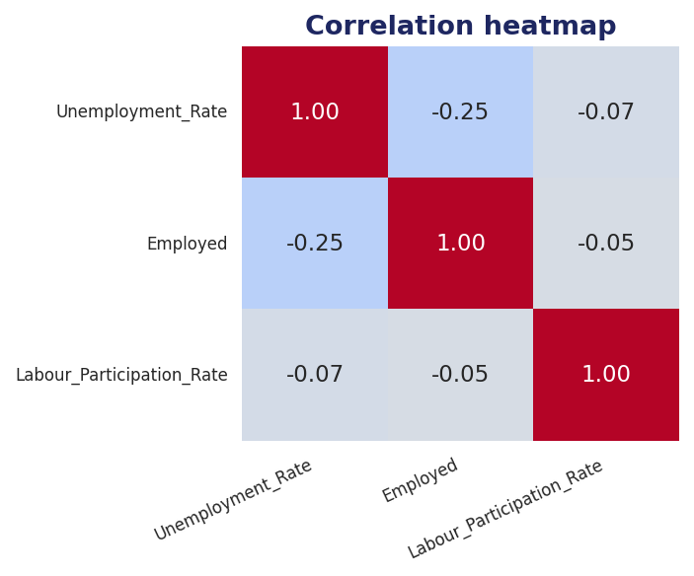
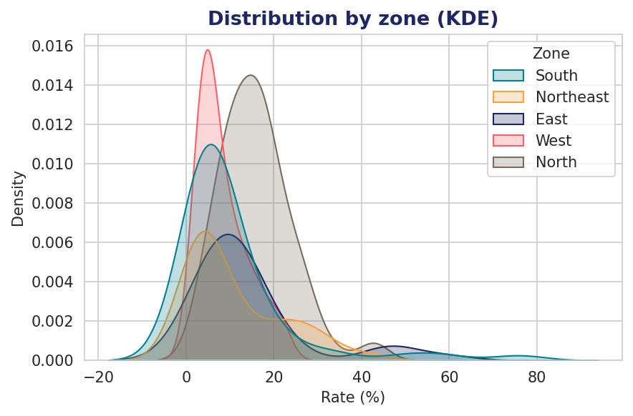
Relationships — seeing the structure
Two views of the same data: correlation between measures, and the distribution of unemployment across zones.
Exploratory Data Analysis in Python · IndabaX Botswana 2026
10

Slide 11
Chapter 4
Turning EDA into Action
From exploration to decisions and hypotheses
1
Class balance. value_counts(normalize=True) checks for imbalance.
2
Cross-tabs. pd.crosstab() relates two categoricals, or aggregates a value.
3
New features. pd.cut() percentile bands; extract date & lockdown flags.
4
Hypotheses. Compare groups to frame concrete, testable questions.
Exploratory Data Analysis in Python · IndabaX Botswana 2026
11

Slide 12
Chapter 4
Turning EDA into Action — implementation
Six core techniques, with code · rate = Unemployment_Rate for brevity
1
1. Check class imbalance
2
2. Cross-tabulation
df["Region"].value_counts(
normalize=True)
pd.crosstab(df["Zone"],
df["rate_band"])
3
3. Percentile bands with cut
4
4. Generate new features
df["band"] = pd.cut(df["rate"],
bins=[0,5,10,20,100],
labels=["Low","Mod","High","VHigh"])
df["lockdown"] = df["month"] \
.isin([4,5]).astype(int)
5
5. Extract features for corr
6
6. Compare groups → hypothesis
df[["rate","lockdown","month"]] \
.corr()
df.groupby("lockdown")["rate"] \
.agg(["mean","median"])
Exploratory Data Analysis in Python · IndabaX Botswana 2026
12

Slide 13

Where exploration leads: testable hypotheses
H1
Lockdown effect
Unemployment in Apr–May 2020 is significantly higher than in other months.
H2
Regional gap
Northern-zone unemployment is systematically higher than Western-zone.
H3
Participation trade-off
Higher labour participation is associated with lower measured unemployment.
EDA is not the end — it is the foundation for the questions worth answering next.

Slide 14

The EDA toolkit at a glance
Explore & validate
.head() .info() .describe() · .value_counts() .nunique() · .isin() · groupby().agg()
Clean & transform
.isna().sum() · .fillna() / sub-group impute · .str.contains() np.select · .transform() · IQR
Relate & visualize
pd.to_datetime() .dt · lineplot · .corr() heatmap · scatterplot pairplot · kdeplot
Act
value_counts(normalize) · pd.crosstab() · pd.cut() · feature engineering · hypotheses
Exploratory Data Analysis in Python · IndabaX Botswana 2026
14

Slide 15



Ke a leboga!
Thank you — from raw data to real questions
Four chapters. One workflow. A companion Jupyter notebook runs every technique end-to-end on this dataset.
Deep Learning IndabaX Botswana · IndabaX Zimbabwe · Data Science Zimbabwe

