Slide 1
Distributed Test Environment: a Framework for Testing Distributed Systems
Jon Beverly
Maurice Roth-Miller
Walter Scarborough

Slide 2
Agenda
Introduction
Background
Framework
Experiment
Future Work
Questions

Slide 3
Introduction
Conventional testing methods may not necessarily cover distributed system fault tolerance.
We have created a testing tool called “Distributed Test Environment” (DTE) that gives developers the ability to inject faults into messages passed in a distributed system.
Our tool intercepts TCP messages passed in socket connections, and can therefore work with a target program written in any language, and without any modifications being done to its source code.

Slide 4
Background
We surveyed other distributed system testing approaches and tools:
Netflix’s “Chaos Monkey” system randomly crashes nodes. [1] [2]
Interesting approach, but we wanted developers to have more control and to be able to rerun tests deterministically.
Researchers at Lancaster University have experimented with automatically inserting and removing test harnesses from distributed system nodes. [3]
Another interesting approach, but we did not want to be tied down to a specific target language for target programs.
DTE addresses the weaknesses in other testing approaches:
Users can select the fault(s) that they are interested in testing.
No modifications to target programs are necessary.
Any program that uses TCP sockets is supported - there are no constraints on implementation languages.

Slide 5
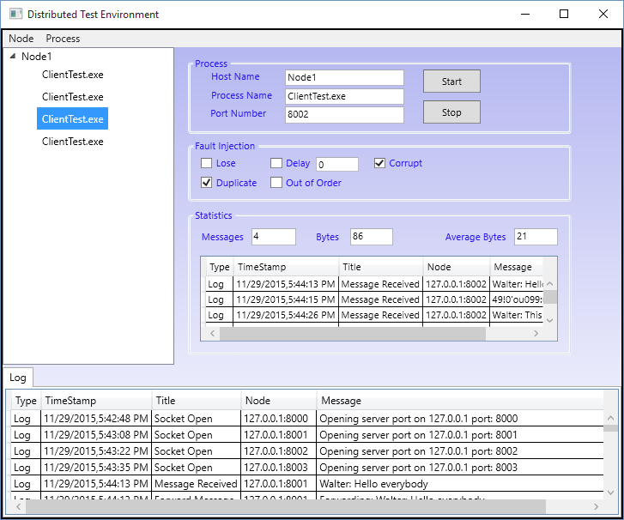
Framework
C#, WPF, XAML, MVVM [4] [5]
Models
Fault Injection
Routing
Statistics
Process
Node
Log
Server/Client TCP Sockets
Internal and External nodes and processes

Slide 6
Experiment - Using DTE to Debug Circle Chat
We created a ring network based chat program called “Circle Chat” using node.js to exercise our DTE tool. [6] [7]
Chat program messages are simple, intuitive, and offer immediate visual feedback.
Every DTE message manipulation feature was tested with Circle Chat.
We found interesting and unexpected results - testing with DTE helped fix two unknown bugs in the Circle Chat program! (nodes would crash when encountering corrupt messages, and were not closing TCP sockets properly)
Serves as an example of debugging a distributed program with DTE!
Notes:
DTE message manipulation features include: lose a message, delay sending a message, corrupting a message, duplicating a message, and delivering messages out of order

Slide 7
Experiment - Circle Chat Overview
Circle Chat rules
Each node points at a neighboring node
Last node is connected to the first node
Messages are passed to every neighbor node
Sender caches all sent messages, does not pass them on if received
Node A
Node C
Node B

Slide 8
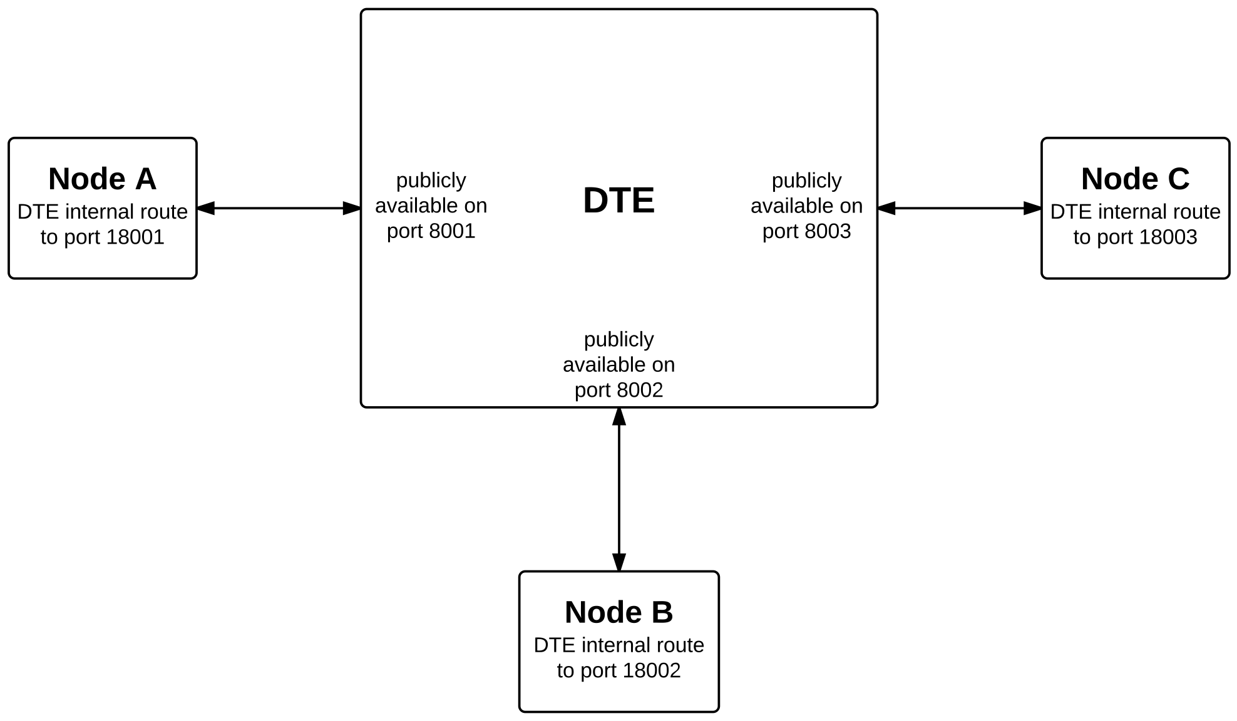
Experiment - Circle Chat Routing with DTE
Notes:
DTE intercepts messages on specific public ports, and routes them to their destination ports. Circle Chat instances listen on destination ports, and broadcast to public ports.

Slide 9
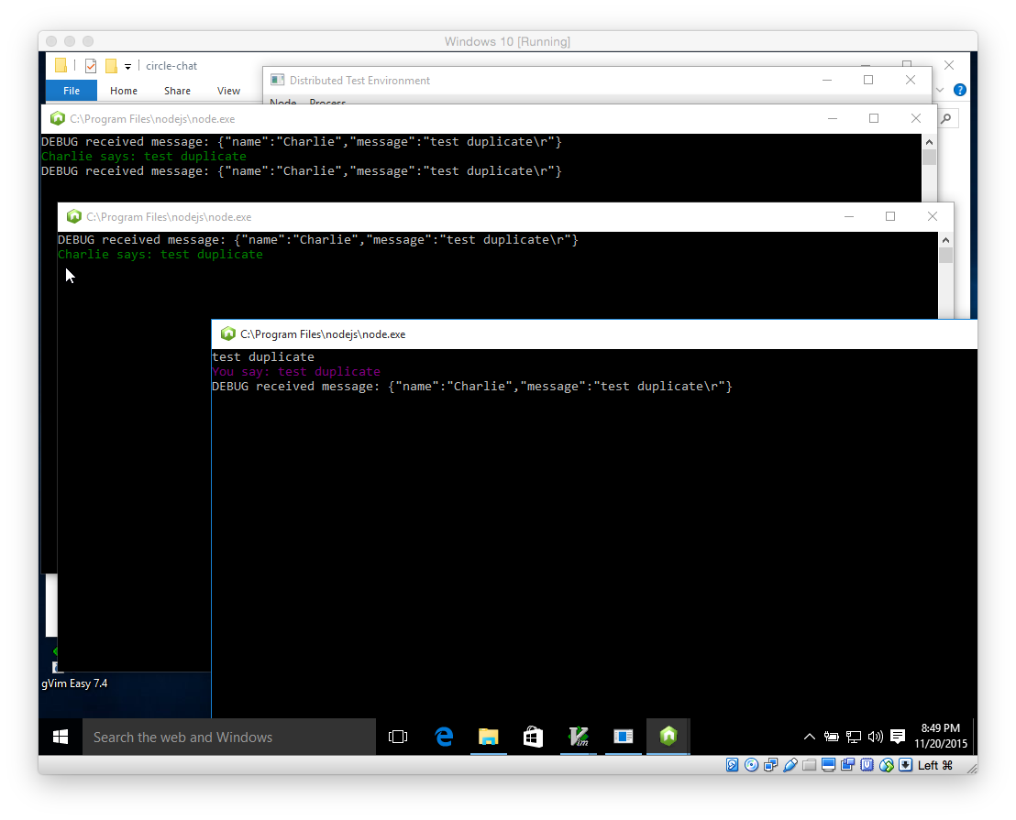
Experiment - Duplicate Messages

Slide 10
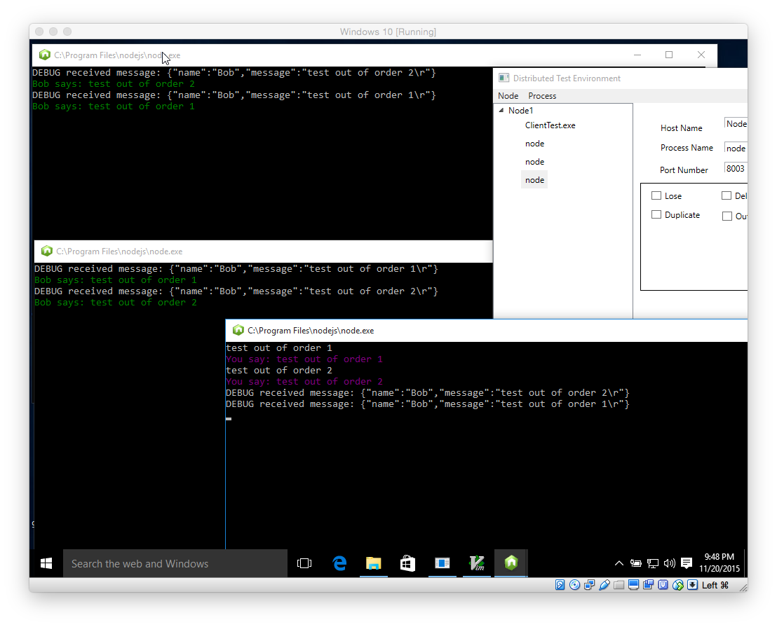
Experiment - Out of Order Messages

Slide 11
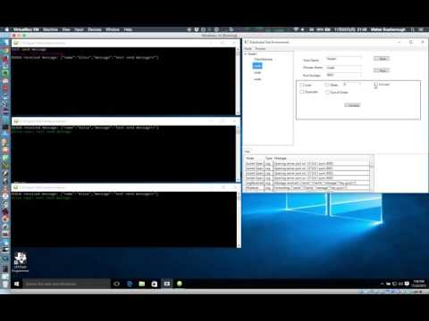
Experiment - Corrupt Messages

Slide 12
Future Work
Expand DTE to support more message faults
Add support for UDP messages
Add scripting engine to support automated testing of distributed systems
Code instrumentation library

Slide 13
Questions

Slide 14
References
[1] “The Netflix Simian Army” http://techblog.netflix.com/2011/07/netflix-simian-army.html. Accessed 22/Nov/2015
[2] “Four Reasons We Chose Amazon’s Cloud as Our Computing Platform” http://techblog.netflix.com/2010/12/four-reasons-we-choose-amazons-cloud-as.html. Accessed
22/Nov/2015
[3] “A Framework for Testing Distributed Systems” http://citeseerx.ist.psu.edu/viewdoc/download?doi=10.1.1.1.9399&rep=rep1&type=pdf. Accessed 22/Nov/2015
[4] “Introduction to WPF” https://msdn.microsoft.com/en-us/library/mt149842.aspx. Accessed 22/Nov/2015
[5] “The MVVM Pattern” https://msdn.microsoft.com/en-us/library/hh848246.aspx. Accessed 22/Nov/2015
[6] “Intro to Algorithms - Ring Network” https://www.udacity.com/course/viewer#!/c-cs215/l-48369875/m-48743003. Accessed 22/Nov/2015
[7] Node.js https://nodejs.org/en/. Accessed 22/Nov/2015

