Slide 1


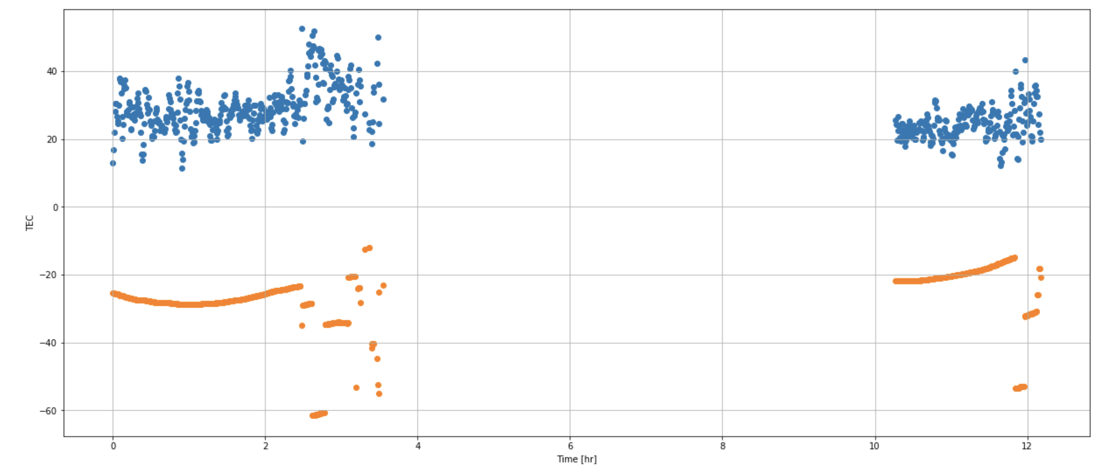
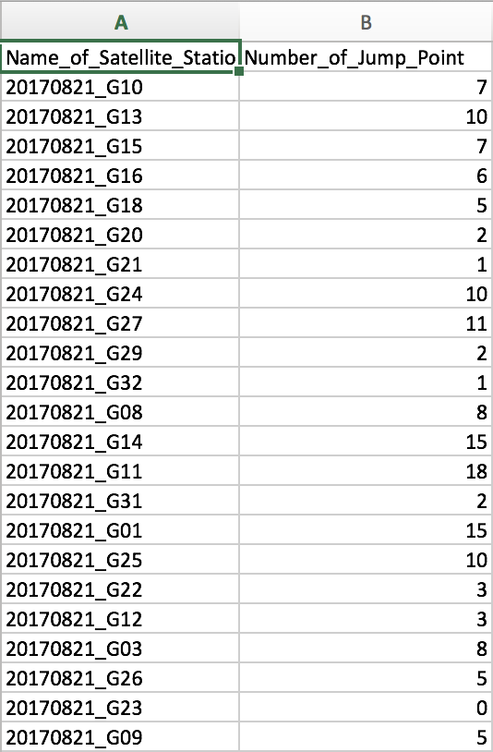
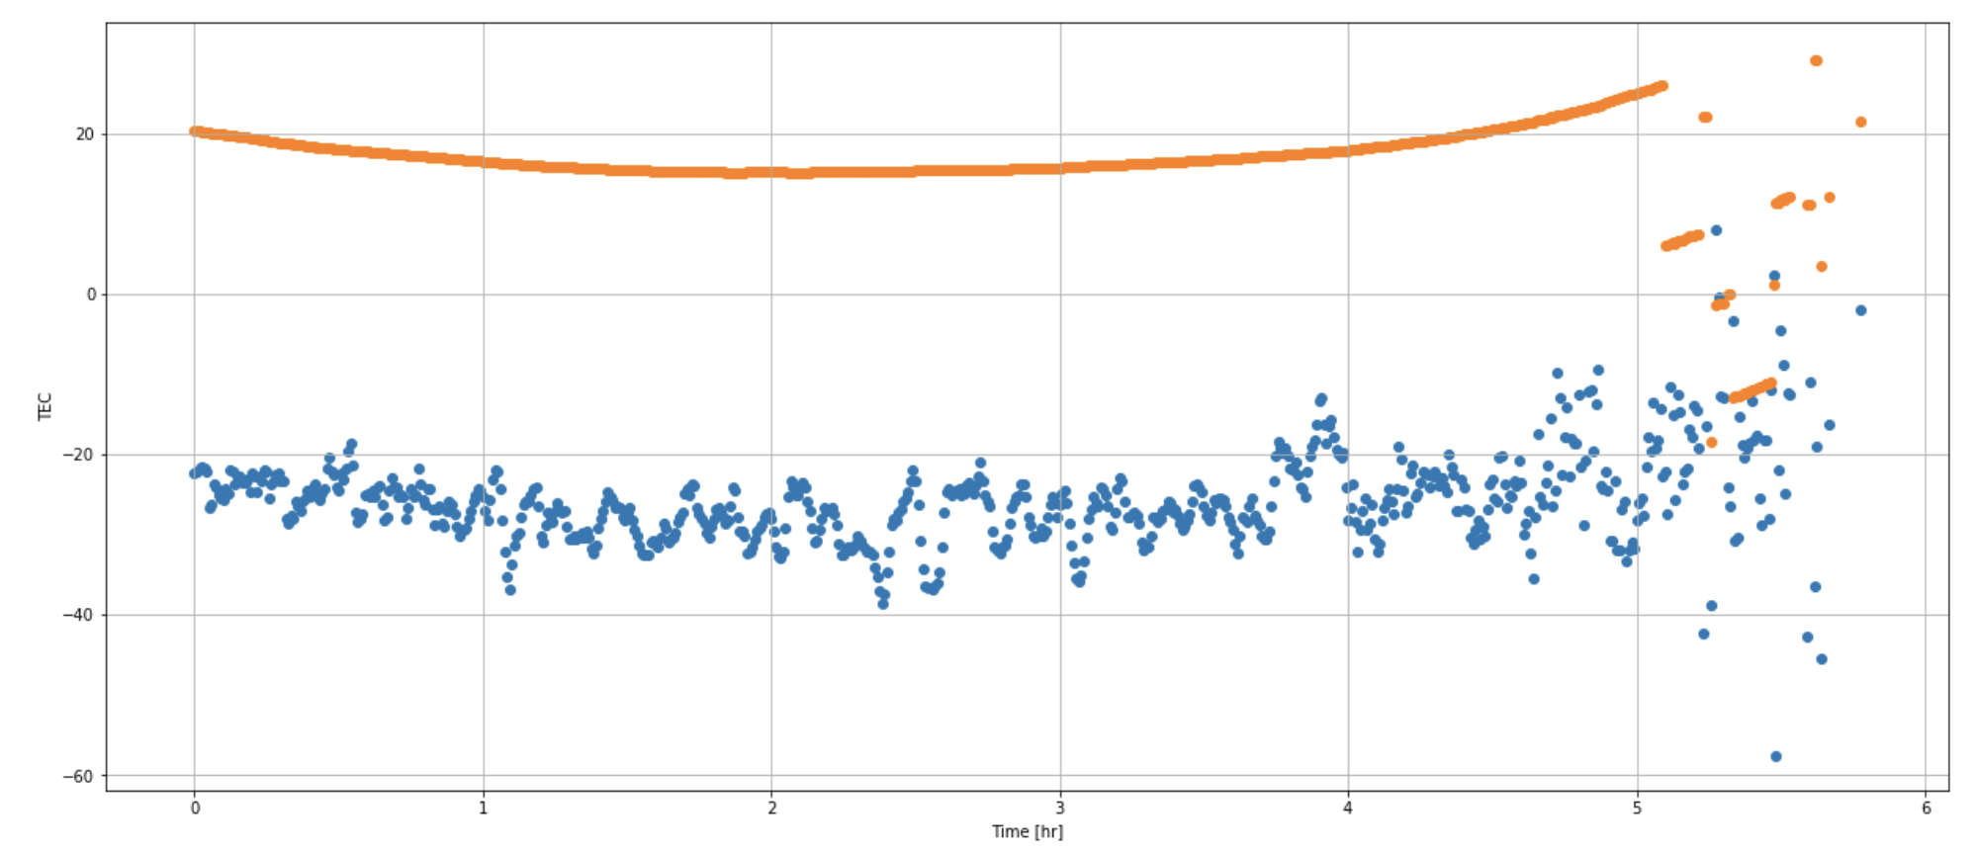
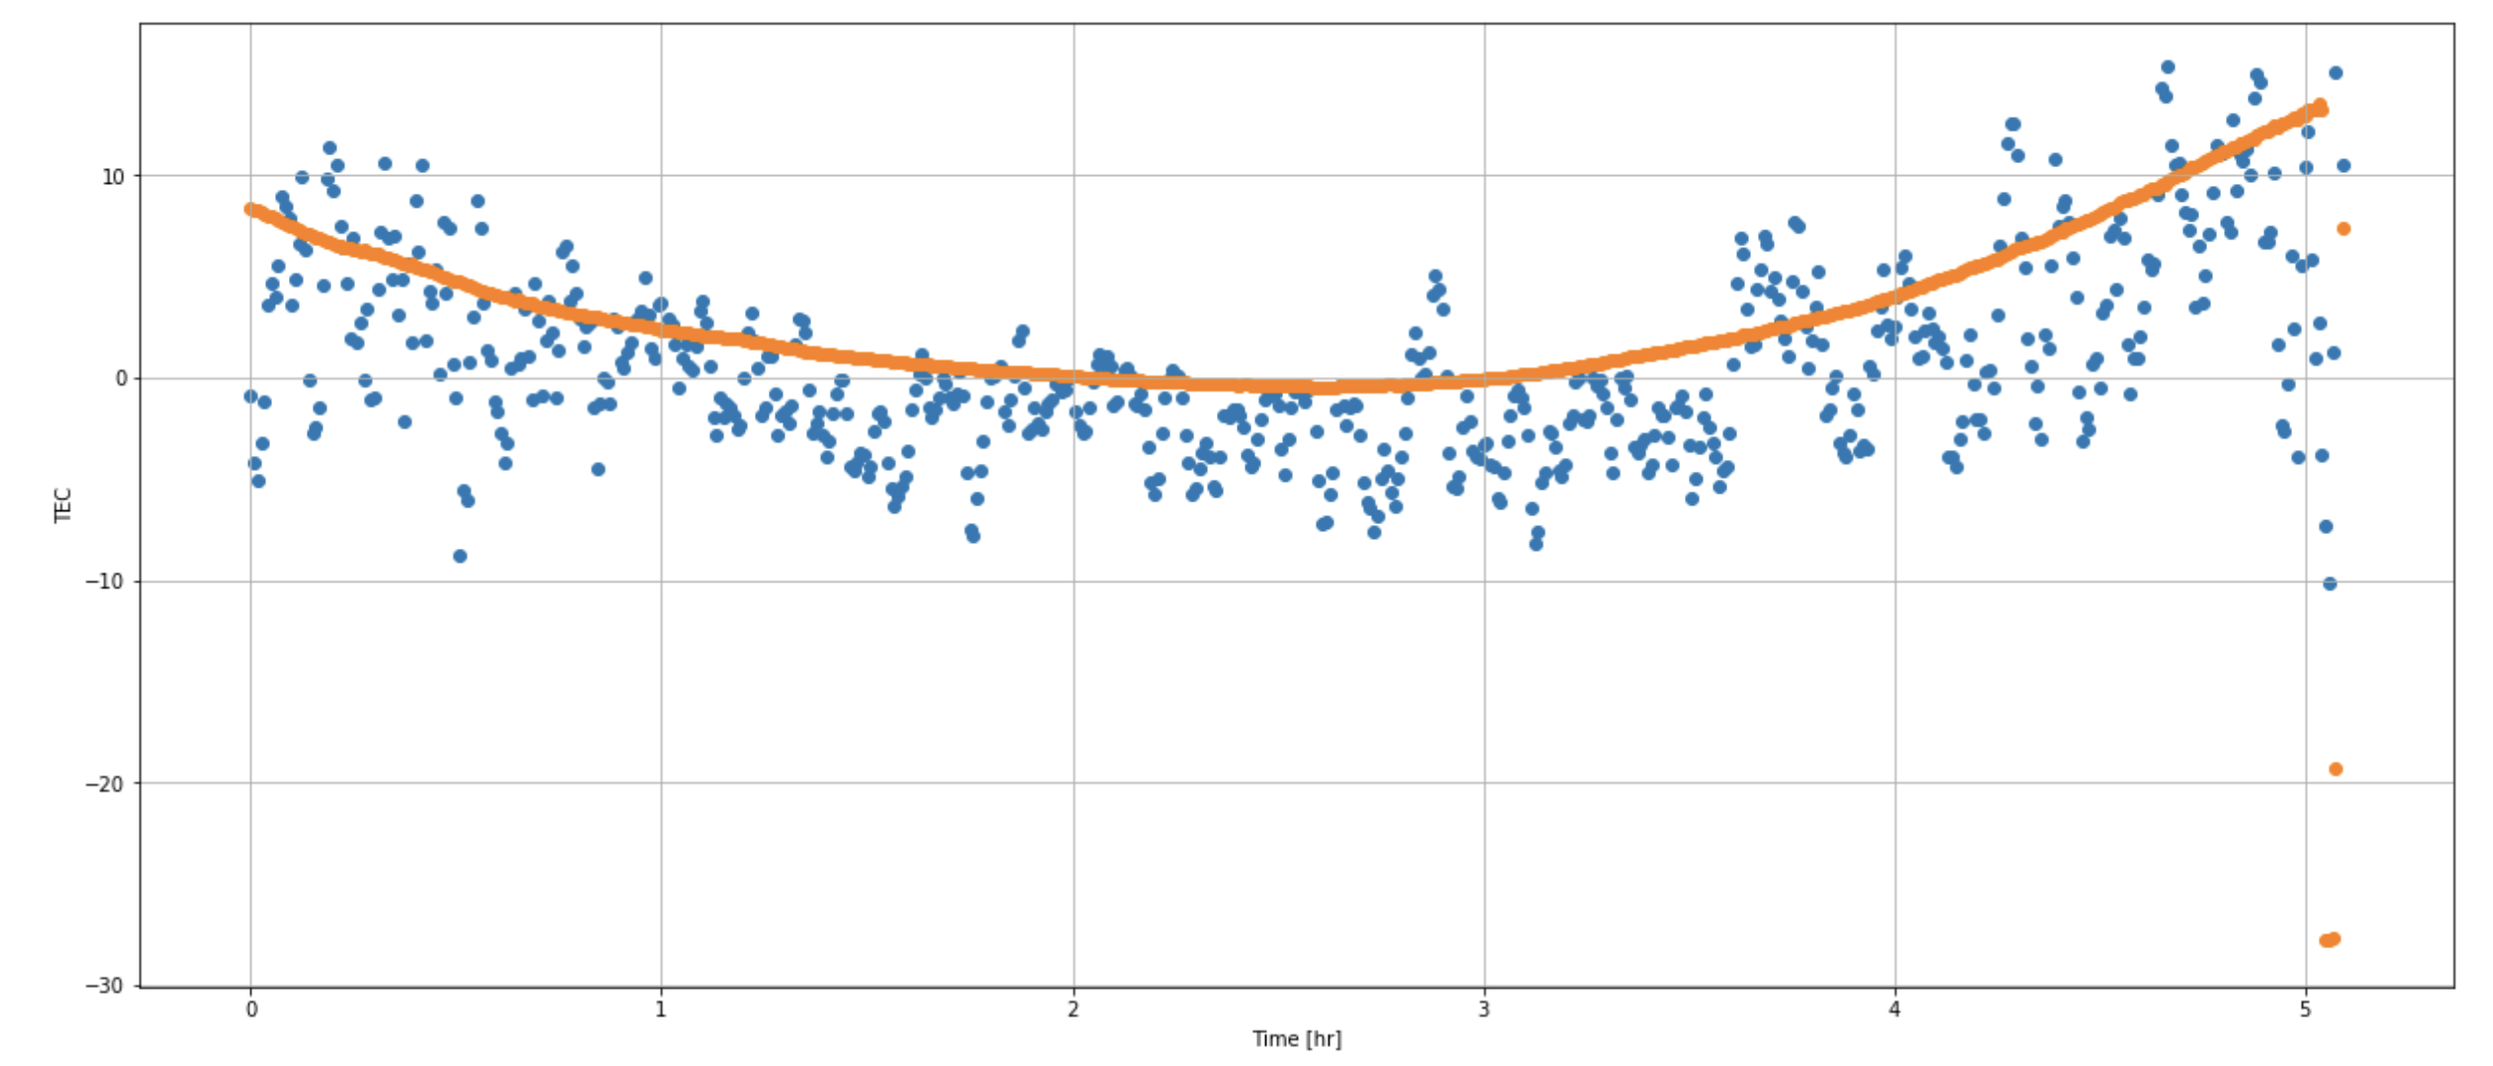
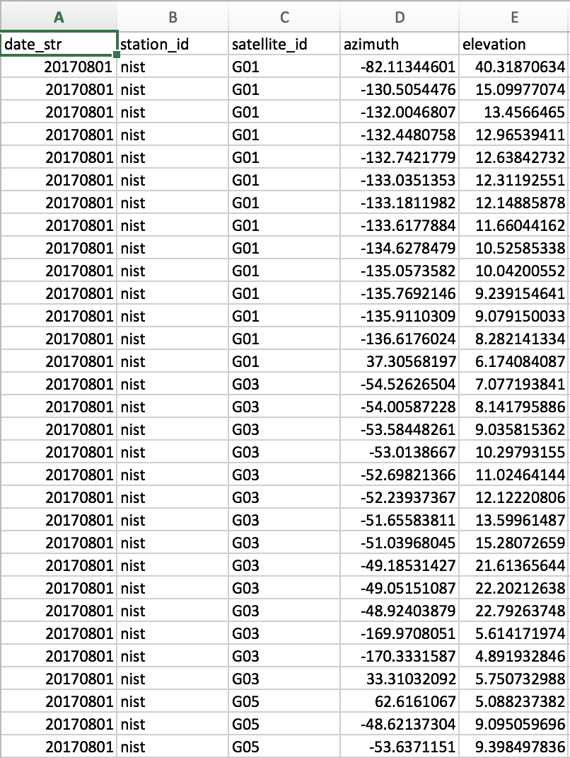
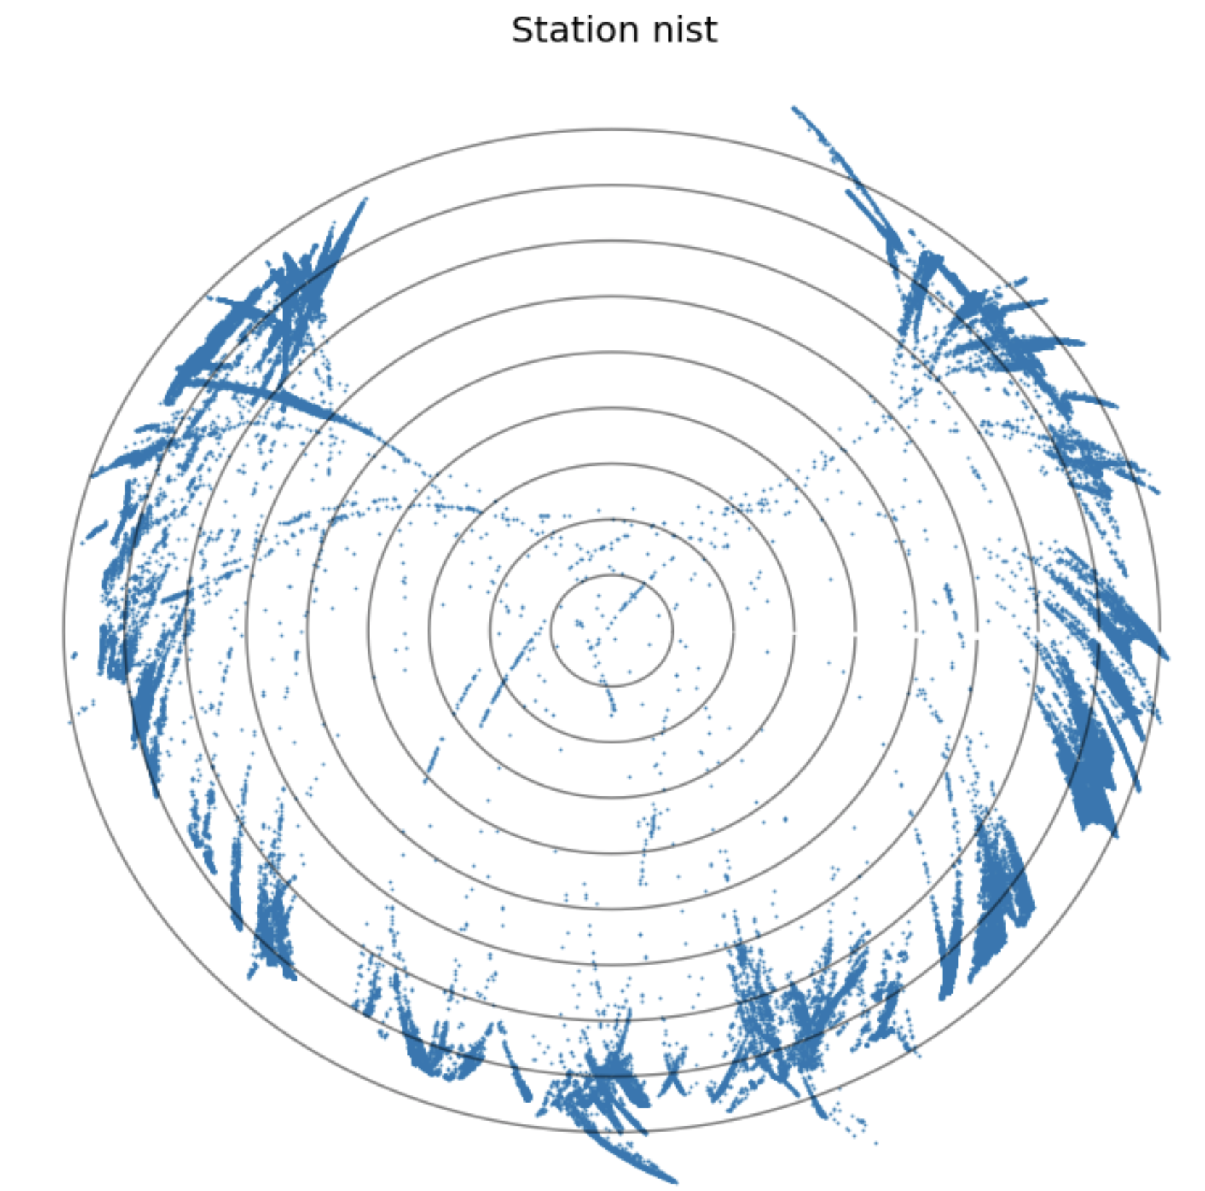
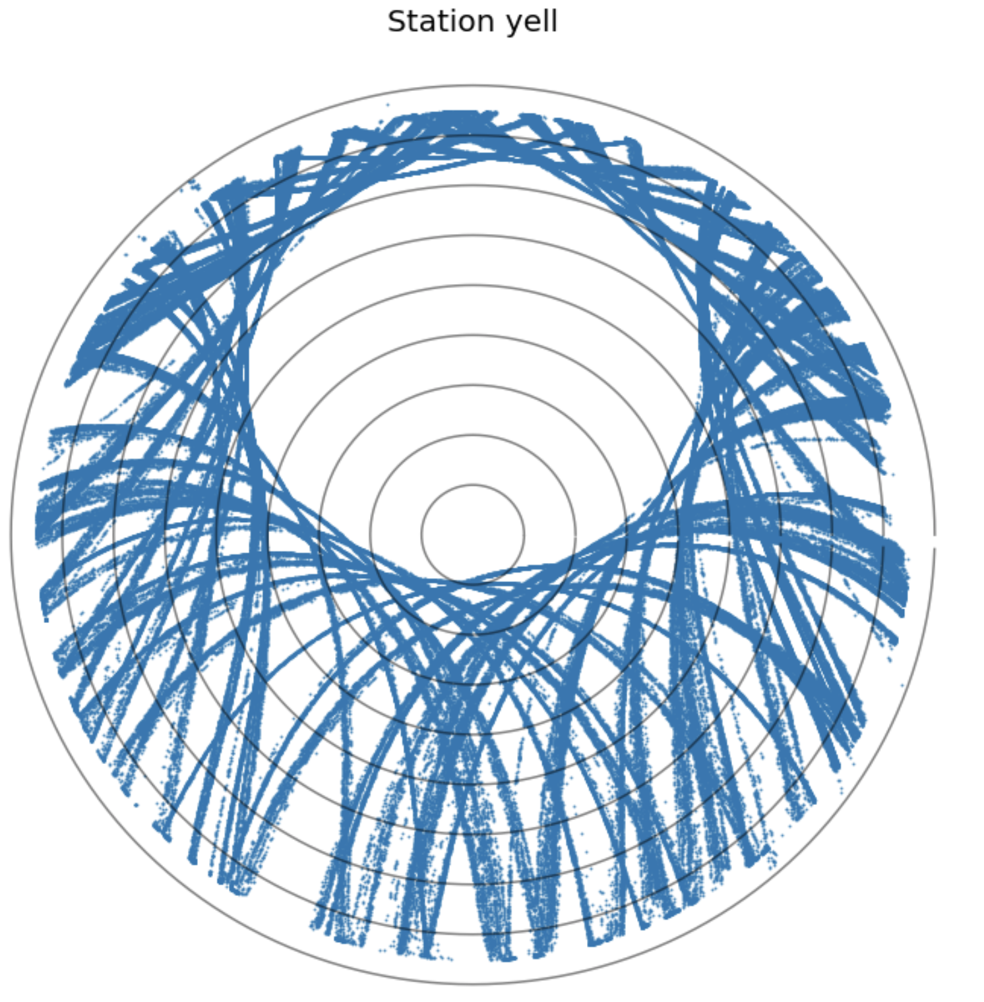
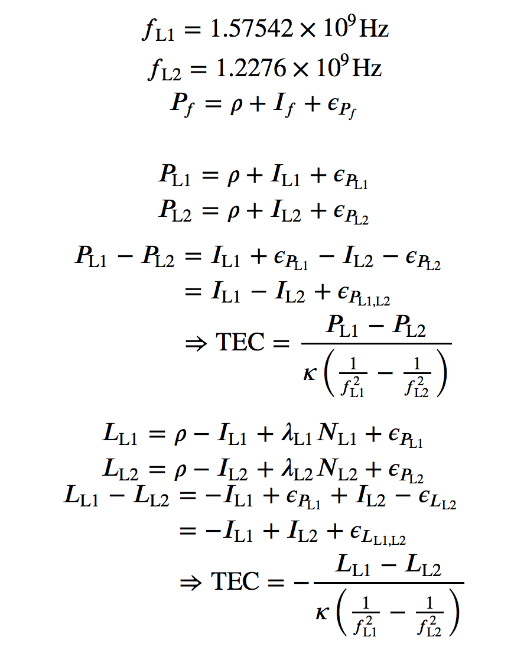
Analysis of Phase Jump Occurrence in IGS Station Data
Zijun Liu and Brian Breitsch
Email: zili5742@colorado.edu
Introduction
Method
I had a chance to work with graduate mentor for research project at the spring semester of 2019. It was such a great opportunity to practice with solving practical problems with everything that I have learned. After discussed with graduate mentor, we decided to focus on what factors that casuse TEC line jump points. The reason that I chose this topic, because it’s basic for aerospace area and it can be used for Machine Learning to collect the data and analyze why it causes these jump points.
I want to talk about what is TEC. TEC means that the total electron context in 1 cube cross section extending from receiver to satellite station.
About what is TEC is Total Electron Context. Why we want to do this, because the global positional system is a wide applied tool and it investigates the earth’s ionosphere. Also, Global Positioning System is an technology for navigation, timing and studying geophysical phenomena like earthquakes, ionosphere, and so on. In this research, cycle slips are a disruption in GPS phase measurement, which caused low signal-to-noise ratio and interference. Looking at jumps in ionosphere of TEC can be a simple way to detect cycle slips. We’re going to use dual-frequency relative TEC measurements to detect cycle slips. And then, we will look the occurrence of cycle slops depends on satellite azimuth, elevation, location and time. This research will help me determining where to focus in mitigation of cycle slips in GPS data.
As for the Figure 1, this is the TEC line jump point picture from Sep 1st, 2018 in G02 satellite. As for x-axis is the Time, y-axis is the TEC. As seen from the Figure, the orange scattered point is the TEC line jump point at the end of the the line.
F
Figure 1
For this research, there are three subsections for this research.
First, I called it as Plot Jump Point.
The first part is about plot the TEC line and check what is be the reasons cause it. I use the difference between dual frequency signal from satellite receiver and use the equation above to plot it. Here is the example of the plot. The left one is satellite G01 from Sep 3rd, 2018 (see Figure 2). The right one satellite G05 from Sep 3rd, 2018 (see Figure 3).
G
Figure 2
Figure 3
The second part is about auto download the data and plot the data. In this research project, I have to check many data for the similarity. For example, I go through the data from satellite G02 about 1 or 2 year’s data. it will take long if I plot each data manually, so that’s why we work on how to auto download the data from the website to get the observation data and how to auto plot it. After that, I will automatically save it in my laptop as picture. And then, I will check for difference and similarity.
The next step is that I have to check how many jump point occurring at each satellite in whole year. I called this step as count for How many Jump point. The same problem is that I have to check the data as much as possible. It could automatically do the calculation on what I will work on it. I use threshold to compare with each data and then export it as .csv file. It’s very important because we have to use these data to find out the Azimuth and elevation to make sky plot. Here is the example about how the table in .csv file like (see Figure 4).
(see Figure 4)
In the third step, I’m going to use Azimuth and Elevation to get the sky Plot. I called it as Sky Plot by Azimuth and Elevation. I’m going to get the Azimuth and Elevation for each station and export it in the .csv file too (see Figure 5).
And then, I’m going to use it to make sky plot to show the jump point in the sky plot. It can directly show where jump occurrence in the universe (see Figure 6). This figure is for station yell, which located on Yellowknife city in Canada, for 2017 whole year. We can see the jump point occur in the similarity on the different dates.
(see Figure 5) (see Figure 6)
Research Objectives
My research topic is Analysis of Phase Jump Occurrence in IGS Station Data. I’m going to focus on factors about why jump point occurred. As seen from Figure 1, I used the difference between Pseudorange for dual frequency.
Equations

