Slide 1
Option pricing
Options are financial instruments that are based on the values of underlying tradable financial assets such as stocks.
An option contract offers the buyer the opportunity to buy/sell the underlying asset (we focus on stock here).
Each option contract will specify a date called expiry date, and a stated price called strike price.
Each option contract comes with a premium. When the contract is signed, the contract buyer needs to pay this premium and the contract seller receives it. Option pricing is the process of determining the amount of this premium.

Slide 2
Option pricing
There are two types of options.
Call option: allow the holder to buy the stock at the strike price on the expiry date†.
Put option: allow the holder to sell the stock at the strike price on the expiry date.
Buyer has the right not to exercise the contract, and in such case, he loses nothing, except for the premium he paid when he bought the option.
Seller has the obligation to execute the contract if the buyer decides to do so.
† Here, we are talking about European options, not American options.

Slide 3
An example on Call option
Someone has bought a call option for stock X on 2022/1/1 with expiry date 2022/6/30 and strike price $58.
If on 2022/6/30,
stock X’s price is $64, the buyer can exercise his call option and buy the stock from the option seller at the strike price $58, and thus he earns $6.
stock X’s price is $25, then the buyer can choose not to exercise the option.

Slide 4
An example on Put option
Someone has bought a put option for stock X on 2022/1/1 with expiration date 2022/6/30 and strike price $58.
If on 2022/6/30,
stock X’s price is $64, the buyer can choose not to exercise the option.
stock X’s price is $25, then the buyer can buy stock X at $25 from the market, and then sell it to the option seller at the strike price $58, and he earns $33.

Slide 5
Some observation
For call options buyers: they spend premium, and their losses are limited to premium spent. And the profits they can make do not have bounds.
For put options buyers: Again, losses are limited to the premium spent. But the profits they can make is between 0 and the strike price.

Slide 6
Some old and new methods for option pricing
Black-Scholes model
Binomial option pricing
Monte-Carlo simulation
Machine learning method

Slide 7
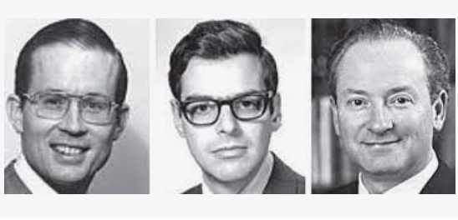
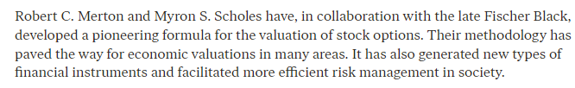
Black-scholes-(Merton) model
In 1997, Scholes and Merton were awarded the Nobel Prize in Economic Sciences:

Slide 8
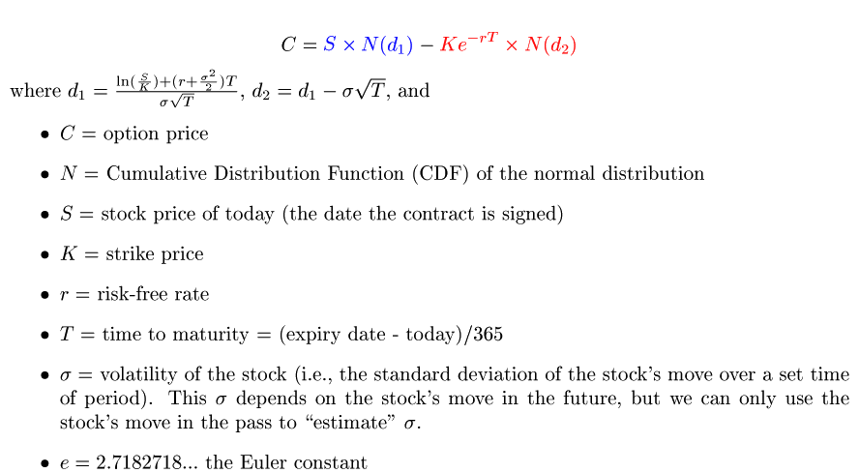
The most famous equation in Finance
The Black-Scholes-Merton equation

Slide 9
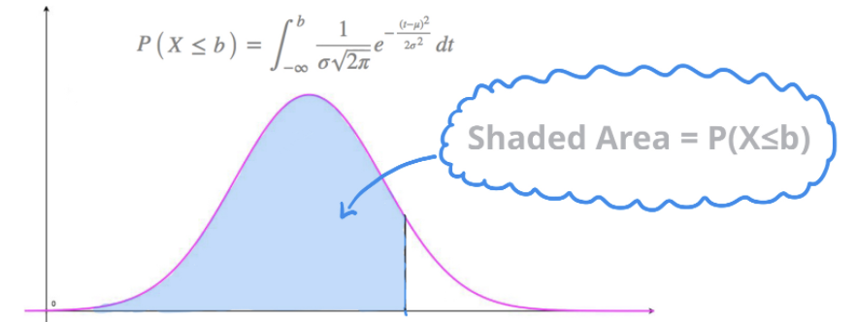

What’s N(d₁) and N(d₂)?
Normal distribution
with mean=0 and
standard deviation = 1
d

Slide 10
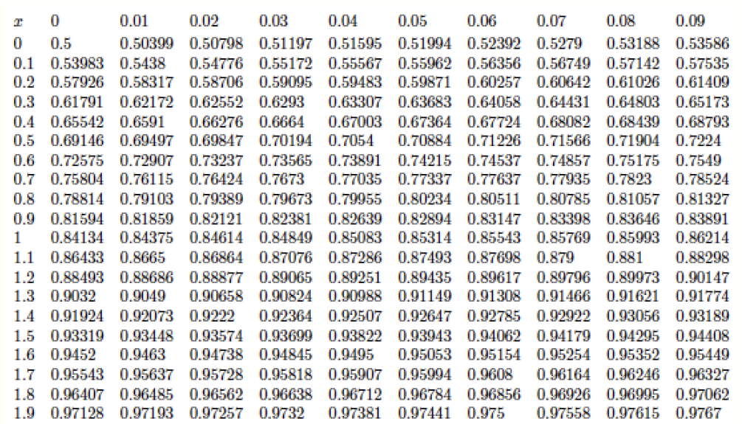

Slide 11
N(1.14)

Slide 12
Objective of option pricing
The premium must be fair so that the buyer and seller will have an equal chance to win (i.e., gain profit).

Slide 13
How does black-scholes-merton achieve this objective?
We focus on call option.
To get some insight, let’s first consider the simplest case: the stock price does not change over time.
S
S
At this point, we know
that in the future expiry
date, buyer will earn S-K
seller will lose S-K.
To be fair, we should
set the premium to be
S-K.
K: strike price
expiry date

Slide 14
Let’s consider more external effect
Risk-free rate (RFR): It is the theoretical rate on an investment with zero risk. It can be the bank rate, or the government bond yields.
We now determine the stock price on the expiry date with the assumption that the stock price is only determined by RFR r.
For example, if r=0, then the stock price does not change over time, and we return to the simplest case.

Slide 15
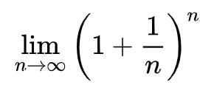
Let’s consider a little more
Let us consider the case when r > 0.
Suppose today is day 0, and the expiry day is day T. If today’s stock price is S, then by simple compound interest computation, the stock price on the expiry day is
Note: e is the Euler constant, which can be defined as follows:
e = = 2.718281.
S* ≅ S e^{rT}
K: strike price
S
expiry date

Slide 16
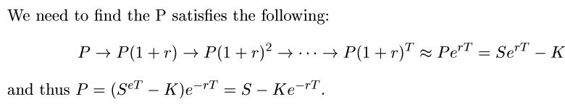
Let’s consider a little more
Let us consider the case when r > 0.
We now have the picture:
S* ≅ S e^{rT}
K: strike price
S
What is the value P of
“Se^{rT} – K on day T”
on day 0?
At this point, we know
that on the future expiry
date, buyer will earn Se^{rT} -K
seller will lose Se^{rT} -K.
To be fair, we should set the premium to be Se^{rT} -K.
expiry date

Slide 17

The black-scholes-merton equation
Compare with black-scholes-merton
We get black-scholes-merton from by considering further the situation that the stock prices fluctuate according to some probability distribution.

Slide 18
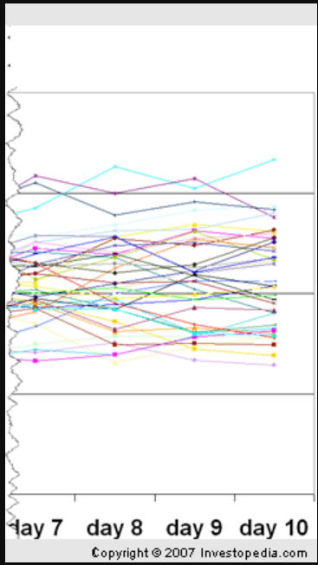
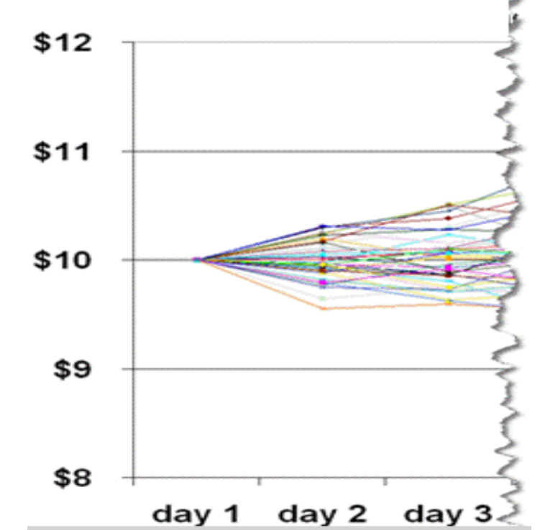
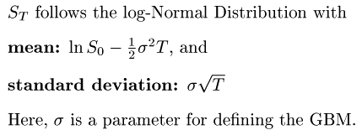
Key assumption of black-scholes-merton
Black-scholes-merton assumes that the stock prices follow the Geometric Brownian Motion (GBM).
Bottom line for us:
On expiry date T:
Today:
price = S₀

Slide 19
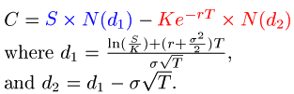
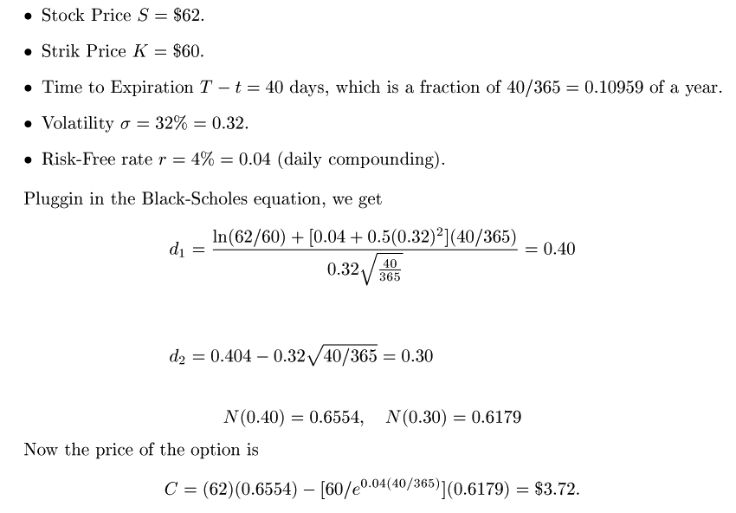
An example on option pricing using BSM

Slide 20
Option pricing by machine learning
Our discussion will be based on the paper
“Option Pricing by Deep Learning” by Ke and Yang,
and their Python programs posted on GitHub
https://github.com/ycm/cs230-proj

Slide 21
Option pricing by machine learning
Basically, it is a problem supervising learning for regression, i.e., train a model (e.g., polynomial) to approximate the relation between the input and output.
Recent researches on this problem focus on designing and training neural network models that beat the Black-Scholes-Merton model.
Based on the outputs, these researches can be characterized in three categories:
directly predict the option premium
predict the volatility of the stock, and then use it as an input to Block-Scholes-Merton to determine the option premium
“guess” the ratio between the option premium and strike price.

Slide 22
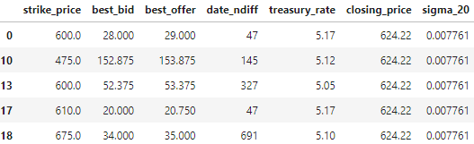
The MLP1 model given by Ke and Yang
Dataset: A collection of 12 million examples of roughly half calls and half puts. To train the MLP1 model, 98% of the data is used as a training set, 1% for validation set during training, and 1% for testing.
A glimpse of the input

Slide 23
The MLP1 model given by Ke and Yang
Dataset: A collection of million 12 million examples of roughly half calls and half puts. To train the MLP1 model, 98% of the data is used as a training set, 1% for validation set during training, and 1% for testing.
A glimpse of the input
option premim = (best_bid + best_offer)/2
T
r
S
σ
K

Slide 24
The MLP1 model given by Ke and Yang
Dataset: A collection of million 12 million examples of roughly half calls and half puts. To train the MLP1 model, 98% of the data is used as a training set, 1% for validation set during training, and 1% for testing.
A glimpse of the input
σ
The standard deviation of the
stock prices of the last 20 days.

Slide 25
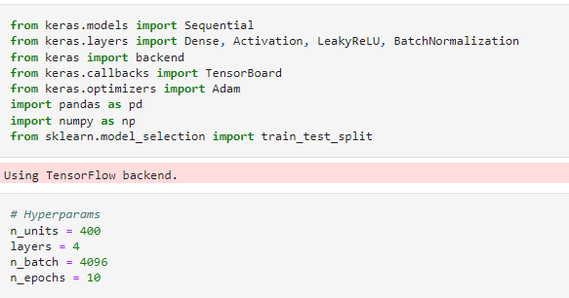

Slide 26
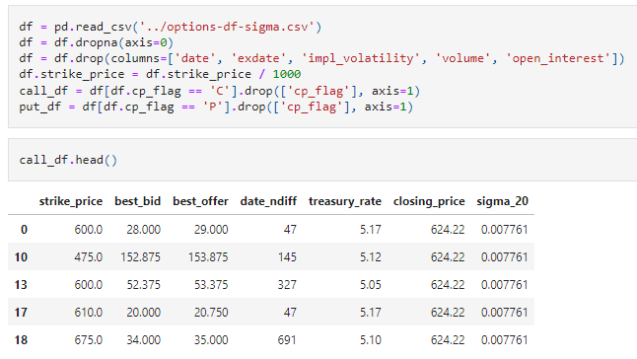

Slide 27
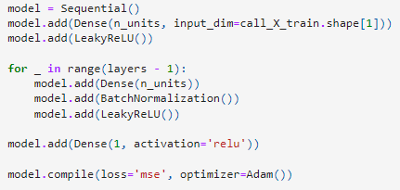

Slide 28
