Slide 1

Final Project Reducing Commute Time with
Machine Learning and Graph Analysis
Yu, Walter
CSCI E-63 Big Data Analytics
Harvard University Extension School
Prof. Zoran B. Djordjević

Slide 2

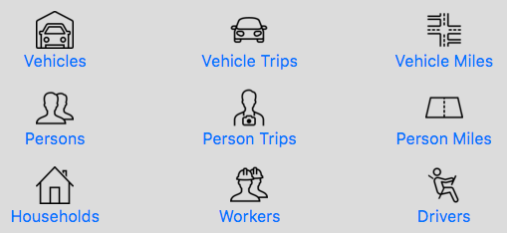
Introduction
Analyze commuter data (NHTS) to identify trends
Goal to reduce U.S. commute time
Machine learning (ML) and graph analysis
Github: https://github.com/walteryu/e63-final

Slide 3

Introduction
National Household Transportation Survey (NHTS) dataset: https://nhts.ornl.gov/
Based on 2017 NHTS Data Challenge contest entry
Final project extends analysis with ML and graph analysis
National survey with ~1M records; ~700MB total

Slide 4
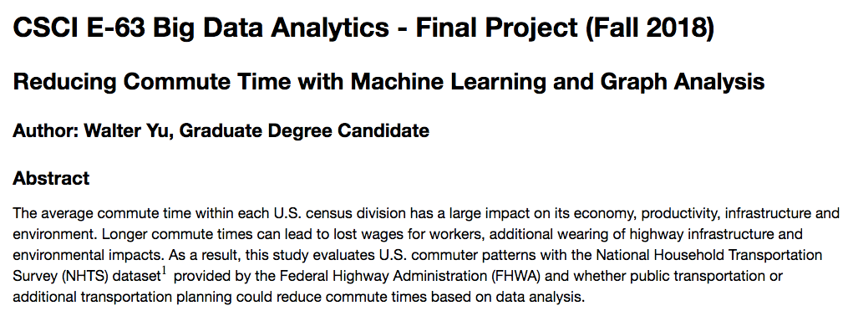
Data Analysis
Data cleaning, exploration and visualization
Calculate summary statistics
Analyze with ML and graph analysis
Document results in Jupyter Notebook

Slide 5
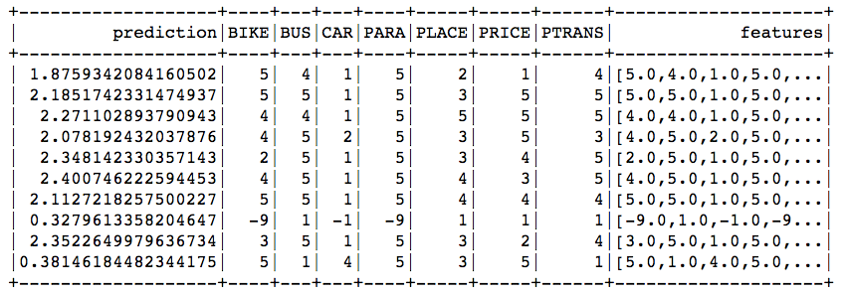

ML and Graph Analysis
Evaluate ML algorithm performance
Identify key factors with feature importance
Develop graph and calculate out-degree relationships
Example ML Output
Feature Importance:
Example Graph
Analysis Output:

Slide 6
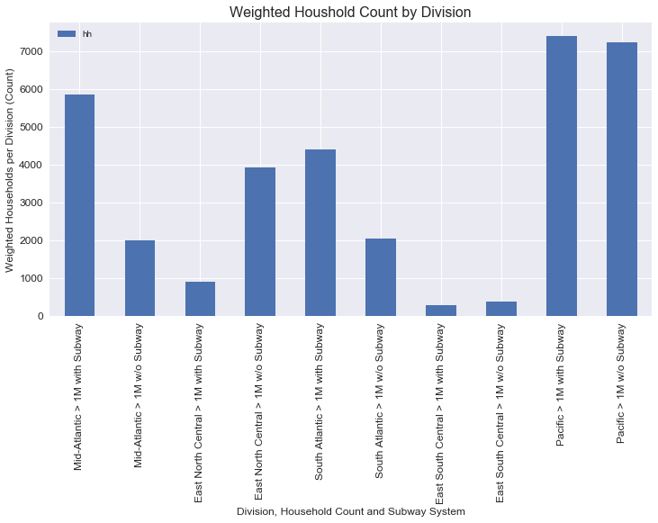
Household Data - Summary Statistics
Calculate household count by division
Separate by access to mass transit
Areas with mass transit typically have higher household count

Slide 7
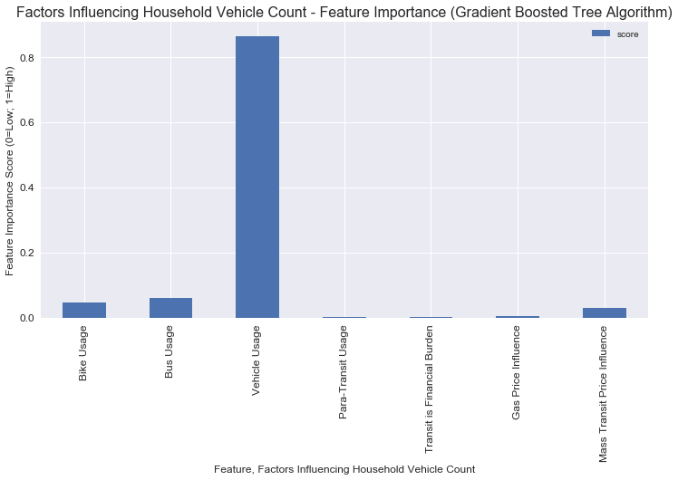
Household Data - Feature Importance
Vehicle usage most impacts total count
Other features have low significance
Mass transit feature has low significance with vehicle usage

Slide 8
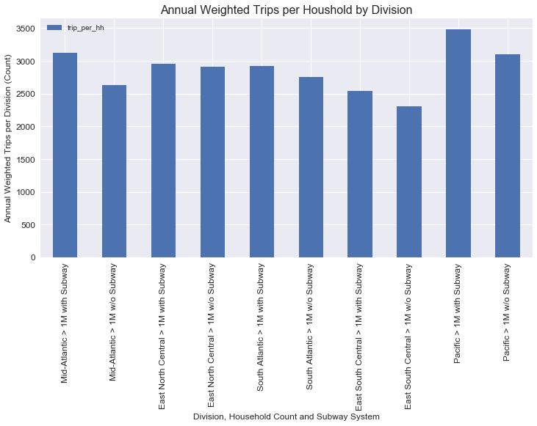
Trip Data - Summary Statistics
Calculate trip count by division
Separate by access to mass transit
Areas with mass transit typically have higher trip count

Slide 9
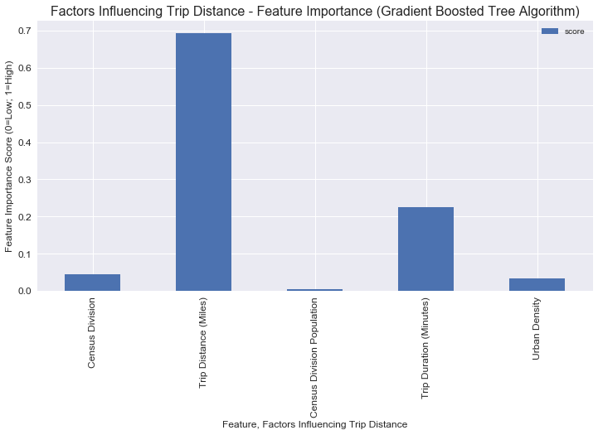
Trip Data - Feature Importance
Trip distance most impacts vehicle miles per trip
Trip duration is also significant feature
Other features have low significance

Slide 10
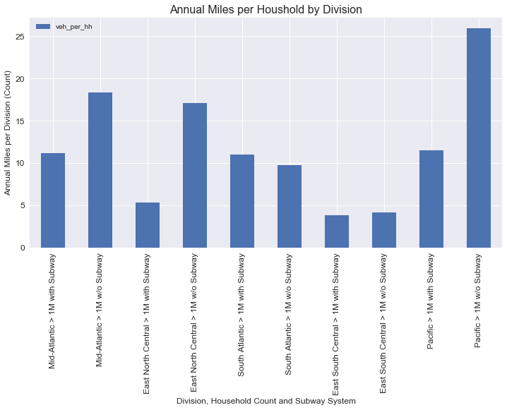
Annual Miles Driven - Summary Statistics
Calculate annual miles driven by division
Separate by access to mass transit
Areas without mass transit typically have higher miles driven

Slide 11
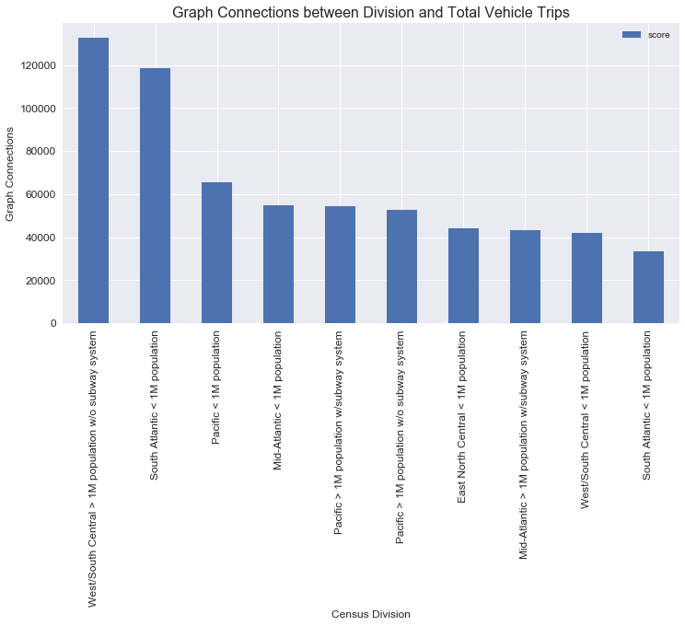
Graph Analysis - Out-Degree Relationship Count
Calculate out-degree relationships between division and total trips
Areas without mass transit and lower population

Slide 12
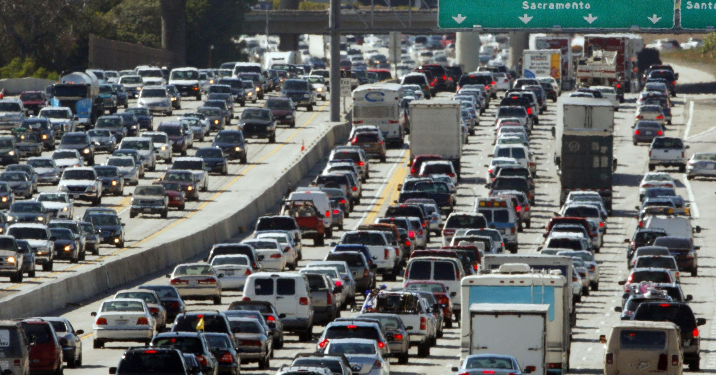
Observations
Photo Reference: http://bit.ly/2DZ2avA
Mass transit does not appear to directly influence driving behavior; however, trip distance/length has high significance
Urban areas have higher population so appear to have higher total trips but shorter distances; rural areas have lower population so have lower total trips but longer distances
Households with higher income appear to have higher vehicle count and usage; trip destination also has significance

Slide 13

Recommendations
Photo Reference: http://bit.ly/2E2N7Rh
Public education is recommended to raise awareness
Results may be useful to urban planners
Encourage households to take action by living near urban areas instead of relying on urban planning to solve problem
Mass transit alone is unlikely to reduce vehicle usage; actions to change driving behavior are recommended

Slide 14
YouTube URLs, Last Page
Two minute (short):
15 minutes (long):

