Slide 1
Walt Mayfield
Applied-Data-Science Capstone Project

Slide 2
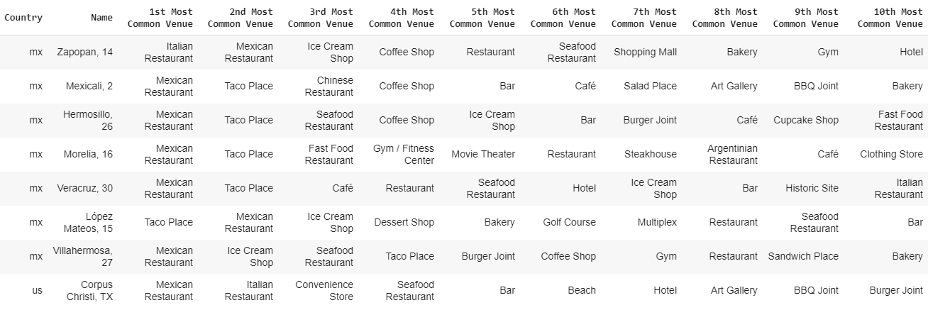
Mixed cluster #1
There are a number of Mexican cities similar to Corpus Christi

Slide 3
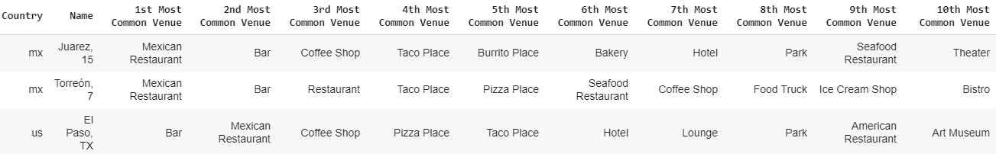
Mixed cluster #2
El Paso is a good city for those looking for Mexican restaurants, bars and coffee shops.

Slide 4
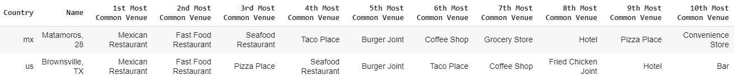
Mixed cluster #3
Brownsville and Matamoros both have large amounts of Mexican restaurants, fast food, and sea food.

Slide 5
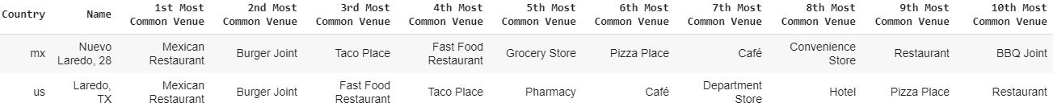
Mixed cluster #4
Unsurprisingly, Larado and Nuevo Laredo are similar cities.

