Slide 1
ACME Data Restructuring
Walton Macey

Slide 2

Background
ACME
Large-scale earth simulation to project global climate
ALM
Terrestrial land component
Data Restructuring
Complex user-derived data types
New datatype requirements
From 50 to 8 primary data-types
Notes:
Large-scale earth system simulation codes
Designed to represent the interactions of atmosphere, ocean, land, ice and biosphere to project global climate under a wide variety of conditions

Slide 3
Motivation & Challenges
Simplify Implementation of Submodels
For Other Scientists
Future Restructuring
Challenge
Active Development
Testing Framework
BFB
Notes:
Since the code is developed with the community governance, we have to ensure that the restructuring does not interface the other development which, with dozens of changes occurring every day, make it impossible to work on a shared development branch. The active development also occurs on almost five hundred branches, making it extremely difficult to assess potential interactions.

Slide 4
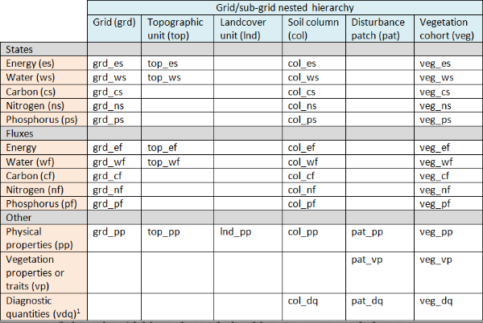
Work
Approach
Iterative procedure
Determine what is easy to automate
What is hard to do manually
Modularization
Combine Data Structures
Change global variable
Estimate effort

Slide 5
Scripts
Summary
Input – location, variable
Return distribution and counts of variable occurrence
Preview
Input – location, original variable, new variable
Return before and after of potential variable replacement according to type of use
Replace
Input – location, original variable, new variable
Replace all instances according to type

Slide 6
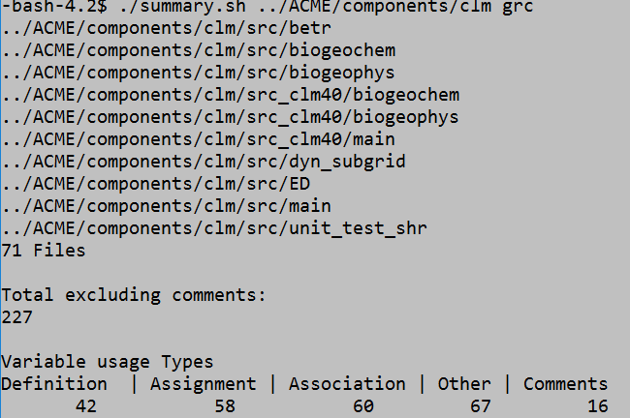
Summary

Slide 7
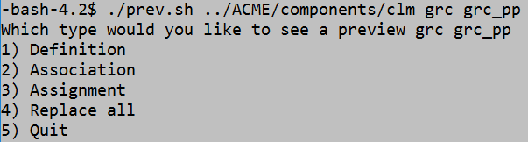
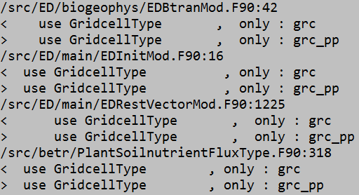
Preview

Slide 8
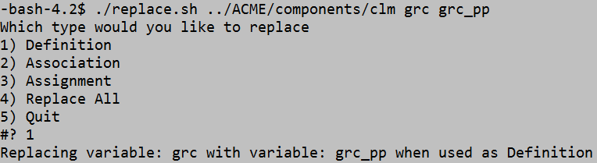
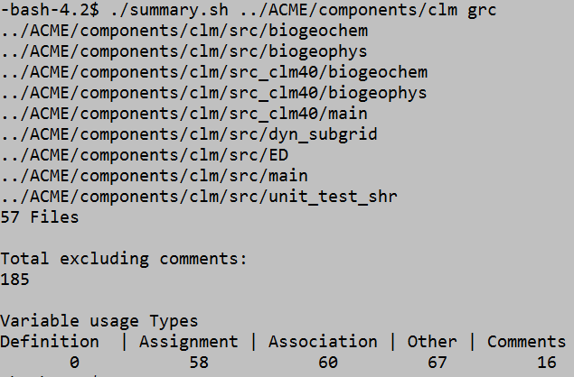
Replace

Slide 9
Issues
Variable Naming/Dependency
Caused by individual’s different style of programming
Aliasing issue, changed but not everywhere
Module and Variable name interference
Ex: “pft” in 4.0, “patch” in 4.5; not a clean change for this variable
Change in Testing framework
Issue in merge with master
Solution
Rebase and exclude problem commits
Patch problem commits and commit xml changes

Slide 10
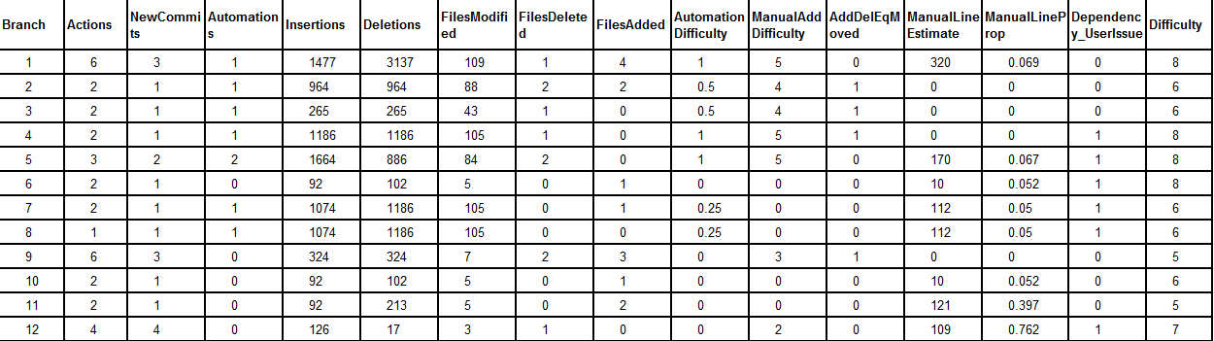
Analysis
Data restructuring history

Slide 11
Development Effort Data: Clear
Branch (Incorporates Time)
Actions per Branch
Addition, Deletion, Automation, Merge, Modification
New Commits
Automations
Insertions
Deletions
Files Modified, Deleted, Added

Slide 12
Development Effort Data: Calculated
Automation Difficulty
(0 to 1) Incorporate experience, extent of variable distribution and aliasing difficulty when automation occurs
Manual Line Estimate
Estimate of lines changed not due to auto replacement procedures
Manual Add Difficulty
(1-5) Attempted to estimate how tricky non-automated insertions were
Dependency or User Issue
Flag (1 or 0) – If mistake made, or error discovered in previous naming (i.e variable match module name leads to missed replacements
Difficulty
(1-10) Engineer’s apparent estimate of difficulty for each branch

Slide 13
Predictors – Model of Development Effort
Fitting observed data to Engineer’s input
Weight different parameters
Log transform data
Range of Data now (0 to 8)
PCA
Narrow list of predictors and reduce similar variables
Linear Model

Slide 14
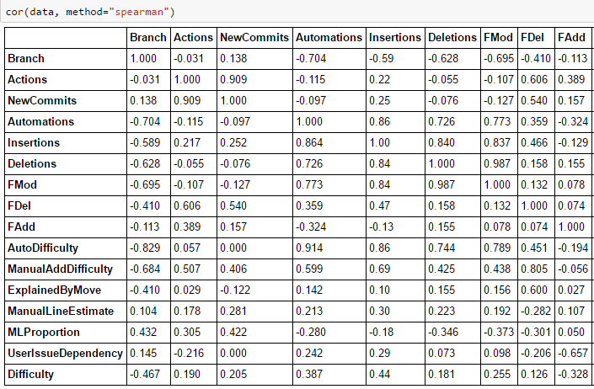
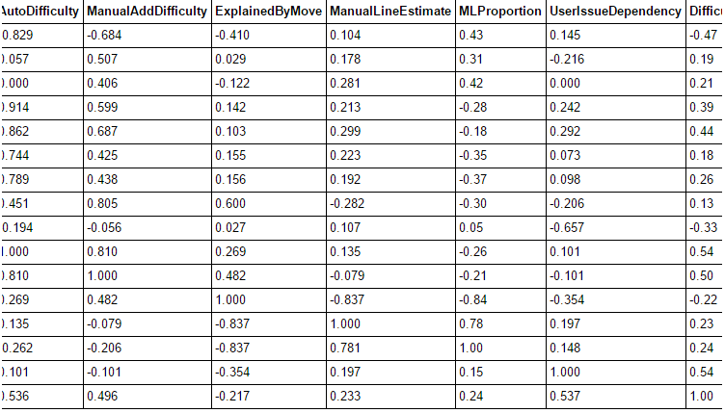
Notes:
Spearman – rank value relationship between two values
Different than pearson, doesn’t have to be linear

Slide 15
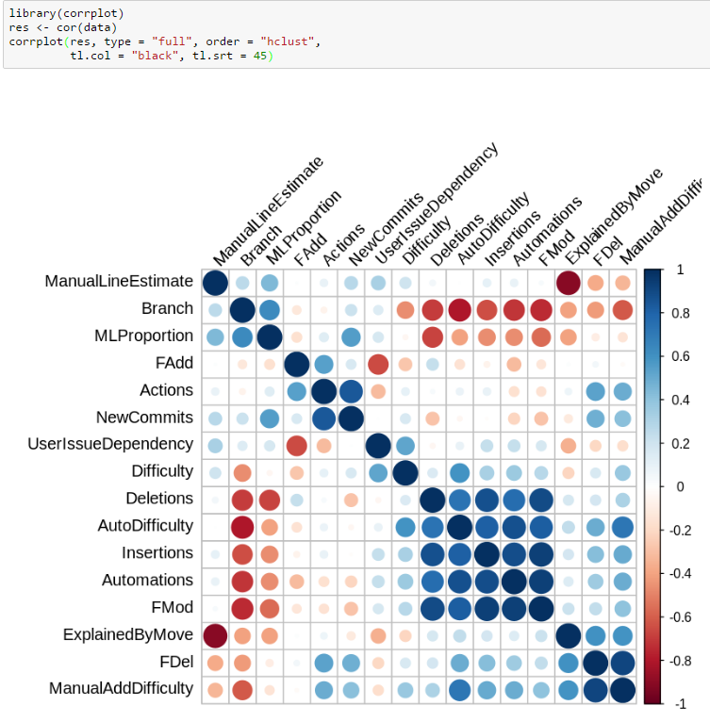
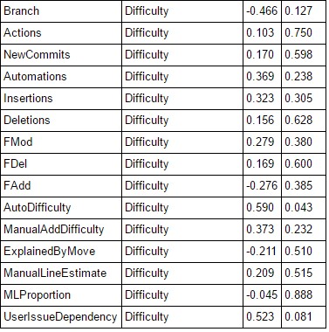

Slide 16
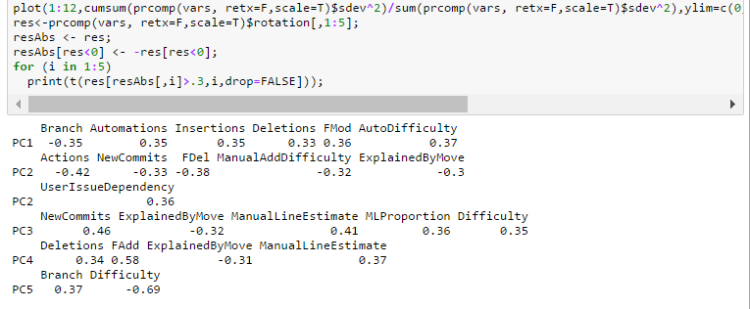
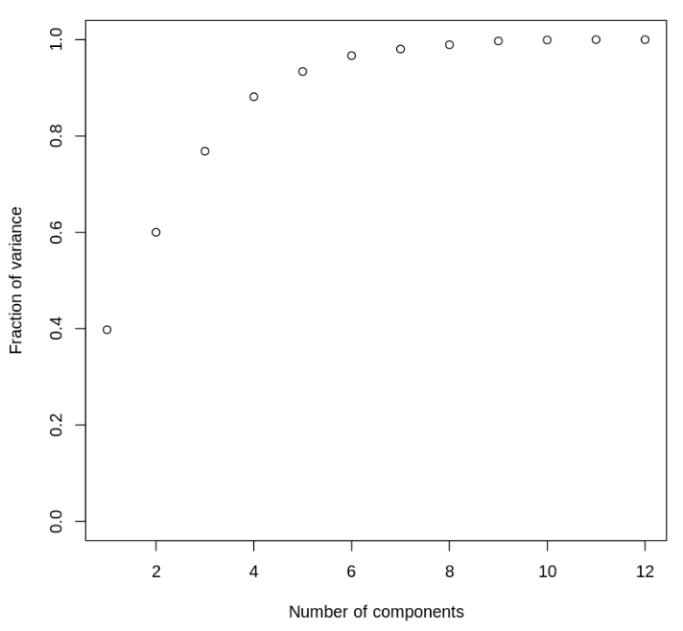
Principle Component Analysis
Notes:
To select subset of predictors

Slide 17
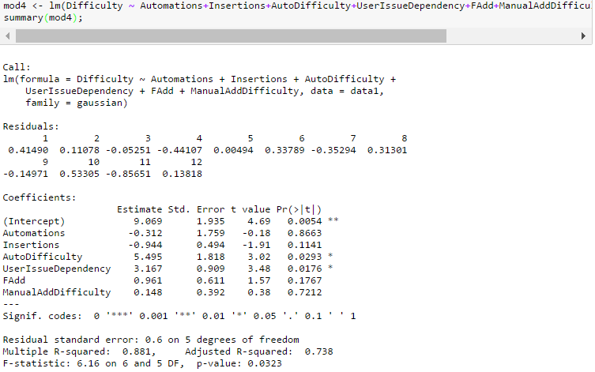
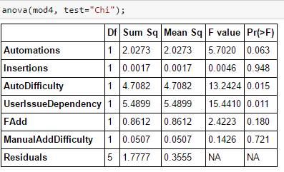
Notes:
P value which terms show significance
Adj R squared
Summary of overall goodness of fit
Fraction of overall variance the model accounts for

Slide 18
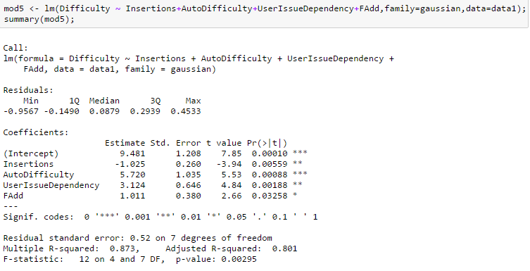
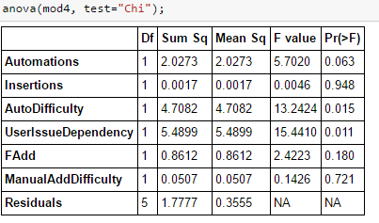
Predictor Weights
Difficulty ~= -1.025(Insertions) + 5.72(Automation Difficulty) + 3.124(UserIssueDependency Flag) + 1.011 (Fadd)
Notes:
Difficulty ~= -1.025(Insertions) + 5.72(Automation Difficulty) + 3.124(UserIssueDependency Flag) + 1.011 (Fadd)
P-value of AutoDifficulty and UserIssueDependency
Strong evidence

Slide 19
Future Work
Predict Difficulty of any further work
Quantify the benefits of restructuring the data architecture
Visualization of Data Structures
Doxygen paremeters to Neo4j

Slide 20
Future Work
Doxygen
Semantic diff between relevant files of two different branches
XML output of different branches convert to Canonical XML
Diff of two xml branches
3rd Party Tool- Smart Differencer

