Slide 1
Capstone final project
Opening a Thai restaurant in Manhattan, New York

Slide 2
Context and business problem
The City of New York, usually called either New York City (NYC) or simply New York (NY), is the most populous city in the United States. With an estimated 2018 population of 8,398,748 distributed over a land area of about 302.6 square miles (784 km2), New York is also the most densely populated major city in the United States.
My client wants to open a new Thai restaurant chain in Manhattan area, so I only focus on that borough during my analysis. The objective is to locate and recommend to the management which neighborhood of New york city will be best choice to start a restaurant. The Management also expects to understand the rationale of the recommendations made.

Slide 3

Data Selection
To identify the characteristics of our competitors' venues in Manhattan, we would first need to find out the number of Thai restaurants in Manhattan currently and their location.
We then used Google Map API to find their geographic coordinates based on their postal code addresses.
In Manhattan, there is 1763 sushi bars are currently operating.

Slide 4
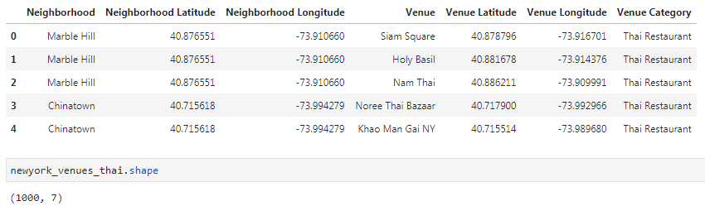
Data Selection
Next, we also used Google Map API to find their geographic coordinates of the 5 locations shortlisted for the Thai restaurants:
Table 2: Data frame containing geographic coordinates of our 5 shortlisted locations

Slide 5
Methodology
Addresses are converted into their equivalent latitude and longitude values.
Foursquare API is used to explore neighborhoods in Manhattan, New York.
After that, explore function to get Thai restaurants categories in each neighborhood.

Slide 6
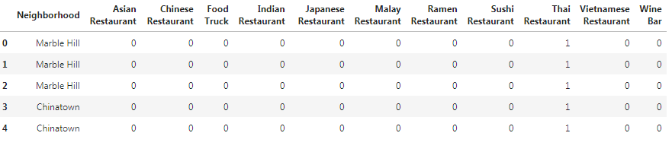
Methodology

Slide 7
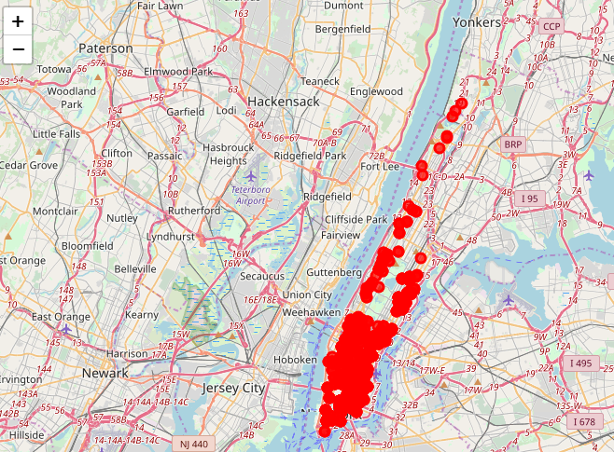
Methodology
Thai restaurants in Manhattan

Slide 8
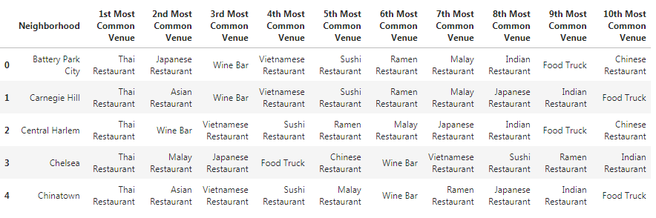
Methodology
Then using this feature to group the neighborhoods into clusters K-means clustering algorithm will be use to complete this task. And also, the Folium library to visualize the neighborhoods in Manhattan and its emerging clusters.

Slide 9
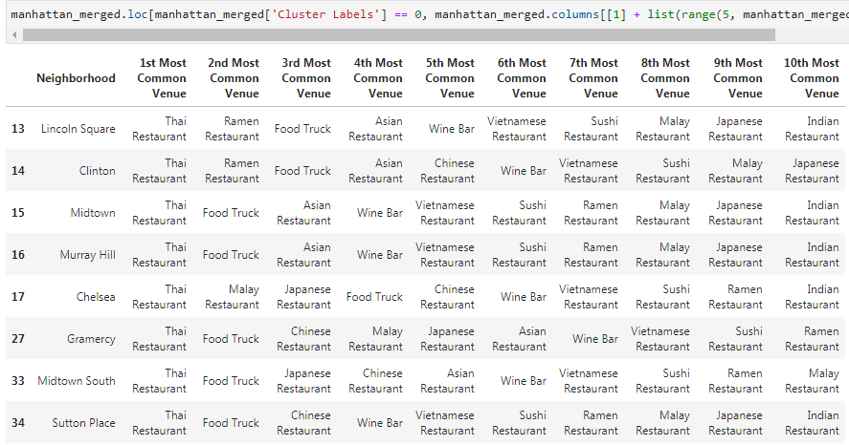
Results
Using K-mean to clustering data area with less number of sushi bars
Cluster 0

Slide 10
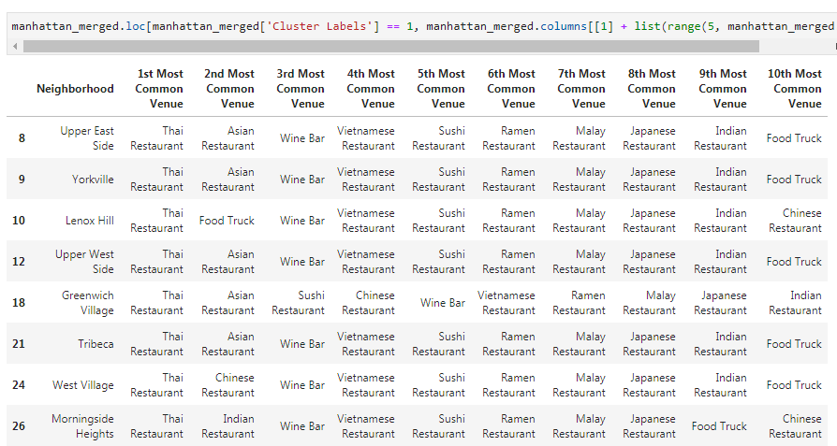
Result
Cluster 1

Slide 11
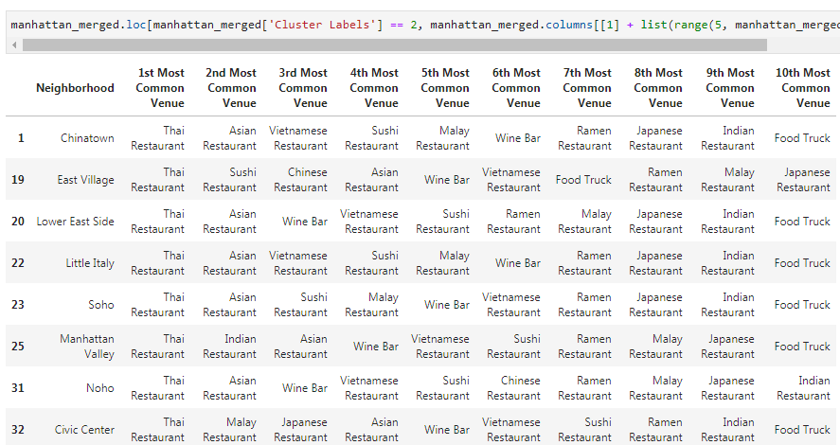
Result
Cluster 2

Slide 12
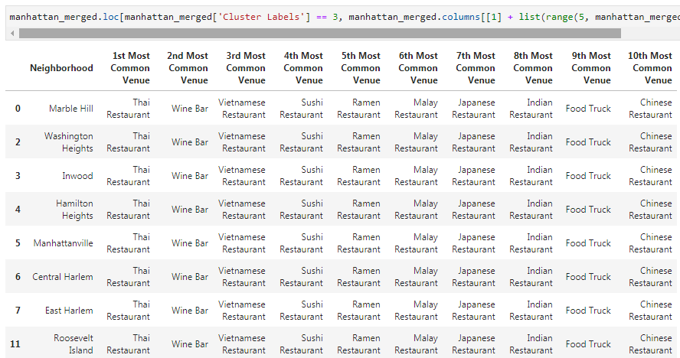
Result
Cluster 3

Slide 13
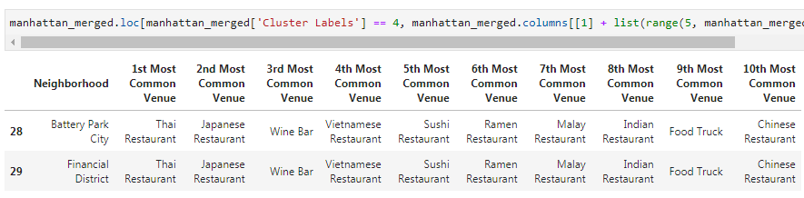
Result
Cluster 4

Slide 14
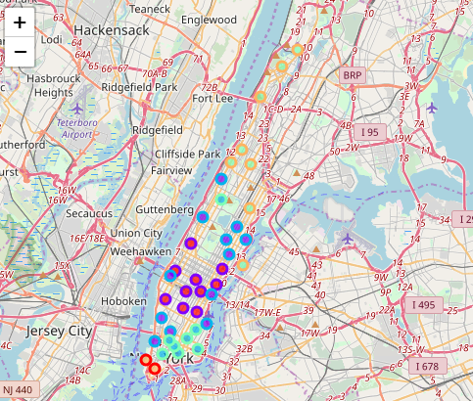
Result

Slide 15
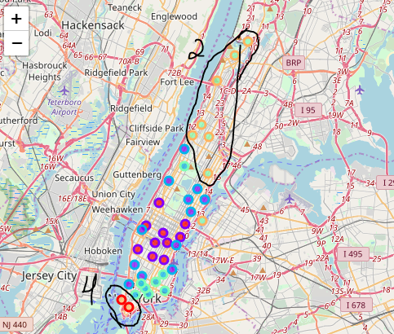
Result
Based on dataframe analysis above Cluster 2 and Cluster 4 areas are the best places to open a new sushi bar business.

Slide 16
Discussion
This analysis is performed on limited data. This may be right or may be wrong. But if good amount of data is available there is scope to come up with better results.
There is high competition in Midtown and Soho so it is very risky to open business in these areas.
Central Harlem has also potential where closes to Morningside Heights area.
It can be done more detailed analysis by adding other factors such as transportation, demographics of inhabitants.

Slide 17
Conclusion
Although all of the goals of this project were met there is definitely room for further improvement and development as noted below. However, the goals of the project were met and, with some more work, could easily be developed into a fully pledged application that could support the opening a business idea in an unknown location.

