Slide 1
Miscellaneous notes on what has been done

Slide 2
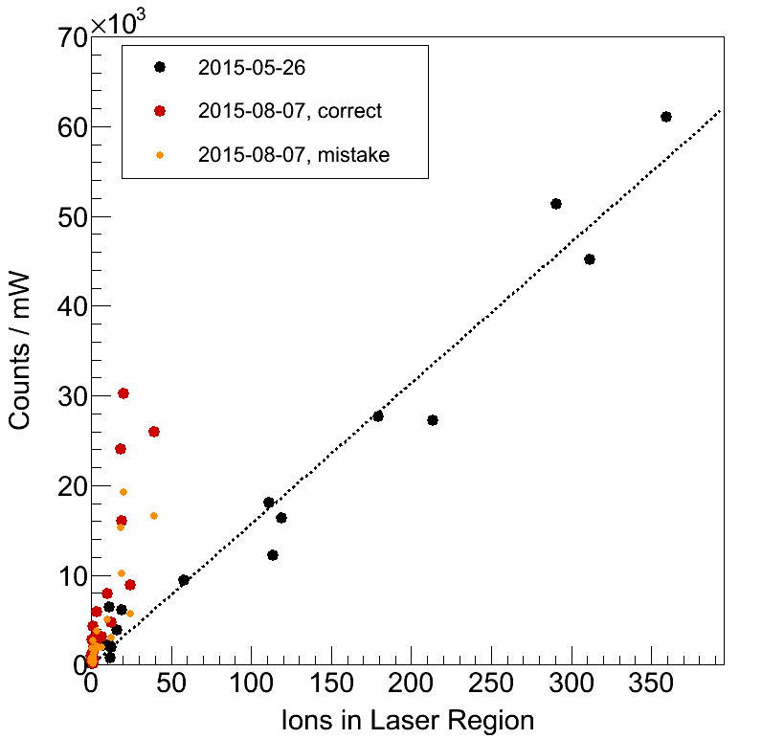
… the slope, after scaling, um actually it’d be good if you re-did this.
“correct” means after taking out the x1.57 which shouldn’t have been in there.

