Slide 1

MILCIV: Visual ML System for Identifying and Minimizing Civilian Fatality in Urban War Zones
Walter Pach & Vera Svensson

Slide 2
Problem Statement
Can object classification models be used to differentiate between military and civilian vehicles?
If so, what technology is efficient at doing so, and can it be deployed reliably?
Influences
Increased need for AI models in human-dependent environments
Return to conventional nation-state warfare, more distinction between civilian and military actors
Edge deployable, light, quick and accurate

Slide 3
Technical Challenges
Data Preparation
Standardizing image resolution using scaling
Automation
Difficulty automating the data preparation and training process, especially for MobileNet
Front-End Server Deployment
Developed custom server for serving the model, including all necessary functionality without overloading local environment

Slide 4
Related Works
TensorFlow
Open-Source platform for implementing machine learning
MobileNet
Implementation of neural networks for efficient convolution on mobile/embedded devices
Low resource consumption, sacrifices some accuracy for speed of processing
Depth-wise convolution
SSD
Single-Shot Multibox Detector
Uses neural network architecture to classify objects based on a feature-overlay
Generates classification predictions at all different thresholds

Slide 5
Our Approach
Data: Pre-labeled publicly available set
Preparation: Configuring SSD and MobileNet
Training: TensorFlow, 50,000 steps
Evaluation: Every 100 steps, generating a graph
Linting: GitHub Actions running Super-Linter
Useability: Developing a front-end in HTML, JS, CSS and Python

Slide 6
Our Approach
User Input (image file)
Front-End Application (JavaScript)
Back-End
Image Encoder (base64)
Image Decoder
AJAX Request
Inference
Display
Image Encoder

Slide 7
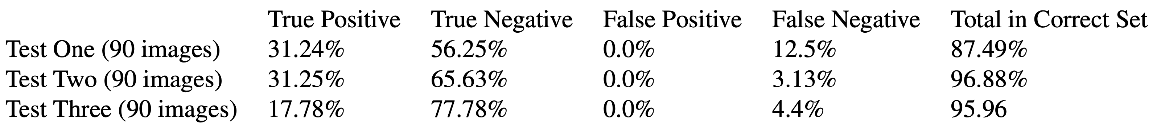
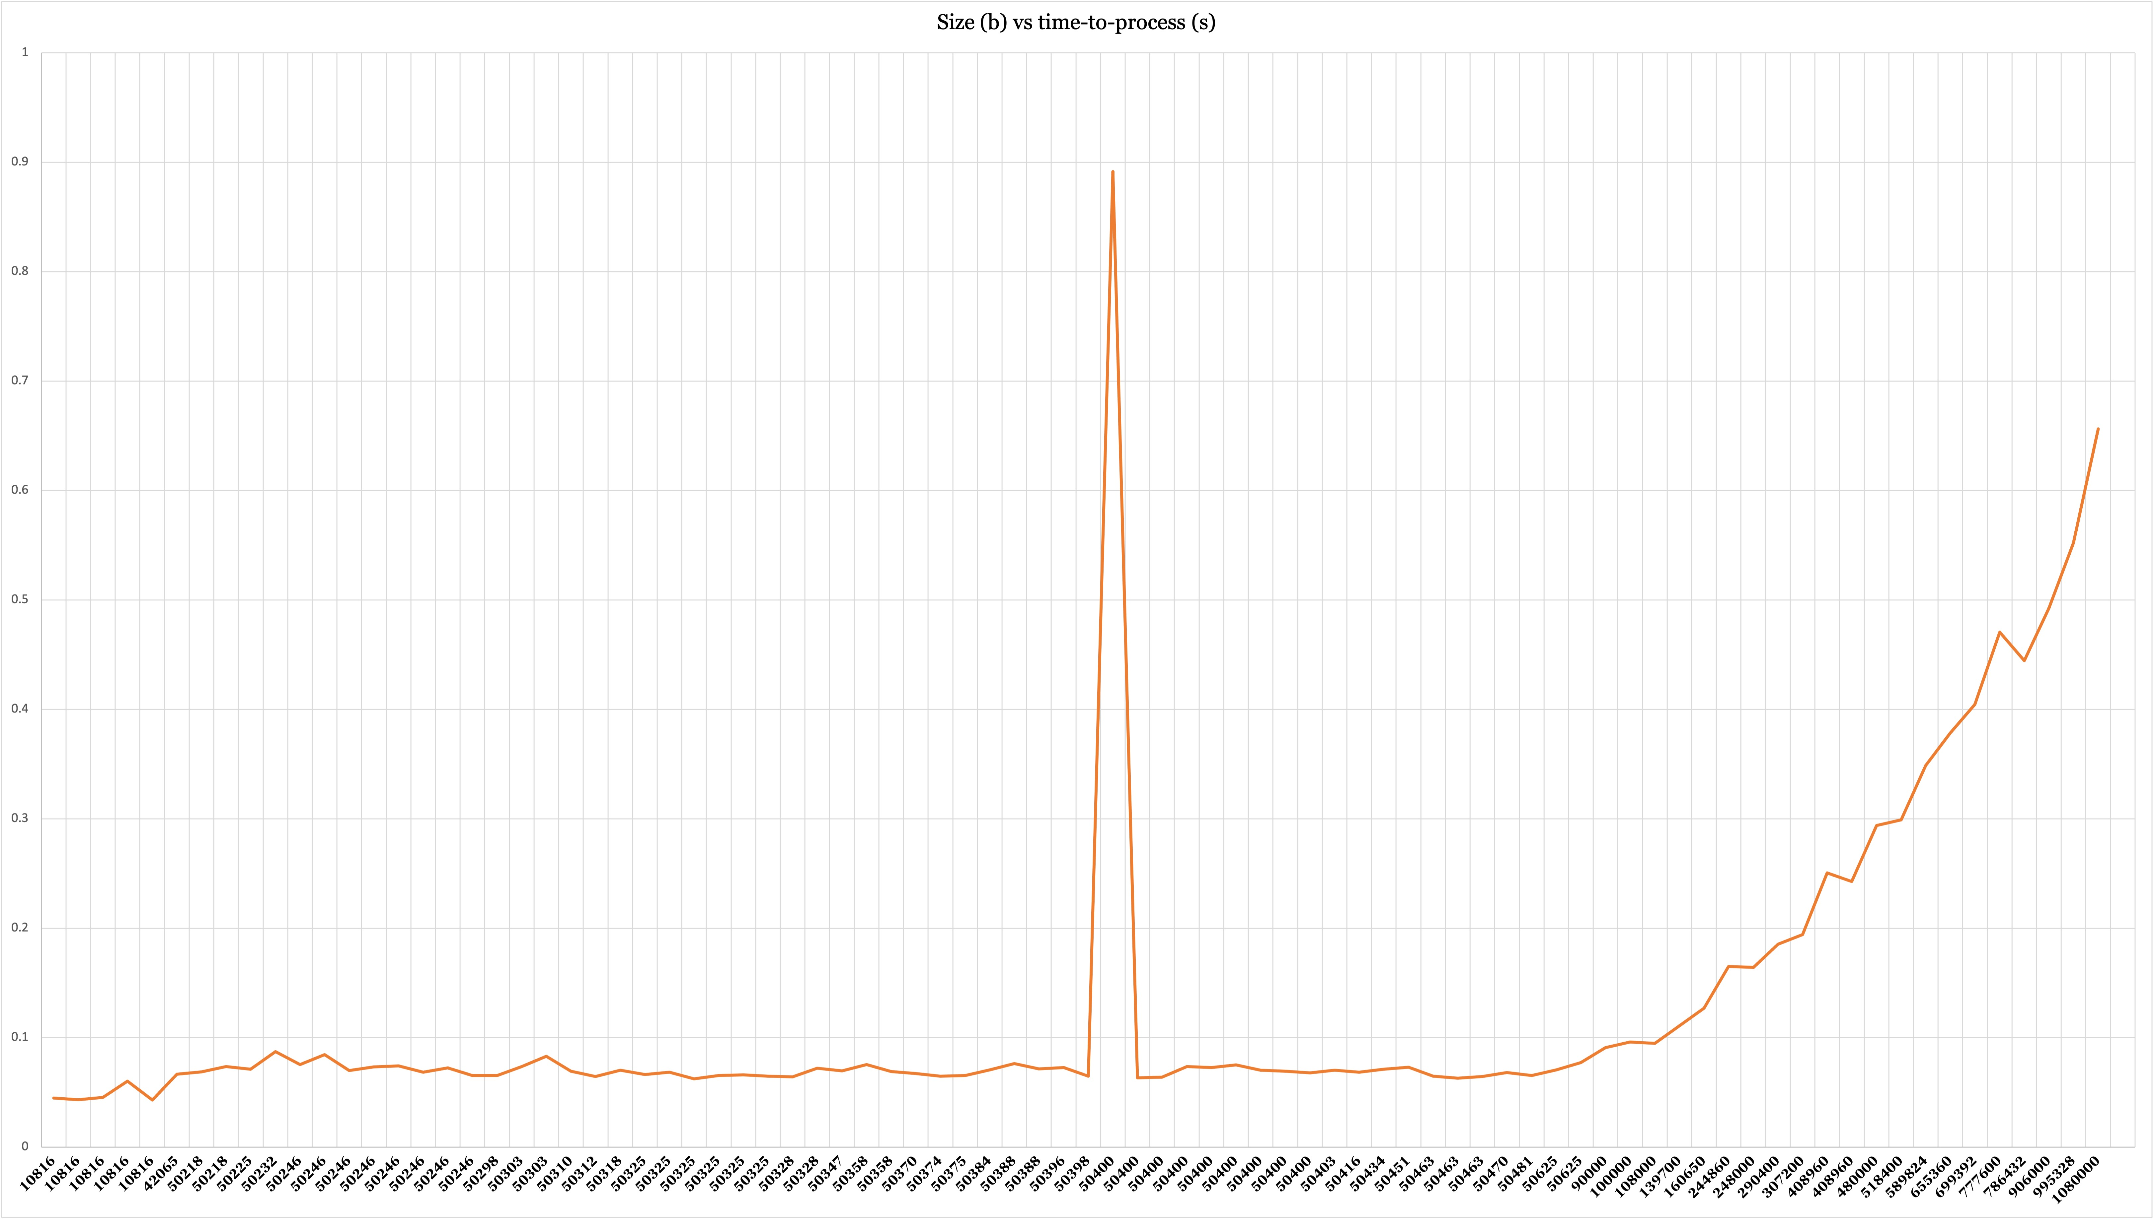
Results
Accuracy
Inference time dependent on image size
Front-end with server running locally

Slide 8
Conclusion
Product
Reached our most of our goals
Front-end was successful
Automated linting unnecessary
Future
More robust testing needed
Experiment with more parameters
Move to Rust
Threading

Slide 9
DEMO

