Slide 1
Kommunikationen Plattform
Dr. Felix Beckmann, Dr. Lars Lottermorse,
Igor Khokhryakov

Slide 2
Agenda
1. Introduction
2. Architecture overview
3. Technologies used
4. Goals

Slide 3
Part of the standard data format project (HDRI).
The project is dedicated to collect pre-experiment information
Standalone web-based platform
Provides access to the information after experiment
Notes:
This slide should describe the place of the system within borders of the big project “data format and etc”

Slide 4
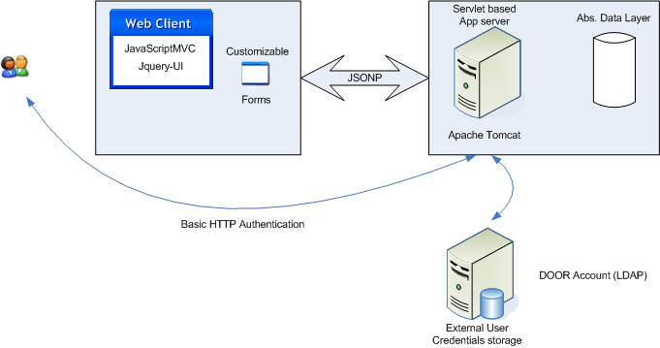
Architecture overview
Notes:
Place picture of the architecture here

Slide 5
Technologies used
Security
  Basic HTTP Authentication
Client side
  JavaScriptMVC (ver. 1.5)
  jquery-UI (ver. 1.8)
Server Side
  Servlet based business logic (servlet api 2.4)
  Apache Tomcat servlet container (ver. > 7)
Transport
  JSONP

Slide 6
Benefits
Client and server side development separated
Well established development lifecycles (Testing, Deployment)
Xplatforming
Possibility of external user accounts source usage (dedicated LDAP server)
Notes:
Quick talk about the benefits of the technologies chosen …

Slide 7
Framework for further usage
Flexibility in changing different parts of the system
Heavy reused code to new code ratio can be achieved
  Implement forms
  Implement abs. Data layer… Voila!
Notes:
For instance transport can be changed to different one or client can be replaced with different implementation
The most part of the system can be reused for different
The proposed architecture is designed to be adopted for different needs (Tomography, SAX etc). Only

Slide 8
Quick JavaScriptMVC overview
A good implementation of the MVC pattern
Code generation tools
Testing tools
Deployment tools
Compromised balance between development automatization and simplicit
JavaDoc like documentation
More info: http://1-5.javascriptmvc.com/index.html
Notes:
Dynamic controllers binding. Compileable HTML templates (html+javascript). Models – javascript object model wrapped around transport
Cli utility for main parts of the program generation
Testing console with unit and functional tests
Script compression. Easy integration with ant and maven scripts
Not too complex to learn and rather open for understanding, from the other hand large raw code base should be written

Slide 9
Quick JSONP overview
JSON with Padding
JSON – JavaScript Object Notation
Very easy in use, i.e. very little amount of the developer efforts is required
Notes:
JSONP – is a pattern of using JSON in client-server communications
JSON data wrapped with javascript function call
On a server side one can introduce single servlet with request/response logic and then use it with different logic

