Slide 1
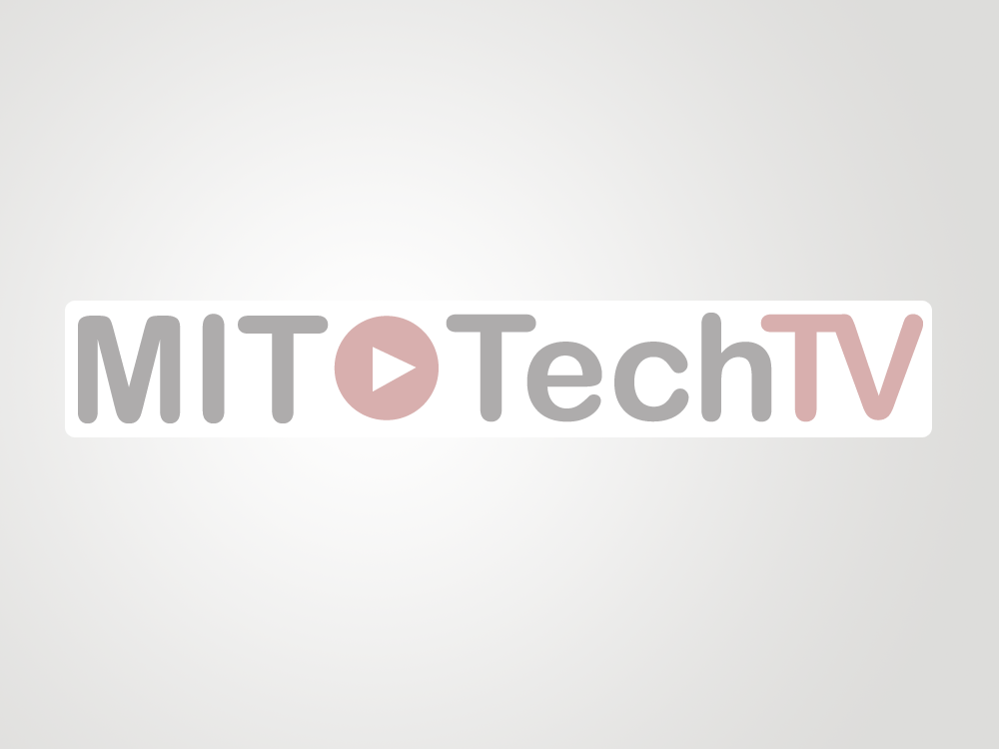
The Institute’s Web Video Platform For All
Ready and running to serve the Educational, Research and Outreach needs of MIT!
http://techtv.mit.edu

Slide 2

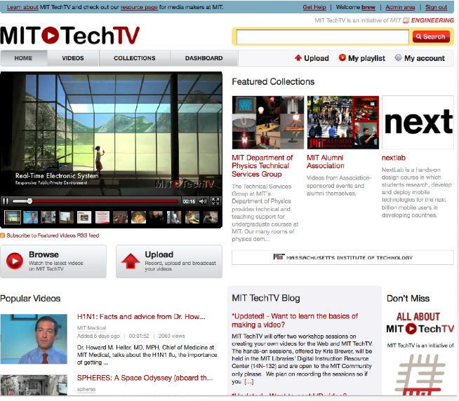
http://techtv.mit.edu

Slide 3
Background
MIT TechTV first launched in April 2007 as an initiative of the School of Engineering and the Libraries.
Originally built off of Blip.tv.
Now customized and owned by MIT.
MIT TechTV uses Viddler.com for transcoding and delivery to MIT TechTV’s world-wide audience.
July 1, 2009 - Most important event for MIT TechTV… JOINED THE LIBRARIES!
http://techtv.mit.edu

Slide 4
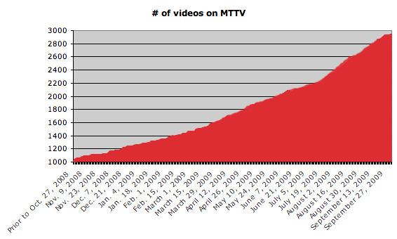
Statistics
Total number of videos on MIT TechTV 218
as of Dec 1st, 2007:
Total number of videos on MIT TechTV 1,050+
as of October 1st, 2008:
Total number of videos on MIT TechTV 1,600+
as of March 26th, 2009:
Total number of videos on MIT TechTV 2935+
as of October 1st, 2009:

Slide 5
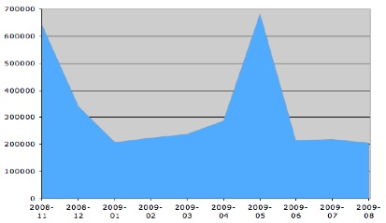
Statistics Continued
# of Video Hits:
All of 2007 - ~725,000
January 2008 through June 2008 ~1.305 mil
July 2008 through December 2008 ~3.185 mil
January 2009 through March 2009 ~555,000
March 2009 through Oct 1, 2009 ~2.13 mil
Total Video Hits on MIT TechTV almost 8 (up to October 1st, 2009) million hits
http://techtv.mit.edu

Slide 6
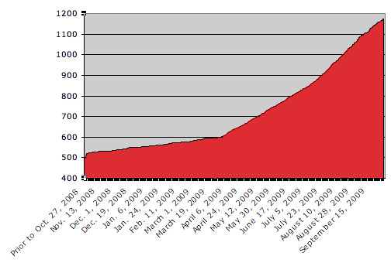
Statistics Continued
# of MIT Users on MIT TechTV:
As of March 26th, 2009: 600
As of October 1st, 2009: 1175

Slide 7
Major DLCs using MIT TechTV
School of Engineering
Physics Lecture Demonstration Group
Office of Educational Outreach Programs
Industrial Liaison Program
Center for Transportation and Logistics
MIT Sloan
New Media Literacies
Edgerton Program
MIT News Office
Legatum
MSRP
Foreign Languages and Literatures Section
MIT Alumni Association
Lemelson-MIT Program
Koch Institute
MIT 100K Business Plan Competition
LAI
MIT Museum
MIT ESD
MIT Energy Conference
RLE
BLOSSOMS
PSC
CCC
AeroAstro
URIECA
Singapore-MIT Gambit
Game Lab
Research Science Institute
Compton Lecture Series
MIT Resource Development
Global Initiatives
2.003
1.961
2.007
And many, many more
http://techtv.mit.edu

Slide 8
How is MIT TechTV Used?
Education - Research - Outreach
Lecture Capture
Course Review
Demonstrations
Research Sharing
Student Activities
Conferences, Seminars and Presentations
Alumni and Donor Relations
Training
Special Events
Life at MIT
Much More
http://techtv.mit.edu

Slide 9
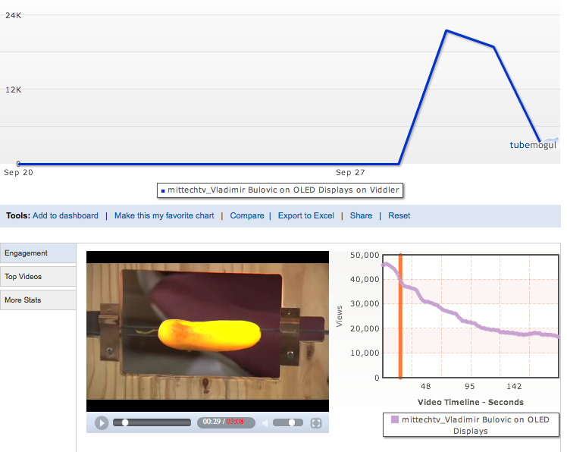
Viral Videos
MIT TechTV videos have the potential to become “viral” and spread your message to a huge audience in no time. For example, just this week the video “Vladimir Bulovic on OLED Displays”, featuring a glowing pickle, was picked up by some blogs and reached 65,000 views in a matter of days!
http://techtv.mit.edu

Slide 10
Streamlined Video Delivery
MIT TechTV is the key component to get a lecture/event, that has just been captured, posted and live to your audience in a matter of hours or less!
Examples
  15.053 Recitations --> review for students
  Koch Institute: Topping-off Ceremony --> outreach and development
  MLK Breakfast --> building community
  Compton Lecture Series --> broadening your audience
http://techtv.mit.edu

Slide 11
What Features on MIT TechTV support delivery of Educational content?
In-line Commenting - allows a user to insert comments/chapter markers in the timeline of a video which creates corresponding links to allow a “quick jump” to that spot/time in the video through a web link.
Sub Collections - allows a users to have many different groupings of videos, each with their own information, in their single account/collection.
Additional Files - allows a user to upload additional supporting files to a video’s page to make it one stop shopping for a viewer (syllabus, pdf, images, other).
Private Feature - allows a user to make a video private and share it only with those they want (course roster, lab, other colleagues, etc.).
Groups - allows any user to designate other MIT TechTV accounts (MIT or outside guest accounts) to access all of their private videos by default. Perfect for courses, discussion groups, labs, etc.

Slide 12
Other Custom Features
More Detailed Video Statistics - on March 10th, we turned on Tubemogul stats which gather more detailed and video specific information such as:
  How long a video is viewed on average,
  What part of the video viewers start and stop watching
  Global Audience Attention Span
  Much, much more
Ability to embed simple or full player - full player allows you to also embed “in-line comments” if you want and bring the links into your own website (great for making section or chapter markers in a single video).
Sharing Features - users can allow or disable sharing, download and embed features on a per video basis.
Yahoo! Media RSS/iTunes OneClick Feeds - allow users and visitors to quickly and easily subscribe or syndicate content to their own websites, other platforms, etc.
Moderated Commenting - users have control to remove or turn on/off commenting for their own videos on a per video basis.
Custom Thumbnail - users can now set the thumbnail they want for in MIT TechTV or for their video being embedded in other sites.
Much, much more.
http://techtv.mit.edu

Slide 13
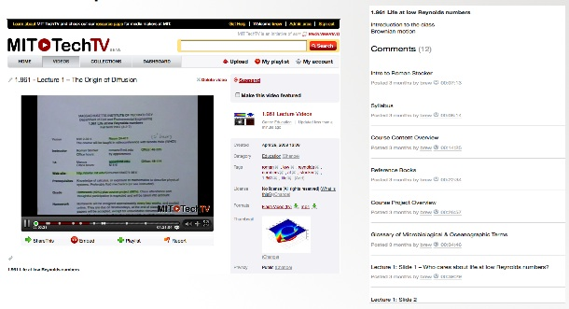
Examples - In-line Comments/Chapters
Prof. Stocker filmed and posted all lectures for 1.961 for his students to be able to review lectures at any time. In-line commenting was used to break up sections for easy navigation to topics.

Slide 14
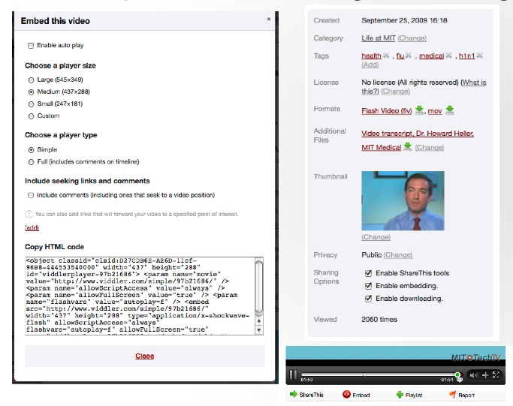
Examples - Embedding & Sharing

Slide 15
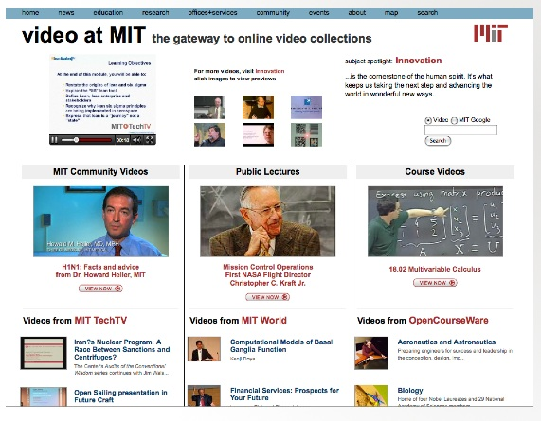
Examples - Media RSS Feeds
Watch.mit.edu - MIT’s Video Gateway

Slide 16
Examples - Private Videos
The Gleason Lab uploads “private” videos to share among the lab for other colleagues to review research tests and data while not allowing the public to see keeping their research safe.
The Legatum Center uploads “private” videos for speakers, center members and others involved in the approval process to view and review before making the videos “public”.
The Industrial Liaison Program uploads “private” videos to allow them to embed the videos in their own website to take advantage of sign-in security already set up on their site for members only. The same can easily be done with Stellar for courses.
HASS Course 21W - East Boston Social History Project uploads “private” video to share clips between team members for compilation and knowledge sharing.
H2O-1B (Safe Water for 1 Billion Dollar Project run by Senior Lecturer Susan Murcott) uploads “private” videos of tutorials on how to use slow bio-sand water filters in several languages to share with groups in Ghana to make sure it is accurate before making the video “public”.
http://techtv.mit.edu

Slide 17
Comments from Current MIT TechTV Users
“I have been really happy using Tech TV. It is really user-friendly…I am really looking forward to learning more about getting statistics about our videos. I also like the chapter function…We hope to use Tech TV to get the word out about the Legatum Fellowship on campus.”
Anna Omura - Operations Manager, Legatum Center for Development and Entrepreneurship
“We produced a video related to computing at MIT and posted it on Tech TV last August 2008…All in all my experience with Tech TV has been one of the best I've ever had.”
Phyllis Galt - Computing Support Services, Information Systems & Technology
“As you know, we love MIT TechTV. It has provided a wonderful video platform for our BLOSSOMS video learning modules. We look forward to embedding Web 2.0 'user feedback capabilities' in our embedded MIT TechTV sites, embedded in our BLOSSOMS web pages. Looking forward to the next 2 years, the next 10 years! :)”
Dick Larson - Director, CESF & Mitsui Professor, Civil Eng & ESD
“TechTV has a better interface than YouTube and has given me a targeted place to put my tech videos. It makes cross-posting very simple and the statistics tracking is great. (Just broke 150,000 Total views today.) Very glad to continue posting.”
Shane Colton - Mechanical Engineering - School of Engineering
http://techtv.mit.edu

Slide 18
Comments to videos on MIT TechTV
I have been a mentor for Team 126 - Gael Force since 2000. This video sums up all that I have tried to convey to my students. This is the way the world should work and in some cases, does work. Thank you for strengthening my commitment
— Jim Brodrick Team 126 Woodie Flowers Award Winner on video “2.007 Documentary”
I am a 14 years old girl my name is Marcelina and I am Polish girl i have been studying English for 3 years already and I am very amazed by these videos that are being posted. I have been interested in MIT for a long time. Seeing these videos have inspired me to study more and choose my future. I love to know many things especially about technology and modern art. And I love this video
— Anonymous User on video “Seeing Machine”
Nice video can you make them longer I'm really interested not only with electrical engineering and computer science but MIT.
— Anonymous User on video “Aaron’s Introduction”
My jaw just fell to the floor. I better pick it up
— Anonymous User on video “The Making of Mens et Mans (in origami), Vol. 1”
uhm...I love you, Mr. Lewin. You are the best, to be honest. I'd like to have a teacher like you. Now I understand (in addition of the money) the main fact that make de USA universities the best in the world: you know how to motivate the people. congratulations.
— a guy from Spain on video “Impulse Demo #17 Impulse CO2”
I'm from Poland and I must to say physics is great with Walter Lewin
— Anonymous User on video “Demo Lecture 14 8.01 Physics I: Classical Mechanics, Fall 1999”
I love it and i feel more worldwide and I’m only 11
— Anonymous User on video “Scratch Overview”
Excellent! Great! I’m a Mexican teacher from Guadalajara, Mexico. Wowow what kind of installations of the teacher
— Anonymous User on video “Walter Lewin Video Promo”
Wow~ simply amazing.
— Anonymous User on video “Work Potential Energy Demo Lecture 11”
Wow! That’s cool!
— Anonymous User on video “Robocopter”
Extraordinarily brilliant!!!!!!!!!!!!!!!!!!!!!…
— Anonymous User on video “Doctor Doctor Episode 1: Steel Drum Implosion”

Slide 19
Thank You!
http://techtv.mit.edu

