Slide 1
Excel Fundamentals
D-Lab at Berkeley
Intelligent research design for data intensive social science

Slide 2
Content
Excel Overview
How Formulas Work
Math, Date, Text, and Logic Functions
Conditional Calculations
Charts
Pivot Tables
Lookup Functions

Slide 3
Excel as an Analytics Tool
Pros
Cons
Functionality
Quickly inspect and summarize data
Flexible for charts and tables
Ease of Use
Integrate easily with other programming tools, or with final report/presentation
Intuitive early learning curve
Widespread adoption
Widespread use and familiarity
Incredible online resources to solve problems
Can handle huge variety of tasks
Not a Database
Holds up to 1,048,576 rows, but calculations are slower at a fraction of maximum size
Advanced Statistics are Limited
Not intended for complex statistics or econometrics, limited functions available
Only basic linear programming (optimization)
Other
Tedious to automate production tables and charts at scale
Costs money! (Google Sheets is free)
Mac vs PC differences

Slide 4
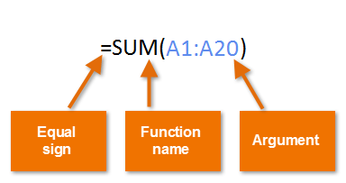
How Excel Functions Work
Functions Have 3 Ingredients
Usually arguments will contain cell references
Cell references are by default dynamic but we can choose to lock cell references to meet our needs using $ symbol:
Row lock (A$1) - as formula is dragged down + right, only column reference will update
Column lock ($A1) - as formula is dragged down + right, only row reference will update
Double lock ($A$1) - as formula is dragged down + right, cell reference will not update
Begin with an equal sign to signal that what comes next is a formula (rather than data)
Specify the function name which is then immediately followed by parentheses
Within the parentheses we pass arguments (inputs) to the function, which the function uses to calculate outputs

Slide 5
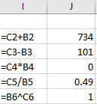
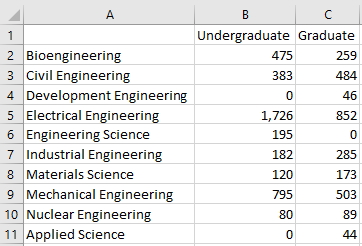
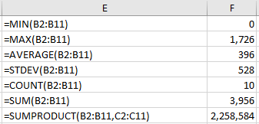
Math Functions
Basic Operators (+, -, *, /, ^)
Data
Math Functions

Slide 6
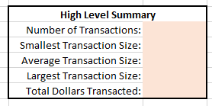
Challenge Exercise - Math
Complete the orange-filled cells

Slide 7
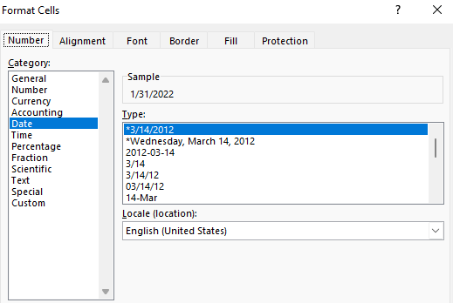
Date Functions
Excel has many useful functions to deal with date and time
June 1, 2020 = 6/1/2020
Get specific attributes
Add/subtract days and dates
YEAR(“6/1/2020”) = 2020
MONTH(“6/1/2020”) = 6
DAY(“6/1/2020”) = 1
6/1/2020 + 8 = 6/9/2020
6/1/2020 - 1 = 5/31/2020
6/1/2020 - 6/1/2019 = 366
DATEDIF(“6/1/2019”, “6/1/2020”, “D” ) = 366
Combine attributes into date
Get end of the month
DATE(2020, 6, 1) = 6/1/2020
TODAY() = [today’s date]
EOMONTH(“6/1/2020”, 0) = 6/30/2020
EOMONTH(“6/1/2020”, -1) = 5/31/2020
Displayed date format is a formatting decision:

Slide 8

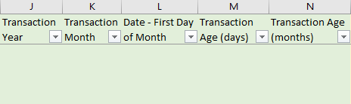
Challenge Exercise - Dates
Complete the green-filled cells

Slide 9
Text Functions
Split and combine text data
Syntax
Example
LEFT(text, number of characters)
RIGHT(text, number of characters)
MID(text, start character, end character)
LEN(text)
LEFT(“Testing”, 4) = “Test”
RIGHT(“Testing”, 3) = “ing”
MID(“Testing”, 4, 6) = “tin”
LEN(“Testing”) = 7
CONCAT(text1, text2, …)
CONCATENATE(text1, text2, …)
text1&text2&...
TRIM(text)
CONCAT(“Linked”, “in”) = “Linkedin”
CONCATENATE(“D”, “-“, “Lab“) = “D-Lab”
“Go”&” “&”Warriors“ = “Go Warriors”
TRIM(“ testing “) = “testing” (no edge whitespace)

Slide 10

Challenge Exercise - Text
Complete the gold-filled cells
City, State

Slide 11
Logic Functions
Most logic functions use a conditional test to determine if condition is TRUE or FALSE
Conditional tests use logical operators
=, <>, <, >, <=, >=

Slide 12

Logic Functions: IF
IF(conditional test, value if true, value if false)
IF(A25 < B25,
“A is smaller than B”,
“A not smaller than B”)
IF(A25 = B25,
“A equals B”,
“A and B are different values”)
Since 1 < 2 is TRUE, take the value if true which is “A is smaller than B”
Since 1 = 2 is FALSE, take the value if false which is “A and B are different values”

Slide 13

Challenge Exercise - Logic #1
Complete the dark grey-filled cells

Slide 14
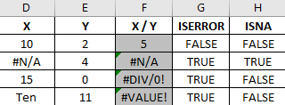
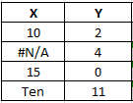
Logic Functions & Errors:
ISERROR, IFERROR, ISNA
Detect and handle errors & missing values
ISERROR(value) returns TRUE if argument is any error type, FALSE otherwise
ISNA(value) returns TRUE if argument is #N/A,
FALSE otherwise
IFERROR provides a backup option if an error occurs
IFERROR(function or value, value if error in evaluation)
These return the same thing:
IF(ISERROR(X1/Y1), “There is an error”, X1/Y1)
IFERROR(X1/Y1, “There is an error”)
Check specifically for N/A:
IF(ISNA(X2),“NA value detected”, “No NA value”)

Slide 15
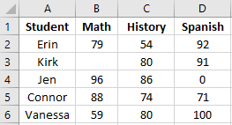
Logic Functions:
ISBLANK, ISNUMBER, ISTEXT
Test for basic characteristics of a cell
ISBLANK(A3) returns FALSE
ISBLANK(B3) returns TRUE
ISNUMBER(A2) returns FALSE
ISNUMBER(B2) returns TRUE
ISTEXT(A4) returns TRUE
ISTEXT(B4) returns FALSE
IF(conditional test, value if true, value if false)
IF(ISBLANK(B3), “Missing Test”, “Test Taken”)
IF(ISNUMBER(A6), “That’s a test score”, “That’s a student name”)
IF(ISTEXT(A5), “That’s a student name”, “That’s a test score”)

Slide 16
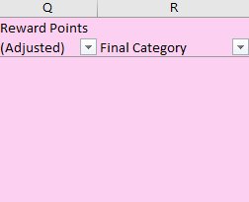
Challenge Exercise - Logic #2
Complete the pink-filled cells
If rewards are an error, calculate at 100 points per $1 spent
Blank categories should = “Home”

Slide 17
Logic Functions: AND, OR
Stack multiple conditions with AND & OR functions
AND(1 >2, 3>2) returns FALSE
OR(1 >2, 3>2) returns TRUE
IF(conditional test, value if true, value if false)
IF(AND(test1, test2, …), value if true, value if false)
IF(OR(test1, test2, …), value if true, value if false)
IF(AND(B5>60, C5>60, D5>60), “Connor graduates”, “Connor repeats grade”)
IF(OR(C2<60, C3<60, C4<60, C5<60, C6<60), “Someone failed history”, “Everyone passed history”)

Slide 18

Challenge Exercise - Logic #3
Complete the light grey-filled cells
“Groceries” and “Dining & Alcohol” categories are considered “Food”
All other categories are “Not Food”

Slide 19
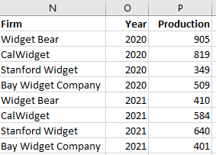
Calculation With Logic:
SUMIFS, COUNTIFS, AVERAGEIFS
Include/exclude cells in a calculation based on conditions
SUMIFS(sum range, criteria range 1, criteria 1, …)
Total widgets produced in 2020?
SUMIFS(P2:P9, O2:O9, 2020) = 2582
Total widgets produced by CalWidget?
SUMIFS(P2:P9, N2:N9, “CalWidget”) = 1403
AVERAGEIFS(average range, criteria range 1, criteria 1, …)
COUNTIFS(criteria range 1, criteria 1, …)
Company average widgets produced in 2020?
Number of firms in the data in 2021?
AVERAGEIFS(P2:P9, O2:O9, 2020) = 645.5
COUNTIFS(O2:O9, 2021) = 4
Average widgets produced annually by CalWidget?
Firms in 2020 with > 500 widgets produced?
AVERAGEIFS(P2:P9, N2:N9, “CalWidget”) = 701.5
COUNTIFS(O2:O9, 2020, P2:P9, “>500” ) = 3

Slide 20
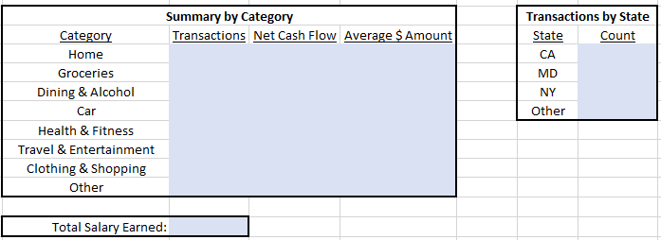
Challenge Exercise -
Logic with Math #1
Complete the blue-filled cells

Slide 21
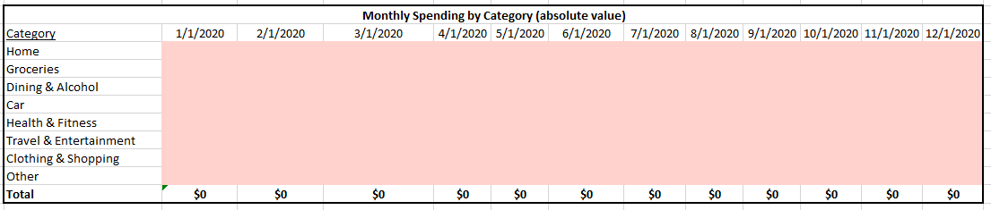
Challenge Exercise -
Logic with Math #2 (extra difficulty)
Complete the red-filled cells

Slide 22
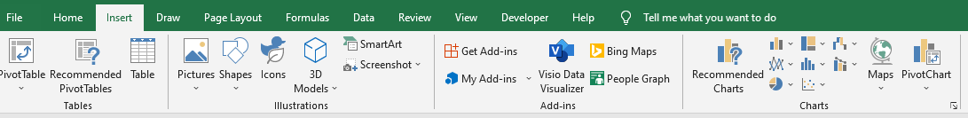
Data Visualization With Charts
Charts can show insights and patterns that are very hard to see in a table format
Making good visualizations is a combination of art and science
What is the primary goal of your communication?
What type of data are you working with? Time series? Comparison of groups? Percentages?
Who is the intended audience? Are they technical or non-technical? Do they require an aesthetically pleasing graph?

Slide 23
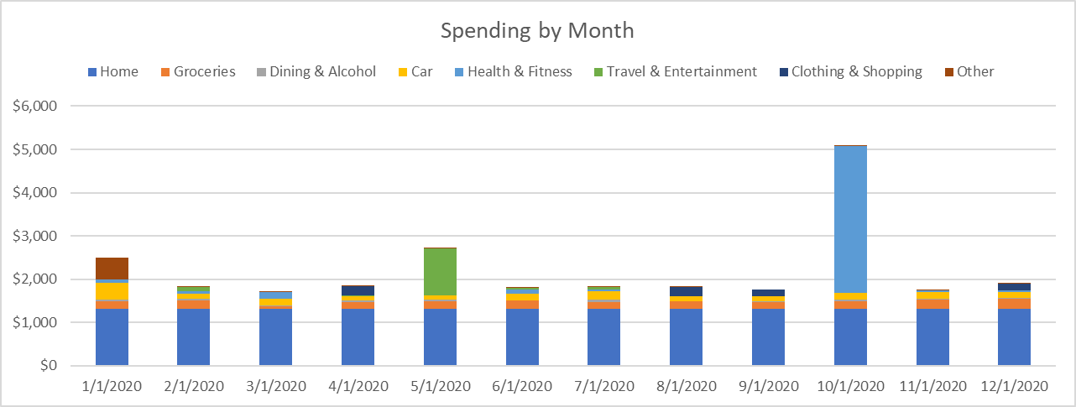
Challenge Exercise - Graph #1
Spending by Category over Time
Create the following graph

Slide 24
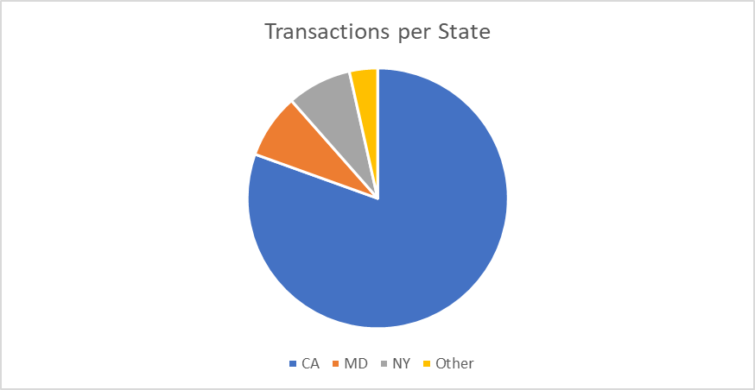
Challenge Exercise - Graph #2
Spending by State
Create the following graph

Slide 25
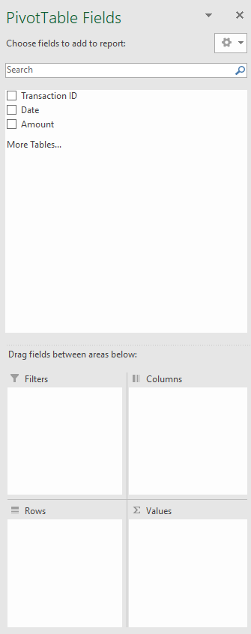
Pivot Tables: Drag and Drop Insights
Pivot tables are a no-code or low-code approach to analysis
3-Step Process to Creating a Pivot Table:
Select data to analyze and insert pivot table
Drag and drop fields from dataset into the relevant area to create exactly the table you’re imagining
Format the data labels, number values, and other aesthetics
Create an accompanying Pivot Chart if desired

Slide 26
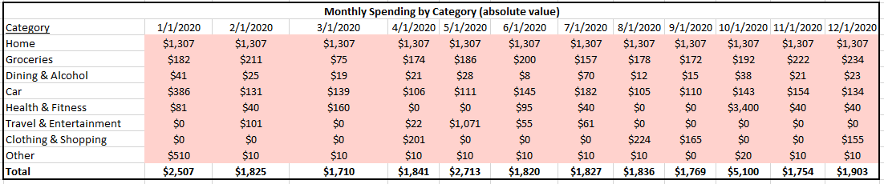
Challenge Exercise - Pivot Table #1
Monthly Spending by Category
Re-create our earlier table using a pivot table

Slide 27
Challenge Exercise - Pivot Table #2
Get Creative!
Create a pivot table of your choice to analyze the data
?
Once complete, interpret the table - what insights does it give?

Slide 28
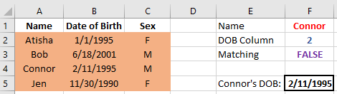
Lookup Functions:
VLOOKUP
VLOOKUP(what are we looking for,
where are we looking,
which column number is the data we want,
matching argument)
VLOOKUP(F1,
A2:C5,
F2,
F3)

Slide 29
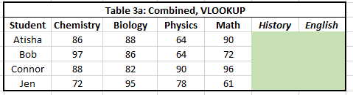
Challenge Exercise - VLOOKUP
Complete the green-filled cells

Slide 30


Lookup Functions:
MATCH
MATCH(what are we looking for,
where are we looking,
exact argument)
MATCH(“Bonds”,
B1:D1,
0)
= 2
MATCH(what are we looking for,
where are we looking,
exact argument)
MATCH(“Mix 2”,
A2:A4,
0)
= 2

Slide 31
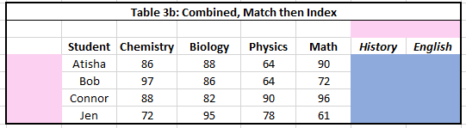
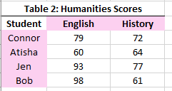
Challenge Exercise - MATCH
Complete the pink-filled cells (save blue for later)
Use MATCH to return position of Student or Subject in Table 2

Slide 32
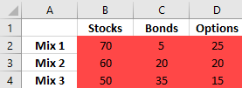

Lookup Functions:
INDEX
INDEX(where to look,
row #,
column #)
INDEX(B2:D4,
2,
2)
= 20

Slide 33
Challenge Exercise - INDEX
Complete the blue-filled cells (use completed pink as aid)

Slide 34
Lookup Functions:
INDEX-MATCH-MATCH
INDEX(where to look,
row #,
column #)
INDEX(where to look,
MATCH(),
MATCH() )
INDEX(B2:D4,
MATCH(“Mix 2”, A2:A4,0),
MATCH(“Bonds”, B1:D1,0) )
INDEX(B2:D4,
2,
2) = 20

Slide 35
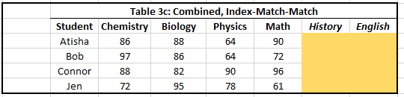
Challenge Exercise -
INDEX-MATCH-MATCH
Complete the gold-filled cells

Slide 36
Thank you!
dlab.berkeley.edu

