Slide 1
An effective search of information
Software aplicado a ciencias sociales
Por: William Martínez

Slide 2
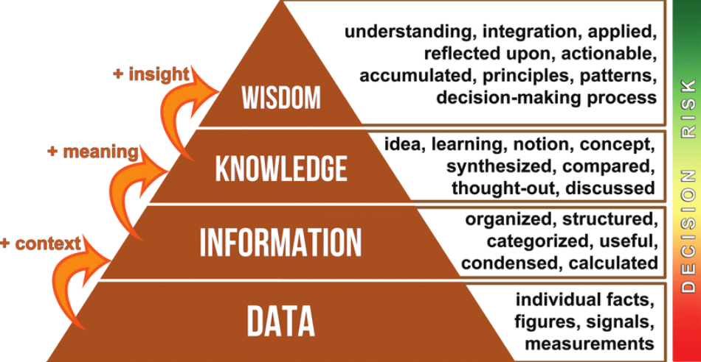
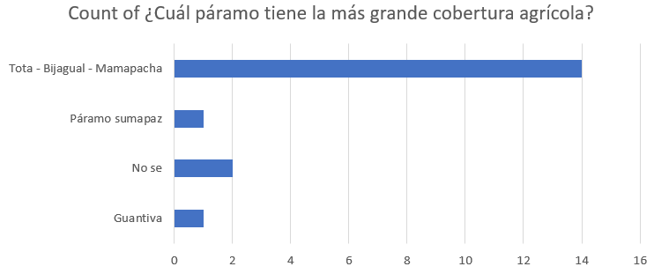

Slide 3
Boolean operators:
Software aplicado a ciencias sociales
Por: William Martínez

Slide 4
Aim of the class
What is a Boolean operator?
How does it work?
How to perform a Boolean search?

Slide 5
What is a Boolean operator?
A Boolean operator
The most important
It is a simple word used to CONNECT two or more IDEAS together
Help to WIDEN or NARROW a KEYWORD search
AND
OR
NOT
“”

Slide 6
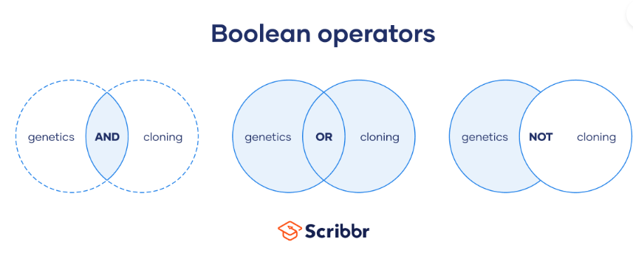
Provides results that contain both or all keywords
Provides results that contain the first keyword but not the second
Provides results that contain either keyword

Slide 7
Putting It Together
KEYWORDS + Boolean = Better Searching

Slide 8
Start Simple→Increase Complexity
QUEEN
QUEEN AND RULER
QUEEN AND RULER AND 19th CENTURY
QUEEN AND RULER AND 19th CENTURY AND GREAT BRITAIN
QUEEN AND RULER AND 19th CENTURY AND GREAT BRITAIN AND IMPACT
DATES, NAMES and PLACES can be used as MODIFYING KEYWORDS

Slide 9
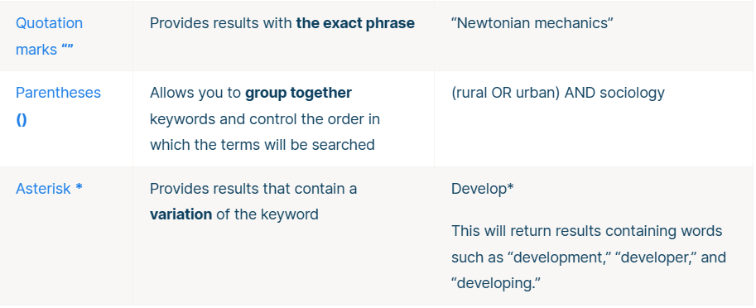

Slide 10








Conjunction AND
(pregrado + sociología +bogotá) -unal

Slide 11
Summary
Quotation marks “” = “For sentence”
Conjuntion (+) = A y B
Negation (-) = A and not B
Disyunction (OR) = A o B

Slide 12
Advanced search
Filetype:, one example is
“Conflictos del uso del suelo” filetype:pdf
Truncar

Slide 13
Some remarks
Pros
AND > reduces results and increases precision
OR > increases results and reduces precision
NOT > reduces results and increases precision
Cons:
AND > increases precision but removes information
OR > increases results but increases noise
NOT > reduces noise but removes information

Slide 14
Follow-up
Given the following need for information:
"scholarships and grants for film and video productions", which of the following equations in pseudo code is better?:
(scholarships AND grants) AND (cinema AND video)
(scholarships OR grants) AND (cinema OR video)
Copy the wording of this question and the chosen answer into your report.

Slide 15
Advanced search in academic databases
Software applied to social sciences
By: William Martínez

Slide 16
Tips
Is your database relevant to your topic?
Check for spelling mistakes or other errors in entering the search terms
Add a synonym, related term for a concept using OR
Are the Boolean operators used correctly?
Use truncations/wildcards to find variations of your terms
Snowball backward and forward in time (check for keywords)

Slide 17
Data bases and academic data bases
It is an organized information storage system that allows you to enter, store, retrieve and manage data efficiently.
Scopus, SciELO, google scholar and Redalyc

Slide 18


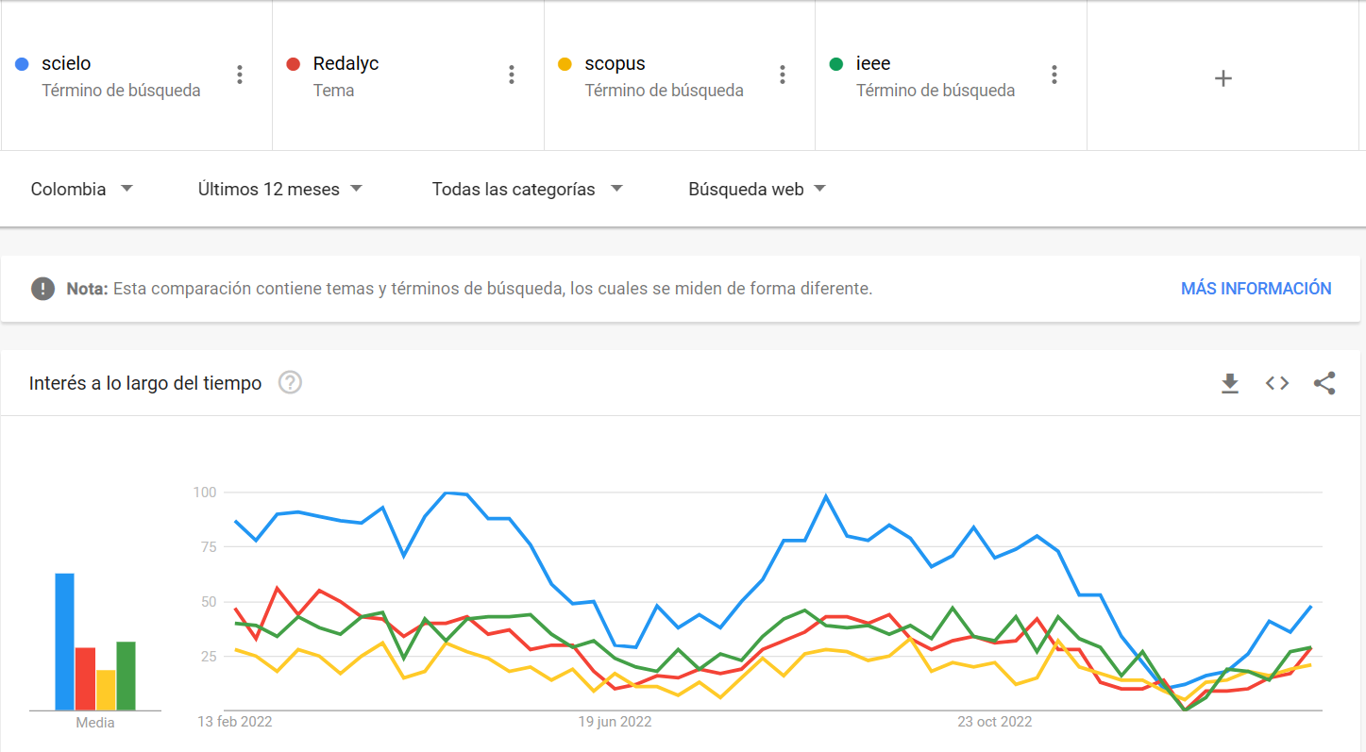


Slide 19
Workshop
Try to think in a research question:
For example: Conflicto armado en el Putumayo después del proceso de paz en Colombia
How many results do we obtain from this search?
Scopus
Google scholar
Scielo

