Slide 1
Creating Citations & Bibliographic Entries
Software aplicado a ciencias sociales

Slide 2
What is a citation?
A citation attributes the use of words, ideas, or information taken from another author, or any other work as part of scholarly research.
If the information is not general knowledge and it came from somewhere else, then a citation is necessary to give credit to the source.

Slide 3
What is an in-text citation?
An in-text citation is also called a parenthetical citation.
An in-text citation can be a direct quote, summary, or a rephrased thought or idea from another source.
An in-text citation draws the reader's attention to an outside source and denotes a reference in the bibliographic page.

Slide 4
Citation examples
…esto ha sido visto en un estudio australiano (Conger, 1979).
Conger ( 1979) ha argumentado que…
In 1979, Conger realizó un estudio que demostró que…
(Davidson & Harrington, 2002)
Davidson and Harrington (2002)...

Slide 5
What is a bibliographic style?
Bibliographic elements consists of information needed to verify the source of information.
The style of the citation or bibliographic elements depends upon the school for which the academic paper is written.
The style determines punctuation, order of presentation, and which bibliographical information must be included

Slide 6
Citation Style Guides
APA American Psychological Association | Used by Education, Psychology, and Sciences
Chicago/Turabian | Similar styles that are used by business, economics, the social sciences and humanities.
MLA Modern Language Association | Used by the Humanities which may include the study of modern and classical languages, linguistics, literature, philosophy, religion, and ethics.
Most Common Style Guides

Slide 7
Personal thoughts, observations, or opinions do not need citations. Likewise, citations are not necessary if the information used is considered common knowledge.
Once someone else's information is used in a research paper, the source needs to be acknowledged in-text and a complete entry of the source information should be given in a bibliographic page. Common sources used by academic writers include books, journal articles, newspapers, electronic resources, websites, organizational statistics, video, and personal interviews.
Other examples of sources that should also be included in a reference are magazines, letters or emails, online forums, notes from university lectures or webinars, pictures, songs, or any other work created by someone else that is relevant to the research at hand.

Slide 8
Lista de Referencias APA: Fuentes Electrónicas - Purdue OWL® - Purdue University

Slide 9
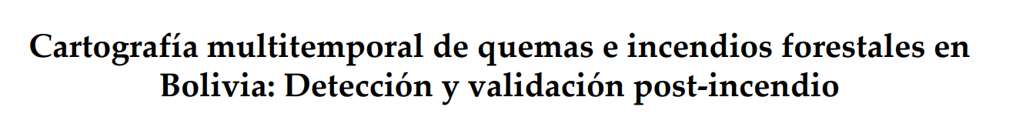
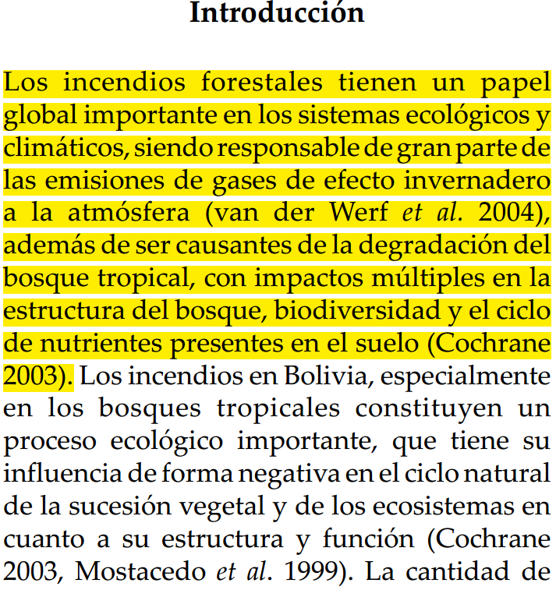
paraphrase, a quotation?

Slide 10

paraphrase, a quotation?

