Slide 1
An effective search of information
Software aplicado a ciencias sociales
Por: William Martínez

Slide 2
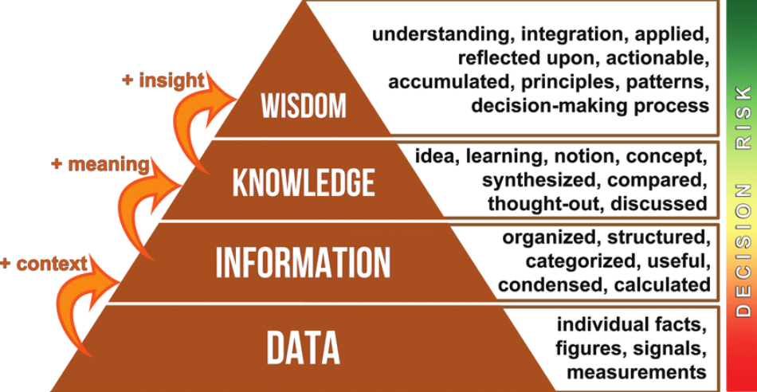
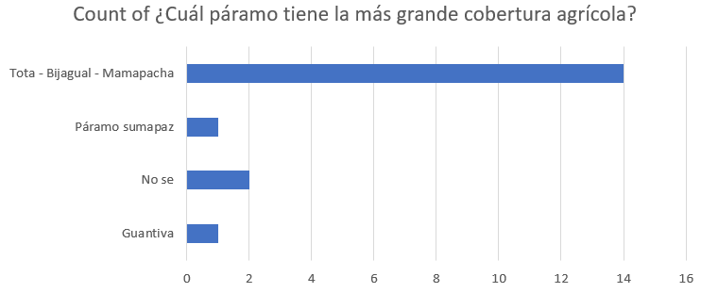

Slide 3
Boolean operators:
Software aplicado a ciencias sociales
Por: William Martínez

Slide 4
Aim of the class
What is a Boolean operator?
How does it work?
How to perform a Boolean search?

Slide 5
What is a Boolean operator?
A Boolean operator
The most important
It is a simple word used to CONNECT two or more IDEAS together
Help to WIDEN or NARROW a KEYWORD search
AND
OR
NOT
“”

Slide 6
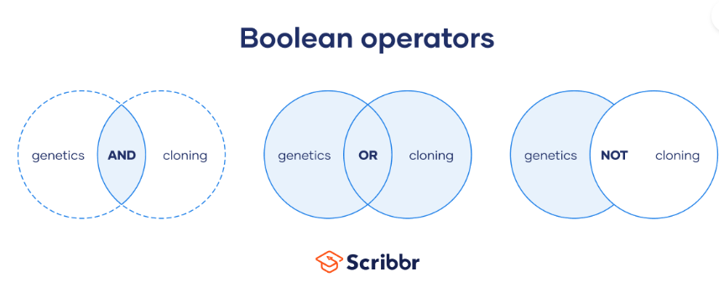
Provides results that contain both or all keywords
Provides results that contain the first keyword but not the second
Provides results that contain either keyword

Slide 7
Putting It Together
KEYWORDS + Boolean = Better Searching

Slide 8
Start Simple→Increase Complexity
QUEEN
QUEEN AND RULER
QUEEN AND RULER AND 19th CENTURY
QUEEN AND RULER AND 19th CENTURY AND GREAT BRITAIN
QUEEN AND RULER AND 19th CENTURY AND GREAT BRITAIN AND IMPACT
DATES, NAMES and PLACES can be used as MODIFYING KEYWORDS

Slide 9
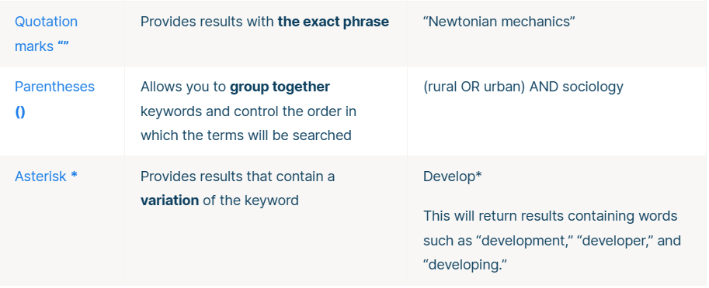

Slide 10








Conjunction AND
(pregrado + sociología + bogotá) NOT unal

Slide 11
Summary
Quotation marks “” = “For sentence”
Conjuntion (+) = A y B
Negation (-) = A and not B
Disyunction (OR) = A o B

Slide 12
Advanced search
Filetype:, one example is
“Conflictos del uso del suelo” filetype:pdf

Slide 13
Some remarks
Pros
AND > reduces results and increases precision
OR > increases results and reduces precision
NOT > reduces results and increases precision
Cons:
AND > increases precision but removes information
OR > increases results but increases noise
NOT > reduces noise but removes information

Slide 14
Busqueda avanzada en gestores de busqueda bibliográficos
Software aplicado a ciencias sociales
Por: William Martínez

Slide 15


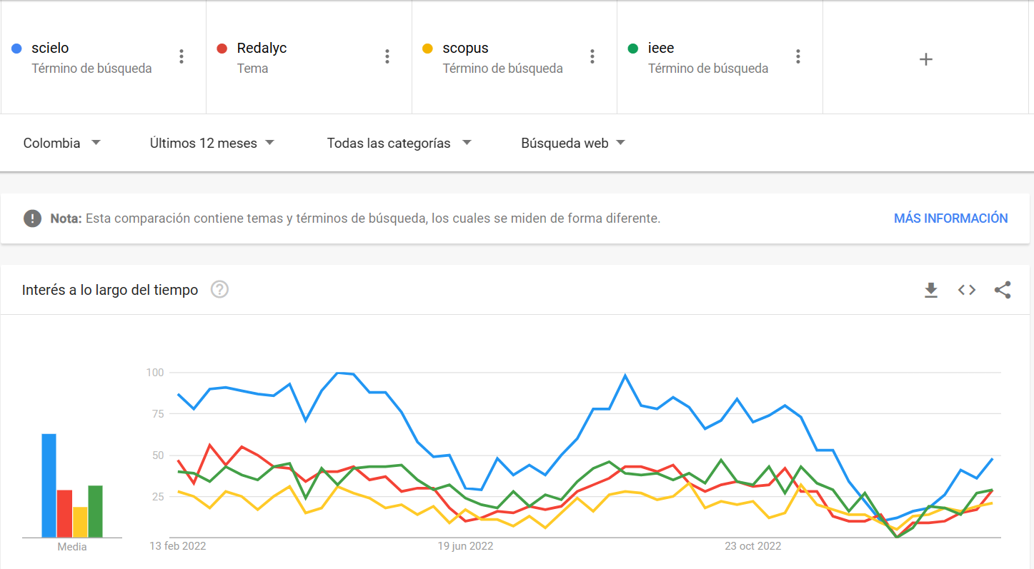


Slide 16
Workshop
Given the following need for information:
"scholarships and grants for film and video productions", which of the following equations in pseudo code is better?:
(scholarships AND grants) AND (cinema AND video)
(scholarships OR grants) AND (cinema OR video)
Copy the wording of this question and the chosen answer into your report.

Slide 17
Workshop
Try to think in a research question:
For example: Conflictos de uso del suelo en el amazonia.
Use Google scholar
Scielo

