Slide 1


TRADE WITH JOREEM
JOREEM LEARNING SERIES • MASTERCLASS 01
ULTIMATE SUPPLY &
DEMAND
MASTERCLASS
Beginner to Pro • From market logic to top-down execution
JOREEM
30-SLIDE DECK
ZONE CHECKLISTS
PRACTICE PROMPTS
LEARN THE PROCESS.
RESPECT THE RISK.
Understand the theory. Validate the zone. Align the timeframes. Plan the risk.
EDUCATIONAL ONLY • TRADING INVOLVES RISK • NO RETURNS ARE GUARANTEED
01 / 30
Notes:
Introduce the masterclass as a complete learning path. The deck reorganises the supplied transcript into four progressive parts.
Source: ULTIMATE Supply and Demand Masterclass (Beginner to Pro).txt — 00:00–00:18.
Charts are original schematic illustrations, not live market data. Educational use only; not financial advice.

Slide 2
TRADE WITH JOREEM
ULTIMATE MASTERCLASS • BEGINNER TO PRO
YOUR BEGINNER-TO-PRO ROADMAP
Four connected layers — each one filters the decisions that follow.
01
02
03
04
Market logic &
zones
Trend & validation
Entries &
confirmation
Top-down range
plans
Connect scarcity and pressure
to demand, supply, discount
and premium.
Use market structure,
imbalance and first-tap
freshness to qualify a zone.
Choose between an
extreme-zone limit and a
lower-timeframe confirmation
entry.
Build the high-timeframe
narrative, then use opposing
zones for entries and targets.
FOUNDATION
FILTER
EXECUTION
INTEGRATION
KEY TAKEAWAY
Do not start with an entry. Start with context, then earn the right to execute.
EDUCATIONAL • ILLUSTRATIVE EXAMPLES • NOT FINANCIAL ADVICE
02 / 30
Notes:
Four connected layers — each one filters the decisions that follow.
Source: ULTIMATE Supply and Demand Masterclass (Beginner to Pro).txt — 00:00–00:18 and full masterclass structure.
Charts are original schematic illustrations, not live market data. Educational use only; not financial advice.

Slide 3
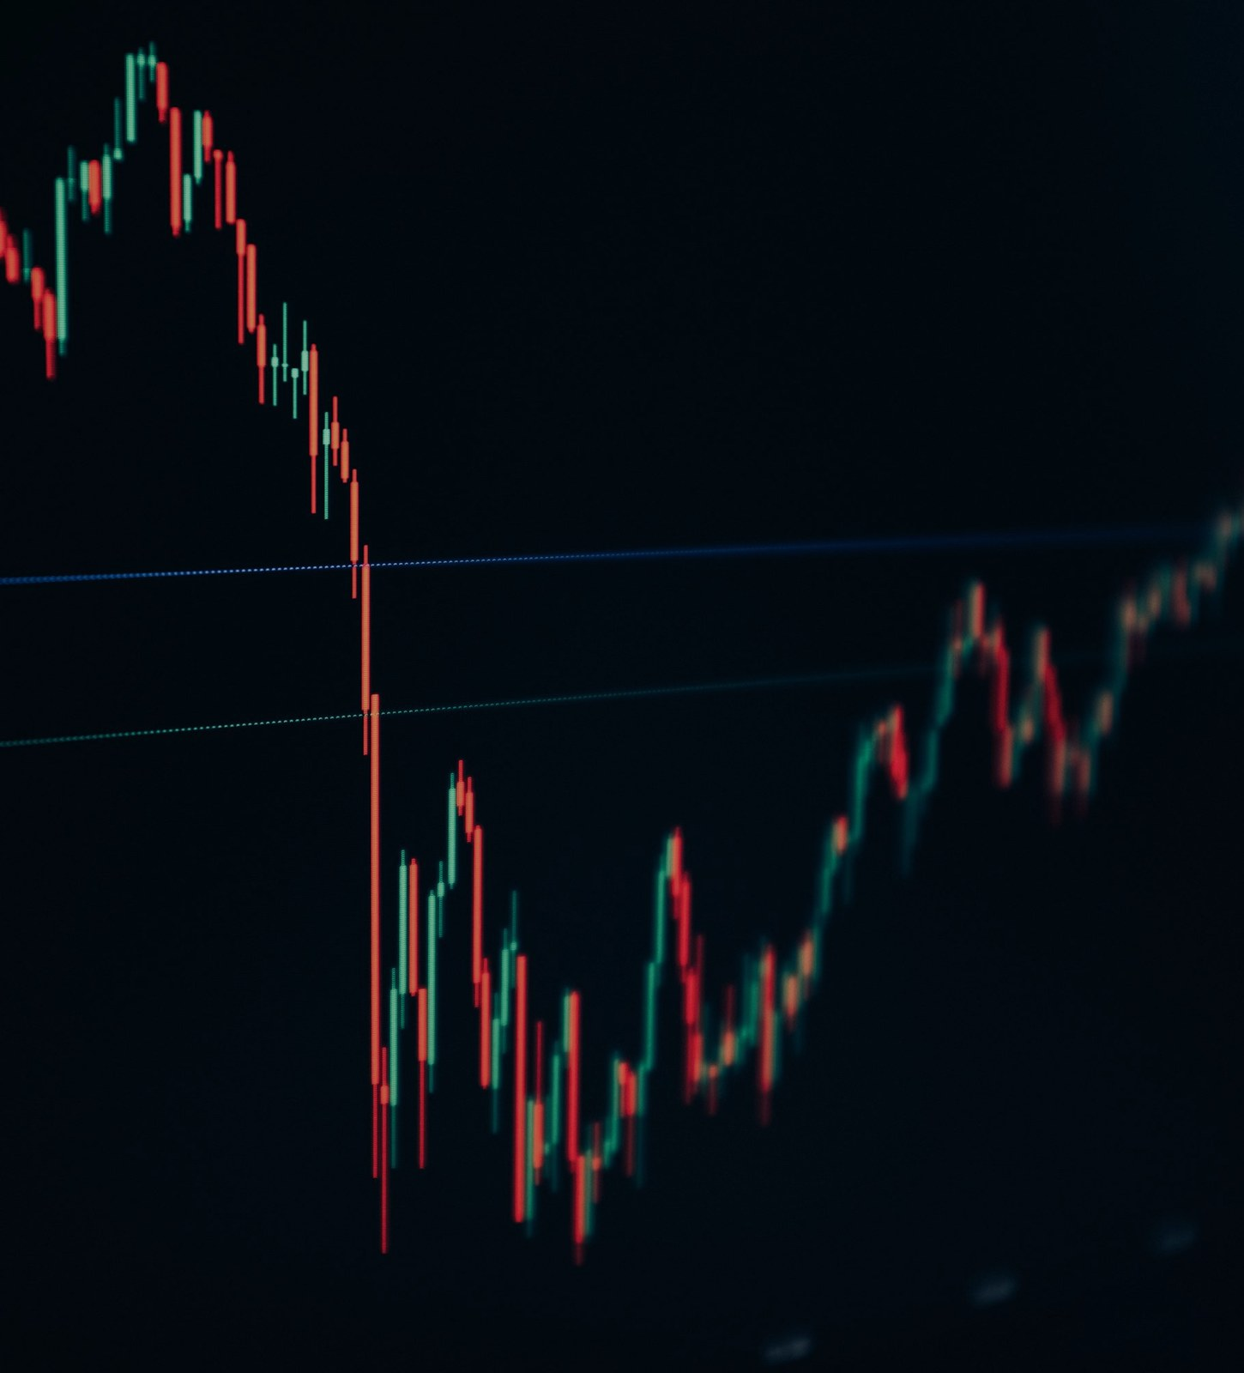
TRADE WITH JOREEM
ULTIMATE MASTERCLASS • BEGINNER TO PRO
PART 01 • FOUNDATIONS
What supply and demand mean — and how a zone is drawn.
01
THE LOGIC BEHIND THE ZONES
PRESSURE LEAVES A FOOTPRINT
A zone marks where buying or selling pressure previously
became strong enough to drive price away.
1
Understand scarcity and price
2
Separate indecision from impulse
3
Mark the full high-to-low range
THEORY → FOOTPRINT → TRADABLE AREA
EDUCATIONAL • ILLUSTRATIVE EXAMPLES • NOT FINANCIAL ADVICE
03 / 30
Notes:
What supply and demand mean — and how a zone is drawn.
Source: ULTIMATE Supply and Demand Masterclass (Beginner to Pro).txt — 00:19–09:41.
Charts are original schematic illustrations, not live market data. Educational use only; not financial advice.

Slide 4
TRADE WITH JOREEM
ULTIMATE MASTERCLASS • BEGINNER TO PRO
WHY PRICE MOVES
The transcript begins with a simple economic chain, using gold as its example.
1
Demand rises
THE CAUSE-AND-EFFECT CHAIN
More buyers compete for the available asset.
DEMAND RISES
More buyers compete for the asset
2
Available supply falls
Buying removes readily available units from the
market.
AVAILABLE SUPPLY FALLS
Units are bought from the market
3
Scarcity supports price
SCARCITY RISES
A scarcer asset can command a higher price; the
reverse applies when supply expands.
The remaining asset becomes scarcer
PRICE RESPONDS
Higher scarcity can support higher prices
CORE IDEA: PRICE RESPONDS TO THE BALANCE BETWEEN
AVAILABLE SUPPLY AND DEMAND.
EDUCATIONAL • ILLUSTRATIVE EXAMPLES • NOT FINANCIAL ADVICE
04 / 30
Notes:
Keep this conceptual rather than predictive. Many factors affect real markets; this chain explains the transcript's underlying model.
Source: ULTIMATE Supply and Demand Masterclass (Beginner to Pro).txt — 00:19–02:16.
Charts are original schematic illustrations, not live market data. Educational use only; not financial advice.

Slide 5
TRADE WITH JOREEM
ULTIMATE MASTERCLASS • BEGINNER TO PRO
FROM ECONOMICS TO TRADABLE ZONES
Zones identify where pressure previously entered before a strong directional move.
DEMAND ZONE
SUPPLY ZONE
A base or indecision area before a large upward move.
A base or indecision area before a large downward move.
1
Pressure
1
Pressure
Buying pressure overcame available supply.
Selling pressure entered as demand declined.
2
Location
2
Location
The area is treated as a potential discount region.
The area is treated as a potential premium region.
3
Plan
3
Plan
Look for buying only when the wider context agrees.
Look for selling only when the wider context agrees.
KEY TAKEAWAY
The zone is a decision area — not a guarantee that the same orders remain.
EDUCATIONAL • ILLUSTRATIVE EXAMPLES • NOT FINANCIAL ADVICE
05 / 30
Notes:
Zones identify where pressure previously entered before a strong directional move.
Source: ULTIMATE Supply and Demand Masterclass (Beginner to Pro).txt — 02:17–05:37.
Charts are original schematic illustrations, not live market data. Educational use only; not financial advice.

Slide 6
TRADE WITH JOREEM
ULTIMATE MASTERCLASS • BEGINNER TO PRO
THE BUILDING BLOCK: INDECISION + IMPULSE
The source uses the last candle before the impulse — regardless of its colour.
1
Indecision candle
LAST CANDLE BEFORE THE IMPULSE
A relatively small body and visible wicks show
rejected prices and limited progress.
3
2
2
Impulsive move
1
One or more strong candles show clear directional
control.
MARK HIGH → LOW
3
The source rule
Use the final indecision candle immediately before
that impulse, not simply the last opposite-colour
candle.
DEMAND
RETEST
THE BASE SHOWS PAUSE. THE IMPULSE SHOWS WHO TAKES
CONTROL.
SCHEMATIC • NOT LIVE MARKET DATA
EDUCATIONAL • ILLUSTRATIVE EXAMPLES • NOT FINANCIAL ADVICE
06 / 30
Notes:
The source uses the last candle before the impulse — regardless of its colour.
Source: ULTIMATE Supply and Demand Masterclass (Beginner to Pro).txt — 05:43–08:04.
Charts are original schematic illustrations, not live market data. Educational use only; not financial advice.

Slide 7
TRADE WITH JOREEM
ULTIMATE MASTERCLASS • BEGINNER TO PRO
DRAW THE ZONE — HIGH TO LOW
Include the wicks, then project the area to the right.
01
Find the departure
HIGH → LOW • WICKS INCLUDED • PROJECT RIGHT
Locate a clear impulsive move away from a pause or
base.
3
2
02
Select the last candle
Use the final indecision candle before the impulse.
1
03
Mark the complete range
MARK HIGH → LOW
Draw from that candle's high to its low, including
wicks.
DEMAND
04
Extend and wait
Project right. If relevant, include the immediately
following wick extreme as shown in the source.
RETEST
SCHEMATIC • NOT LIVE MARKET DATA
EDUCATIONAL • ILLUSTRATIVE EXAMPLES • NOT FINANCIAL ADVICE
07 / 30
Notes:
Include the wicks, then project the area to the right.
Source: ULTIMATE Supply and Demand Masterclass (Beginner to Pro).txt — 08:10–08:45 and 12:16–12:48.
Charts are original schematic illustrations, not live market data. Educational use only; not financial advice.

Slide 8
TRADE WITH JOREEM
ULTIMATE MASTERCLASS • BEGINNER TO PRO
A SIMPLE SUPPLY-TO-TARGET EXAMPLE
The first trade model in the transcript: return to supply, sell, target a new low.
SELL FROM SUPPLY WITH DEFINED INVALIDATION
SCHEMATIC PLAN
STOP
CONTEXT
Downtrend
SUPPLY / ENTRY
ENTRY
Supply return
ENTRY
STOP
Above zone
TARGET
Prior / new low
STATUS
Example only
DEMAND / TARGET
TARGET
Later lessons add trend, imbalance and
freshness filters. Do not isolate this simple
example from those rules.
SCHEMATIC • NOT LIVE MARKET DATA
EDUCATIONAL • ILLUSTRATIVE EXAMPLES • NOT FINANCIAL ADVICE
08 / 30
Notes:
The first trade model in the transcript: return to supply, sell, target a new low.
Source: ULTIMATE Supply and Demand Masterclass (Beginner to Pro).txt — 08:45–09:41.
Charts are original schematic illustrations, not live market data. Educational use only; not financial advice.

Slide 9

TRADE WITH JOREEM
ULTIMATE MASTERCLASS • BEGINNER TO PRO
PART 02 • CONTEXT & VALIDATION
A visible zone is not automatically a tradable zone.
02
FILTER BEFORE YOU EXECUTE
CONTEXT BEATS A PRETTY
RECTANGLE
The masterclass repeatedly returns to three tests: trade with
structure, require imbalance, and respect the first retest.
1
Read highs and lows objectively
2
Reject already-efficient areas
3
Avoid overused zones
TREND • IMBALANCE • FIRST TAP
EDUCATIONAL • ILLUSTRATIVE EXAMPLES • NOT FINANCIAL ADVICE
09 / 30
Notes:
A visible zone is not automatically a tradable zone.
Source: ULTIMATE Supply and Demand Masterclass (Beginner to Pro).txt — 09:41–19:43.
Charts are original schematic illustrations, not live market data. Educational use only; not financial advice.

Slide 10
TRADE WITH JOREEM
ULTIMATE MASTERCLASS • BEGINNER TO PRO
MARKET STRUCTURE SETS DIRECTION
Use swings to classify the environment before selecting supply or demand.
1
Uptrend
UPTREND
DOWNTREND
Higher highs and higher lows shift attention toward
demand-zone buying.
2
Downtrend
LH
LH
Lower lows and lower highs shift attention toward
supply-zone selling.
HH
LL
Structure shift
HH
3
LL
A break in the existing sequence can change which
side of the market deserves focus.
HL
HL
UPTREND: FOCUS ON DEMAND. DOWNTREND: FOCUS ON SUPPLY.
SCHEMATIC • NOT LIVE MARKET DATA
SCHEMATIC • NOT LIVE MARKET DATA
EDUCATIONAL • ILLUSTRATIVE EXAMPLES • NOT FINANCIAL ADVICE
10 / 30
Notes:
Use swings to classify the environment before selecting supply or demand.
Source: ULTIMATE Supply and Demand Masterclass (Beginner to Pro).txt — 09:41–12:16.
Charts are original schematic illustrations, not live market data. Educational use only; not financial advice.

Slide 11
TRADE WITH JOREEM
ULTIMATE MASTERCLASS • BEGINNER TO PRO
WHY COUNTER-TREND ZONES ARE FILTERED OUT
Zones appear everywhere; the source treats trend alignment as the first quality filter.
DOWNTREND: PRIORITISE SUPPLY — IGNORE COUNTER-TREND DEMAND
IN A DOWNTREND
1
Prioritise
SUPPLY
Fresh supply zones that agree
with lower highs and lower lows.
SUPPLY
2
Ignore
Demand zones that require
fighting the prevailing sequence.
DEMAND?
3
Reassess
Only after structure genuinely
shifts — not merely because price
looks cheap.
COUNTER-TREND = NO TRADE
Filtering reduces trade frequency; it does not
eliminate losses.
SCHEMATIC • NOT LIVE MARKET DATA
EDUCATIONAL • ILLUSTRATIVE EXAMPLES • NOT FINANCIAL ADVICE
11 / 30
Notes:
Zones appear everywhere; the source treats trend alignment as the first quality filter.
Source: ULTIMATE Supply and Demand Masterclass (Beginner to Pro).txt — 09:47–10:51 and 12:16–14:38.
Charts are original schematic illustrations, not live market data. Educational use only; not financial advice.

Slide 12
TRADE WITH JOREEM
ULTIMATE MASTERCLASS • BEGINNER TO PRO
THE THREE-PART VALIDITY FILTER
A concise checklist drawn directly from the masterclass's recurring rules.
01
02
03
01 • Trend
02 • Imbalance
03 • First tap
Does the zone agree with the current
high-timeframe structure and narrative?
Is there still an open, inefficient price range
leading into the zone?
Is this the first meaningful return, rather
than the third, fourth or fifth?
DIRECTION
FRESH PATH
FRESH ZONE
KEY TAKEAWAY
If one core filter fails, the source treats the zone as lower probability or no trade.
EDUCATIONAL • ILLUSTRATIVE EXAMPLES • NOT FINANCIAL ADVICE
12 / 30
Notes:
A concise checklist drawn directly from the masterclass's recurring rules.
Source: ULTIMATE Supply and Demand Masterclass (Beginner to Pro).txt — 19:24–19:43.
Charts are original schematic illustrations, not live market data. Educational use only; not financial advice.

Slide 13
TRADE WITH JOREEM
ULTIMATE MASTERCLASS • BEGINNER TO PRO
IMBALANCE VS EFFICIENCY
Look for an open price range whose wicks have not yet filled the area.
1
Imbalance
IMBALANCE STILL OPEN
EFFICIENT / ALREADY FILLED
An unfilled range remains between relevant wick
extremes ahead of the zone.
2
Efficiency
Later price trade has already filled that range; the
original open path is gone.
SUPPLY
USED ZONE
OPEN PRICE RANGE
3
Why it matters
The source prefers the fresh imbalanced area and
avoids zones whose imbalance has already been
consumed.
DO NOT TREAT AS FRESH
NO IMBALANCE INTO THE ZONE = NO VALID ZONE IN THIS
PLAYBOOK.
SCHEMATIC • NOT LIVE MARKET DATA
SCHEMATIC • NOT LIVE MARKET DATA
EDUCATIONAL • ILLUSTRATIVE EXAMPLES • NOT FINANCIAL ADVICE
13 / 30
Notes:
Look for an open price range whose wicks have not yet filled the area.
Source: ULTIMATE Supply and Demand Masterclass (Beginner to Pro).txt — 14:38–17:16.
Charts are original schematic illustrations, not live market data. Educational use only; not financial advice.

Slide 14
TRADE WITH JOREEM
ULTIMATE MASTERCLASS • BEGINNER TO PRO
THE FIRST-TAP RULE
Repeated returns can consume resting interest and increase the chance of a break.
FRESHNESS: THE FIRST RETEST MATTERS
FRESHNESS CHECK
3
1
2
1
First retest
The source's preferred
opportunity after a valid
departure.
SUPPLY
2
Later retests
Treat repeated taps as evidence
that the zone is being used up.
3
After a reaction
REPEATED TAPS CONSUME THE ZONE
Move on and locate the next
fresh, imbalanced zone.
Repeated failure of a zone can also reveal
strength in the opposing direction.
SCHEMATIC • NOT LIVE MARKET DATA
EDUCATIONAL • ILLUSTRATIVE EXAMPLES • NOT FINANCIAL ADVICE
14 / 30
Notes:
Repeated returns can consume resting interest and increase the chance of a break.
Source: ULTIMATE Supply and Demand Masterclass (Beginner to Pro).txt — 17:16–19:24 and 35:34–36:24.
Charts are original schematic illustrations, not live market data. Educational use only; not financial advice.

Slide 15

TRADE WITH JOREEM
ULTIMATE MASTERCLASS • BEGINNER TO PRO
PART 03 • ZONE SELECTION & ENTRIES
Choose the location, then choose how much confirmation you require.
03
FROM ANALYSIS TO EXECUTION
EXTREME FIRST. CONFIRM WHEN
INTERNAL.
When several zones exist inside one leg, the source
distinguishes the furthest fresh extreme zone from internal
zones.
1
Map every fresh zone in the leg
2
Separate extreme from internal
3
Match entry style to location
LOCATION → ENTRY STYLE → INVALIDATION
EDUCATIONAL • ILLUSTRATIVE EXAMPLES • NOT FINANCIAL ADVICE
15 / 30
Notes:
Choose the location, then choose how much confirmation you require.
Source: ULTIMATE Supply and Demand Masterclass (Beginner to Pro).txt — 19:43–30:37.
Charts are original schematic illustrations, not live market data. Educational use only; not financial advice.

Slide 16
TRADE WITH JOREEM
ULTIMATE MASTERCLASS • BEGINNER TO PRO
SELECTING THE EXTREME ZONE
Within the current leg, the extreme is the furthest valid fresh zone from current price.
WHEN MULTIPLE ZONES EXIST, LOCATE THE EXTREME
SELECTION LOGIC
FURTHEST FRESH ZONE IN THE CURRENT LEG
1
Start with freshness
EXTREME ZONE
Remove zones whose imbalance
has already been filled.
2
Find the extreme
Identify the final valid zone at the
far end of the current leg.
INTERNAL ZONE
3
Treat internal differently
INTERNAL = CONFIRMATION
If using a closer internal zone, the
source prefers lower-timeframe
confirmation.
“Highest probability” in the transcript is a framework
claim, not a measured win-rate guarantee.
SCHEMATIC • NOT LIVE MARKET DATA
EDUCATIONAL • ILLUSTRATIVE EXAMPLES • NOT FINANCIAL ADVICE
16 / 30
Notes:
Within the current leg, the extreme is the furthest valid fresh zone from current price.
Source: ULTIMATE Supply and Demand Masterclass (Beginner to Pro).txt — 19:43–22:20 and 27:03–28:09.
Charts are original schematic illustrations, not live market data. Educational use only; not financial advice.

Slide 17
TRADE WITH JOREEM
ULTIMATE MASTERCLASS • BEGINNER TO PRO
LIMIT OR CONFIRMATION?
Both approaches are described in the source; each has a different trade-off.
EXTREME-ZONE LIMIT
CONFIRMATION ENTRY
A resting order at the furthest valid zone.
Wait for lower-timeframe structure to agree.
1
Strength
1
Strength
Can capture a move that leaves without a lower-timeframe
shift.
No shift means no entry, which can avoid some failed zones.
2
Trade-off
2
Trade-off
Price can trade through the zone before any confirmation
appears.
The market may leave without offering the pattern.
3
Requirement
3
Requirement
Predefined stop and a strong higher-timeframe location.
A clear shift plus a fractal supply or demand retest.
KEY TAKEAWAY
Missing a trade is acceptable. Forcing an entry without the required evidence is not.
EDUCATIONAL • ILLUSTRATIVE EXAMPLES • NOT FINANCIAL ADVICE
17 / 30
Notes:
Both approaches are described in the source; each has a different trade-off.
Source: ULTIMATE Supply and Demand Masterclass (Beginner to Pro).txt — 22:20–24:01 and 28:09–30:00.
Charts are original schematic illustrations, not live market data. Educational use only; not financial advice.

Slide 18
TRADE WITH JOREEM
ULTIMATE MASTERCLASS • BEGINNER TO PRO
THE BEARISH CONFIRMATION SEQUENCE
Use the lower timeframe to align execution with a bearish higher-timeframe narrative.
01
Reach higher-timeframe supply
BEARISH CONFIRMATION: LTF STRUCTURE SHIFT + RETEST
Price enters the predefined area of interest.
02
Map the small bullish structure
HTF SUPPLY
Mark the short-term highs and higher lows inside the
return.
STRUCTURE LOW
LTF SUPPLY
03
Wait for a bearish shift
A close below the relevant higher lows creates a
lower low.
LOWER LOW
04
Sell the fractal supply retest
Use the last indecision candle before the bearish
impulse; place invalidation above the confirmed
structure.
SCHEMATIC • NOT LIVE MARKET DATA
EDUCATIONAL • ILLUSTRATIVE EXAMPLES • NOT FINANCIAL ADVICE
18 / 30
Notes:
Use the lower timeframe to align execution with a bearish higher-timeframe narrative.
Source: ULTIMATE Supply and Demand Masterclass (Beginner to Pro).txt — 24:01–26:55.
Charts are original schematic illustrations, not live market data. Educational use only; not financial advice.

Slide 19
TRADE WITH JOREEM
ULTIMATE MASTERCLASS • BEGINNER TO PRO
THE BULLISH MIRROR
The same confirmation logic is inverted when demand and bullish structure agree.
1
Higher-timeframe demand
BULLISH CONFIRMATION: BREAK ABOVE STRUCTURE + RETEST
Price returns to a valid area within a bullish narrative.
2
Bullish break
Lower-timeframe price breaks above the relevant
lower-high structure.
HIGHER HIGH
3
Fractal demand retest
STRUCTURE HIGH
LTF DEMAND
Use the last candle before the impulse that broke
structure, with invalidation below the confirmed area.
HTF DEMAND
BIG PICTURE BULLISH + SMALL PICTURE BULLISH = ALIGNED
EXECUTION.
SCHEMATIC • NOT LIVE MARKET DATA
EDUCATIONAL • ILLUSTRATIVE EXAMPLES • NOT FINANCIAL ADVICE
19 / 30
Notes:
The same confirmation logic is inverted when demand and bullish structure agree.
Source: ULTIMATE Supply and Demand Masterclass (Beginner to Pro).txt — 30:06–30:37.
Charts are original schematic illustrations, not live market data. Educational use only; not financial advice.

Slide 20
TRADE WITH JOREEM
ULTIMATE MASTERCLASS • BEGINNER TO PRO
WORKED SHORT: TWO LAYERS OF CONFIRMATION
A higher-timeframe supply reaction followed by a lower-timeframe structural shift.
BEARISH CONFIRMATION: LTF STRUCTURE SHIFT + RETEST
ALIGNED SHORT
HTF
Bearish
HTF SUPPLY
TRIGGER
LTF lower low
STRUCTURE LOW
ENTRY
LTF supply
LTF SUPPLY
STOP
Above LTF high
LOWER LOW
TARGET
HTF low
If the shift never forms, the confirmation
model produces no trade. The diagram is a
process example, not a signal.
SCHEMATIC • NOT LIVE MARKET DATA
EDUCATIONAL • ILLUSTRATIVE EXAMPLES • NOT FINANCIAL ADVICE
20 / 30
Notes:
A higher-timeframe supply reaction followed by a lower-timeframe structural shift.
Source: ULTIMATE Supply and Demand Masterclass (Beginner to Pro).txt — 24:01–26:55.
Charts are original schematic illustrations, not live market data. Educational use only; not financial advice.

Slide 21
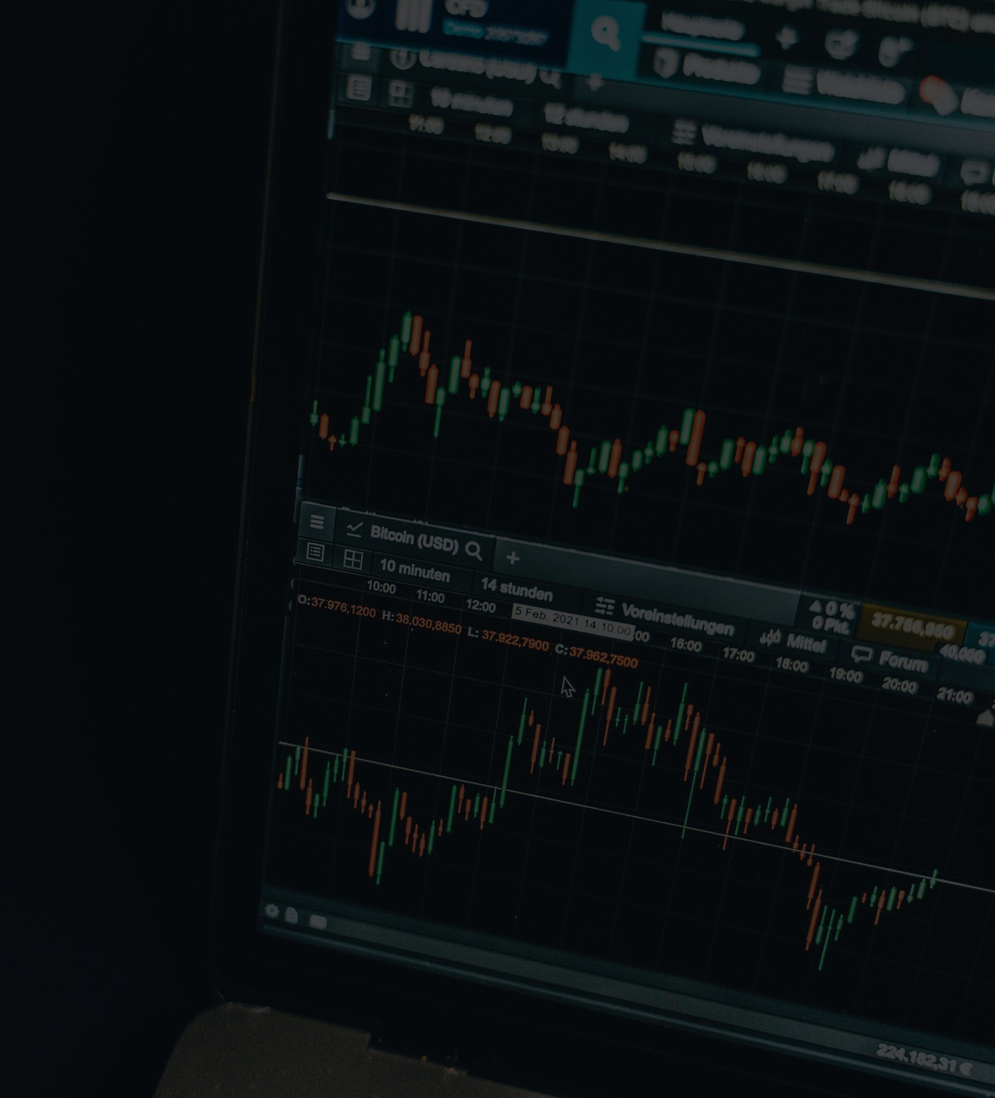
TRADE WITH JOREEM
ULTIMATE MASTERCLASS • BEGINNER TO PRO
PART 04 • FRACTAL & TOP-DOWN
Use higher timeframes for narrative and lower timeframes for execution.
04
ONE LOGIC • MULTIPLE TIMEFRAMES
BUILD THE MAP BEFORE THE TRADE
Supply and demand can frame targets and entry locations on
weekly, daily, intraday and lower-timeframe charts.
1
Recognise the fractal pattern
2
Mark high-timeframe ranges
3
Execute only with alignment
WEEKLY → DAILY / 4H → EXECUTION
EDUCATIONAL • ILLUSTRATIVE EXAMPLES • NOT FINANCIAL ADVICE
21 / 30
Notes:
Use higher timeframes for narrative and lower timeframes for execution.
Source: ULTIMATE Supply and Demand Masterclass (Beginner to Pro).txt — 30:43–39:25.
Charts are original schematic illustrations, not live market data. Educational use only; not financial advice.

Slide 22
TRADE WITH JOREEM
ULTIMATE MASTERCLASS • BEGINNER TO PRO
THE FRACTAL PRINCIPLE
The same base–impulse–retest logic can appear at very different time compressions.
1
Structure repeats
1 MINUTE
1 HOUR
4 HOURS
The transcript shows similar-looking zone behaviour
on one-minute, one-hour and four-hour charts.
2
Style changes, rules do not
Scalping, day trading and swing trading still require
context and validation.
3
Timeframe is a choice
There is no universal best timeframe; test a coherent
top-down combination.
DEMAND
DEMAND
DEMAND
FRACTAL DOES NOT MEAN IDENTICAL RESULTS. IT MEANS
REPEATING STRUCTURAL LOGIC.
SAME LOGIC • DIFFERENT TIME COMPRESSION
SCHEMATIC • NOT LIVE MARKET DATA
SCHEMATIC • NOT LIVE MARKET DATA
SCHEMATIC • NOT LIVE MARKET DATA
EDUCATIONAL • ILLUSTRATIVE EXAMPLES • NOT FINANCIAL ADVICE
22 / 30
Notes:
The same base–impulse–retest logic can appear at very different time compressions.
Source: ULTIMATE Supply and Demand Masterclass (Beginner to Pro).txt — 30:43–31:32.
Charts are original schematic illustrations, not live market data. Educational use only; not financial advice.

Slide 23
TRADE WITH JOREEM
ULTIMATE MASTERCLASS • BEGINNER TO PRO
A PRACTICAL TOP-DOWN WORKFLOW
Use higher-timeframe supply and demand to create a map of where business may be done.
01
Build the weekly / daily narrative
WEEKLY • NARRATIVE
DAILY / 4H • LOCATION
LTF • EXECUTION
Mark the broad structure and the next meaningful
opposing zones.
Define range-to-range scenarios
SUPPLY
02
Consider sells toward demand or buys toward supply
only when the narrative supports them.
03
Refine on daily / 4H / lower
Look for the pullback, fresh zone or structural shift
that fits the map.
ENTRY
DEMAND
WATCH
HTF DEMAND
DEMAND
04
Execute and target deliberately
Use the lower timeframe for entry and the opposing
high-timeframe area as a potential target.
SCHEMATIC • NOT LIVE MARKET DATA
SCHEMATIC • NOT LIVE MARKET DATA
SCHEMATIC • NOT LIVE MARKET DATA
EDUCATIONAL • ILLUSTRATIVE EXAMPLES • NOT FINANCIAL ADVICE
23 / 30
Notes:
Use higher-timeframe supply and demand to create a map of where business may be done.
Source: ULTIMATE Supply and Demand Masterclass (Beginner to Pro).txt — 31:32–35:22.
Charts are original schematic illustrations, not live market data. Educational use only; not financial advice.

Slide 24
TRADE WITH JOREEM
ULTIMATE MASTERCLASS • BEGINNER TO PRO
ZONES ARE FOR TARGETS, TOO
Opposing supply or demand can define a logical place to exit, not only a place to enter.
TRADE FROM ONE OPPOSING ZONE TO THE OTHER
RANGE LOGIC
1
Entry side
SUPPLY / TARGET
EXIT
A fresh extreme zone with no
unfilled obstacle immediately
behind it.
2
Target side
The opposing zone where
opposing pressure previously
appeared.
3
Benefit
ENTRY
A defined range can avoid holding
through a reversal immediately
beyond the opposing zone.
DEMAND / ENTRY
INVALIDATION
Price can break through either zone. A target is
a plan, not a promise.
SCHEMATIC • NOT LIVE MARKET DATA
EDUCATIONAL • ILLUSTRATIVE EXAMPLES • NOT FINANCIAL ADVICE
24 / 30
Notes:
Opposing supply or demand can define a logical place to exit, not only a place to enter.
Source: ULTIMATE Supply and Demand Masterclass (Beginner to Pro).txt — 35:22–39:25.
Charts are original schematic illustrations, not live market data. Educational use only; not financial advice.

Slide 25
TRADE WITH JOREEM
ULTIMATE MASTERCLASS • BEGINNER TO PRO
DEMAND-TO-SUPPLY RANGE PLAN
The transcript's two-minute example is reframed as a clean, testable planning template.
TRADE FROM ONE OPPOSING ZONE TO THE OTHER
RANGE TICKET
ENTRY
Extreme demand
SUPPLY / TARGET
EXIT
STOP
Below demand
TARGET
Fresh supply
SOURCE R
1:5 illustration
EXPECTANCY
Unknown
ENTRY
DEMAND / ENTRY
INVALIDATION
The 1:5 figure is an illustrative source example,
not an expected return or a reason to ignore
invalidation.
SCHEMATIC • NOT LIVE MARKET DATA
EDUCATIONAL • ILLUSTRATIVE EXAMPLES • NOT FINANCIAL ADVICE
25 / 30
Notes:
The transcript's two-minute example is reframed as a clean, testable planning template.
Source: ULTIMATE Supply and Demand Masterclass (Beginner to Pro).txt — 35:22–38:23.
Charts are original schematic illustrations, not live market data. Educational use only; not financial advice.

Slide 26
TRADE WITH JOREEM
ULTIMATE MASTERCLASS • BEGINNER TO PRO
COMMON FAILURE MODES
Most errors in the transcript come from ignoring context or continuing to use old information.
01
02
03
04
Fighting structure
Using filled zones
Selling repeated
taps
Forcing
confirmation
Buying every visible demand
zone inside a clear downtrend
— or doing the reverse in an
uptrend.
Treating an efficient,
already-traded range as if its
original imbalance were still
available.
Returning to the same supply
or demand area after several
reactions.
Drawing a structural shift that
is not really there because
you do not want to miss the
move.
FILTER WITH TREND
CHECK FRESHNESS
MOVE TO THE NEXT ZONE
NO PATTERN = NO TRADE
KEY TAKEAWAY
A disciplined no-trade is a valid outcome of the analysis.
EDUCATIONAL • ILLUSTRATIVE EXAMPLES • NOT FINANCIAL ADVICE
26 / 30
Notes:
Most errors in the transcript come from ignoring context or continuing to use old information.
Source: ULTIMATE Supply and Demand Masterclass (Beginner to Pro).txt — 09:47–19:43 and 28:09–29:02.
Charts are original schematic illustrations, not live market data. Educational use only; not financial advice.

Slide 27
TRADE WITH JOREEM
ULTIMATE MASTERCLASS • BEGINNER TO PRO
THE COMPLETE PRE-TRADE WORKFLOW
Compress the masterclass into one repeatable sequence.
01
1 • Establish direction
MECHANICAL RISK FRAME • EXAMPLE ONLY
Classify structure and write the higher-timeframe
narrative.
2 • Qualify location
TARGET = 2R (EXAMPLE)
02
Require a fresh zone, remaining imbalance and a
first-tap opportunity.
2R UP
03
3 • Select the zone
Prefer the valid extreme; treat internal zones as
confirmation-only in this framework.
ENTRY
04
4 • Choose the trigger
Use a planned extreme limit or wait for
lower-timeframe alignment.
1R DOWN
05
5 • Define risk and exit
STOP = 1R RISK
Set invalidation beyond the relevant structure and
target the opposing area or planned objective.
A 2R TARGET DOES NOT GUARANTEE A WIN OR POSITIVE EXPECTANCY.
EDUCATIONAL • ILLUSTRATIVE EXAMPLES • NOT FINANCIAL ADVICE
27 / 30
Notes:
Compress the masterclass into one repeatable sequence.
Source: ULTIMATE Supply and Demand Masterclass (Beginner to Pro).txt — Full masterclass synthesis.
Charts are original schematic illustrations, not live market data. Educational use only; not financial advice.

Slide 28
TRADE WITH JOREEM
ULTIMATE MASTERCLASS • BEGINNER TO PRO
MASTERCLASS CHEAT SHEET
Six questions to answer before any supply or demand trade.
Trend
Zone
Am I trading with the prevailing structure?
Is it the last indecision candle before a real impulse?
Imbalance
First tap
Is the open range still unfilled?
Is this the first meaningful return?
Trigger
Risk
Does my chosen limit or confirmation model exist?
Are stop, target and maximum loss defined?
KEY TAKEAWAY
When the answers are unclear, the next action is to wait — not to widen the rules.
EDUCATIONAL • ILLUSTRATIVE EXAMPLES • NOT FINANCIAL ADVICE
28 / 30
Notes:
Six questions to answer before any supply or demand trade.
Source: ULTIMATE Supply and Demand Masterclass (Beginner to Pro).txt — Full masterclass synthesis.
Charts are original schematic illustrations, not live market data. Educational use only; not financial advice.

Slide 29
TRADE WITH JOREEM
ULTIMATE MASTERCLASS • BEGINNER TO PRO
PRACTISE THE PROCESS, NOT THE OUTCOME
Turn the framework into evidence you can review and improve.
1
Replay one setup family
MECHANICAL RISK FRAME • EXAMPLE ONLY
Mark trend, zone, imbalance and first tap before
moving price forward.
TARGET = 2R (EXAMPLE)
2
Record the decision
Screenshot the narrative, trigger, invalidation and
opposing-zone target.
2R UP
ENTRY
3
Review a sample, not one win
Use a journal to measure rule adherence and
outcomes across many examples.
1R DOWN
STOP = 1R RISK
NO SETUP IS COMPLETE WITHOUT A POINT AT WHICH THE IDEA
IS WRONG.
A 2R TARGET DOES NOT GUARANTEE A WIN OR POSITIVE EXPECTANCY.
EDUCATIONAL • ILLUSTRATIVE EXAMPLES • NOT FINANCIAL ADVICE
29 / 30
Notes:
This slide is an added learning activity, not a performance claim. Encourage demo or replay practice before any live risk.
Source: ULTIMATE Supply and Demand Masterclass (Beginner to Pro).txt — Educational practice prompt based on the complete masterclass.
Charts are original schematic illustrations, not live market data. Educational use only; not financial advice.

Slide 30
TRADE WITH JOREEM
MASTER THE MAP. THEN WAIT.
The edge of this masterclass is not a rectangle. It is the ordered process that
decides which rectangles deserve attention.
1
Context first
Trend and high-timeframe narrative before location.
2
Freshness second
Imbalance and first tap before entry.
3
Risk always
JOREEM
Invalidation, target and maximum loss before execution.
TRADE WITH JOREEM
LEARNING SERIES
Trading can result in losses. These are schematic examples, not signals or performance claims. Test on demo,
define risk in advance, and never trade money you cannot afford to lose.
CONTENT & IMAGE NOTES
Content: supplied transcript, edited for learning. Charts: original schematic illustrations. Photos: Joreem (supplied); Pexels photo IDs 26743048,
7567486 and 14751274; Unsplash and stock images from the existing Joreem library and supplied template. Full links: IMAGE_CREDITS.md.
REVIEW THE RULES • PRACTISE ON DEMO • KEEP A JOURNAL
30 / 30
Notes:
Close by reviewing the process and encouraging deliberate practice rather than outcome-focused trading.
Source: ULTIMATE Supply and Demand Masterclass (Beginner to Pro).txt — 00:00–39:57.
Charts are original schematic illustrations, not live market data. Educational use only; not financial advice.

