Slide 1


TRADE WITH JOREEM
JOREEM LEARNING SERIES • COURSE 02
COMPLETE SUPPLY &
DEMAND
TRADING COURSE
Read momentum • Mark zones • Wait for confirmation • Add
confluence
JOREEM
3 ZONE METHODS
ENTRY WALKTHROUGHS
FIB CONFLUENCE
LEARN THE PROCESS.
RESPECT THE RISK.
A practical, chart-led course built from the supplied transcript.
EDUCATIONAL ONLY • TRADING INVOLVES RISK • NO RETURNS ARE GUARANTEED
01 / 19
Notes:
Read momentum • Mark zones • Wait for confirmation • Add confluence
Source: COMPLETE Supply & Demand Trading Course.txt — 00:00–00:39.
Charts are original schematic illustrations, not live market data. Educational use only; not financial advice.

Slide 2
TRADE WITH JOREEM
COMPLETE SUPPLY & DEMAND COURSE
WHAT YOU WILL LEARN
A direct progression from spotting momentum to planning a confluence trade.
01
02
03
04
Read momentum
Mark zones three
ways
Trade the retest
Stack confluence
Understand aggressive buying
and selling, and distinguish
strong candles from weak
overlap.
Use momentum departures,
consolidation and repeated
wick rejection.
Compare pending orders with
manual confirmation, then
define entry, stop and target.
Combine demand with
Fibonacci retracement and a
clear confirmation response.
FOUNDATION
LOCATION
EXECUTION
REFINEMENT
KEY TAKEAWAY
The method is rinse-and-repeat only when the rules remain the same.
EDUCATIONAL • ILLUSTRATIVE EXAMPLES • NOT FINANCIAL ADVICE
02 / 19
Notes:
A direct progression from spotting momentum to planning a confluence trade.
Source: COMPLETE Supply & Demand Trading Course.txt — 00:00–00:39.
Charts are original schematic illustrations, not live market data. Educational use only; not financial advice.

Slide 3

TRADE WITH JOREEM
COMPLETE SUPPLY & DEMAND COURSE
PART 01 • READ MOMENTUM
Supply and demand begin with aggressive directional pressure.
01
START WITH THE CANDLES
MOMENTUM BEFORE MARKUP
The course looks for strong buying or selling that can reveal
decisive participation, rather than marking every small pause
on the chart.
1
Spot directional pressure
2
Avoid tiny-candle ambiguity
3
Use zones as reaction areas
PRESSURE → ZONE → REACTION
EDUCATIONAL • ILLUSTRATIVE EXAMPLES • NOT FINANCIAL ADVICE
03 / 19
Notes:
Supply and demand begin with aggressive directional pressure.
Source: COMPLETE Supply & Demand Trading Course.txt — 00:44–03:18.
Charts are original schematic illustrations, not live market data. Educational use only; not financial advice.

Slide 4
TRADE WITH JOREEM
COMPLETE SUPPLY & DEMAND COURSE
WHAT SUPPLY & DEMAND LOOK LIKE
In this course, the first clue is a series of large, directional momentum candles.
1
Demand
SMALL / OVERLAPPING CANDLES
LARGE DIRECTIONAL CANDLES
Aggressive buying drives price upward with strong
bullish candles.
2
Supply
Aggressive selling drives price downward with strong
bearish candles.
3
Weak contrast
Small, overlapping candles provide less evidence of
decisive pressure and are not the preferred
departure.
WEAK EVIDENCE
MOMENTUM
MOMENTUM IS EVIDENCE OF PRESSURE — NOT PROOF OF WHO
PLACED EACH ORDER.
SCHEMATIC • NOT LIVE MARKET DATA
SCHEMATIC • NOT LIVE MARKET DATA
EDUCATIONAL • ILLUSTRATIVE EXAMPLES • NOT FINANCIAL ADVICE
04 / 19
Notes:
The transcript attributes momentum to large institutions. The slide softens this into an interpretation because candle shape alone cannot identify the participant.
Source: COMPLETE Supply & Demand Trading Course.txt — 00:44–01:53.
Charts are original schematic illustrations, not live market data. Educational use only; not financial advice.

Slide 5
TRADE WITH JOREEM
COMPLETE SUPPLY & DEMAND COURSE
WHY TRADERS WATCH THESE AREAS
The aim is to respond where strong pressure previously appeared — without treating the story as certainty.
01
02
03
Participation
Reaction, not prediction
Defined decisions
Large directional candles can show that
one side temporarily controlled the auction.
A zone tells you where to watch; it does
not tell you that price must reverse.
A marked area makes entry, invalidation
and target easier to plan consistently.
READ THE FOOTPRINT
WAIT FOR EVIDENCE
PLAN THE RISK
KEY TAKEAWAY
Retail traders cannot move the market like large participants — but they can choose when not to trade.
EDUCATIONAL • ILLUSTRATIVE EXAMPLES • NOT FINANCIAL ADVICE
05 / 19
Notes:
The aim is to respond where strong pressure previously appeared — without treating the story as certainty.
Source: COMPLETE Supply & Demand Trading Course.txt — 01:53–03:18.
Charts are original schematic illustrations, not live market data. Educational use only; not financial advice.

Slide 6

TRADE WITH JOREEM
COMPLETE SUPPLY & DEMAND COURSE
PART 02 • THREE WAYS TO MARK ZONES
Momentum, consolidation and wick rejection.
02
BUILD THE AREA OF INTEREST
THREE FOOTPRINTS. ONE PURPOSE.
Each method identifies an area where price previously paused,
rejected or departed with force.
1
Find at least three momentum candles
2
Box meaningful consolidation
3
Respect repeated wick rejection
DRAW • PROJECT • WAIT FOR THE RETURN
EDUCATIONAL • ILLUSTRATIVE EXAMPLES • NOT FINANCIAL ADVICE
06 / 19
Notes:
Momentum, consolidation and wick rejection.
Source: COMPLETE Supply & Demand Trading Course.txt — 03:18–06:49.
Charts are original schematic illustrations, not live market data. Educational use only; not financial advice.

Slide 7
TRADE WITH JOREEM
COMPLETE SUPPLY & DEMAND COURSE
METHOD 01 • MOMENTUM DEPARTURE
The course's primary drawing rule uses at least three momentum candles in a row.
01
Spot the sequence
3+ MOMENTUM CANDLES • PREVIOUS-CANDLE ZONE
Find three or more strong candles driving in the
same direction.
3
2
02
Find the origin
Select the candle immediately before the impulsive
sequence.
1
03
Mark high to low
MARK HIGH → LOW
Box the previous candle's complete range and
extend it right.
DEMAND
04
Wait for the retest
Demand follows a strong up-move; supply follows a
strong down-move.
RETEST
SCHEMATIC • NOT LIVE MARKET DATA
EDUCATIONAL • ILLUSTRATIVE EXAMPLES • NOT FINANCIAL ADVICE
07 / 19
Notes:
The course's primary drawing rule uses at least three momentum candles in a row.
Source: COMPLETE Supply & Demand Trading Course.txt — 03:18–05:35.
Charts are original schematic illustrations, not live market data. Educational use only; not financial advice.

Slide 8
TRADE WITH JOREEM
COMPLETE SUPPLY & DEMAND COURSE
METHOD 02 • CONSOLIDATION
Box the sideways area and watch how price behaves when it returns.
CONSOLIDATION → EXPANSION → RETEST
READ THE BOX
RETURN TO THE BOX
1
Identify
A clear sideways patch where
price makes little net progress.
SUPPLY
2
Project
Extend the consolidation range
into future price action.
3
Observe
The source example treats a
return into the box as a potential
supply reaction.
Do not assume every consolidation will hold;
wait for the response.
SCHEMATIC • NOT LIVE MARKET DATA
EDUCATIONAL • ILLUSTRATIVE EXAMPLES • NOT FINANCIAL ADVICE
08 / 19
Notes:
Box the sideways area and watch how price behaves when it returns.
Source: COMPLETE Supply & Demand Trading Course.txt — 05:35–05:58.
Charts are original schematic illustrations, not live market data. Educational use only; not financial advice.

Slide 9
TRADE WITH JOREEM
COMPLETE SUPPLY & DEMAND COURSE
METHOD 03 • WICK REJECTION
Multiple long wicks can mark an area where prices were repeatedly rejected.
WICKS SHOW REJECTED PRICES
READ THE WICKS
1
Cluster
Look for several long wicks
rejecting a similar price area.
2
Box
Mark the rejection region rather
than a single exact price.
3
Confirm
REJECTION AREA
A later return still requires
evidence before a manual entry.
LONG LOWER WICKS
Lower wicks illustrate demand rejection here;
upper wicks can illustrate supply.
SCHEMATIC • NOT LIVE MARKET DATA
EDUCATIONAL • ILLUSTRATIVE EXAMPLES • NOT FINANCIAL ADVICE
09 / 19
Notes:
Multiple long wicks can mark an area where prices were repeatedly rejected.
Source: COMPLETE Supply & Demand Trading Course.txt — 05:58–06:49.
Charts are original schematic illustrations, not live market data. Educational use only; not financial advice.

Slide 10

TRADE WITH JOREEM
COMPLETE SUPPLY & DEMAND COURSE
PART 03 • FROM ZONE TO TRADE
Choose an entry style, wait for evidence and define the exit.
03
PATIENCE AT THE RETEST
THE TOUCH IS NOT THE TRIGGER
The course's preferred manual method waits for rejection and
then a stronger directional candle before entry.
1
Compare limit and manual entries
2
Wait for bullish or bearish confirmation
3
Place stop and target with structure
RETEST → REJECT → CONFIRM → PLAN
EDUCATIONAL • ILLUSTRATIVE EXAMPLES • NOT FINANCIAL ADVICE
10 / 19
Notes:
Choose an entry style, wait for evidence and define the exit.
Source: COMPLETE Supply & Demand Trading Course.txt — 06:49–12:36.
Charts are original schematic illustrations, not live market data. Educational use only; not financial advice.

Slide 11
TRADE WITH JOREEM
COMPLETE SUPPLY & DEMAND COURSE
TWO WAYS TO ENTER A RETEST
The transcript presents both, while stating a preference for manual confirmation.
PENDING ORDER
MANUAL CONFIRMATION
Let the broker enter when price reaches the zone.
Observe the return and enter only after evidence.
1
Advantage
1
Advantage
The entry does not require watching every candle at the zone.
Rejection and follow-through can filter some failed zones.
2
Risk
2
Trade-off
Price can trade straight through without showing rejection.
The entry may be later, or the move may leave without you.
3
Best practice
3
Best practice
Predefine position size and invalidation before placing the
order.
Define exactly which candle response qualifies as
confirmation.
KEY TAKEAWAY
No matter how strong a zone appears, price can break it.
EDUCATIONAL • ILLUSTRATIVE EXAMPLES • NOT FINANCIAL ADVICE
11 / 19
Notes:
The transcript presents both, while stating a preference for manual confirmation.
Source: COMPLETE Supply & Demand Trading Course.txt — 06:49–08:17.
Charts are original schematic illustrations, not live market data. Educational use only; not financial advice.

Slide 12
TRADE WITH JOREEM
COMPLETE SUPPLY & DEMAND COURSE
THE CONFIRMATION SEQUENCE
A touch begins the observation; it does not complete the setup.
01
Wait for the return
REJECTION IS NOT ENOUGH — WAIT FOR CONFIRMATION
Let price reach the marked demand or supply area.
BULLISH ENGULFING
02
Read rejection
A long-wick doji or multiple rejection wicks show
indecision at the area.
2
03
Wait for follow-through
ENTRY
The bullish example uses a strong bullish engulfing
candle after rejection.
1
Enter only after confirmation
DEMAND
04
The next candle or candles must support the
intended direction; then apply the risk plan.
LONG-WICK / DOJI
SCHEMATIC • NOT LIVE MARKET DATA
EDUCATIONAL • ILLUSTRATIVE EXAMPLES • NOT FINANCIAL ADVICE
12 / 19
Notes:
A touch begins the observation; it does not complete the setup.
Source: COMPLETE Supply & Demand Trading Course.txt — 07:53–09:08.
Charts are original schematic illustrations, not live market data. Educational use only; not financial advice.

Slide 13
TRADE WITH JOREEM
COMPLETE SUPPLY & DEMAND COURSE
WORKED LONG: DEMAND TO SUPPLY
A complete plan using the course's confirmation-first example.
DEFINE THE PLAN BEFORE ENTRY
EXAMPLE TICKET
TARGET
ENTRY
After bullish confirmation
SUPPLY / TARGET
STOP
Below HL or zone
TARGET
Opposing supply
TRIGGER
Rejection + engulfing
ENTRY
GUARANTEE
None
DEMAND
STOP
The source shows both a tighter structural
stop and a safer stop below the full zone. Test
the trade-offs rather than choosing arbitrarily.
SCHEMATIC • NOT LIVE MARKET DATA
EDUCATIONAL • ILLUSTRATIVE EXAMPLES • NOT FINANCIAL ADVICE
13 / 19
Notes:
A complete plan using the course's confirmation-first example.
Source: COMPLETE Supply & Demand Trading Course.txt — 08:48–10:24.
Charts are original schematic illustrations, not live market data. Educational use only; not financial advice.

Slide 14
TRADE WITH JOREEM
COMPLETE SUPPLY & DEMAND COURSE
FAKEOUT, RECLAIM & ZONE MAINTENANCE
A brief break is not automatically a short signal; the source waits for renewed strength.
BREAK → RECLAIM → CONFIRM
WHAT TO WATCH
RECLAIM + STRENGTH
1
Do not chase
A small break below demand can
reverse before follow-through.
✓
2
Wait for the reclaim
Growing bullish candles provide
the source example's
confirmation.
DEMAND
Redraw after invalidation
3
Once price breaks convincingly
through a zone, remove it and
remap fresh areas.
FALSE BREAK
A fakeout is only obvious in hindsight; define
the reclaim rule before entry.
SCHEMATIC • NOT LIVE MARKET DATA
EDUCATIONAL • ILLUSTRATIVE EXAMPLES • NOT FINANCIAL ADVICE
14 / 19
Notes:
A brief break is not automatically a short signal; the source waits for renewed strength.
Source: COMPLETE Supply & Demand Trading Course.txt — 10:24–12:36.
Charts are original schematic illustrations, not live market data. Educational use only; not financial advice.

Slide 15
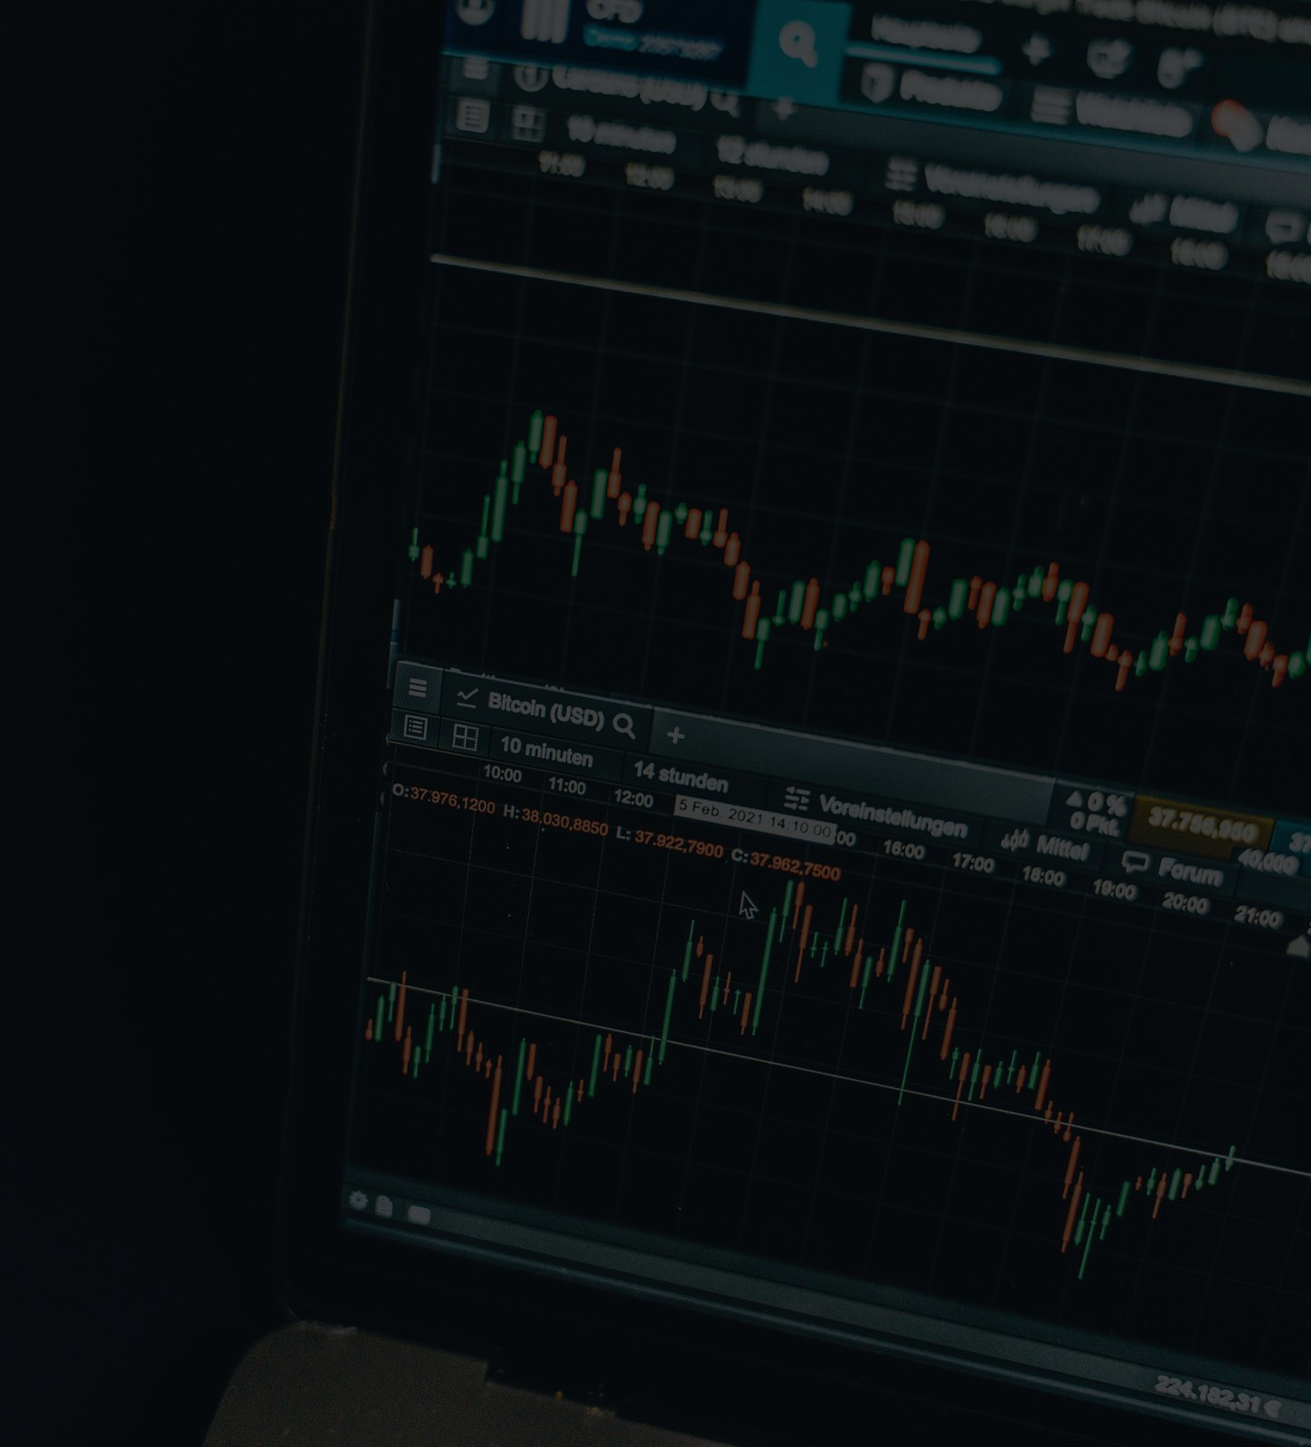
TRADE WITH JOREEM
COMPLETE SUPPLY & DEMAND COURSE
PART 04 • FIBONACCI CONFLUENCE
Add an independent location tool without abandoning confirmation.
04
THE COURSE'S ADDITIONAL FILTER
WHEN 61.8% MEETS DEMAND
The final section combines a Fibonacci retracement with an
existing demand zone and waits for a confirmed response.
1
Map swing low to swing high
2
Watch key retracement levels
3
Require zone + level + response
LOCATION + CONFLUENCE + CONFIRMATION
EDUCATIONAL • ILLUSTRATIVE EXAMPLES • NOT FINANCIAL ADVICE
15 / 19
Notes:
Add an independent location tool without abandoning confirmation.
Source: COMPLETE Supply & Demand Trading Course.txt — 12:36–16:35.
Charts are original schematic illustrations, not live market data. Educational use only; not financial advice.

Slide 16
TRADE WITH JOREEM
COMPLETE SUPPLY & DEMAND COURSE
STACK FIBONACCI WITH THE ZONE
Confluence is useful when each component is defined before price reaches the area.
1
Draw the swing
FIBONACCI + DEMAND CONFLUENCE
For the bullish example, drag from swing low to
swing high when the retracement begins.
2
Watch retracements
The source names 38.2%, 50%, 61.8% and 78.6%; its
worked example reacts around 61.8%.
0 / SWING HIGH
3
Wait for the retest
38.2%
The source avoids entering on the first bounce alone
and prefers the level to align with demand and
confirmation.
50%
DEMAND + 61.8%
61.8%
4
Plan the target
78.6%
The source illustration uses the −27% extension;
treat this as an example to test, not a universal
target.
1 / SWING LOW
CONFLUENCE ADDS EVIDENCE. IT DOES NOT REMOVE
UNCERTAINTY.
SCHEMATIC • NOT LIVE MARKET DATA
EDUCATIONAL • ILLUSTRATIVE EXAMPLES • NOT FINANCIAL ADVICE
16 / 19
Notes:
Confluence is useful when each component is defined before price reaches the area.
Source: COMPLETE Supply & Demand Trading Course.txt — 12:47–16:12.
Charts are original schematic illustrations, not live market data. Educational use only; not financial advice.

Slide 17
TRADE WITH JOREEM
COMPLETE SUPPLY & DEMAND COURSE
RISK BEFORE REWARD
Confidence in a setup must never become permission for uncontrolled exposure.
1
Set a fixed risk limit
MECHANICAL RISK FRAME • EXAMPLE ONLY
Choose the maximum percentage or cash risk before
the entry and calculate size from the stop.
TARGET = 2R (EXAMPLE)
2
Do not improvise size
The source discusses 1% normally and 2% for a
high-confluence example; this deck does not treat
that as a recommendation.
2R UP
ENTRY
3
Measure the full sample
A single winning example says nothing about
expectancy. Journal many setups, including losses.
1R DOWN
STOP = 1R RISK
A BETTER-STORY SETUP CAN STILL LOSE. RISK IS THE PART YOU
CAN CONTROL.
A 2R TARGET DOES NOT GUARANTEE A WIN OR POSITIVE EXPECTANCY.
EDUCATIONAL • ILLUSTRATIVE EXAMPLES • NOT FINANCIAL ADVICE
17 / 19
Notes:
The transcript suggests increasing risk from 1% to 2% when confident. This presentation explicitly avoids recommending that behaviour and reframes it as fixed, predefined risk.
Source: COMPLETE Supply & Demand Trading Course.txt — 15:15–15:28 and educational risk overlay.
Charts are original schematic illustrations, not live market data. Educational use only; not financial advice.

Slide 18
TRADE WITH JOREEM
COMPLETE SUPPLY & DEMAND COURSE
YOUR SUPPLY & DEMAND CHECKLIST
A compact routine for the course's complete workflow.
Momentum
Zone
Was there a decisive departure or valid rejection pattern?
Did I mark the correct origin, consolidation or wick area?
Retest
Confirmation
Has price returned to the area without invalidating it?
Did rejection receive directional follow-through?
Confluence
Risk
Does any Fibonacci level add preplanned evidence?
Are stop, target, size and maximum loss fixed?
KEY TAKEAWAY
Rinse and repeat the checklist — not a trade taken from memory of one winning example.
EDUCATIONAL • ILLUSTRATIVE EXAMPLES • NOT FINANCIAL ADVICE
18 / 19
Notes:
A compact routine for the course's complete workflow.
Source: COMPLETE Supply & Demand Trading Course.txt — Full course synthesis.
Charts are original schematic illustrations, not live market data. Educational use only; not financial advice.

Slide 19
TRADE WITH JOREEM
WAIT FOR THE MARKET TO SHOW YOU.
The course's strongest habit is patience: mark the area, let price return, require
evidence and define the risk before acting.
1
Mark
Use one of the three repeatable zone methods.
2
Confirm
Do not confuse a zone touch with a valid trigger.
3
Review
JOREEM
Journal the setup and its rule adherence, not just the result.
TRADE WITH JOREEM
LEARNING SERIES
Trading can result in losses. These are schematic examples, not signals or performance claims. Test on demo,
define risk in advance, and never trade money you cannot afford to lose.
CONTENT & IMAGE NOTES
Content: supplied transcript, edited for learning. Charts: original schematic illustrations. Photos: Joreem (supplied); Pexels photo IDs 26743048,
7567486 and 14751274; Unsplash and stock images from the existing Joreem library and supplied template. Full links: IMAGE_CREDITS.md.
REVIEW THE RULES • PRACTISE ON DEMO • KEEP A JOURNAL
19 / 19
Notes:
Close by reviewing the process and encouraging deliberate practice rather than outcome-focused trading.
Source: COMPLETE Supply & Demand Trading Course.txt — 00:00–16:35.
Charts are original schematic illustrations, not live market data. Educational use only; not financial advice.

