Slide 1
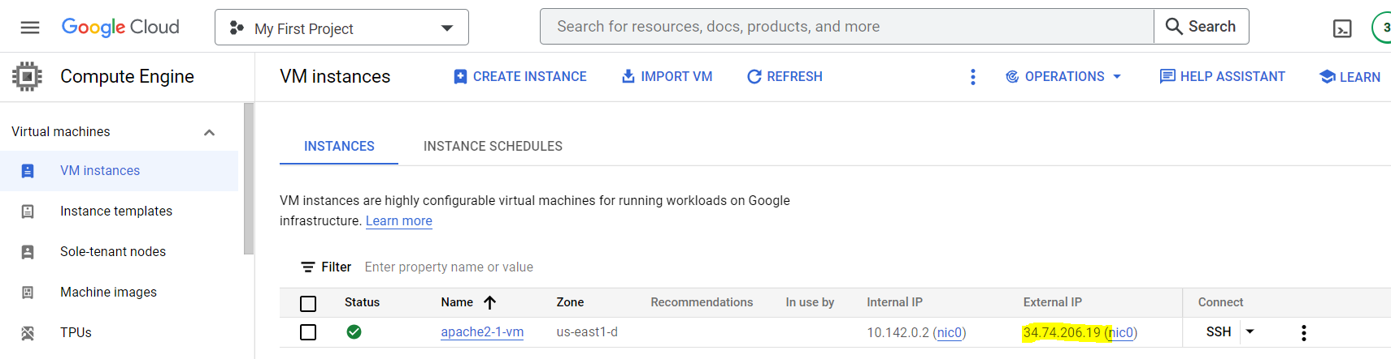
Course Updates
If you have not done Google Virtual Machine
Follow the tutorial and get it ready before proceeding to the next hands-on exercise

Slide 2
Course Updates
About the GCP virtual machine
Available through Google Cloud Platform
Located in a Google Data Center
Cost around $15 per month
A virtual computer running Linux and Apache
Can be used as a Web server

Slide 3
Web Design Lab
Session I

Slide 4
Web design lab
Learning objectives
Understand how WWW works
Understand the use of HTML for creating Webpages
Understand Web hosting on a Web server

Slide 5
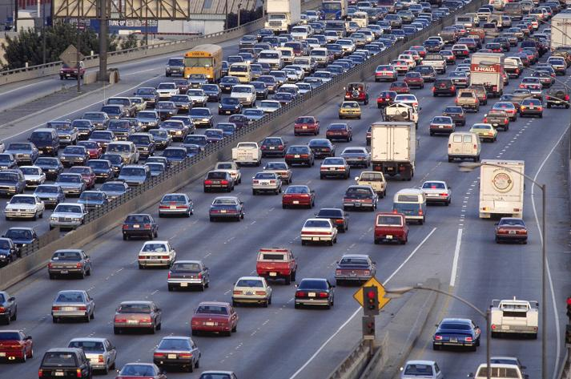
Web Design Lab
The Internet: an information highway
Applications running on the Internet
World Wide Web (WWW)
Email
Video conferencing
Zoom, Webex
Voice over the Internet
Vonage, Skype
Intranets & Extranets

Slide 6

A Website
Amazon.com in 1995

Slide 7
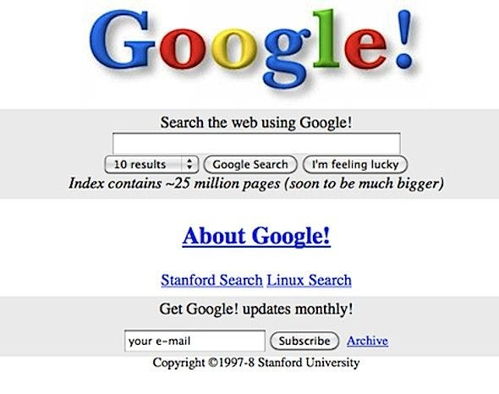
A Website
Google in 1998

Slide 8
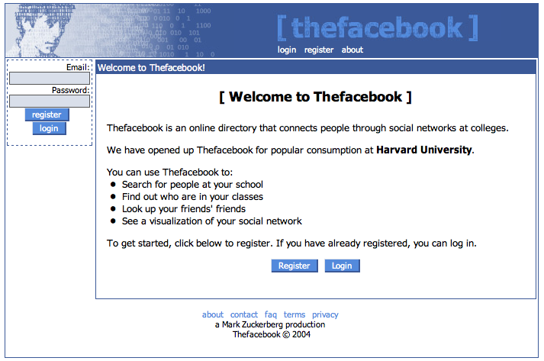
A Website
Facebook in 2004

Slide 9
Web design lab
World Wide Web
One of the many applications on the Internet
WWW ≠ the Internet
Commonly shortened to “the Web”
A system of interlinked, hypertext documents accessed via the Internet
With a web browser, a user views web pages that may contain text, images, videos, and other multimedia and navigates between them using hyperlinks
A content provider uses web server to accommodate the requests

Slide 10
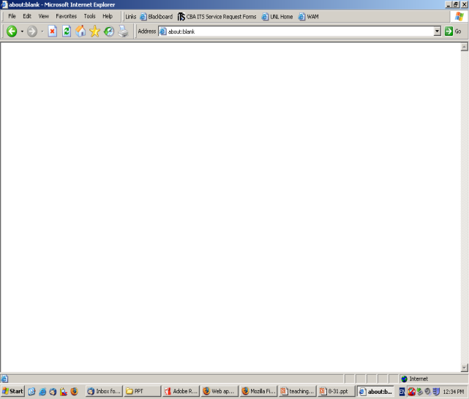
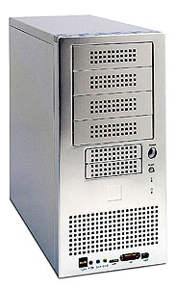
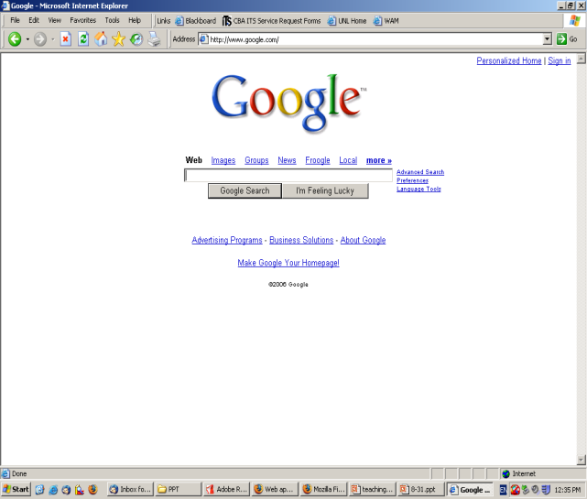

Web design lab
How WWW works?
A round trip (client/server architecture)
Internet
(TCP/IP network)
index.html
Your Web browser
Web server

Slide 11
Web design lab
Two fundamental standards on the Web
HTTP (transmission)
Standard for requesting and transferring Web pages over the Internet
HTML (contents)
Standard for creating and parsing Web pages

Slide 12
Web design lab
HTML
Formatting and Hyperlinking standards
Implemented by markup tags
An HTML file must have an htm or html file extension
An HTML file can be created using a simple text editor or a Web page development application (Frontpage, Dreamweaver)

Slide 13
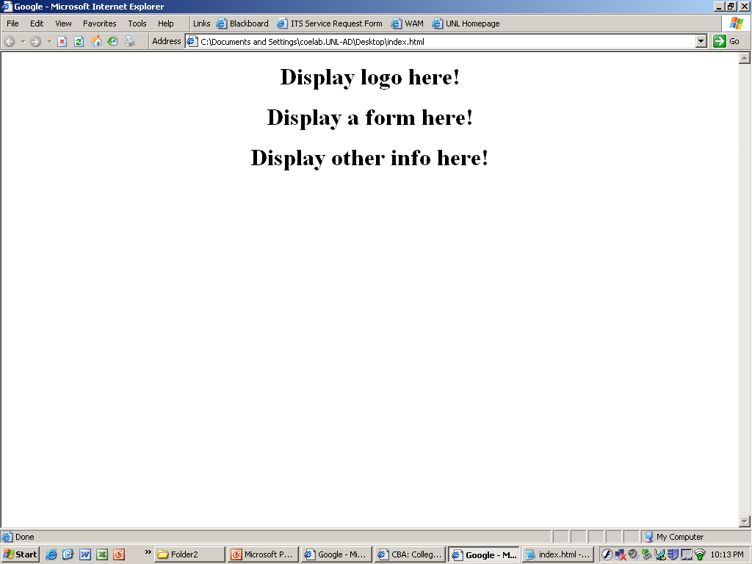
Web design lab
HTML
Standard for creating and parsing Web pages
<html>
<head>
<title>Google</title>
</head>
<body>
<center>
<h1>Display logo here! </h1>
<h1>Display a form here! </h1>
<h1>Display other info here! </h1>
</center>
</body>
</html>

Slide 14
Web design lab
Software needed for Web design
Windows: Notepad
Mac: TextEdit
Change preferences first
Chromebook: Text.app
Install Text.app first (link)
Or use a Web-based editor at https://www.editpad.org/

Slide 15
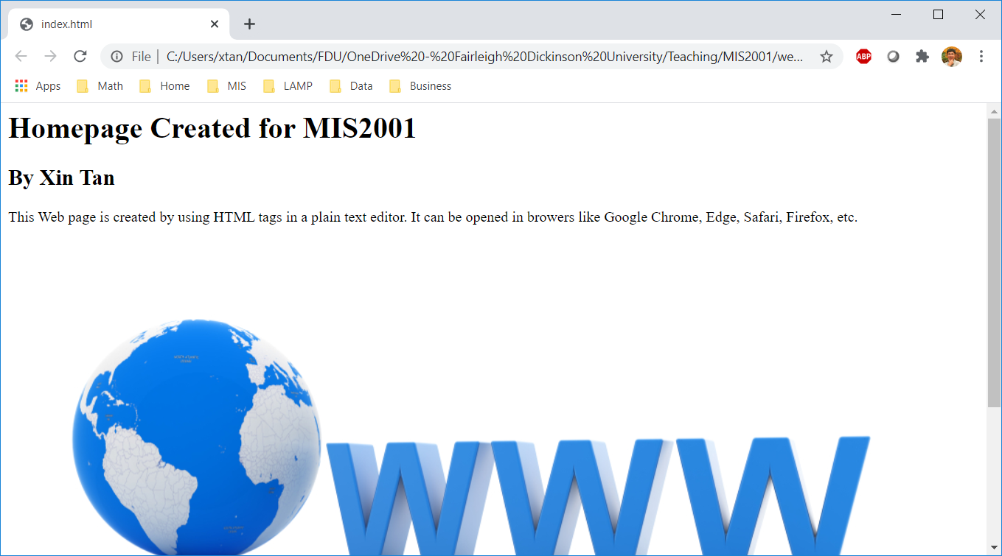
Web design lab
In-class practice
Create contents: follow Tutorial 1 in Webcampus
index.html
Use your own words and picture

Slide 16
Web design lab
In-class practice
Transfer it to your VM: follow Tutorial 2 in Webcampus
Check if you can open the Webpage on your phone
URL: http://IP Address/index.html

Slide 17
Prepare for the following classes
Submit the URL of Web page 1 in Webcampus
Complete before the next class
Next class
Web design lab 2 (more HTML features)

