Slide 1
EXPLORATORY DATA ANALYSIS FOR MICROSOFT’S NEW MOVIE STUDIO
Insights for Creating Successful Movies
Keziah Gicheha
3/06/2024

Slide 2
Project Overview
This project uses exploratory data analysis to generate insights for Microsoft.
Tasked with exploring the performance of other films in the box office market, actionable insights have been drawn that aim to be useful to the head of Microsoft's new movie studio to help them decide what type of films to create.
OBJECTIVES
To analyze current box office trends and generate actionable insights for Microsoft’s new movie studio

Slide 3

Business Problem
Initiative: Microsoft is seeking to venture into the film industry and wants to create a new movie studio and original video content.
Challenge: Lack of experience and knowledge in movie creation.
Goal: Identify successful film types to guide Microsoft’s new movie studio.

Slide 4

Data Description & Understanding
Two datasets were used for this EDA (Exploratory Data Analysis)
IMDB database
Box Office Mojo – CSV
Key columns and their importance
IMDB tables utilized – Movie _basics table(columns : movie_id, ordering,primary_title, start-year, runtime_minutes genres.)
And
movie_ratings table (movie_id, averagerating, numvotes)
Box office movies columns used – title, domestic gross, foreign gross, genres, average rating
Sources of data
https://www.imdb.com/
https://www.boxofficemojo.com/

Slide 5
Methodology
1. Data cleaning and preprocessing
It was established that both datasets had missing values
Movies basics
runtime_minutes column – 21% of that column had missing values(31,739/773,855 rows)
Original title column – 0.014% (21 /773,855)
Genres column – 3.7% (5408/773,855)
Box office movies
Studio 5/3386 ( 0.15%)
domestic_gross 28 /3386 (0.8%)
foreign_gross 1350/3386 (40%)

Slide 6
Methodology(continued)
2. Handling missing values
Both datasets were cleaned, and null/missing values were removed
As my rule of thumb, the columns with missing values that are less than 5%, and the rows with the missing values will be dropped, as this will not significantly impact the analysis.
In both datasets, columns with missing data of more than 20% were imputed using the median to fill in the missing values.
The median was used, in this case, there were outliers in both datasets - to prevent skewness

Slide 7
Exploratory Data Analysis (EDA)
1. Which movies have the highest average ratings?ratings?
id | primary_title | genres | averagerating
922 | Love on a Leash | Documentary,Family,Romance | 9.7
921 | Foosballers | Comedy,Documentary,Sport | 9.7
920 | Lost Conquest | Comedy,Documentary,Fantasy | 9.4
919 | Sunakali | Documentary,Family,Musical | 9.3
918 | The Long Count Teaser | History,Sport | 9.2

Slide 8
Exploratory Data Analysis (EDA)
Which movies have the lowest ratings?
 | primary_title | genres | averagerating
0 | Maldito Amor | Comedy,History,Horror | 1.1
1 | Futures Past | Action,Biography,History | 1.3
2 | Eyal Hirrifah | Comedy,Musical,Sport | 1.4
3 | The Devil's Flower | Mystery,Romance | 1.7
4 | Foodfight! | Action,Animation,Comedy | 1.9

Slide 9
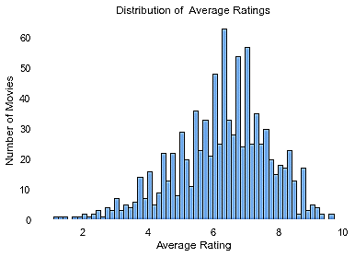
2. Distribution of Movie Ratings

Slide 10

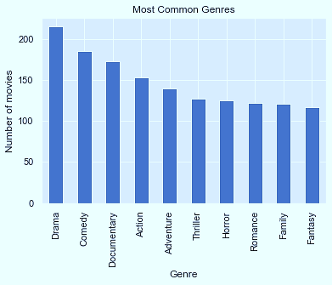
3. Most Common Movie Genres
10

Slide 11
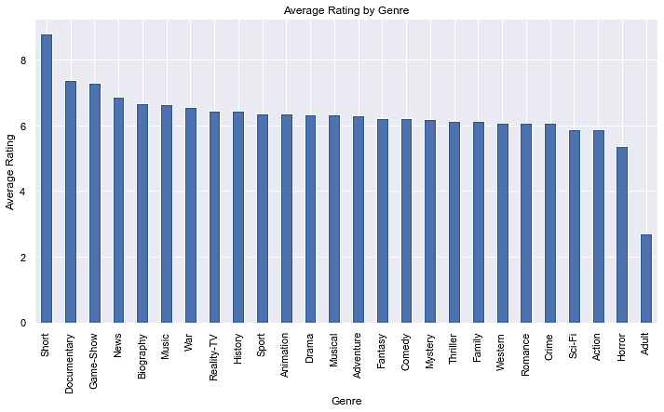
4. Average rating based on each genre?

Slide 12
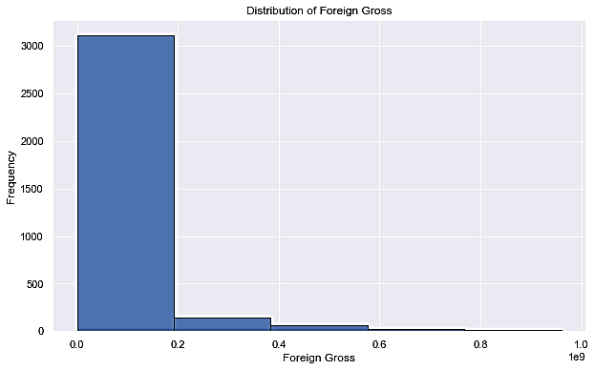
5. Distribution of Foreign Gross

Slide 13
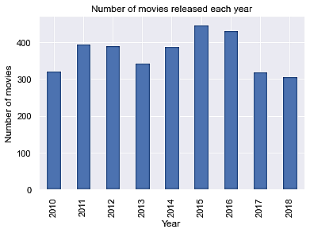
6. Distribution of movies per year
13

Slide 14
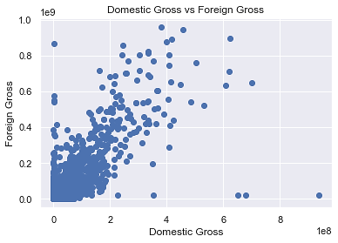
7. Comparison of Gross revenues

Slide 15
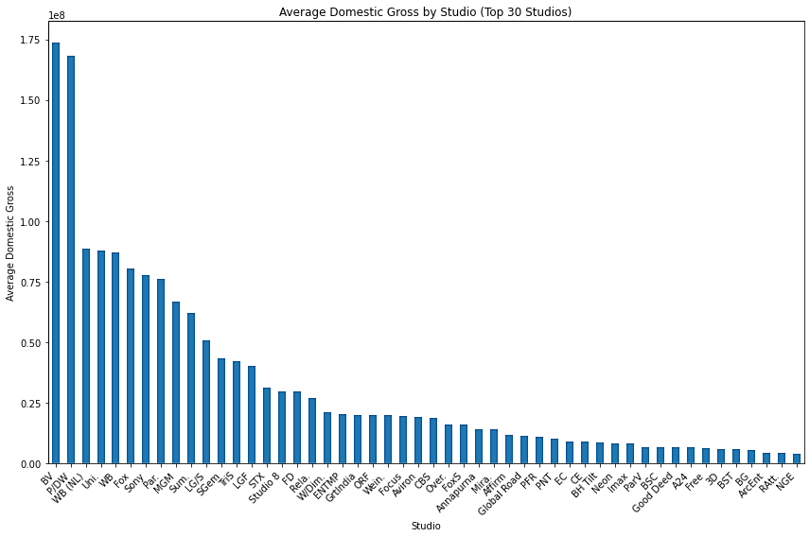
Gross Domestic Revenue by Studio

Slide 16
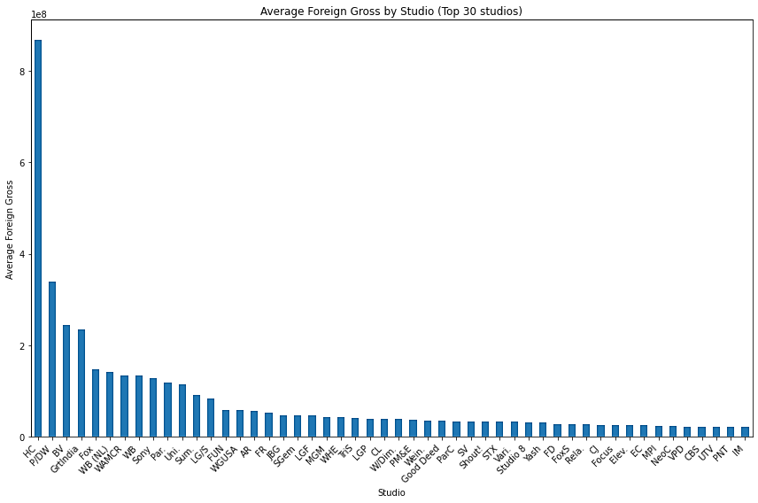
Gross Foreign Revenue by Studio

Slide 17
Top-rated movies by Gross revenues
id | TITLE | TOTAL_GROSS
727 | Marvel's The Avengers | 1.518900e+09
1875 | Avengers: Age of Ultron | 1.405400e+09
3080 | Black Panther | 1.347000e+09
328 | Harry Potter and the Deathly Hallows Part 2 | 1.341500e+09
2758 | Star Wars: The Last Jedi | 1.332600e+09
3081 | Jurassic World: Fallen Kingdom | 1.309500e+09
1127 | Frozen | 1.276400e+09

Slide 18
Recommendations
Focus on popular movie genres with a high rating – Invest in genres that are consistently performing well at the box office(Documentaries, Action, Drama, Adventure, Comedy,)
Benchmark on studios that have a high domestic gross and foreign gross(BV, P\DW, WB, Uni,)- possibly collaborate in new movies with them.
Adapt to Trends: Monitor and adapt to changing genre trends to stay relevant.

Slide 19
Next steps
Further analysis of specific sub-genres or niche markets
Research on production costs vs. revenue for different genres
Pilot projects or collaborations to gain industry experience

Slide 20

Conclusion
In conclusion, this venture stands out to be a wise business venture, as the revenue to be drawn from this is promising in both the domestic and gross numbers.
Focus on the recommended movie genres, documentaries, action and comedy
Collaborate with current leading studios for pilots.

Slide 21

Thank you! Any Questions?
Presenter : Keziah Gicheha
www.linkedin.com/in/gichehawambui

