Slide 1

NCKU Programming Contest Training Course
Course 4
2016/03/16
Po-Hsing Wu (0140454)
s1994928@yahoo.com.tw
Department of Computer Science and Information Engineering
National Cheng Kung University
Tainan, Taiwan
NCKU CSIE Programming Contest Training Course
made by 0140454

Slide 2
Outline
Binary Search
Introduction of STL
  lower/upper_bound
  pair/tuple
  priority_queue
Learn more
  struct
made by 0140454

Slide 3
Binary Search
made by 0140454

Slide 4
Binary Search
Find the position of a target value within a sorted array.
搜尋已排序的一串資料。
made by 0140454

Slide 5
Binary Search
Example
  從排序好的陣列中，找出小於 34的最大值
6
13
14
25
33
43
51
53
64
72
84
93
95
96
97
0
1
2
3
4
5
6
7
8
9
10
11
12
13
14
L
R
made by 0140454

Slide 6
Binary Search
Example
  Index of mid = (L+R+1)/2 = (0+14+1)/2 = 7
6
13
14
25
33
43
51
53
64
72
84
93
95
96
97
0
1
2
3
4
5
6
7
8
9
10
11
12
13
14
L
mid
R
made by 0140454

Slide 7
Binary Search
Example
  判斷mid有沒有小於34 => 沒有，找左半部
6
13
14
25
33
43
51
53
64
72
84
93
95
96
97
0
1
2
3
4
5
6
7
8
9
10
11
12
13
14
L
R
made by 0140454

Slide 8
Binary Search
Example
  Index of mid = (L+R+1)/2 = (0+6+1)/2 = 3
6
13
14
25
33
43
51
53
64
72
84
93
95
96
97
0
1
2
3
4
5
6
7
8
9
10
11
12
13
14
L
mid
R
made by 0140454

Slide 9
Binary Search
Example
  判斷mid有沒有小於34 => 有，找右半部
6
13
14
25
33
43
51
53
64
72
84
93
95
96
97
0
1
2
3
4
5
6
7
8
9
10
11
12
13
14
L
R
made by 0140454

Slide 10
Binary Search
Example
  Index of mid = (L+R+1)/2 = (4+6+1)/2 = 5
6
13
14
25
33
43
51
53
64
72
84
93
95
96
97
0
1
2
3
4
5
6
7
8
9
10
11
12
13
14
L
mid
R
made by 0140454

Slide 11
Binary Search
Example
  判斷mid有沒有小於34 => 沒有，找左半部
6
13
14
25
33
43
51
53
64
72
84
93
95
96
97
0
1
2
3
4
5
6
7
8
9
10
11
12
13
14
L
R
made by 0140454

Slide 12
Binary Search
Example
  小於34的最大值 = 33
6
13
14
25
33
43
51
53
64
72
84
93
95
96
97
0
1
2
3
4
5
6
7
8
9
10
11
12
13
14
L
R
made by 0140454

Slide 13
Binary Search
Linear search : O(n)
Binary search : O(lgn)
made by 0140454

Slide 14
Binary Search
#include <cstdio>
int binary_search(int *numbers, int n, int val) {
int left = 0, right = n - 1;
while(left < right) {
int middle = (left + right) / 2;
if (numbers[middle] < val) {
left = middle + 1;
} else {
right = middle - 1;
}
}
return right;
}
int main() {
int array[] = {6, 13, 14, 25, 33, 43, 51, 53, 64, 72, 84, 93, 95, 96, 97};
printf("%d\n", binary_search(array, 15, 34)); // 10 50 60
return 0;
}
made by 0140454

Slide 15
UVa 10341
Problem Description
Solve
p*e^{-x} + q*sin(x) + r*cos(x) + s*tan(x) + t*x² + u = 0
where 0<=p, r<=20 and -20<=q,s,t<=0
made by 0140454

Slide 16
Introduction of STL
(Standard Template Library)
made by 0140454

Slide 17
lower/upper_bound
Binary Search 不用自己寫，STL 替你完成一切
#include <cstdio>
#include <algorithm>
using namespace std;
int main() {
int array[] = {6, 13, 14, 25, 33, 43, 51, 53, 64, 72, 84, 93, 95, 96, 97};
printf("%d\n", lower_bound(array, array + 15, 34) - array - 1);
return 0;
}
made by 0140454

Slide 18
pair/tuple
pair: (x, y)
tuple: (x1, x2, …, xn) Since C++11
Example
  pair
    pair<string, int> data = make_pair(“ACM分數”, 100);
  tuple
    tuple<string, int, int, int> = make_tuple(“陳識宇”, 98, 99, 100);
made by 0140454

Slide 19
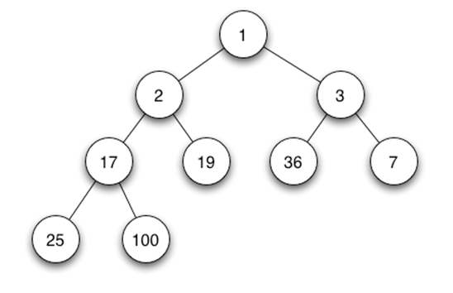
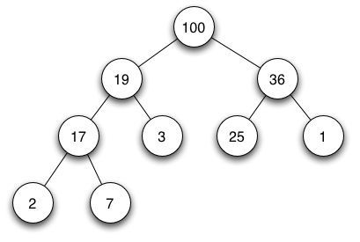
priority_queue
底層以 Binary Heap 實作
  是一棵 Complete Binary Tree
  滿足 Heap 的條件
  Min-heap: Max-heap:
  父節點的值總是小於或等於 父節點的值總是大於或等於
  任何一個子節點的值 任何一個子節點的值
made by 0140454

Slide 20
priority_queue
Insertion: O(lgn)
Removal: O(lgn)
made by 0140454

Slide 21
priority_queue
用法跟 queue 類似
#include <cstdio>
#include <queue>
#include <vector>
using namespace std;
int main() {
const int data[] = {6, 100, 1, 0};
priority_queue<int> prique1;
priority_queue<int, vector<int>, greater<int> > prique2;
made by 0140454

Slide 22
priority_queue
for (int i = 0; i < 4; ++i) {
prique1.push(data[i]);
prique2.push(data[i]);
}
while(!prique1.empty()) {
printf("%d ", prique1.top()); // 100 6 1 0
prique1.pop();
}
puts("");
while(!prique2.empty()) {
printf("%d ", prique2.top()); // 0 1 6 100
prique2.pop();
}
return 0;
}
made by 0140454

Slide 23
POJ 3253
Problem Description
Farmer John wants to repair a small length of the fence around the pasture. He measures the fence and finds that he needs N (1 ≤ N ≤ 20,000) planks of wood, each having some integer length Li (1 ≤ Li ≤ 50,000) units. He then purchases a single long board just long enough to saw into the N planks (i.e., whose length is the sum of the lengths Li). FJ is ignoring the "kerf", the extra length lost to sawdust when a sawcut is made; you should ignore it, too.
FJ sadly realizes that he doesn't own a saw with which to cut the wood, so he mosies over to Farmer Don's Farm with this long board and politely asks if he may borrow a saw.
Farmer Don, a closet capitalist, doesn't lend FJ a saw but instead offers to charge Farmer John for each of the N-1 cuts in the plank. The charge to cut a piece of wood is exactly equal to its length. Cutting a plank of length 21 costs 21 cents.
Farmer Don then lets Farmer John decide the order and locations to cut the plank. Help Farmer John determine the minimum amount of money he can spend to create the N planks. FJ knows that he can cut the board in various different orders which will result in different charges since the resulting intermediate planks are of different lengths.
made by 0140454

Slide 24
Learn more
struct
made by 0140454

Slide 25
struct
Q. 如何直接利用 < 來比較 struct ?
(常應用於 sort, priority_queue 等)
運算子重載
struct _DATA {
int data1, data2;
char data3;
bool operator<(const struct _DATA &rhs) const {
return data1 < rhs.data1;
}
};
made by 0140454

Slide 26
struct
Q. 如何用 lower/upper_bound 搜尋 struct ?
運算子重載
struct _DATA {
int data1, data2;
char data3;
bool operator<(const int val) const {
return data1 < val;
}
};
made by 0140454

Slide 27
Problem List
UVa (6 Problems)
  714、10611、11413、11621、11876、12192
POJ (3 Problems)
  1905、2431、3253
made by 0140454

