Slide 1
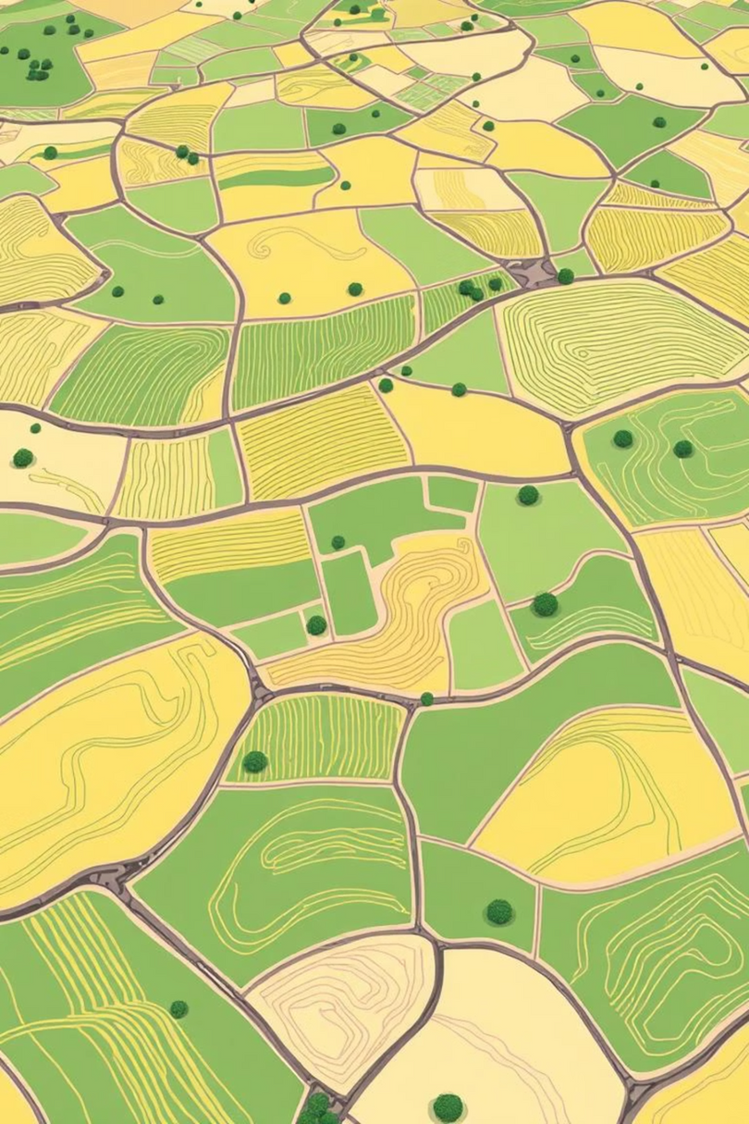
Final Presentation
By
Syed Wamiq ul Islam
Abdul Rehman Tahir
Supervisor
Dr Naseer Bajwa

Slide 2
Problem Statement
Using Bayesian models and Active Learning to aid in Domain Adaptation for crop mapping

Slide 3
Models used
Basic Structure
Convblock: Conv1D (kernel: 5) + Batch Normalisation + ReLU + Dropout(0.3)
Block | Input Channels | Output Channels
Conv1 | 6 | 64
Conv2 | 64 | 128
Conv3 | 128 | 256
Conv4 | 256 | 512
Conv5 | 512 | 1024
AdaptiveAvgPool1d | - | -
FC layer | 1024 | 3
Deterministic CNN
Approximated Bayesian CNN (Using MC dropoutsduring evaluation)
True Bayesian CNN (Using Bayesian layers)

Slide 4
Active Learning methods applied
Using Deterministic CNN
Entropy
Best vs Second Best
Diversity (Core-set)
Entropy-Diversity hybrid
Approximated Bayesian CNN (Using MC dropouts) and
True Bayesian CNN (Using Bayesian layers)
Predictive entropy
Best vs Second Best
BALD (Bayesian AL by Disagreement)
Variation ratio

Slide 5
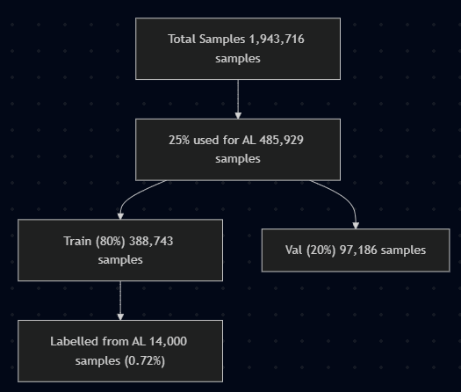
Data Used
For Active Learning
Site B, 2020 data: 1,943,716 samples
25% (485,929) used for Active Learning
80/20 Train/val split (388,743/ 97,186)
14000 labelled samples acquired through AL from train data (14000/388,743) (3.6%)
For Evaluation
Train data = (0.72%) labelled samples acquired from AL (14000)
Val data = 0.5% of total data of (9719)
Test data = complete data 1,943,716

Slide 6
Domain Adaptation
Models were trained on data of Site A, 2019 and Active Learning and Evaluation was applied on Site B, 2020,
No domain adaptation techniques were applied

Slide 7
Results
F1 score
Active Learning Methods/ Models | Deterministic CNN | True BCNN | Approximated BCNN
random | 0.9013 | 0.8954 | 0.9073
deterministic CNN diversity | 0.896 | 0.8875 | 0.8981
deterministic CNN entropy | 0.8589 | 0.8846 | 0.8999
deterministic CNN entropy-diversity | 0.8798 | 0.8801 | 0.8953
deterministic CNN margin | 0.8848 | 0.8727 | 0.907
true BCNN BALD | 0.9044 | 0.8918 | 0.909
true BCNN BvsSB | 0.9016 | 0.8898 | 0.9061
true BCNN predictive-entropy | 0.88 | 0.8785 | 0.8946
true BCNN variation-ratio | 0.8994 | 0.8859 | 0.91
approx BCNN BALD | 0.9091 | 0.8976 | 0.913
approx BCNN BvsSB | 0.8946 | 0.8938 | 0.9103
approx BCNN predictive-entropy | 0.8865 | 0.8794 | 0.8982
approx BCNN variation-ratio | 0.901 | 0.8927 | 0.9092

Slide 8
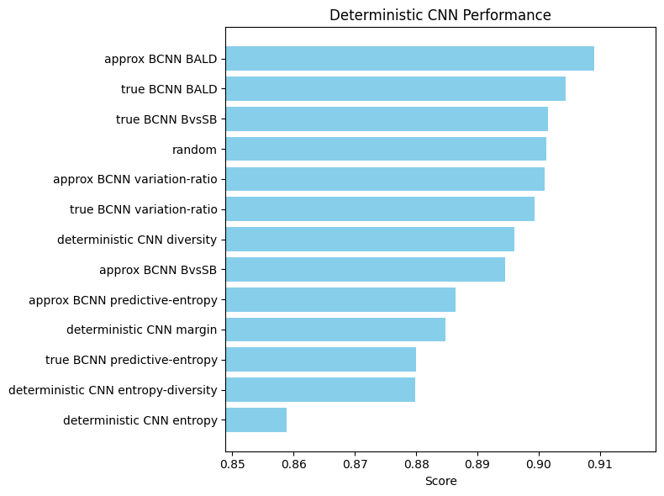

Slide 9
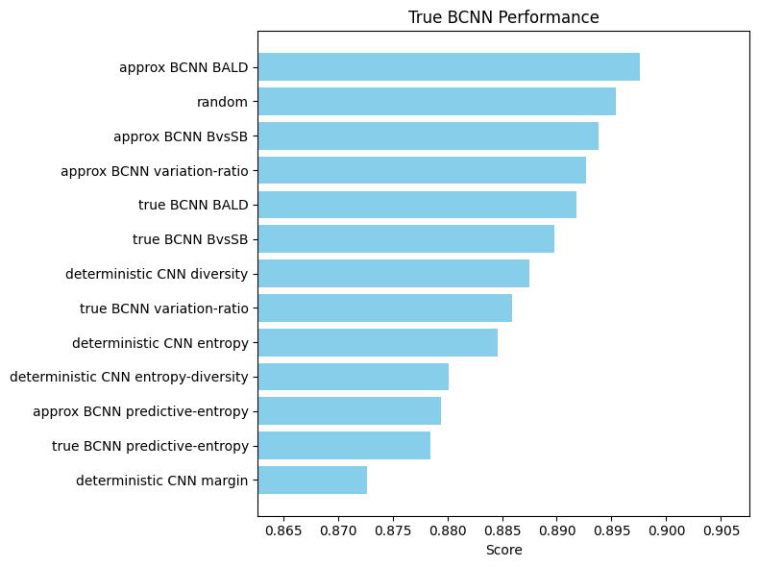

Slide 10
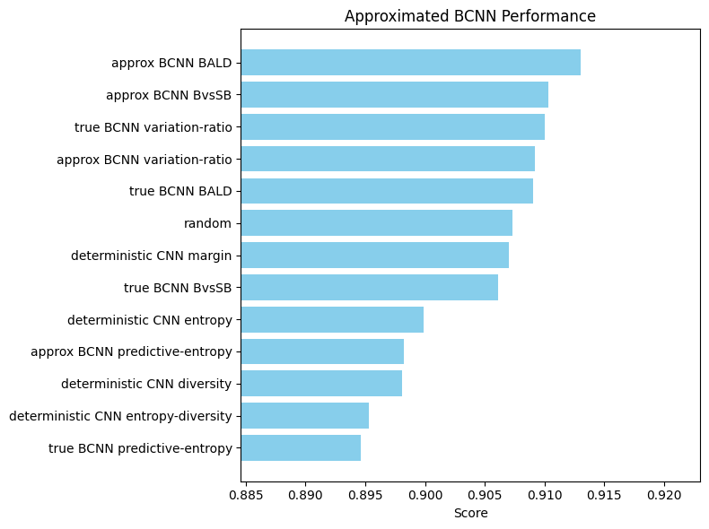

Slide 11
Conclusion
The results indicate that the Active Learning technique BALD (Bayesian Active Learning by Disagreement) applied on Approximated Bayesian model using MC dropouts gives best dataset followed by Best vs Second best, and Variation ratio, and in comparison, AL techniques using deterministic models perform worse than random samping.

Slide 12
Thank You

