Slide 1
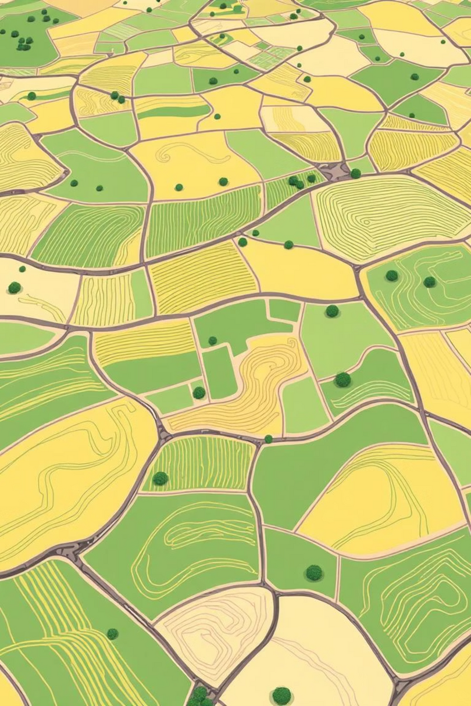
Domain adaptation for Early Season Crop mapping
By
Syed Wamiq ul Isam
Supervisor – Dr. Naseer Bajwa

Slide 2
Problem Statement:
The Challenge of Crop Mapping
Crop mapping is critical for agricultural monitoring, food security, and resource planning.
In countries like Pakistan, agriculture is a key economic sector, but reliable crop type maps are lacking.
A major challenge is the scarcity of labeled data in many regions and seasons.
Manually labeling satellite data is expensive, time-consuming, and often impractical.

Slide 3
Objectives
Use domain adaptation to transfer models trained on labeled regions (e.g., USA) to unlabeled target regions (e.g., Pakistan).
Apply active learning to minimize annotation effort by selecting only the most informative samples for labeling.
Combine both methods to build an efficient, generalizable crop mapping system suitable for data-scarce regions.
Enable accurate classification while significantly reducing the need for ground truth data.

Slide 4
Topics Studied
MLPs, CNNs
RNNs, LSTMs, GRUs
Transformers
Remote Sensing
Domain Adaptation
Active Learning
Bayesian Neural Networks

Slide 5
Practice Implementations
MLPs – practiced on telecom customer churn dataset
CNNs – practiced on CIFAR-10 (image classification)
RNNs / LSTMs / GRUs – practiced on IMDb Movie Reviews dataset (binary sentiment classification)
Transformers – practiced on IWSLT14 German to English translation dataset (machine translation)

Slide 6
Remote Sensing practice
Practiced how to work with Satellite Imagery data and use it for crop mapping
Data:
Multi-year and Multi-Region crop mapping dataset from northern Italy, using Sentinel-2 time series satellite imagery
Models used:
2D CNN
1D CNN + LSTM

Slide 7
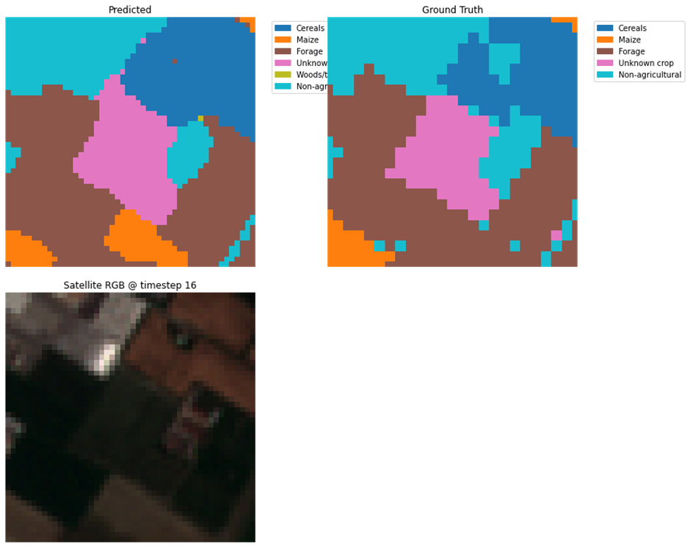
Results
Accuracy
2D CNN: 69.4%
1D CNN+LSTM: 70.5%
F1 score
2D CNN: 65.1%
1D CNN+LSTM: 67.8%
Mean IoU
2D CNN: 49.8%
1D CNN+LSTM: 53.1%

Slide 8
Active Learning
Data:
USA cropland data subset, 20,000 samples, Site B, 2021
Model used:
1D CNN trained on Site A, 2019 data
Active Learning techniques used:
Random (baseline)
Uncertainity based: Entropy, Margin, Least Confident
Diversity Based: Using Core-set
Hybrid: Entropy + Diversity

Slide 9
Results
Model Accuracy on complete dataset (16000 samples):
90%
Model Accuracy on small dataset with active learning (300 samples):
84.5%
Conclusion
We were able to achieve 94% of the results using only 1.5% of the data using Uncertainity (margin) based Active Learning

Slide 10
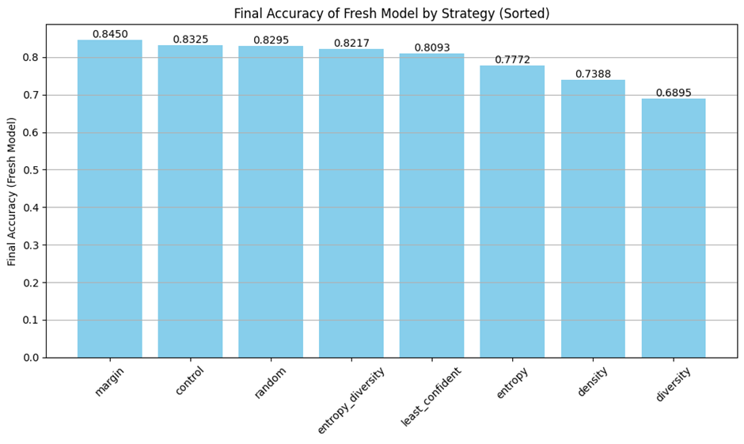

Slide 11
Path Forward
Utilise Bayesian Neural Networks for active Learning and experiment with:
Partial BNNs
Bayesian CNNs
Bayesian Transformers
Graph Neural Networks

Slide 12
Thank You

